Slide 1

Design for Mission
Church Leadership Fundamentals

Slide 2
SDA Governance Principles
Representative/constituency-based system
Authority rooted in God, distributed throughout
Authority of groups—the committee system
Shared administration, not presidential system
Unity of entities based on mission, purpose, belief, and commitment to collaborative decision-making
Integrity of each entity is recognized
Interdependence—each a part of something larger; do not act without reference to the whole

Slide 3
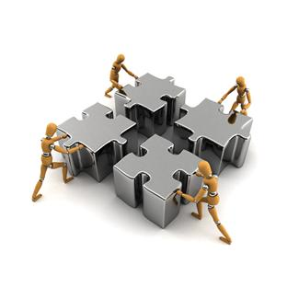
SDA Church policy
Congregational
Hierarchical
Interdependent

Slide 4
…the presidential system is defined as any constitutional or organizational provision that would center authority in one person to whom the secretary and treasurer would be responsible, as compared to a committee system in which authority is shared and exercised by elected officers who are accountable to the executive committee which in turn derives its authority from the constituency.

Slide 5
Two SDA governance systems:
Ecclesiastical system
“Executive Committee”
Each entity part of a chain of organizations
Many employees--voting members of Exec Comm
Ex Com chair—internal
3 officers accountable to Exec Comm
More involved—mngmnt
Unincorporated status
Institutional system
“Governing Board”
Each entity a ‘stand-alone’ organization
Few employees—voting members of board
Board chair—external
CEO primarily accountable to board
Less involved—mngmnt
Incorporated status

Slide 6
The Bottom Line
Both systems can function effectively
Effective functioning of the system requires:
Skilled leadership in group decision-making
Group members with diversity of competencies appropriate to the business
Attention to good group dynamics

Slide 7
Why board processes matter:
Most leadership training is for individualized positions of responsibility. Most major decisions are made in groups.
Institutional success is ultimately the responsibility of the board/executive committee.
Effective group decisions do not arise spontaneously. They result from deliberate designs in structure and social dynamics.

Slide 8
Our challenge:
“…there is one thing all boards have in common, regardless of their legal position. They do not function.”
—Peter Drucker

Slide 9
Board diseases: (Larry Walker, Trustee, September 2011)
Agendasclerosis—clogging of valuable meeting time with unproductive activity
Dialog deficit disorder—leads to irritable trustee syndrome
Knowledgedystrophy—making decisions without sufficient information

Slide 10
Board diseases: (cont’d)
Successionitis—lack of long-term governance succession/development plan
Leadershipresbyopia (also missionmyopia)—short-sighted mission, cloudy vision

Slide 11
Effective Meetings
Diverse skill set
Focus on Mission
Boardroom culture
Good group dynamics

Slide 12
Elements of boardroom culture
Attitude
Commitment to excellence
Enthusiasm about mission
Attention
Effective use of time
Focus on strategic issues
Atmosphere
Safe to talk
Altitude
Good group dynamics
Governance not management
Big picture/future perspective

Slide 13
Creating good social dynamics
Physical arrangements (seating, lighting, sound) of the meeting place.
Make the board room a safe place to talk.
A virtuous cycle of respect, trust and candor.
Minimal impact of political factions.
A culture of open dissent encouraged. (Be careful not to confuse dissent with disloyalty.)

Slide 14
“…the highest-performing companies have extremely contentious boards that regard dissent as an obligation and that treat no subject as un-discussable.” —Sonnenfeld

Slide 15
Creating good social dynamics (cont’d)
Deliberately develop/examine alternatives. Challenge cherished roles and assumptions.
Give board members meaningful tasks that involve accountability.
Regular evaluation of a group’s performance.

Slide 16
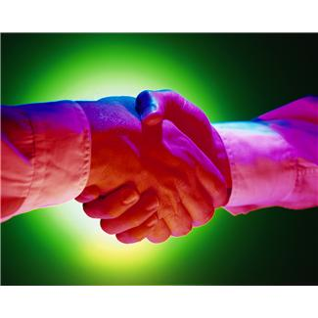
The most important
human resource for the Church is
TRUST

Slide 17
Trust
Possibly the most important trait in the leadership of voluntary organizations
Built on two perceptions—character and competence
Quickest way to decrease trust– violate a behavior of character
Quickest way to increase trust—demonstrate a behavior of competence

Slide 18
Trust —cont’d
Two kinds of trust:
Personal trust—Am I a trustworthy person?
Organizational trust—The organization to which I belong has a noble purpose, its operations will be consistent with its policies, it will treat people and issues fairly
Distrust emanating from a specific incident can metabolize into general distrust of the entire organization

Slide 19
“…we have renounced secret and shameful ways; we do not use deception, nor do we distort the word of God. On the contrary, by setting forth the truth plainly we commend ourselves to every man’s conscience in the sight of God.”
—2 Corinthians 4:1-2 (NIV)

Slide 20
Conclusion:
The Church organization is strong and fragile.
Any leader, with determination, can weaken the structure.
Any leader, with determination, can help to keep it strong.

