Slide 1
Strengthening the right arm Leadership and the Seventh-Day Adventist Health Message
Delbert W Baker, Presenter | March 28, 2011 | GC Health Ministries Advisory

Slide 2
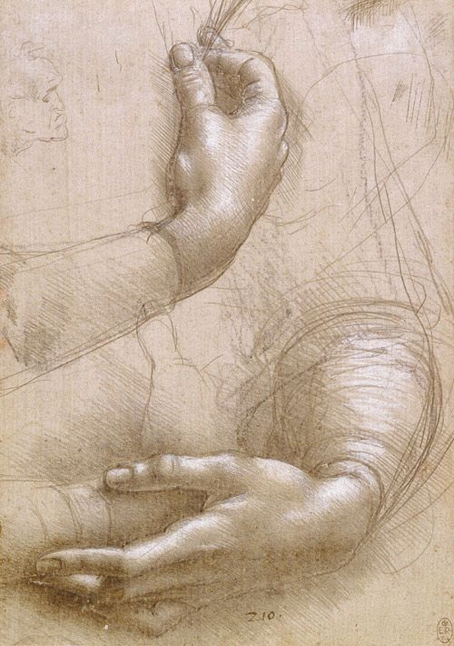
Strengthening the right arm: Global Need

Slide 3
A huge global challenge
A top global challenge is health and health care status
Healthcare cost are escalating our of control and people are getting sicker and sicker
Current rate of spending cannot be maintained…
Health is declining that some authorities worry if we are raising children that may not outlive their parents
While there is no single cause for the problem clearly wellness and prevention is part of the solution
Here is the providential role of Seventh-day Adventist

Slide 5
Strengthening the right arm: The Concept

Slide 6
Our Example Jesus

Slide 7
The example of jesus
MATTHEW 9:35 “And Jesus went about all the cities and villages, teaching in their synagogues, preaching the gospel of the kingdom, and healing every sickness and every disease among the people”.
Health Ministry is committed to promoting optimal levels of health to men, women, and children in our church and the surrounding community;
by educating them on ways to prevent disease and ways to effectively manage existing health conditions.
it is dedicated to fulfilling the commission of Christ in
3 John 2, “Beloved, I wish above all things that thou mayest prosper and be in health, even as thy soul prospereth.”

Slide 8
Jesus’ Development Models what ours can be like…
“AND JESUS INCREASED IN WISDOM (MENTAL) AND STATURE (PHYSICAL) AND IN FAVOR WITH GOD (SPIRITUAL) AND MAN (SOCIAL).” LUKE 2:52
Mental
Physical
Spiritual
Social

Slide 9
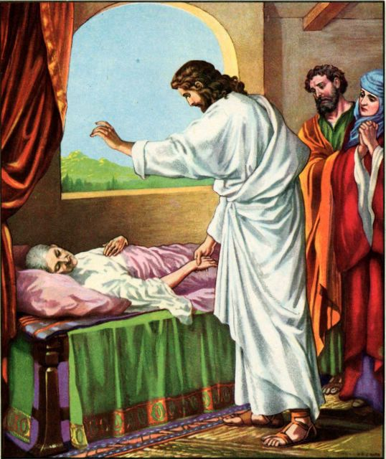
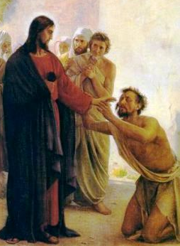
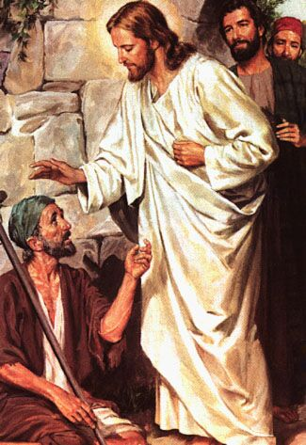
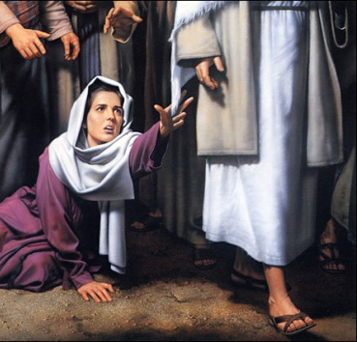
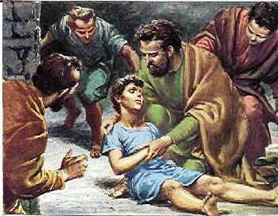
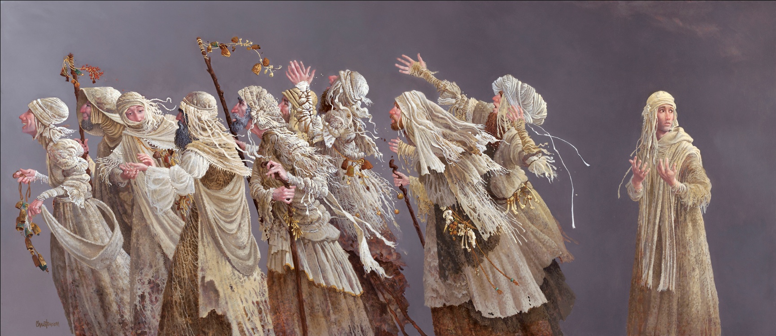

Slide 10
Christ’s Pattern—Seven Steps to Making Friends and influencing People
“CHRIST’S METHOD ALONE WILL GIVE TRUE SUCCESS IN
REACHING THE PEOPLE” MINISTRY OF HEALING, P. 143
“The Savior ……………………………..……(Consistent)
mingled with men………………………….(Contact)
as One who desired their good,………(Concern)
He showed His sympathy for them….(Compassion)
ministered to their needs,………………(Commitment)
and won their confidence……………….(Confidence)
Then He bade them. ‘follow Me.’”…….(Conversion)
Ministry of Healing, p. 143

Slide 11
The bible is full of counsel
Inspire a healthy and spiritually balanced lifestyle (3 John 2)
Restore our bodies, to become a living sacrifice (Romans 12:1)
Motivate taking care of mind, body, and spirit, as God's temple
(1 Corinthians 3:16)
Incorporate a variety of healthy activities and principles to achieve optimal health (1 Corinthians 10:31)

Slide 12
Our Example
Christ, the Great Medical Missionary, is our example. Of Him it is written that He went about all Galilee, teaching in their synagogues, and preaching the gospel of the kingdom, and healing all manner of sickness and all manner of disease among the people. He healed the sick and preached the gospel. In His service, healing and teaching were linked closely together. Today, they are not to be separated.
EG White, R&H, Oct.29, 1914

Slide 13
Adventist Health Message

Slide 14
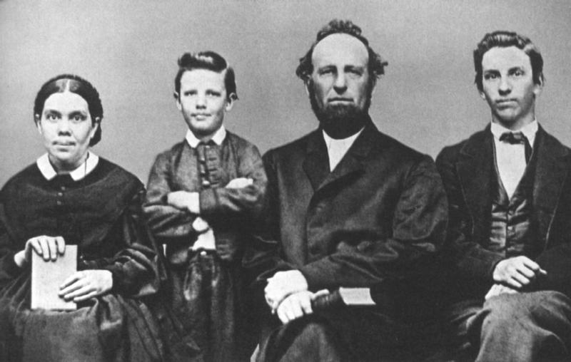
Top three priorities
#1: Doctrinal Framework—1840s
#2: Church Organization—1850s
#3: Health/Lifestyle Message—1860s:
**1st major vision on health was given Friday evening, June 6, 1863, at Otsego, MI, in the home of layman Aaron Hilliard, during a family Sabbath vespers worship fellowship (16 days after the GC was organized
(Two other visions were given 1848 and 1854)
**2nd The last of the first four (2nd major) health-reform vision would come two years later, on Christmas Day, 1865, in the church at Rochester, NY, in a service especially called to pray for the restoration of James White's deteriorating health condition.

Slide 15
Timeliness of the health message
PURPOSE: “When rightly understood, the message of health, hope, & healing that God has given to Seventh-Day Adventists is a message of restoration and redemption. It is a message that needs to be lived out in the lives of Seventh-Day Adventists today. And it is a message that needs to be proclaimed boldly to the world. When followed in its completeness, it is a message that restores mankind into the image of God-physically, mentally, and above all, spiritually. It is imperative then that we understand the components of that message.”
Adventist Heritage of Health, Hope, & Healing, pg.60
ACCOUNTABILITY: “My People are destroyed for lack of knowledge…”/“And the times of this ignorance God winked at; but now commandeth all men every where to repent.” There can be no excuse for ignorance. The knowledge necessary for healthful living is readily available. It is for us to make the effort, first to procure the books, secondly to read and study closely, thirdly to apply the instruction..
Hosea 4:6; Acts 17:30

Slide 16
Ten Components of the Otsego, Michigan Health Vision: :
(1.) Care of Health is a Religious Duty.
(2.) The Cause of Disease is a Violation of Health Laws.
(3.) Intemperance in Every Form is to be Shunned.
(4.) Vegetarianism is the Ideal Diet.
(5.) Regularity in Eating Habits.
(6.) The Role of the Mind in Sickness and Health.
(7.) Natural Remedies in Healing.
(8.) Personal Cleanliness.
(9.) Environmental Concerns.
(10.) Health Education by the Church.

Slide 17
Four reasons for the health message
QUALITY enjoyment and length of life
HUMANITARIAN serving others
EVANGELISTIC attracting others
SALVIFIC character development

Slide 18
Strengthening the right arm: The Challenge

Slide 19
The Health Strategy

Slide 20
End Time Combination
“The gospel of health is to be firmly linked with the ministry of the word. It is the Lord’s design that the restoring influence of health reform shall be a part of the last great effort to proclaim the gospel message.”
MEDICAL MINISTRY, P. 259

Slide 21
Open Doors…

Slide 22
Health Ministry Center
“Every church should be a training school for Christian workers. … There should be schools of health, cooking school, and classes in various lines of Christian help work.”
MINISTRY OF HEALING, P. 149

Slide 23
Medical Ministers
We have come to a time when every member of the church should take hold of medical missionary work.
Testimonies, vol. 7, p. 62.
“All who receive the life of Christ are ordained to work for the salvation of their fellow men. For this work the church was established, and all who take upon themselves its sacred vows are thereby pledged to be co-workers with Christ.”
Desire of the Ages, 822

Slide 24
Deliberate Coordination
“Again and again I have been instructed that the medical missionary work is to bear the same relation to the work of the third angel’s message that the arm and hand bear to the body.
Under the direction of the divine Head they are to work unitedly in preparing the way for the coming of Christ.
The right arm of the body of truth is to be constantly active, constantly at work, and God will strengthen it.
But it is not to be made the body.
At the same time the body is not to say to the arm: ‘I have no need of thee.’ The body has need of the arm in order to do active, aggressive work.
Both have their appointed work, and each will suffer great loss if worked independently of the other.” Testimonies for the Church, Volume 6, p. 288.

Slide 25
Analysis behind the analogy
“The gospel ministry is needed to give permanence and stability to the medical missionary work; and the ministry needs the medical missionary work to demonstrate the practical working of the gospel.
“Neither part of the work is complete without the other.”
Testimonies for the Church, vol. 6, p. 289

Slide 26
Disconnection=Disorganized Atoms
“The medical missionary work should be a part of the work of every church in our land. Disconnected from the local church it would soon become a strange medley of disorganized atoms.”
Testimonies, vol. 6, p. 289

Slide 27
Breakthroughs are possible . . .
“The gospel of health has able advocates, but their work has been made very hard because so many ministers, presidents of conferences, and others in positions of influence, have failed to give the question of health reform its proper attention. They have not recognized it in its relation to the work of the message as the right arm of the body…
“…While very little respect has been shown to this department by many of the people, and by some of the ministers, the Lord has shown His regard for it by giving it abundant prosperity.”
Testimonies for the Church, vol. 6, p. 327

Slide 28
Health Message Today Adventist Have the Tools

Slide 29
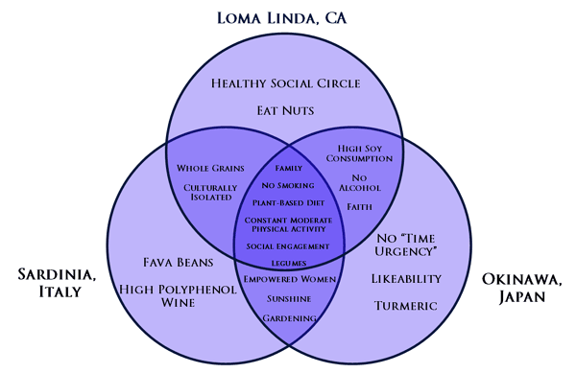
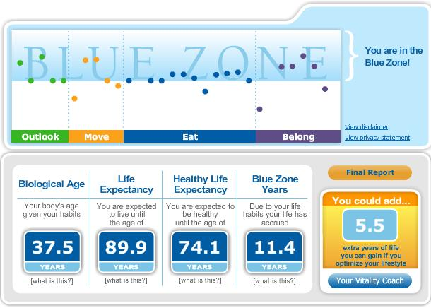

Slide 30
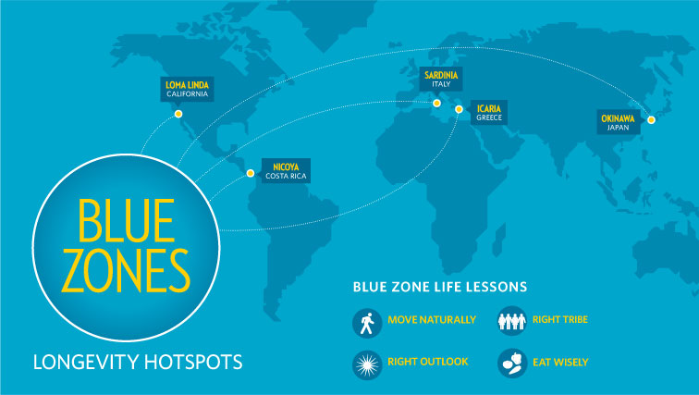
Blue Zone Life Lessons
Move Naturally—Longevity all-stars engage in low-intensity physical activity, part of a daily work routine.
Right Outlook—People have a sense of purpose and their daily lives are infused with a sense of calm.
Right Tribe—Blue zone inhabitants have strong social support networks and prioritize family and faith.
Eat Wisely—Common thread is a plant-based diet, which avoids meat and processed foods.

Slide 31
LIFESTYLE CHANGE PROGRAM
COMMUNITY BASED / FOCUSED
30 DAY PROGRAM
PARTICIPATIVE / DEMONSTRATIVE
SCIENTIFICALLY VALIDATED / PEER REVIEWED
DEVELOPED IN 1988 BY DR HANS DIEHL
50,000 GRADUATES WORLD WIDE

Slide 32
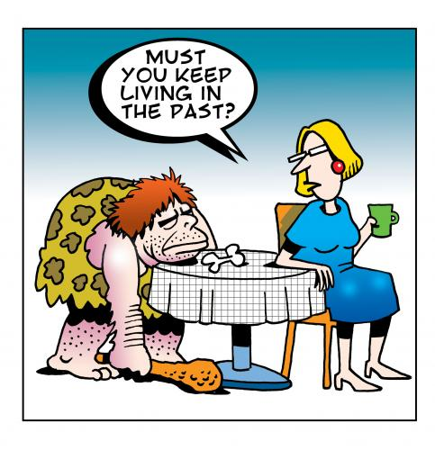

Slide 33
HEALTH EVANGELISM: logical choice
Changes people
Creates good will
Improves health
Prevents disease, lengthens life
Clears the mind to hear God’s voice
Results in good will
Deeper Spiritual experience
Results in baptism and church growth

Slide 34
Health Evangelism
Neutral way to introduce others to Lord
Universal goal of people-Everybody has a body
Generic & cross-cultural
No divisional boundaries
Non-threatening
Meets health needs of all cultures

Slide 35
HEALTH PROGRAMS (1)
First Aid
Stress Management skills
Weight Management
Family and Mental Health
How to respond to the problem of AIDS
Regeneration Seminar
Dietary Control of Heart Disease
Cancer Reduction Seminar

Slide 36
HEALTH PROGRAMS (2)
Breathe Free: The Plan to Stop Smoking
Drug Awareness program
Vegetarian Cooking Classes
Home Health Care Classes
Physical Fitness program
Cardiopulmonary Resuscitation (CPR)
Breast-feeding support groups

Slide 37
Strengthening the right arm: The Consequences

Slide 38
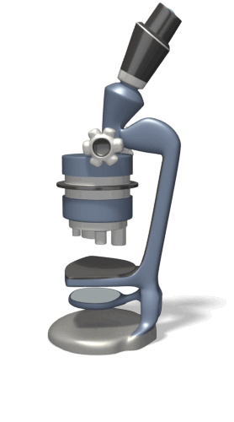
a dawning realization . . .
“I wish to tell you that soon there will be no work done in ministerial lines but medical missionary work.”
Counsels on Health, p. 533

Slide 40
World Statistics relative to health ministries and the 10-40 window
Members Ministers Employees | Countries of the world | Churches & companies (Potential Health Centers) | Total Schools & Students | Hospitals... & Outpatient Visit | Tithe Tithe/Offering Per Capita
16,307,880 16,949 213,267 | 206 of 232 Countries | 68,225 Churches 63,800 Companies | 7,804 1,673,580 | 167 16,079,916 | $1.9 Billion $2.7 Billion $172 (Both)
Notes:
Add key points in the history of your country to the timeline.

Slide 41
Health Promotion Strategy
Conceptualize
Organize
Advertize
Energize
Mobilize

Slide 43
L.I.F.T.
LEAD Wisely Account’bly Strategy
TRAIN Educate Empower Evaluate
INITIATE Plan Support Action
FOCUS Needs People Resources

Slide 44
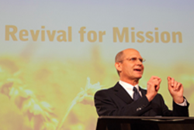
BHAG
Blended Ministry Concept

Slide 45
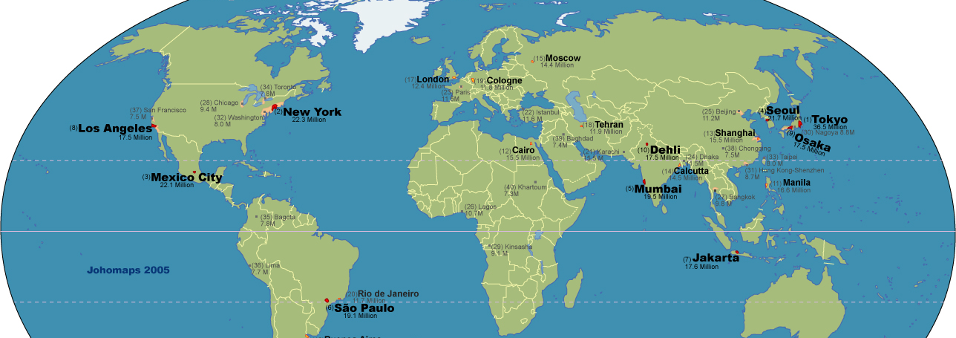
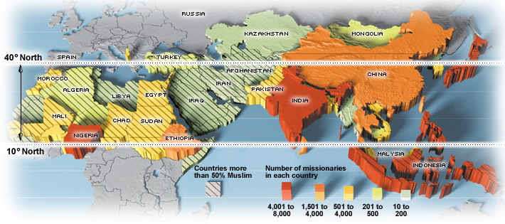
HOPE Into
Every City…

Slide 46
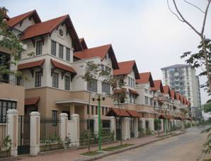
HOPE Into
EVERY Home…

Slide 47
It just makes sense and the time is now…
HEALTH IS GOD’S WILL: The practical reason for a health ministry is that those with clear minds are able to better understand the will of God and those with healthy bodies are better able to serve others.

Slide 48
By Helping Others
We Help Ourselves!

