Slide 1
Five HABITS of a Revived Leader: Moving From SNL to SSL
A Strategy for Deepening and Widening your Leadership Effectiveness
World Literature Ministry Coordinating Board, April 1, 2013

Slide 2
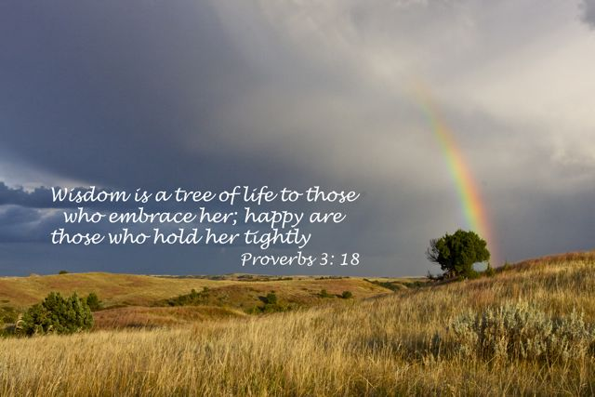

Slide 3
Leadership is Included in Revival and Reformation:
A revival and a reformation must take place under the ministration of the Holy Spirit.
Revival and reformation are two different things.
Revival signifies a renewal of spiritual life, a quickening of the powers of mind and heart, a resurrection from the spiritual death.
Reformation signifies a reorganization, a change in ideas and theories, habits and practices.
Reformation will not bring forth the good fruit of righteousness unless it is connected with the revival of the Spirit. Revival and reformation are to do their appointed work, and in doing this work they must blend. (The Review and Herald, February 25), Christian Service p. 42.

Slide 5
Strong, Natural Leaders (SNLs) are:
1. Visionaries--always looking forward
2. Energetic and action oriented--always on the move
3. Courageous--never lacking the "guts" to say what they think
4. Goal or task oriented rather than people oriented
5. Often paternalistic--the great protector/ teacher (mother hen)
6. Usually egocentric--sometimes admittedly; sometimes unknowingly
7. Intolerant of those who don’t measure up to their expectations
8. Considered indispensable—by themselves
9. Leaders by precept and power
10. Able to super-motivate people verbally and sweep them along

Slide 6
Strong Spiritual Leaders (SSLs)
The symbol of Rome’s leadership—a sword.
The symbol of the Greek’s leadership—a pen.
The symbol of secular leadership—a chair.
The symbol of the Christian’s leadership— a towel and basin (crown of thorns).

Slide 7
Henri Nouwen wrote about the uniqueness of spiritual leadership:
My movement from Harvard to L’Arche [a ministry to the mentally challenged] made me aware in a new way how much my own thinking about Christian leadership had been affected by the desire to be relevant, the desire for popularity, and the desire for power. Too often, I looked at being relevant, popular, and powerful as ingredients for effective ministry.
--In the Name of Jesus: Reflections on Christian Leadership

Slide 8
Identifying the Gap Between the Two Styles
Imperceptible GAP
Strong Natural
Leader
Strong Spiritual
Leaders
Secular Approach
Here to be Served
Spiritual Mindset
Here to Serve
Pride and Power

Slide 9
Ellen White on the Difference between SNL & SSL:
Those [Christian leaders] engaged in the work of God cannot serve His cause acceptably unless they make the best use possible of the religious privileges they enjoy. We are as trees planted in the garden of the Lord; and He comes to us seeking the fruit He has a right to expect.
His eye is upon each of us; He reads our hearts and understands our lives. This is a solemn search, for it has reference to duty and to destiny; and with what interest is it prosecuted.
Let each of those to whom are committed sacred trusts inquire: “How do I meet the inspecting eye of God? Is my heart cleansed from its defilement? or have its temple courts become so desecrated, so occupied with buyers and sellers, that Christ finds no room?” The bustle of business, if continuous, will dry up spirituality and leave the soul Christless.’ --ChL, page 4.

Slide 10
Five HABITS For Revived Leadership

Slide 11
Five HABITS For Revived Leadership
1. Open to be BHAG (Hebrews 11:8-10)
(Big Hairy Audacious Goal to Bold Honorable Anointed Goal)
Abraham: Embrace the unknown

Slide 12
Five HABITS For Revived Leadership
1. Open to be BHAG (Hebrews 118-10)
Abraham: Embrace the unknown
2. Willing to be Patient (Genesis 41:38)
Joseph: Endure in spite of circumstances
3. Determine to be Reflective (Luke 2:19)
Mary: Take time to stop, look, listen, reflect
4. Submit to Restitution (Philemon 10-12)
Onesimus: Make mistakes, have fortitude
5. Courage to be Passionate (Philippians 3:12-14)
Paul: Passionate about beliefs

Slide 13
Habits of a Revived Leader—How To. . .
SSL
1.
BHAG
2.
Patient
3.
Reflection
4.
Restitution
5.
Passionate
Recognition of Need
Resolve to Incorporate
Resign to Accountability

Slide 14
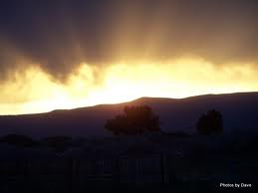

Slide 15
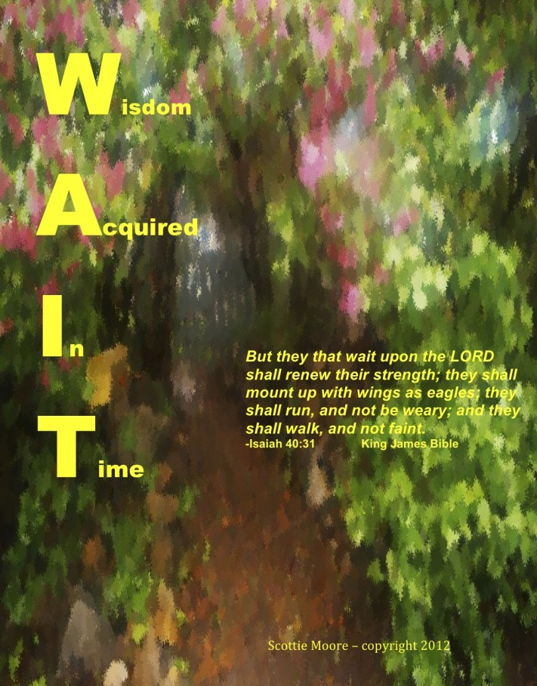
Delbert W. Baker, PhD General Vice President General Conference of SDA
BakerD@gc.adventist.org

