Slide 1
Vision of Commitment
10th Global Leadership Summit
Kiev, Ukraine
February 7, 2017
By: Raymond Wahlen

Slide 2
Thought Questions
Is it good to be committed?
Is commitment to the Adventist Church equivalent to commitment to God?
As leaders, do we want our employees and members to be committed?
Do we want our members to be committed to
Us personally?
The __________________________?
The Adventist Church?
To God?

Slide 3
Commitment [kuh-mit-muh nt]
Noun
1. the act of committing.
2. the state of being committed.
3. the act of committing, pledging, or engaging oneself.
4. a pledge or promise; obligation
engagement; involvement
perpetration or commission, as of a crime.
consignment, as to prison.
http://www.dictionary.com/browse/commitment
Notes:
commitment. (n.d.). Dictionary.com Unabridged. Retrieved January 27, 2017 from Dictionary.com website http://www.dictionary.com/browse/commitment

Slide 4
“Now fear the LORD and serve him with all faithfulness. Throw away the gods your ancestors worshiped beyond the Euphrates River and in Egypt, and serve the LORD.
But if serving the LORD seems undesirable to you, then choose for yourselves this day whom you will serve, whether the gods your ancestors served beyond the Euphrates, or the gods of the Amorites, in whose land you are living. But as for me and my household, we will serve the LORD.”
Joshua 24:15 (NIV)

Slide 5
Irony of Commitment
Commitment is not a state of being bound to some form of dreadful restriction – is Freedom
Choosing Commitment is to have the freedom to explore anything and everything that will strengthen that continuing experience
Clarity
Purpose
Direction
Focus

Slide 6
Overview
A Leader’s Personal Commitment to God
Organizational Commitment
Cultivating a Culture of Commitment

Slide 7
A Leader’s Personal Commitment to God

Slide 8
“Don’t confuse your relationship with the Church --
with your personal relationship with God.”

Slide 9
David’s Mighty Men
…but Eleazar stood his ground and struck down the Philistines till his hand grew tired and froze to the sword. The LORD brought about a great victory that day. The troops returned to Eleazar, but only to strip the dead.
2 Samuel 23:10 (NIV)

Slide 10
David’s Mighty Men
Next to him was Shammah son of Agee the Hararite. When the Philistines banded together at a place where there was a field full of lentils, Israel’s troops fled from them.
But Shammah took his stand in the middle of the field. He defended it and struck the Philistines down, and the LORD brought about a great victory.
2 Samuel 23:11,12 (NIV)

Slide 11
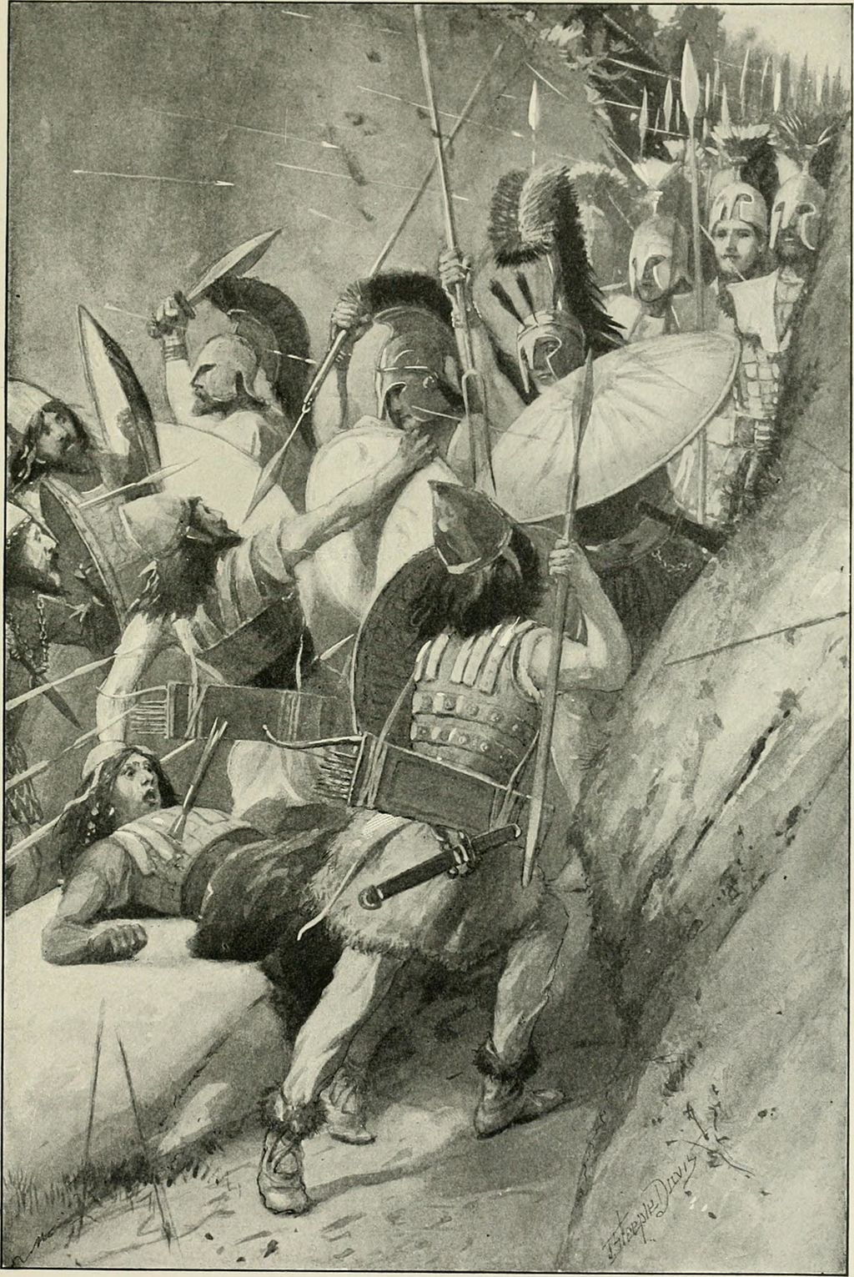
Battle of Thermopylae
Notes:
Attribution: By Ellis, Edward Sylvester, 1840-1916; Horne, Charles F. (Charles Francis), 1870-1942 [No restrictions], via Wikimedia Commons
https://commons.wikimedia.org/wiki/Category:Battle_of_Thermopylae
File link: https://upload.wikimedia.org/wikipedia/commons/a/a0/The_story_of_the_greatest_nations%2C_from_the_dawn_of_history_to_the_twentieth_century_-_a_comprehensive_history%2C_founded_upon_the_leading_authorities%2C_including_a_complete_chronology_of_the_world%2C_and_%2814578677039%29.jpg

Slide 12
Jesus’ Perfect Example
Because the Sovereign LORD helps me, I will not be disgraced. Therefore have I set my face like flint, and I know I will not be put to shame.
Isaiah 50:7 (NIV)

Slide 13
Phrase used in Luke 9:51 | Bible Version
He steadfastly set his face to go | ASV, DBY, JUB, KJV, NKJV, RHE, TMB, WBT, WYC
His face was turned to go | BBE
He determined to go | CEB, CSB, GW
He made his decision to set out for | CJB
He set his face to go | ESV, LEB, NRS, RSV, TYN
He made up his mind | GNT, NIRV
He intently set his face to go | HNV, WEB
He gathered up his courage and steeled himself for | MSG
He was determined to go | NAS, NCV
He resolutely set out for | NIV, NLT
He set his face (deliberately) and resolutely to go | OJB
He proceeded with fixed purpose towards | WNT
He fixed his face to go | YLT
Notes:
http://www.biblestudytools.com/luke/9-51-compare.html

Slide 14
Jesus called out with a loud voice, “Father, into your hands I commit my spirit.” When he had said this, he breathed his last.
Luke 23:46 (NIV)

Slide 15
Strong's Concordance
paratithémi: to place beside, to set before
Original Word: παρατίθημι Part of Speech: Verb Transliteration: paratithémi Phonetic Spelling: (par-at-ith'-ay-mee) Definition: (a) I set (especially a meal) before, serve, (b) act. and mid: I deposit with, entrust to, (c) I bring forward, quote as evidence.
Strong’s Concordance, http://biblehub.com/greek/3908.htm

Slide 16
To this you were called, because Christ suffered for you, leaving you an example, that you should follow in his steps.
“He committed no sin, and no deceit was found in his mouth.”
When they hurled their insults at him, he did not retaliate; when he suffered, he made no threats. Instead, he entrusted himself to him who judges justly.
1 Peter 2:21-23 (NIV)

Slide 17
Faith, saving faith, is to be taught. The definition of this faith in Jesus Christ may be described in few words: It is the act of the soul by which the whole man is given over to the guardianship and control of Jesus Christ. He abides in Christ and Christ abides in the soul by faith as supreme. The believer commits his soul and body to God and with assurance may say, Christ is able to keep that which I have committed unto Him against that day. All who will do this will be saved unto life eternal. There will be an assurance that the soul is washed in the blood of Christ and clothed with His righteousness and precious in the sight of Jesus. Our thoughts and our hopes are on the second advent of our Lord. That is the day when the Judge of all the earth will reward the trust of His people.
White, Ellen G, Mind, Character and Personality, 531.1

Slide 18
Organizational Commitment

Slide 19
Organizational Commitment – Defined Porter, Steers, Mowday and Boulian
“The strength of an individual’s identification with and involvement in a particular organization, characterising it by willingness to exert considerable effort on its behalf and belief in and acceptance of its goals and values.”
Cooper, David J, Leadership for Follower Commitment, Routledge (Taylor & Francis Group), 2003, p. 69

Slide 20
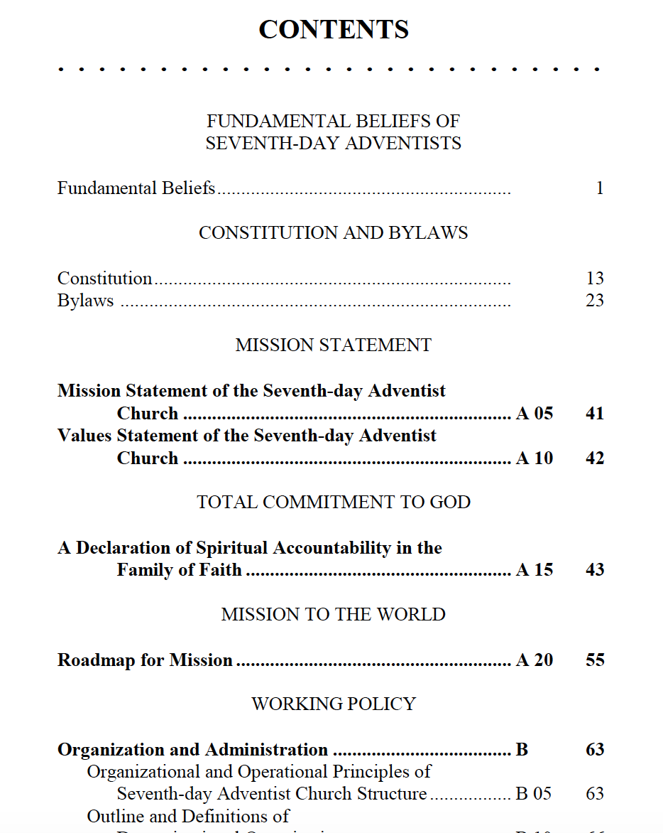

Slide 21
GC Working Policy
A 15 Total Commitment to God—A Declaration
of Spiritual Accountability in the
Family of Faith
Notes:
Document voted in 1996
Added to GC WP in 1998

Slide 22
What Total Commitment to God Involves for
Each Church Member
A Church Pastor
A Congregation
Elementary Schools and Academies
Colleges and Universities
Hospitals and Healthcare Institutions
Institutions of Mass Communication
Conference/Mission/Region/Field Station, or Union
General Conference/Divisions

Slide 23
Danger of Misplaced Commitment?
Nehushtan
“He removed the high places, and brake the images, and cut down the groves, and brake in pieces the brasen serpent that Moses had made: for unto those days the children of Israel did burn incense to it: and he called it Nehushtan.”
2 Kings 18:4

Slide 24
Danger of Misplaced Commitment?
Nehushtan
Made at the specific command of God
Used in an amazing way for the healing of many people
Prophetic illustration of Christ’s death on the cross

Slide 25
Danger of Misplaced Commitment?
What about Programs, Projects, Institutions?
Non-Profits need:
A process for “review, revision, and organized abandonment”
To regularly ask what can accomplish the most good for the work?
Continuous monitoring in the light of current priorities
Drucker, Peter F., Managing the Nonprofit Organization: Practices and Principles, Harper Collins Publishing, 1990, p. 5,6
Notes:
“… managers of non-profits also have to build in review, revision, and organized abandonment. The mission is forever and may be divinely ordained; the goals are temporary.”
Drucker, Peter F., Managing the Nonprofit Organization: Practices and Principles, Harper Collins Publishing, 1990, p. 5
“As you add on, you have to abandon. But you also have to think through which are the few things we can accomplish that will do the most for us, and which are the things that contribute either marginally or are no longer of great significance.”
Drucker, Peter F., Managing the Nonprofit Organization: Practices and Principles, Harper Collins Publishing, 1990, p. 6
“Things that were of primary importance may become secondary or even totally irrelevant. You must watch this constantly, or else very soon you will become a museum piece.”
Drucker, Peter F., Managing the Nonprofit Organization: Practices and Principles, Harper Collins Publishing, 1990, p. 6

Slide 26
The Challenge of Volunteer Organizations
“… trust me – volunteer organizations are more difficult to lead. People follow you only if they want to.”
Maxwell, John C., Leadership Gold: Lessons I’ve Learned from a Lifetime of Leading, Thomas Nelson, 2008, p. 144
In Religious Organizations:
Flight or Fight?
Alignment of Beliefs
Subject to Abuse

Slide 27
Cultivating a Culture of Commitment

Slide 28
Types of Commitment
Behavioral – An employee’s calculation that leaving is not worth the various perceived costs
Cooper, David J, Leadership for Follower Commitment, Routledge (Taylor & Francis Group), 2003, p. 69

Slide 29
Types of Commitment
Behavioral – An employee’s calculation that leaving is not worth the various perceived costs
Affective – Based on the desire to stay with the organization because of holding similar values and having the feeling that it is the right thing to do
Cooper, David J, Leadership for Follower Commitment, Routledge (Taylor & Francis Group), 2003, p. 69

Slide 30
Organizational Commitment - Traits
Based on Trust
Trust is a gift
Trust is earned
Cooper, David J, Leadership for Follower Commitment, Routledge (Taylor & Francis Group), 2003, p. 69
Expectations of new generations?

Slide 31
Organizational Commitment – Traits
It must be Continuous
Occasional or periodic attempts to demonstrate commitment to employees is viewed skeptically and perceived as manipulation
Cooper, David J, Leadership for Follower Commitment, Routledge (Taylor & Francis Group), 2003, p. 69

Slide 32
Organizational Commitment - Traits
It is Reciprocal
“Leaders should not expect willing and committed followership for the betterment of the organization if committed and willing leadership for the betterment of employee needs does not occur.”
Cooper, David J, Leadership for Follower Commitment, Routledge (Taylor & Francis Group), 2003, p. 69

Slide 33
Psychological Alignment
Management Expects | Employees Expect
Dedication to Mission and Strategy | Non-political culture – Mgmt does the “right” thing
High performance | Be on winning team work with the best of the best
Behavior consistent with values | Leader behavior consistent with values
Initiative | Delegation of authority
Collaboration and teamwork | Coworkers who share common values
Self-management | Participation in goal setting
Flexibility | Autonomy
Unselfish contribution | Unselfish and egalitarian behavior at top
Openness to feedback and learning | Opportunity to speak truth to power
Commitment to the organization | Employee development; above average pay and benefits; good faith effort to avoid layoffs
Beer, Michael, High Commitment High Performance, Jossey-Bass (Wiley Imprint), p. 31.

Slide 34
Strengthening Commitment
Democratic-style of leadership
Integration of objectives
Balanced leadership approach
Importance of communication
Natural recognition
Beer, Michael, High Commitment High Performance, Jossey-Bass (Wiley Imprint), p. 58.

Slide 35
Communication
Honest
Fact-based
Two-way
Include multiple key people
Create systems that enable truth to speak to power
Beer, Michael, High Commitment High Performance, Jossey-Bass (Wiley Imprint), p. 58.

Slide 36
Natural Recognition
Ask questions about the followers needs and values
Make decisions with those needs and values in mind
Act on what you learned
Give more responsibility
Place a high value on the employee
Not only for what they can give to the Organization, but for who they are as individuals
Cooper, David J, Leadership for Follower Commitment, Routledge (Taylor & Francis Group), 2003, p. 69

Slide 37
Things that tend to Weaken Commitment
HR Policies that tend to create classes of employees
Terminology that diminishes the value of certain stakeholders
Attempting to generate artificial commitment
Unstable financial position
Over-emphasizing the financial aspect
Inconsistent display of values
Cooper, David J, Leadership for Follower Commitment, Routledge (Taylor & Francis Group), 2003, p. 40 - 81

Slide 38
In Conclusion
As Adventist Leaders we must consistently and in a sustained manner:
cultivate our own spiritual commitment to God as a first priority
model the proactive inclusion of fellow employees and fellow members in ways that will sincerely demonstrate our commitment to them within our community of believers

