Slide 1



General Conference of Seventh-day Adventists
Office of Global Leadership Development
Prepared by: Lowell C Cooper
January 2010

Slide 2

Copyright 2010 by the General Conference of Seventh-day Adventists®. All rights reserved. The information is provided for training purposes only and is not intended nor should it be used as legal counsel. This program may not be used or reformulated for any commercial purposes; neither shall it be published by any person or agency other than an official organizational unit of the Seventh-day Adventist® Church, unless prior written authorization is obtained from the General Conference of Seventh-day Adventists® Office of Global Leadership Development. Subject to the foregoing terms, unlimited permission to copy or use this program is hereby granted upon inclusion of the copyright notice above. “Seventh-day Adventist” and “Adventist” are registered trademarks of the General Conference of Seventh-day Adventists® and may not be used by non-Seventh-day Adventist entities without prior written authorization from the General Conference. Use of all or any part of this program constitutes acceptance by the User of these terms.

Slide 3

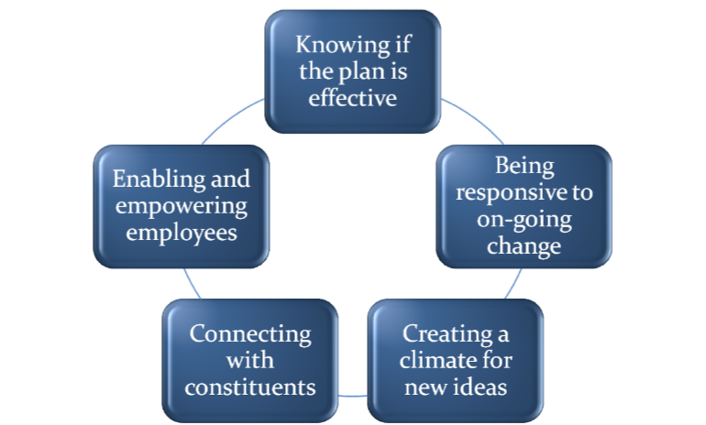
Five challenges in planning:

Slide 4
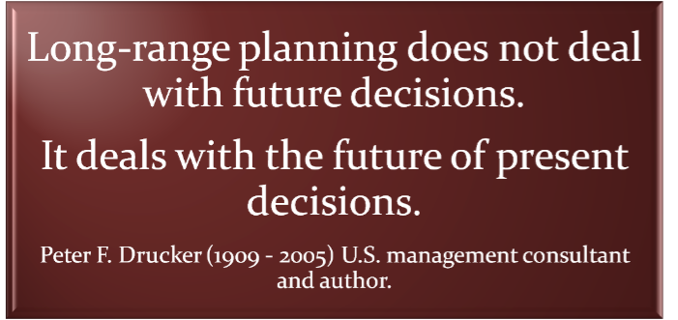

Slide 5

What do we do?
For whom do we do it?
How do we excel?

Slide 6


Slide 7
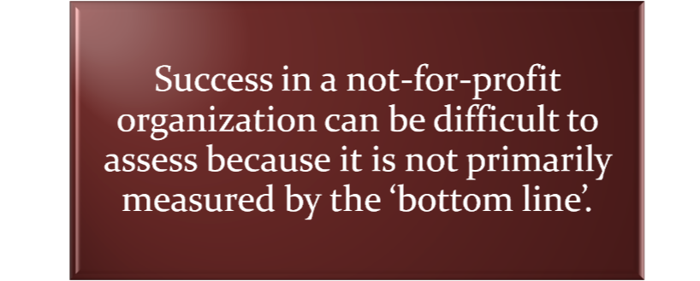

Slide 8
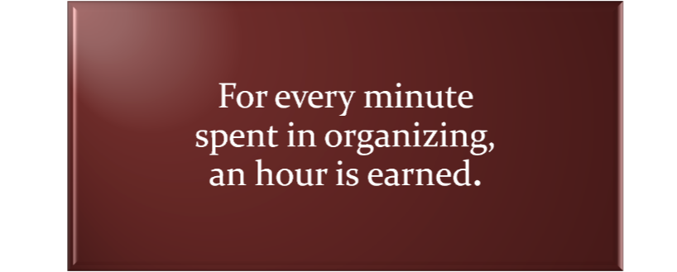

Slide 9

Clarity regarding purpose and goals
Collective sense regarding the future
Realistic objectives in light of current capacity
Alignment of employee energies
Firm reference for decision-making
Efficient use of resources
Base from which progress can be measured
Mechanism for adopting change when needed

Slide 10

Engages widespread input
Looks at whole organization (purposes and structure as well as activities)

Slide 11

SWOT (Strengths, Weaknesses, Opportunities, Threats)
PEST (Political, Economic, Social, Technological)
STEER (Socio-cultural, Technological, Economic, Ecological, Regulatory)
EPISTEL (Environment, Political, Informatic, Social, Technological, Economic, Legal)

Slide 12

Goals-based (most commonly used)
Issues-based (start with issue facing the org)
Organic (vision/value-based)
Scenario (What if...)
Appreciative inquiry (what works well, not what needs to be fixed)

Slide 13
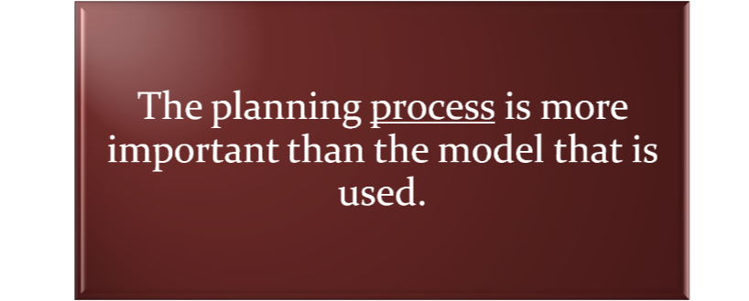

Slide 14
Goals-based (most commonly used)
Issues-based (start with issue facing the org)
Organic (vision/value-based)
Scenario (What if...)
Appreciative inquiry (what works well, not what needs to be fixed)
Strategic intent (one over-arching purpose)

Slide 15



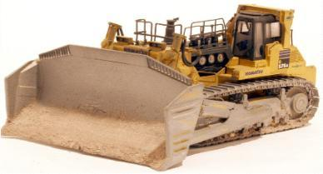

Slide 16

Focuses attention on the essence of winning
Motivates by communicating value of objective
Room for individual and team contributions
Sustains enthusiasm as circumstances change
Uses intent consistently to guide resource allocations.

Slide 17
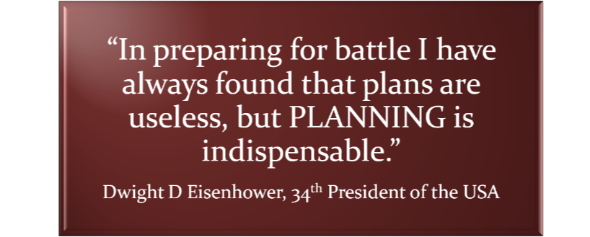

Slide 18

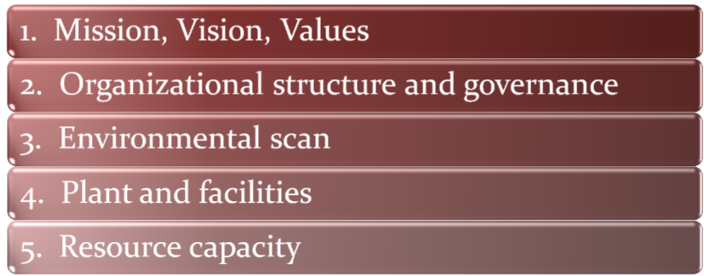

Slide 19
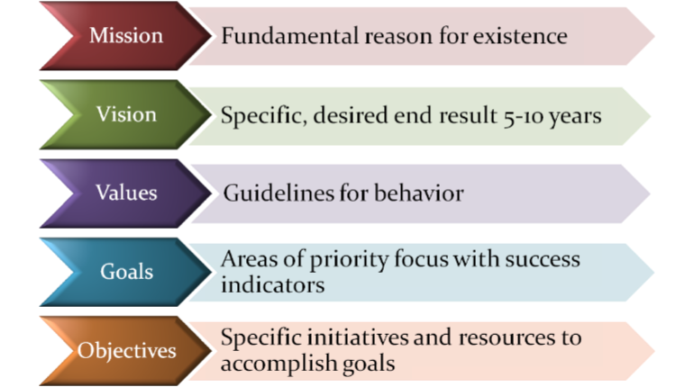
Strategic Plan Content:

Slide 20
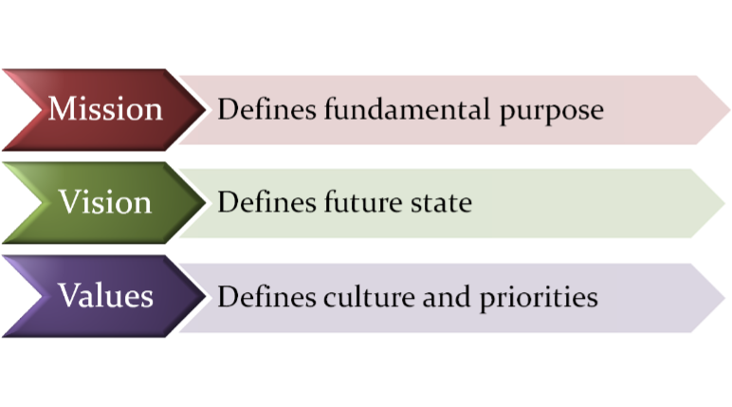
Strategic Plan Content:

Slide 21

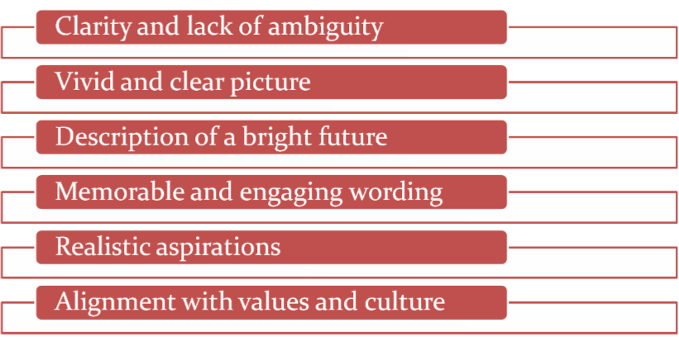

Slide 22

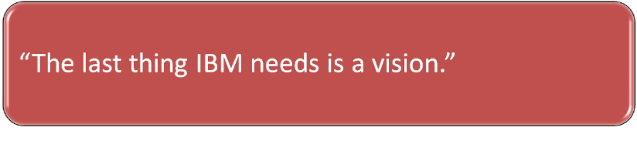

Slide 23
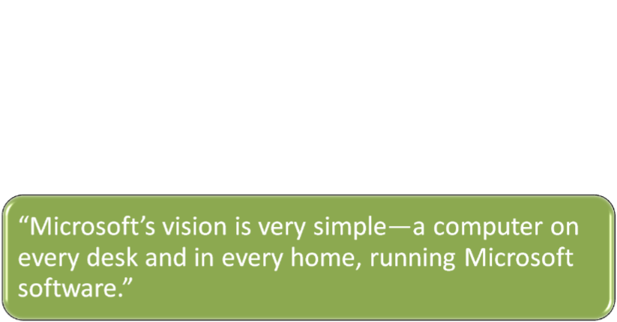


Slide 24

Legal status? Independent or part of a system?
Property—owned, leased, rented?
Board—size, range of expertise?
Board members—sufficient time and attention?
Board education?
Clarity regarding governance and management?
Healthy working relationship?

Slide 25
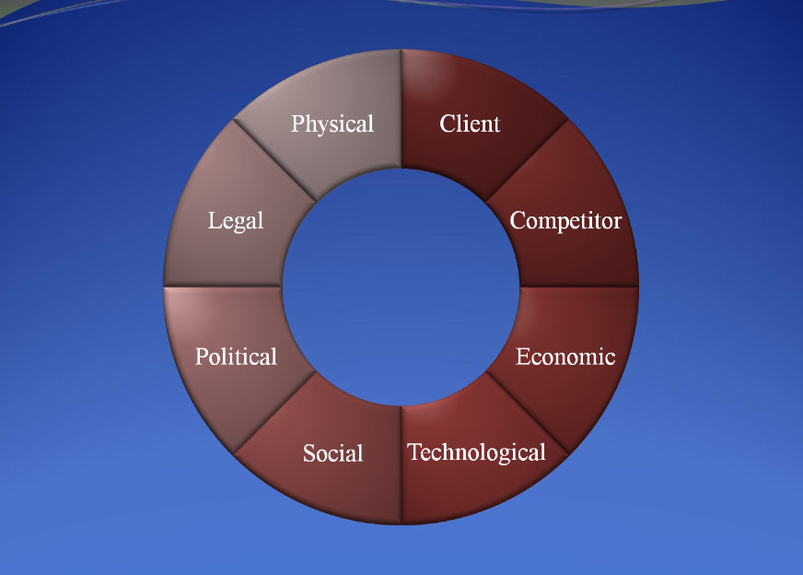
8
Environmental
Factors

Slide 26
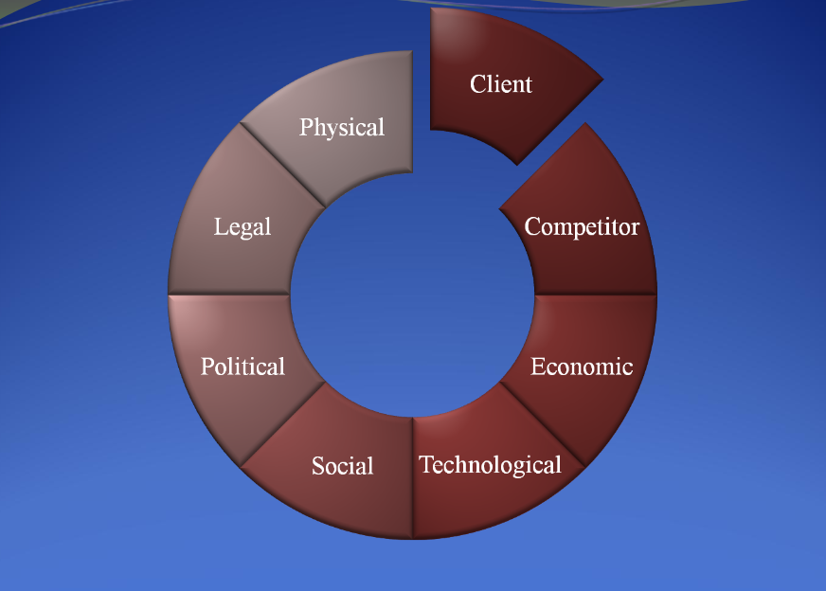
8
Environmental
Factors

Slide 27
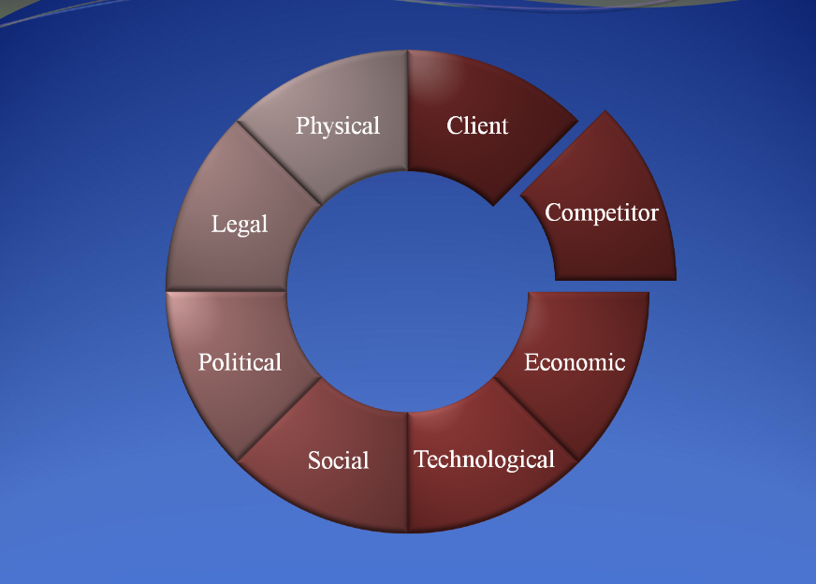
8
Environmental
Factors

Slide 28
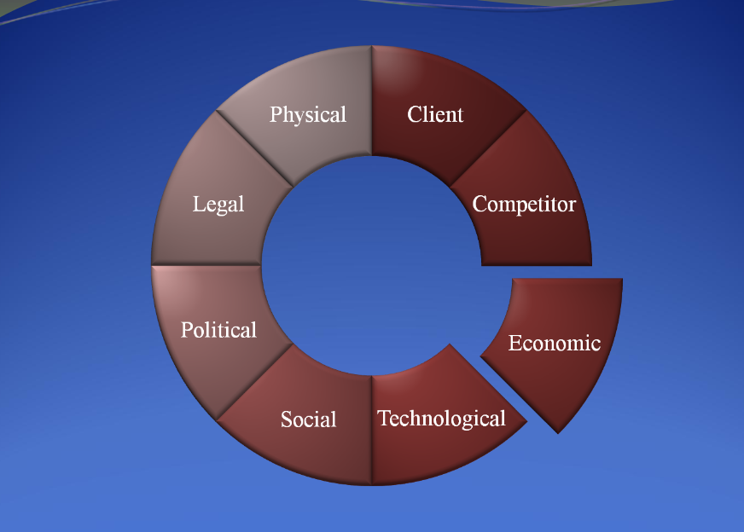
8
Environmental
Factors

Slide 29
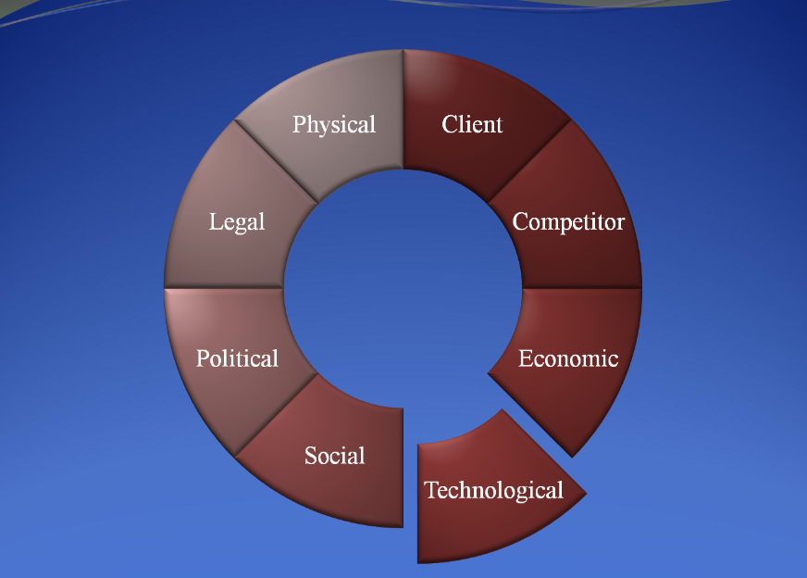
8
Environmental
Factors

Slide 30
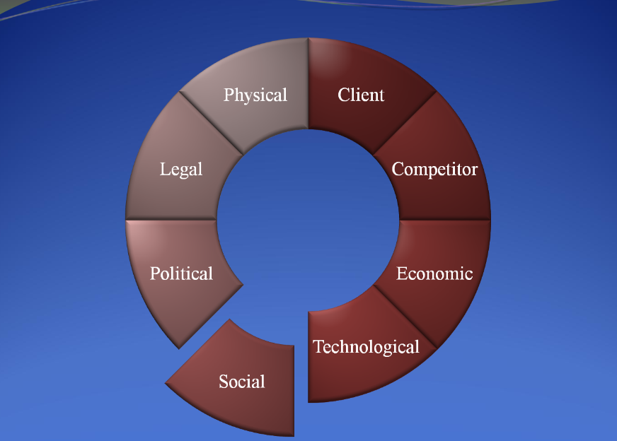
8
Environmental
Factors

Slide 31
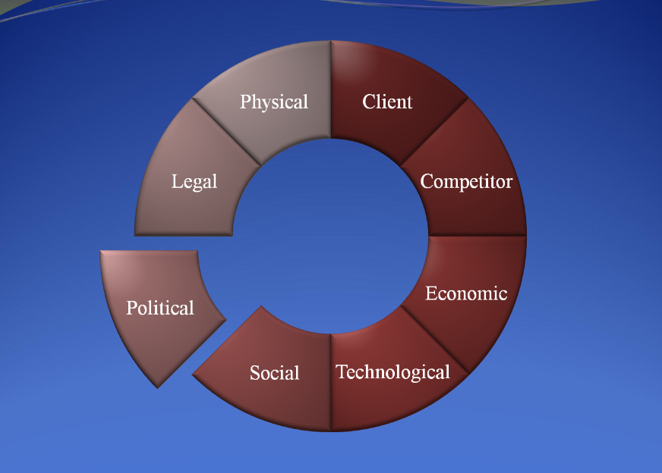
8
Environmental
Factors

Slide 32
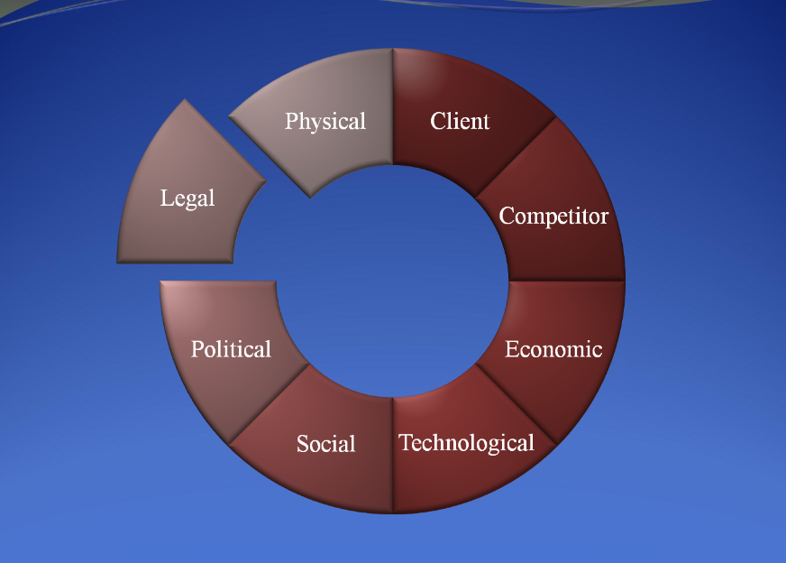
8
Environmental
Factors

Slide 33
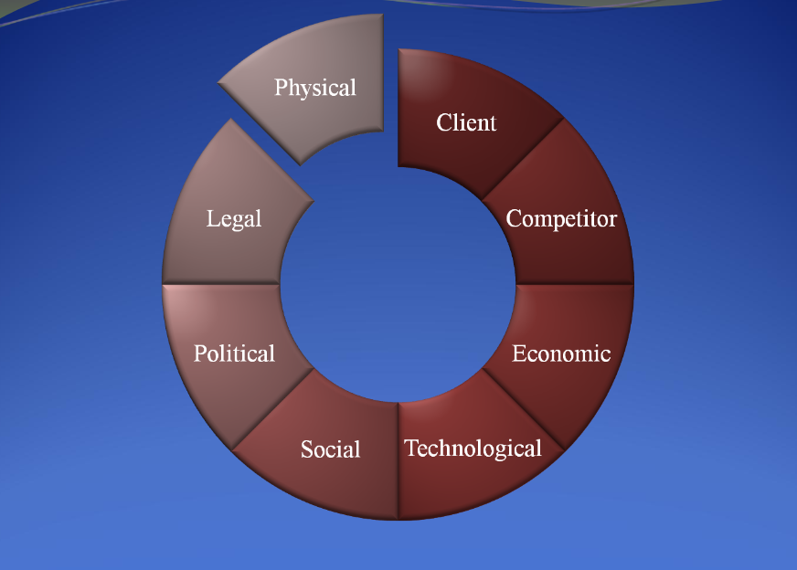
8
Environmental
Factors

Slide 34
Assumptions?
8
Environmental
Factors

Slide 35

Median age of buildings?
Property owned, leased, rented, combination?
Designed for the activities carried out?
Possibilities of re-configuration of services, expansion, relocation?
What adjustments needed to accommodate new lines of service, increase in clients?

Slide 36

Analysis of current financial operations.
Service lines that increase/decrease net revenue?
Service lines related to mission? To community needs?
What is the organization’s debt capacity?
What are the sources for capital?
Validity of partnerships/collaborations?
Rent, lease, purchase high tech equipment?

Slide 37
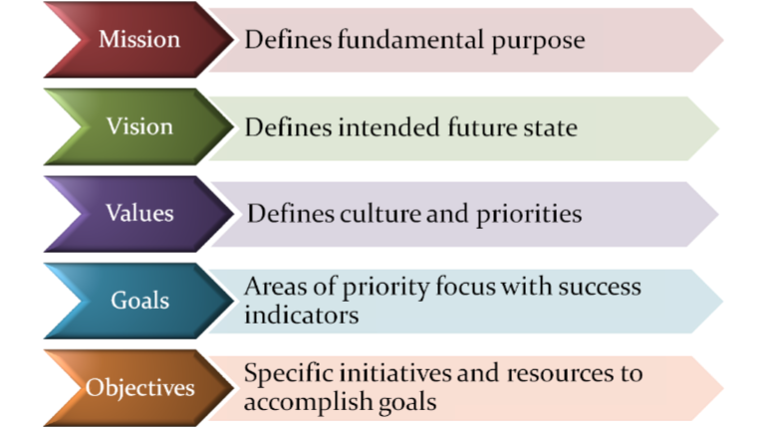
Documenting the plan

Slide 38
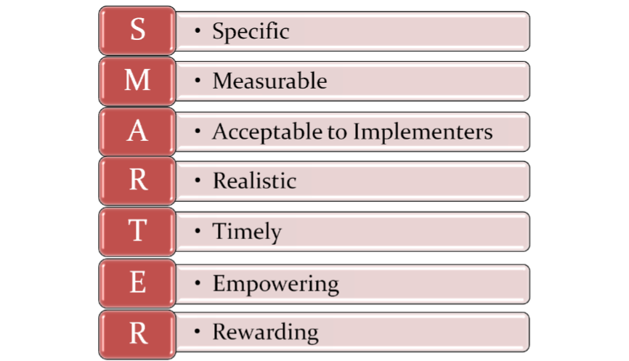
Goal characteristics:

Slide 39
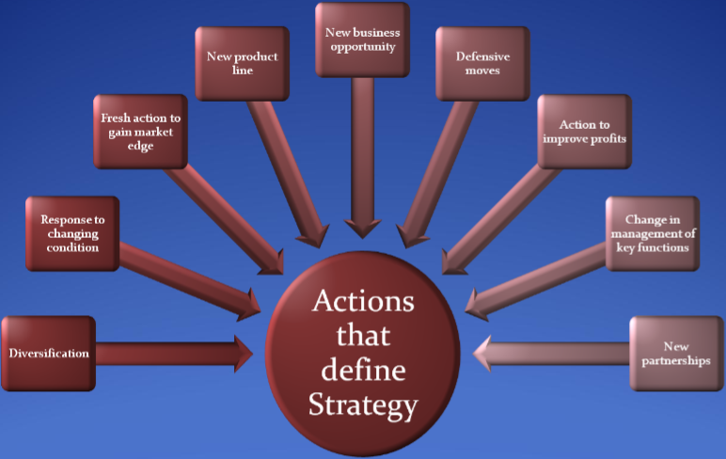

Slide 40

Dependent on size, complexity.
Requires sufficient time for engagement of stakeholders
Administration can delegate but not abdicate
Develop a sense of direction
Retain flexibility
Determine what matters most

Slide 41



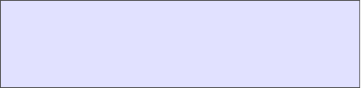


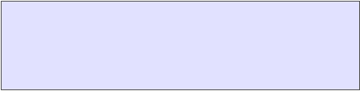




Future State Direction (2009)
Core Goals
The Healthcare Ministry’s full expression of the healing and teaching ministry of Jesus Christ will be fulfilled by becoming the leading health care organization in the broad Inland Empire region:
Recognized regionally and globally as a premier center for whole person clinical
care, teaching, and research.
Strongly differentiated in the market through the full development of recognized clinical sites and centers of excellence.
Preferred for an unwavering commitment
to patient safety and patient-centered “high-touch” and “high-tech” service.
Acknowledged for the professionalism, quality, compassion, and mission-orientation of its caregivers.
SERVICE EXCELLENCE (How we deliver services) Transform processes,systems and environments to assure patient safety and remove barriers to patient access and throughput; promote integrated, efficient, patient care processes.
CLINICAL LEADERSHIP (What we do)Building on the Institute model, fully actualize regional and global leadership in select clinical centers of excellence.
REGIONAL OUTREACH (Who we serve)Strengthen and solidify presence, visibility and overall position as the leading healthcare organization in the region.
WORLD CLASS RESOURCES (What we need)Develop the technologies, facilities, and people to support the teaching, research, and patient care mission.

Slide 42


Motto: To Make Man Whole
Mission: To continue the teaching and healing ministry of Jesus Christ
Vision: Transforming lives through education, healthcare, and research
World Class
Distinction
Quality &
Service
Excellence
Teamwork &
Synergy
Leadership
& Stewardship
Partnerships
Shared Values: Compassion, integrity, excellence…….…

Slide 43
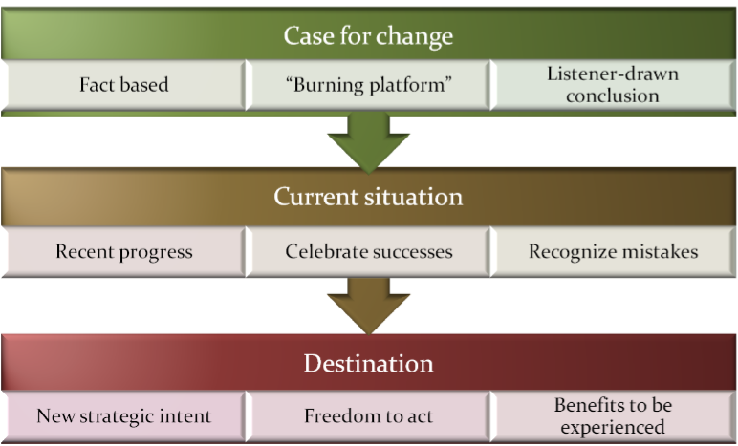
Strategic Plan Rollout:

Slide 44
Implementing the plan
Use the planning process for ongoing education and conversation
Understand stakeholder perspectives
Make sure plan is specific and concrete
Link all activities to the plan
Become involved, but remember your role
Use plan to hold people accountable
Tell the whole community
Report on measurable indicators

Slide 45
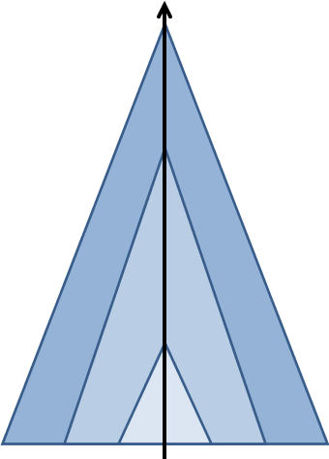



Plan alignment:
Institution plans
Entity/department plans
Individual plans

Slide 46
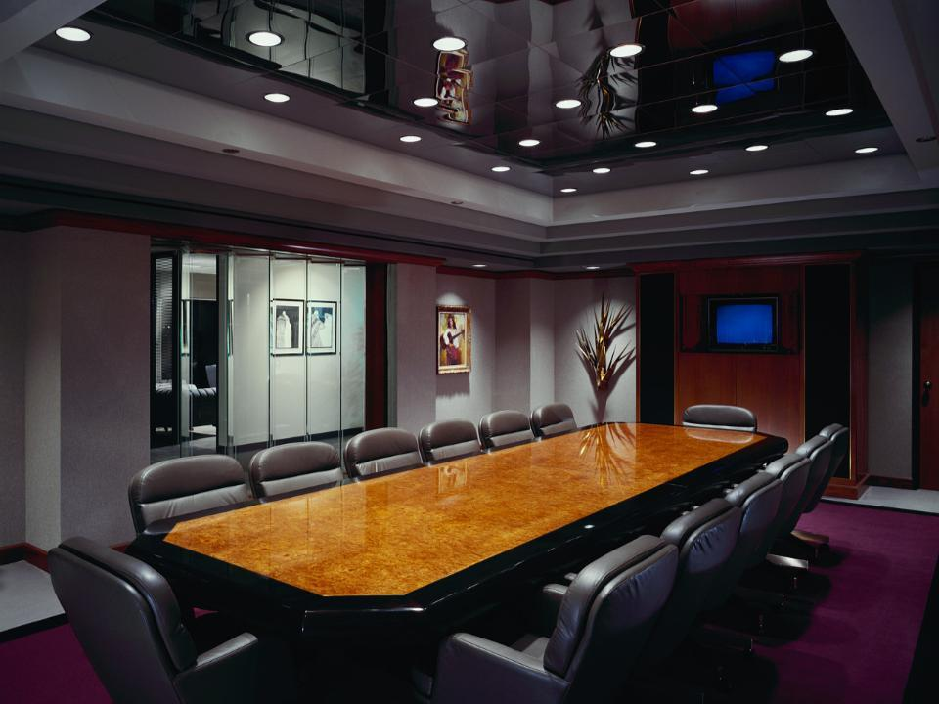

Planning is an essential leadership task.

Slide 47
Leadership must articulate a sense of direction for the organization.

Slide 48
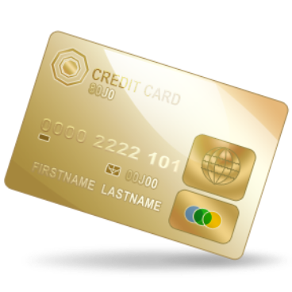



Slide 49
The core objective is to earn and maintain public trust in and commitment to
your healthcare organization.

Slide 50
Past success guarantees n0thing!

Slide 51


“If things seem under control...you’re just not going fast enough.”
—Mario Andretti

Slide 52

Global Conference on Health and Lifestyle
Geneva, Switzerland
July 6-11, 2009
Lowell C Cooper

