Slide 1


Barry Gane PhD
with thanks to Hal Thomsen DMin

Slide 2

When properly understood, the leading and managing functions of president and treasurer are complementary
Notes:
“Searching for Balanced Relationships”
Finding a perspective to examine the relationship between executive officers of a local conference is not a simple task. Treasurers may be at different maturity level and talent-mix, and their abilities may vary as much as the entities they serve. Depending on the size, location, demographic, culture, conferences may be large, medium, small, metropolitan, urban, suburban, agricultural, culturally diverse, majority guided, institutionally endowed or congregationally driven, financially healthy or financially challenged. As the need is, so is the financial talent mix.
I have chosen a descriptive approach to the nature of both functions – Executive and Financial that may be summarized as follows: when properly understood, managing and leading functions are complementary.

Slide 3


Slide 4

Leaders seize opportunities; Managers avert threats.
Leaders amplify strengths; Managers reduce weaknesses.
Leaders optimise the upside; Managers minimise the downside.
Leaders envision possibilities; Managers calculate probabilities.
Leaders focus on the ends; Managers focus on the means.
Leaders focus on the what; Managers focus on the how.

Slide 5
Leaders prepare beyond the limits; Managers focus execution within limits.
Leaders generate energy; Managers preserve energy.
Leaders are the first ones on the battlefield; Managers are the last ones off.
Leaders provide vision; Managers provide execution.
Leaders do the right things; Managers do things right.
Leaders rive change; Managers maintain consistency.

Slide 6

Direction
Values
Purpose
Family feeling
Motives
Effectiveness
Control
Rules and Policies
Process
Implementation
Operation
Efficiency

Slide 7
Subject | Leader | Manager
Essence | Change | Stability
Focus | Leading people | Managing work
Have | Followers | Subordinates
Horizon | Long-term | Short-term
Seeks | Vision | Objectives
Approach | Sets direction | Plans detail
Decision | Facilitates | Makes
Power | Personal charisma | Formal authority
Appeal to | Heart | Head
Energy | Passion | Control
Dynamic | Proactive | Reactive
Persuasion | Sell | Tell

Slide 8
Subject | Leader | Manager
Style | Transformational | Transactional
Exchange | Excitement for work | Money for work
Likes | Striving | Action
Wants | Achievement | Results
Risk | Takes | Minimizes
Rules | Breaks | Makes
Conflict | Uses | Avoids
Direction | New roads | Existing roads
Truth | Seeks | Establishes
Concern | What is right | Being right
Credit | Gives | Takes
Blame | Takes | Blames

Slide 9

Why did you accept the job?
Do I know what the priorities are?
What are the unexpressed fears?
Have you established a working capital and liquidity philosophy?
What is the financial moment of the organization?
Is there a strategic plan?

Slide 10

Do you discuss values, issues and programs periodically?
Do you have or recognize the need of a mentor?
Do you trust each other?
Do you enjoy each other’s company?
Do you have questions about integrity, motive and character?

Slide 11

What are your ultimate objectives in life?
Can you live with less than perfection?
Do you know your limitations?

Slide 12
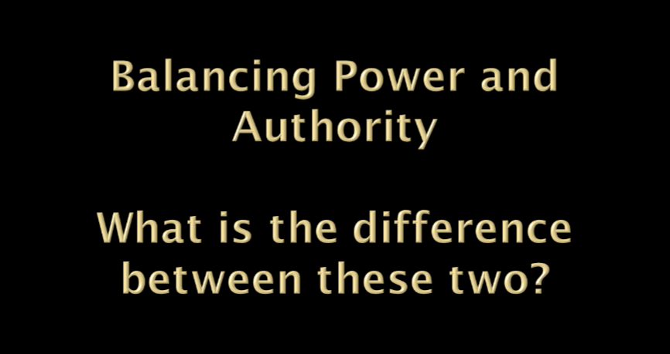
Notes:
Balancing Power and Authority
At the time of your appointment, you are given the authority to do a job; however, it is when the people recognize you, accept you and consent on having you as a leader that your influence will increase to the level of power that you need. Your authority should remain as “a backdrop” as you go about your work.
The ideal is to go through life without even invoking your authority, but rather operate on a collegial basis, where mutual understanding provides all the elements for you to succeed. Persuade, influence and convince by strength of character and integrity. Invoke your authority as little as possible, especially to your fellow officers.
Bernard M. Bass, Bass & Stogdill’s Handbook of Leadership, 3rd ed., The Free Press, New York, 1990, pp. 305-307.
J. Thomas Wren, The Leader’s Companion, The Free Press, New York, 1995, pp. 339-348.

Slide 13

What is position power?
What is personal Power?
Other types of Power
  Financial
  Information
  Social
  Reputation
  Skill/Expertise
  Referent
  Coercive
  What are limits that need to be placed on the use of power?

Slide 14

Phase I Sovereign Foundations Early Experiences
Phase II Inner-Life Growth Personal Life Growth
Phase III Ministry Maturing Professional Maturing
Phase IV Life Maturing Life Maturing
Phase V Convergence Convergence
Phase VI Celebration or Afterglow Conclusion
Notes:
Knowing the developmental phase you are experiencing helps you define your needs of affirmation, support and collegiate interaction with other executive officers. It is important that you neither overestimate, nor underestimate yourself and your abilities.

Slide 15

Immaturity
Passive
Dependence
Behave in a few ways
Erratic shallow interests
Short time perspective
Subordinate position
Lack of awareness of self
Maturity
Active
Independence
Capable of behaving in many ways
Deeper and stronger interests
Long time perspective (past and future)
Equal or superordinate position
Awareness and control over self

Slide 16

John Gardner warns,
"All too often on the long road up young leaders become servants of what is rather than shapers of what might be. In the long process of learning how the system works, they are rewarded for playing within the intricate structure of existing rules, and by the time they reach the top are likely to be trained prisoners of the structure."
“To the extent that leaders enable followers to develop their own initiative, they are creating something that can survive their own departure."

