Slide 1
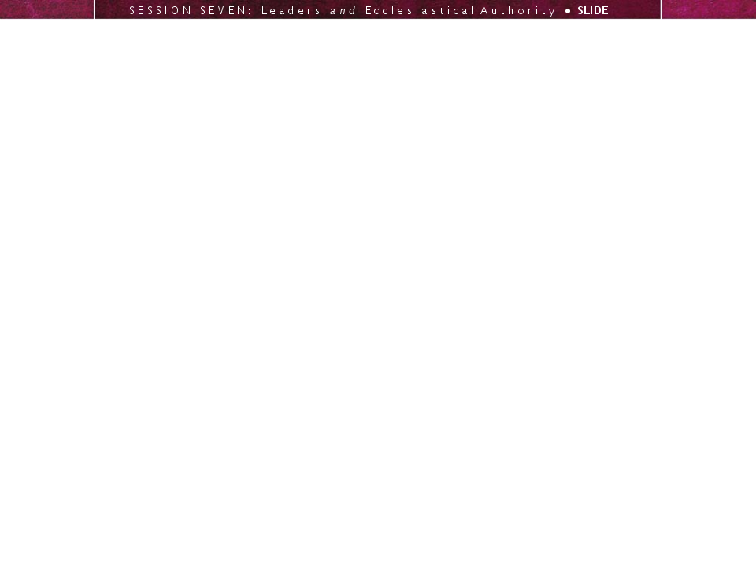

A LEADERSHIP WORKSHOP
Based on the Collected Papers
from the Leadership Symposium
General Conference Session
July 3-7, 2005

Slide 2
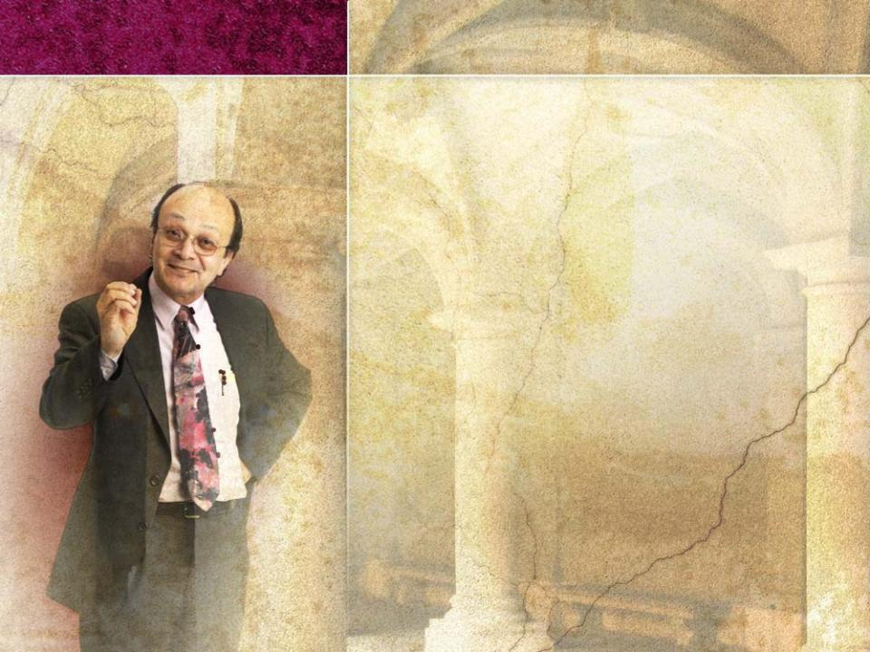
SESSION seven
Leaders and Ecclesiastical Authority:
Acceptance of Authority–
PART 2
Based on the Presentation by
Ángel Manuel Rodríguez
Biblical Research Institute

Slide 3

Session 7 will address the
following questions:
1
For what three purposes should leaders use their ecclesiastical authority?
2
How do these three elements function within the church?
3
Within the Adventist Church, where does final authority reside? Why has the church chosen this model?

Slide 4

4
What challenges do we face in exercising ecclesiastical authority? How can each of these challenges be met?
5
As a church, we follow the consensus model of decision making. What criteria should consensus follow? What should be avoided in achieving consensus?
6
How can we evaluate a leader’s use of ecclesiastical authority?
7
What does the proper use of ecclesiastical authority require of a leader?

Slide 5

III. Understanding the Proper Use and the Limits of Ecclesiastical Authority (continued)
C. Ecclesiastical Authority: Setting Limits
Leaders will use ecclesiastical authority to preserve
the integrity of the biblical message
the mission of the church
the unity of the church
These three elements were of central importance in the work of Christ.

Slide 6
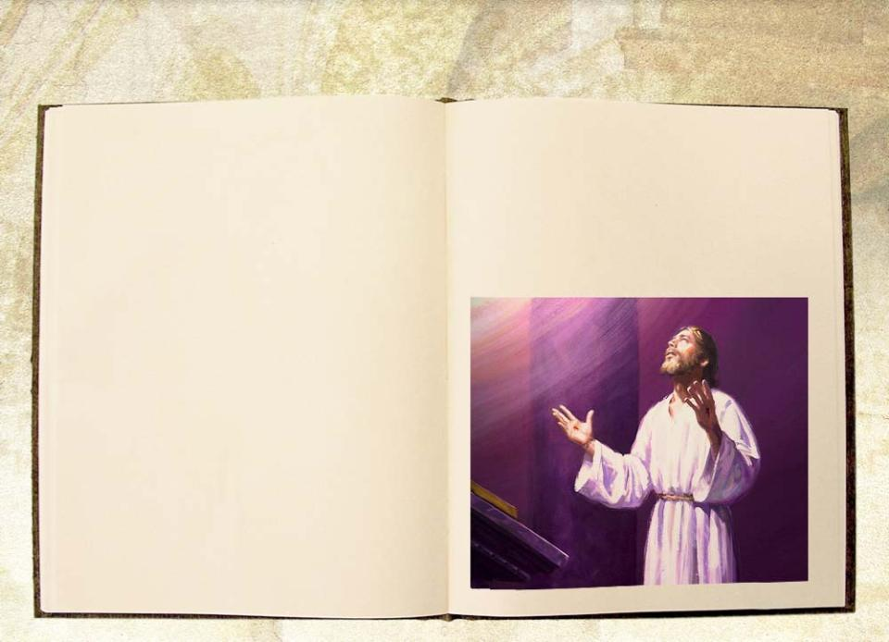
Concerning His mission, Jesus said,
⁴“I have brought you glory on earth by completing the work you gave me to do.
⁸“For I gave them the words you gave me and they accepted them. They knew with certainty that I came from you, and they believed that you sent me.
²²“I have given them the glory that you gave me,
that they may be one, as
we are one:
²³I in them and you in me. May they be brought to complete unity . . .”
John 17:4,8,22,23 (NIV)

Slide 7

This triad
is of fundamental
importance in defining
the role of ecclesiastical
authority
belongs to the
essential core of the
nature of the
Adventist Church
expresses the identity and role of the Advent Movement within God’s plan of salvation
integrity of the biblical message
realization of the mission
global unity of the church

Slide 8
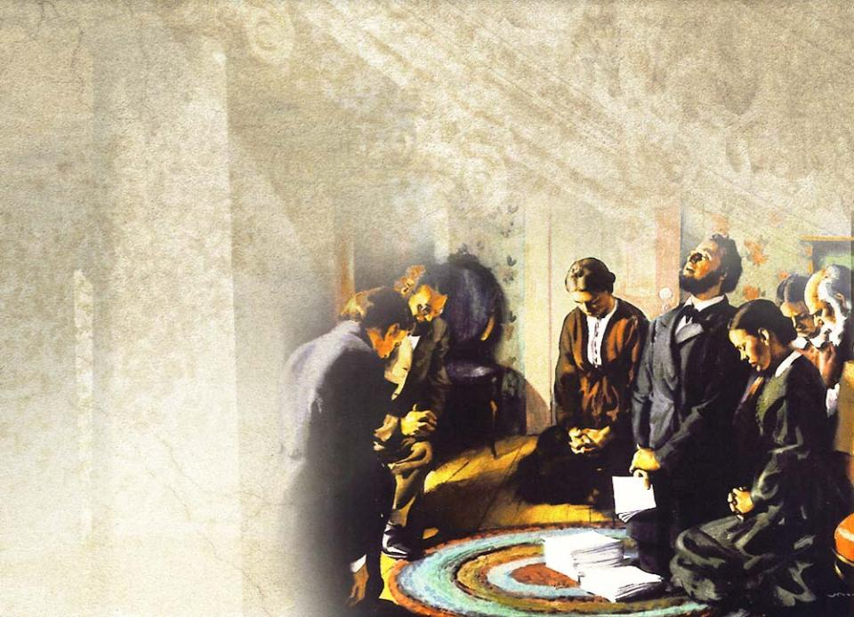
Adventist Church leaders
received the message as
a trust from the Lord.
Leaders do not
own it; it
belongs to
the world
church.

Slide 9

The mission of the Adventist
movement is a call to restore
biblical truth and to
prepare the
world for the
return of Christ.
Leaders are to
be totally
committed to it.

Slide 10

The unity of the church enables the global church to speak with one voice to the world
in proclaiming the
message of the
church
in fulfilling its
mission

Slide 11
This triad
defines the sphere within
which leaders are to
exercise their authority
creates the parameters
within which proper
use or misuse of
authority can be
identified
could be the
fundamental criterion
  for the exercise of ecclesiastical authority
  to free leaders from the threat of authoritarianism and self-service
integrity of the biblical message
realization of the mission
global unity of the church

Slide 12




Every plan, decision, and appointment can be evaluated
through the prism of message, mission, and unity.
INITIAL
plans
decisions
appointments
FINAL
plans
decisions
appointments
TRIAD
Notes:
Presentation copy

Slide 13

D. Ecclesiastical Authority and Final Authority
Although delegated authority is used by
different leaders and at different levels
around the world, there is a final authority
in the church.
The challenge is to define
how that authority is expressed
who should exercise it
what could limit it
Adventist ecclesiology doesn’t allow
ultimate authority to rest on a person,
a group of clergy, or theologians.

Slide 14

Adventists believe that ultimate authority resides in the world church as it is subject to the Lordship of Christ.
This is based on the biblical model of the Jerusalem Council found in Acts 15.
We believe that the voice of the church is authoritative when the world
church convenes in General
Conference (GC) Session.
ULTIMATE AUTHORITY,
however, should always be FAITHFULNESS TO SCRIPTURE.

Slide 15

Ellen White supported this view.
“. . . God has ordained that the
representatives of His church from
all parts of the earth, when assembled
in a General Conference, shall have
authority. The error that some are in
danger of committing is in giving to
the mind and judgment of one man, or
of a small group of men, the full measure of authority and influence that God has vested in His church in the judgment and voice of the General Conference assembled to plan for the prosperity and advancement of His work.”
(Testimonies for the Church, Vol 9, 261)
© Ellen G. White Estate

Slide 16

General Conference secretariat working policy
“The General Conference is the highest organization in the administration of the worldwide work of the church, and is authorized by its Constitution to create subordinate organizations to promote specific interests in various sections of the world;
it is therefore understood that all subordinate organizations and institutions
throughout the world will recognize
the General Conference in session as
the highest authority under God.”
(2003-2004 Edition, 47-48)

Slide 17

The GC Session is the authoritative channel through which the world church reaffirms its
MESSAGE
MISSION
UNITY
The supreme concern in that assembly is
the well-being of the global church
not the narrow regional interests of local territories

Slide 18

In the setting of the GC Session, ecclesiastical authority should seek to preserve the unity
of the church.
This requires global thinking from church members
and leaders at all levels.

Slide 19

E. Ecclesiastical Authority: Implementing the
Will of the Church
Since GC decisions were
reached by representatives
from the global church,
believers around the world
should willingly abide by its decisions.
Christ’s authority within the church seeks to serve the well-being of local churches around the world.

Slide 20
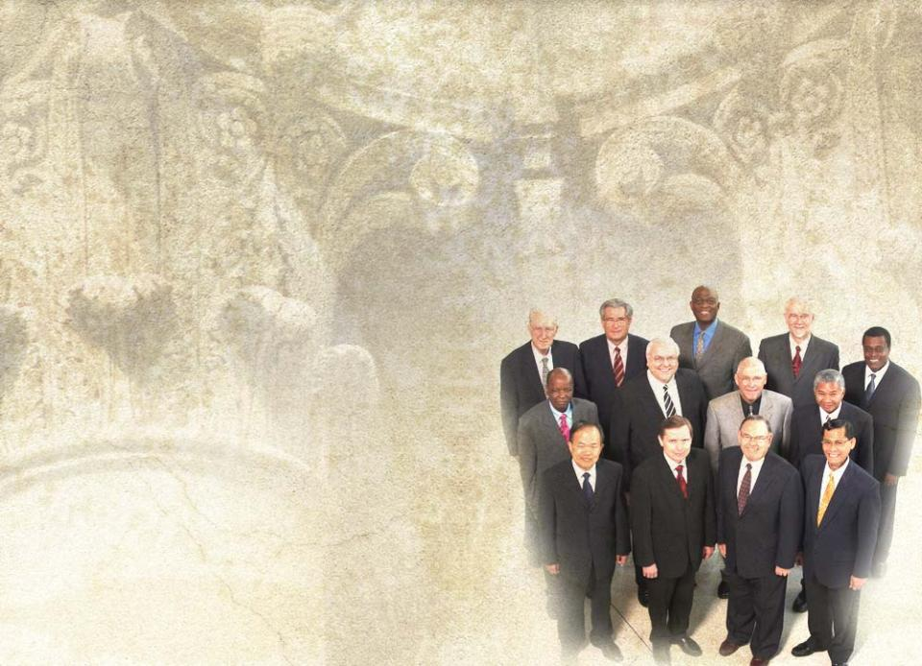
When decisions have been made by the global church, leaders are entrusted with authority to implement these decisions in their regions.
Ecclesiastical
authority does
not ignore
regional needs.

Slide 21

Although there is unity in the church, this unity includes an element of diversity in expression and action.
Diversity within unity
is the goal.
Unity
is the central factor
judges and defines
the limits of diversity
needs to be promoted
Diversity
is subservient to unity
is natural and needs no promotion

Slide 22
When dealing with sensitive issues where diversity is involved, the main interest of church leaders should be
preserving the integrity of the message
fulfilling the mission
preserving the unity
of the church.

Slide 23

A global church is
by nature diverse.
Because of this,
disagreements
concerning
the use of
ecclesiastical
authority can
be expected.

Slide 24

The challenge of the gospel is to form a body of believers that are committed to a global
message
mission
unity

Slide 25

IV. Challenges in the Exercise of Ecclesiastical Authority
Corruption
is one of the most threatening challenges that leaders face
is a natural human tendency for those who exercise power
results from change that is almost imperceptible at the beginning
“Power corrupts; absolute power corrupts absolutely.”

Slide 26

Leaders who do not succumb to the insidious temptation to corruption that goes with power
combine delegated authority with internal spiritual authority
demonstrate a life fully consecrated to the Lord
reveal by their words, deportment, kindness and goodness, their personal communion with Christ
are unconditionally dedicated to the
  integrity of the message
  fulfillment of the mission
  unity of the church

Slide 27
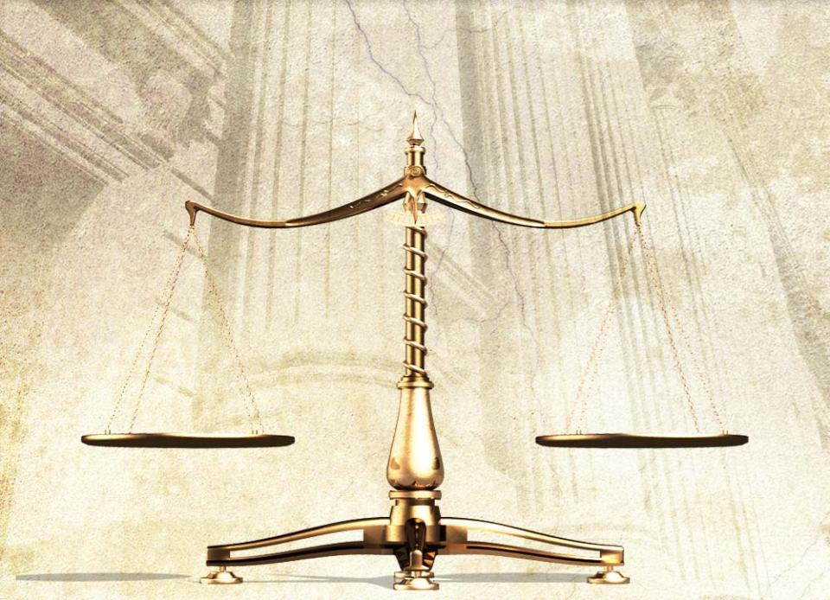


Balancing Local Needs with Needs of the Global Church
local needs
global needs

Slide 28
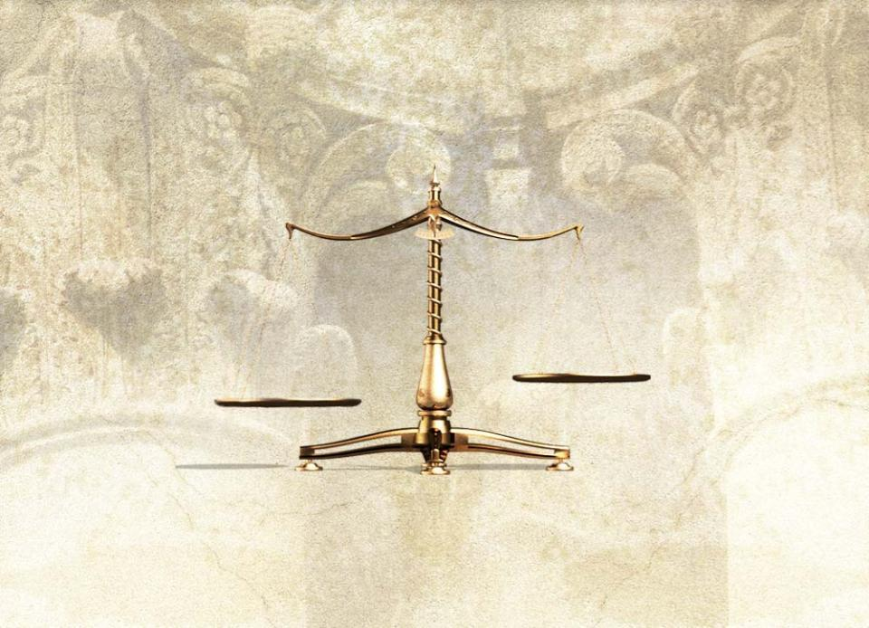


When leaders overemphasize the authority of a particular segment rather than of the world church, fragmentation can occur.
To avoid this, leaders need to remember that their primary concern should be the global community of believers.
global needs
local needs

Slide 29

The Need to Work through Consensus
Leaders should seek consensus based on the best expression of their authority in the areas of
MESSAGE
MISSION
UNITY

Slide 30

A consensus should
be based on the most enriching biblical expression of an item
be faithful to Scripture
A consensus should not
seek to establish the minimum common denominator on an item
allow for contradictory perspectives
accommodate opposing views within the church in order to preserve unity

Slide 31

Attempts to Usurp Leaders’ Power
Leaders must use their power and authority or others will usurp
their authority.
Those who try to usurp leaders’ authority
may promote personal agendas within the church
usually promote a distorted view of the message, mission, and unity of the church
may influence leaders to support their particular agendas
may influence leaders to use church communication channels to promote their personal views and opinions

Slide 32

Uncertainty about the
of the church makes a leader vulnerable to usurpation of power.
A clear understanding of these elements can help leaders avoid power vacuums.
MESSAGE
MISSION
UNITY

Slide 33

The Inclusive Nature of the Global Church

Slide 34

The Adventist movement is made up
of people from “every nation, tribe,
language and people.” (Rev 14:6)
Leaders need to listen to the many
voices of this global community.

Slide 35

Ethnic, gender or racial prejudice
will have a negative impact on a leader’s use of authority
should not be allowed to silence or limit the influence of any segment of the church
Interaction among the different cultural segments of the church will enrich all segments.

Slide 36
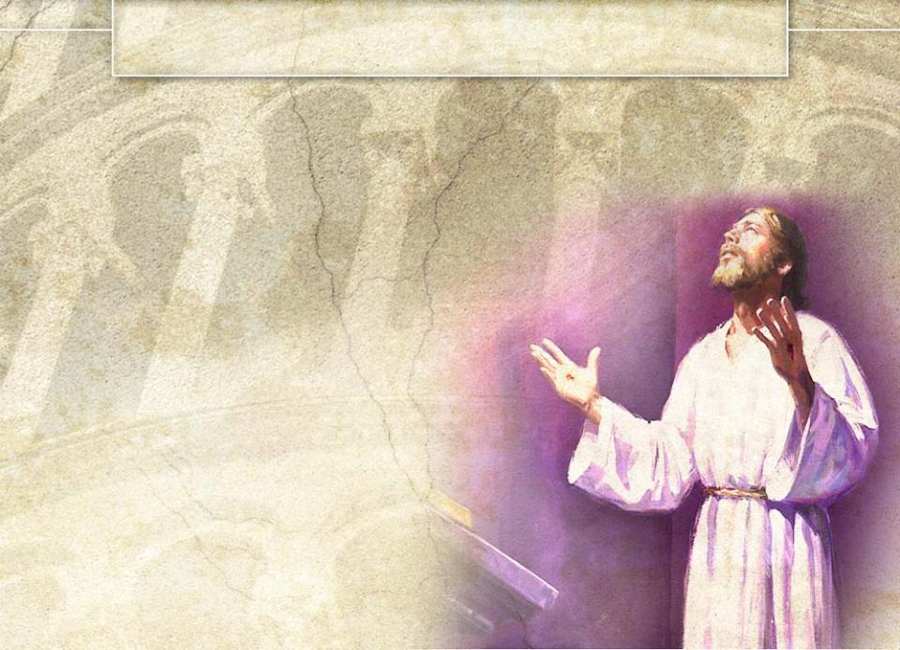
V. Conclusion
Any definition of ecclesiastical authority must begin with an understanding of God’s power and authority
as revealed in Christ.
Christ used His authority
to sustain, redeem, and
preserve His creation.
God’s display of power
reveals His goodness
and love.

Slide 37
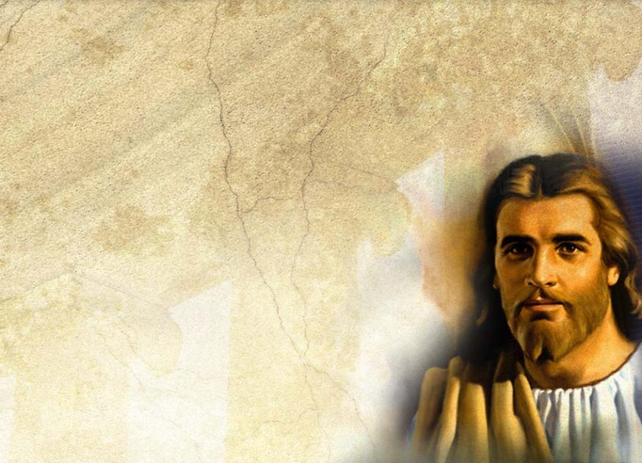
This Christological understanding of authority
forms the basis for
ecclesiastical authority
is oriented toward the
well-being of others
is the theological
grounding of the
authority of
church leaders

Slide 38

Ecclesiastical authority
does not mean that church leaders function as mediators between
Christ and the believers
resides in the global church
consists in the freedom
Christ gave the church to
work with Him in the
consummation of His
mission of redemption

Slide 39

Ecclesiastical authority is best expressed in the commitment
of believers to the
integrity of
the message
fulfillment of
the mission
dedication to the
unity of the church
This formula could be useful for
evaluating the proper or improper
use of ecclesiastical authority.

Slide 40














Authority is diffused throughout the world church,
but some of that authority is delegated to elected representatives.
GC Session
In a GC Session, these delegates speak to the world field with final authority, with one final voice.

Slide 41
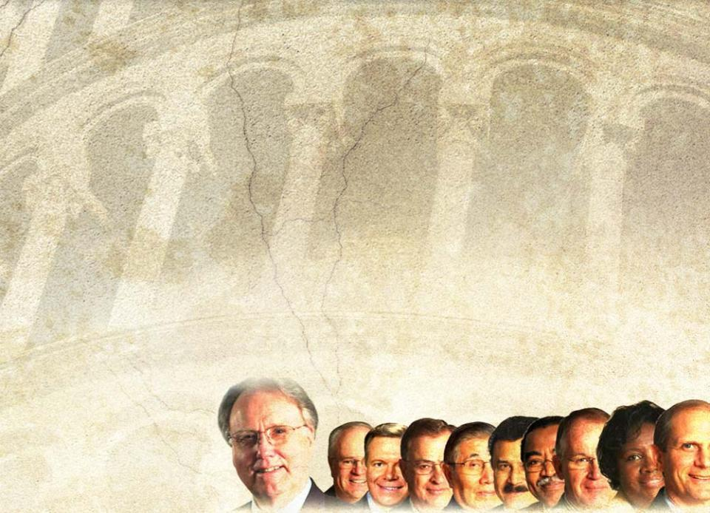
The use of ecclesiastical authority by elected leaders is legitimate to the extent that their understanding and use of it is Christologically determined.
This will be shown in their commitment to the
to procure the well-being of the global community of believers.
MESSAGE
MISSION
UNITY
Notes:
Presentation copy

Slide 42
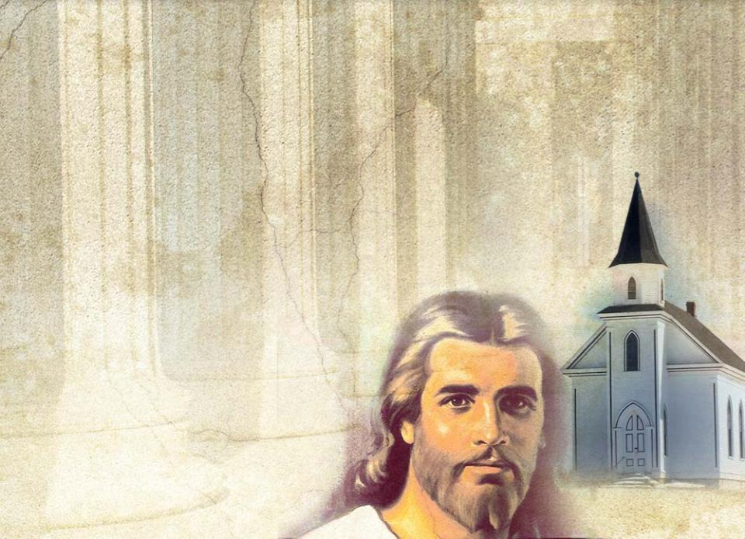
Ecclesiastical Authority:
a sacred trust that makes us accountable to our Lord and
to His church
a gift entrusted to us to serve
the church

Slide 43

Modeled after Christ’s authority, ecclesiastical authority focuses
on the care of God’s people.
²Be shepherds of God’s flock that is under your care, serving as overseers—
not because you must, but because you are willing, as
God wants you to be; not greedy for money, but eager to serve;
³not lording it over those entrusted to you, but being examples to the flock. ⁴And when the Chief Shepherd appears, you will receive the crown of glory that will never fade away. I Pet 5:2-4 (NIV)

Slide 44

The apostles accepted persecution and even martyrdom to fulfill
the mission of the church.
Their compelling goal was
building up the church, not
their personal self-image.

Slide 45
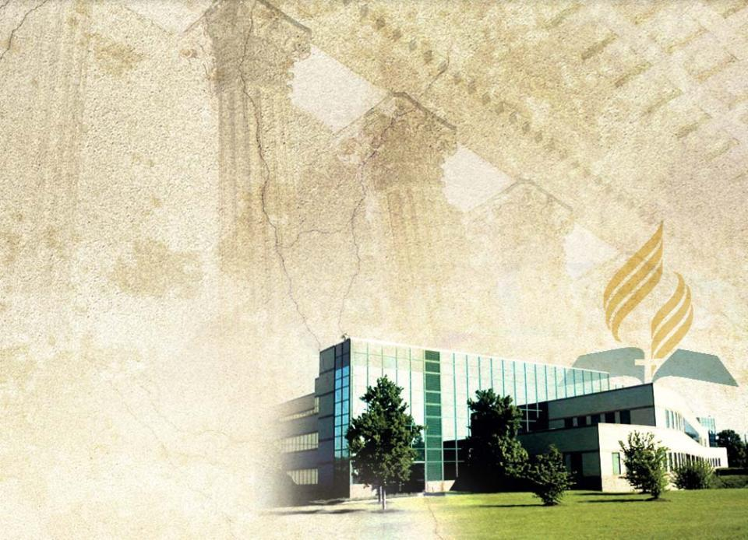
Any use of ecclesiastical authority for personal gain is a misuse of it.
The use of ecclesiastical authority requires leaders to
always do what is good and right
do what ought to be done for the church
not make decisions based on how those decisions would
impact them
personally
WARNING: while you are free to copy and translate the text of the content of this DVD for training purposes within the Seventh-day Adventist Church, illustrations are owned by various entities that have provided us limited use rights. DO NOT COPY OR USE THE ILLUSTRATIONS WITHOUT OBTAINING LICENSES AND PERMISSION TO DO SO IN ADVANCE.

