Slide 1
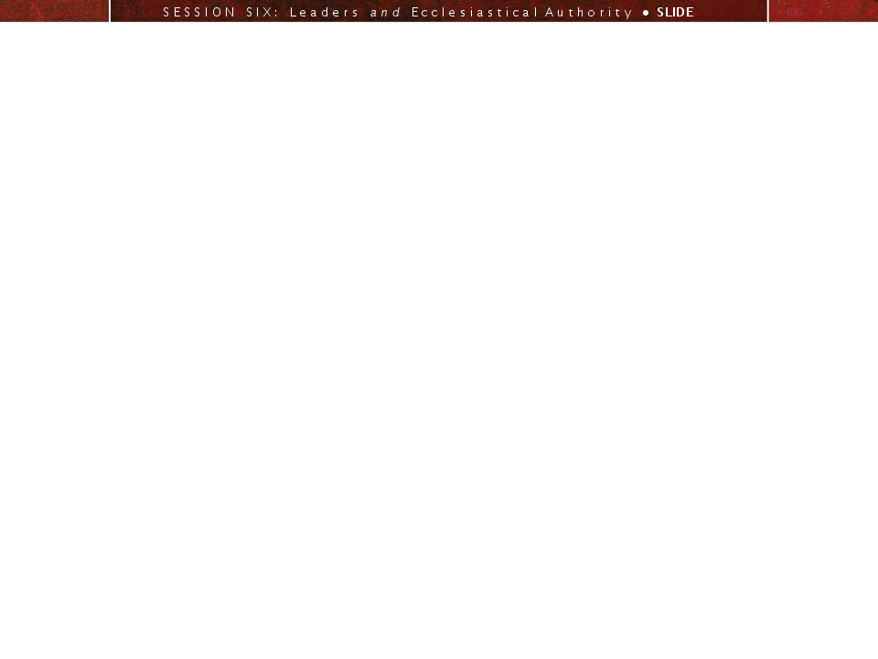
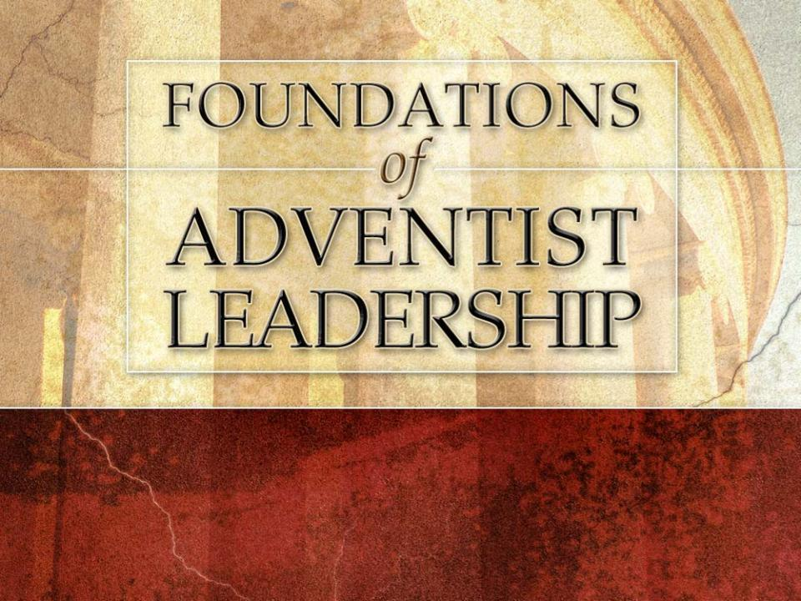
A LEADERSHIP WORKSHOP
Based on the Collected Papers
from the Leadership Symposium
General Conference Session
July 3-7, 2005

Slide 2
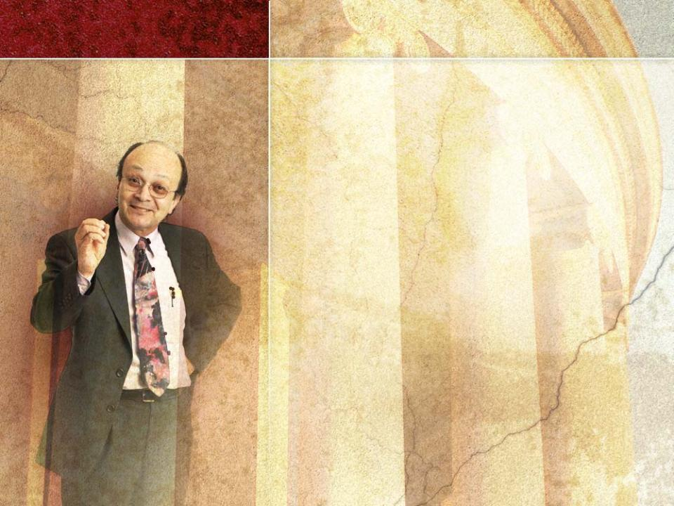
SESSION six
Leaders and Ecclesiastical Authority:
Acceptance of Authority–
PART 1
Based on the Presentation by
Ángel Manuel Rodríguez
Biblical Research Institute

Slide 3

Session 6 will address the
following questions:
1
What is the difference between “authority” and “power” as these apply to the church?
2
Why does God have supreme authority?
3
How does God use His power?
4
In what ways did Jesus use His power and authority?
5
Where does the authority of the church come from?

Slide 4

6
What is implied by the “entrusted” dimension of ecclesiastical authority?
7
What three entities cooperate in exercising ecclesiastical authority?
8
What is the role of Ellen White regarding
church authority?
9
What functions does ecclesiastical authority
serve in the church?
10
What do we mean by “delegated authority”? How does it work in the Adventist Church?

Slide 5

I. Introduction
One of the most difficult
topics in developing the theological doctrine of
the church (ecclesiology)
is defining and
establishing the nature,
extent, and function of
ecclesiastical authority.

Slide 6

Ecclesiastical Authority
Terms Defined
Ecclesiology: “theological doctrine relating to the church” (Webster’s New Collegiate Dictionary)
Ecclesiastical authority: the authority of the church
Power (dunamis):
“being able,” “ ‘capacity’ in virtue of an ability ”
the capacity to carry something out
usually associated with the ability to
produce change

Slide 7

Authority: (exousia)
freedom; ability; power, authority
emphasizes the right of a person to exercise power
The Bible does not make a clear distinction between “authority” and “power.”
Here we use them as follows:
the ability to produce change
the right to exercise power
Power
Authority

Slide 8

II. Searching for a Model for Ecclesiastical Authority
Where does supreme authority lie?
In Christian theology,
God has supreme authority.
Man has limited authority.

Slide 9

Reasons that God has supreme authority:
He is Creator
¹⁷“Ah, Sovereign LORD, You have made the heavens and earth by your great power and outstretched arm. Nothing is too hard for you.”
Jer 32:17 (NIV)
²⁰For since the creation of the world God’s invisible qualities —his eternal power and divine nature—have been clearly seen, being understood from what has been made . . .
Rom 1:20 (NIV)

Slide 10

He is Redeemer
¹⁵“. . . and I lay down my life for the sheep. . . .
¹⁸No one takes it from me, but I lay it down of my own accord. I have authority to lay it down and authority to take it up again…”
John 10:15,18 (NIV)
¹⁶I am not ashamed of the gospel, because it is the power of God for the salvation of everyone who believes . . .
Rom 1:16 (NIV)

Slide 11

The will of the Creator and Redeemer
stands above any other will
is to be recognized as supreme
THE WILL OF GOD
The will of
civil governments
The will of
church leaders

Slide 12

God’s authority and power are part of His very nature.
GOD IS LOVE
AUTHORITY
POWER
LOVE

Slide 13
The authority and power of God
are exercised in love
are constantly seeking the best for
His creatures
provide requirements to preserve the lives of His creatures.
establish what is indispensable for us to enjoy.
are not limiting.
facilitate our self-realization.
promote development of our potential.

Slide 14

God does not use His authority and power as a despot
for self-satisfaction and
self-aggrandizement
to display selfish power or egotistical dominion over others

Slide 15
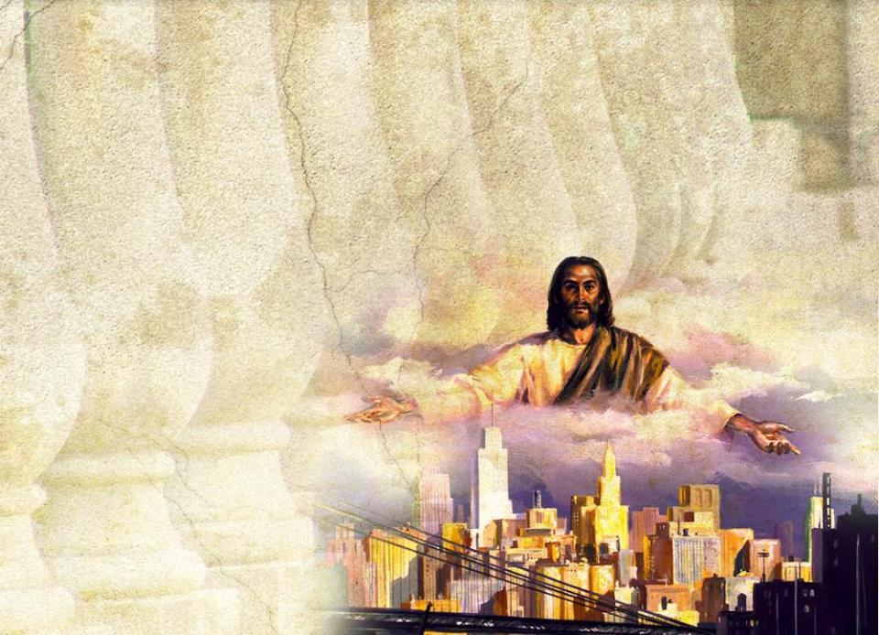
Rather, He uses His authority and power
to show His love
to sustain and preserve His creation
in acts of benevolence
toward others

Slide 16
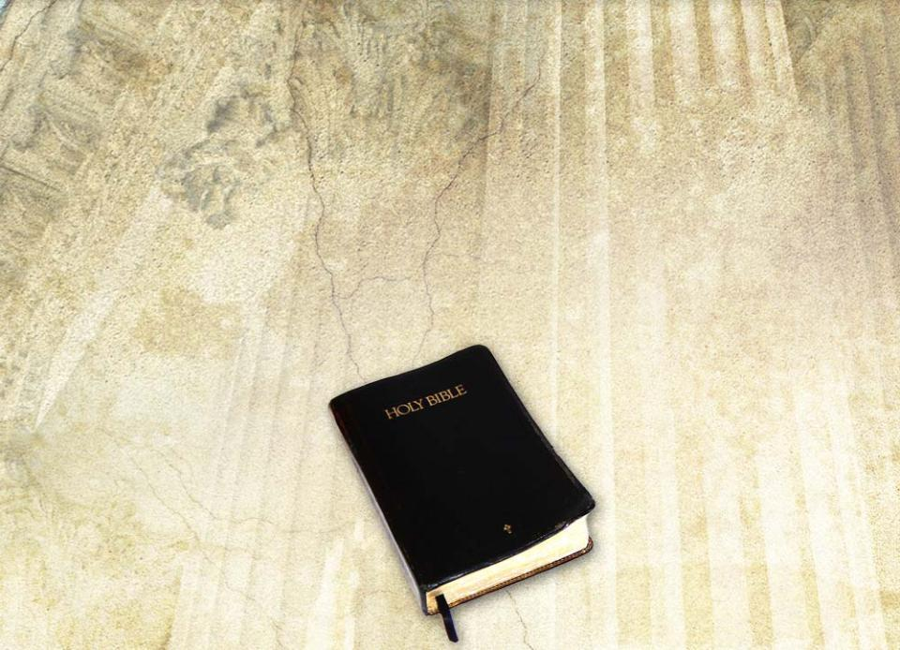
Because God’s power is incorruptible and unique,
Scripture does not acknowledge the existence of any other supreme power.

Slide 17
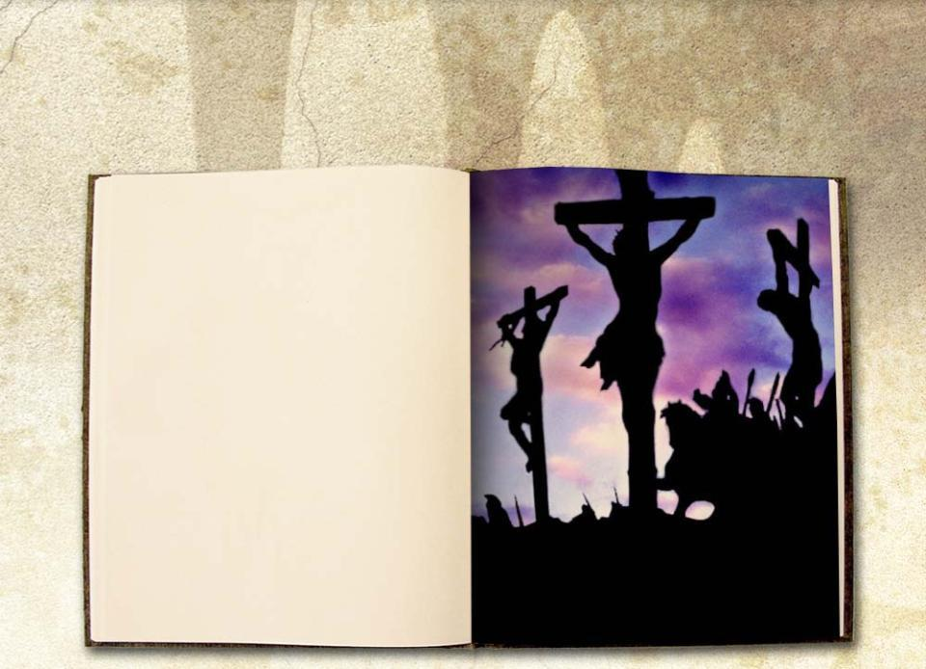
Other powers have enslaved humans, but Christ defeated those powers.
¹⁵And having disarmed the powers and authorities, he made a public spectacle of them, triumphing over them by the cross. Col 2:15 (NIV)
© It Is Written

Slide 18

Because of the goodness of God’s
authority, we should submit to Him
in worship and service.

Slide 19
God works for the welfare of others.
His authority sets limits to chaos and anarchy.
Intelligent creatures cannot enjoy life in chaos.
The authority of God opposes powers that
destroy development of the potential God gave us
distort His character

Slide 20
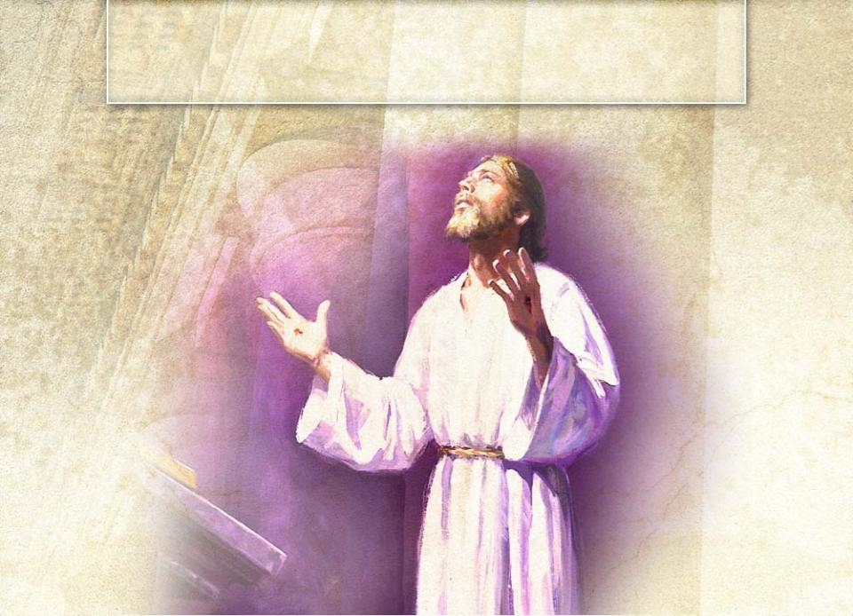
God’s Authority Revealed in the Life and Ministry of Jesus.

Slide 21
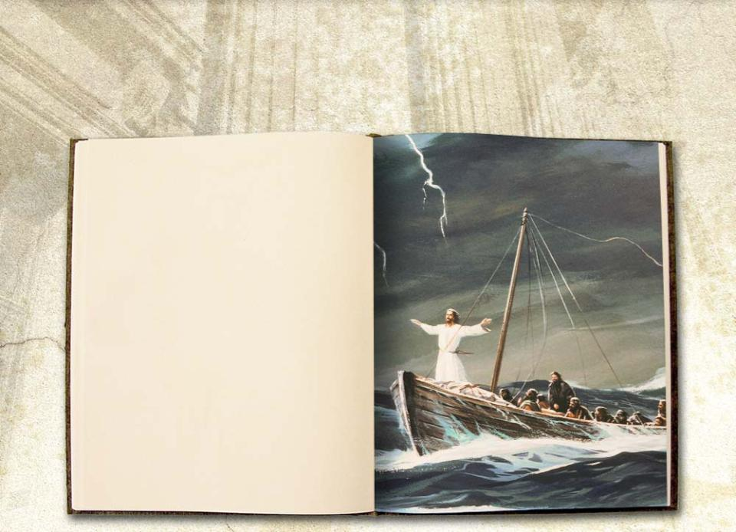
He had authority over the destructive power of nature.
²⁶He replied, “You of little faith, why are you so afraid?” Then he got up and rebuked the winds and the waves, and it was completely calm.
²⁷The men were amazed and asked, “What kind of man is this? Even the winds and the waves obey him!”
Matt 8:26,27 (NIV)

Slide 22
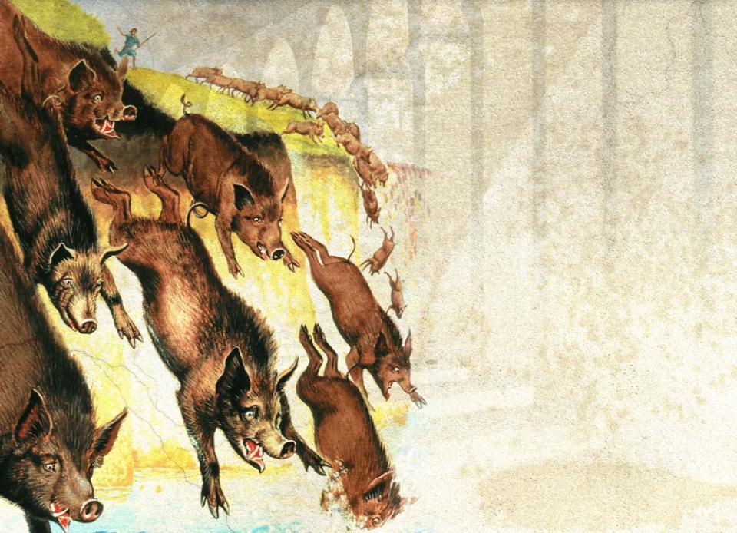
He had power
over demons.

Slide 23
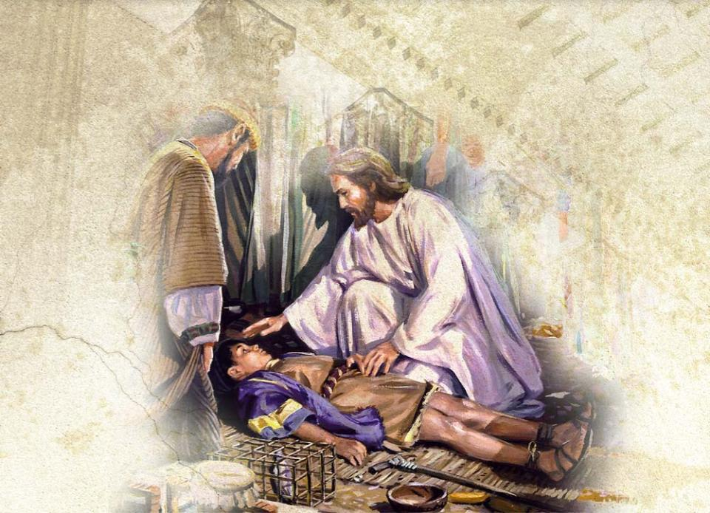
He had authority over sickness.

Slide 24
When Jesus used His authority to overcome those forces, He was
acting in behalf of human beings
offering them the chance to submit to Him in freedom
enabling them to become what God intended them to be

Slide 25
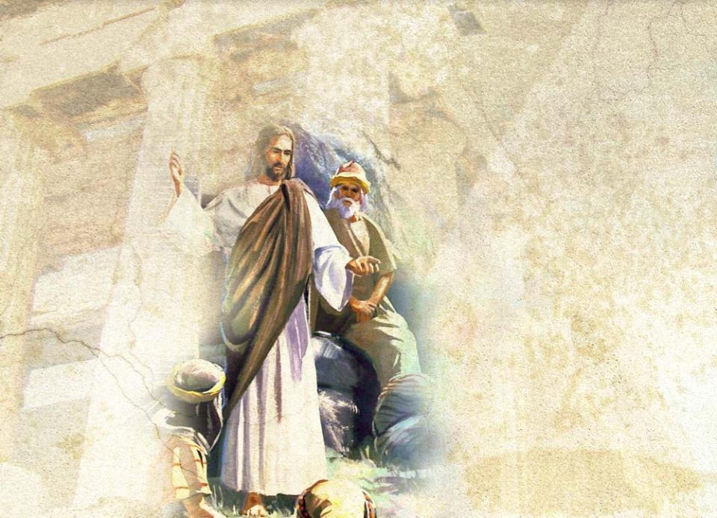
He was mighty and powerful
in speech

Slide 26
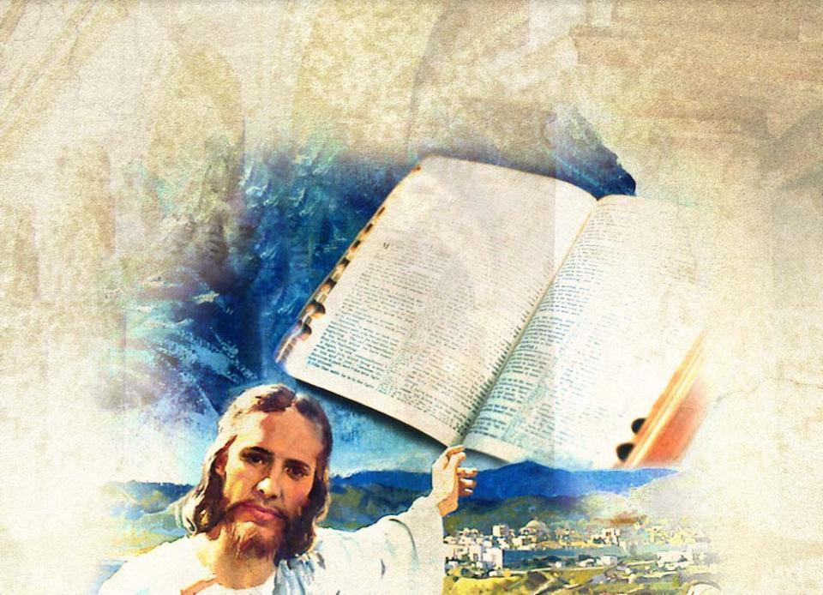
and in the interpretation of
the Scriptures.
© It Is Written

Slide 27
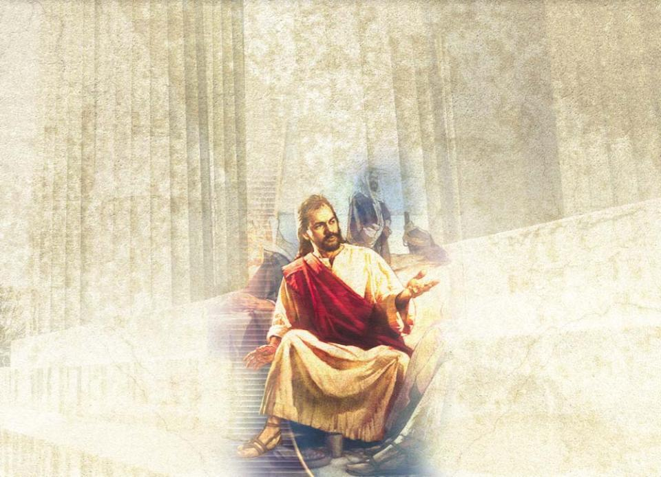
By His authority, He freed humans from the darkness of ignorance of God to the wonderful light of truth.

Slide 28
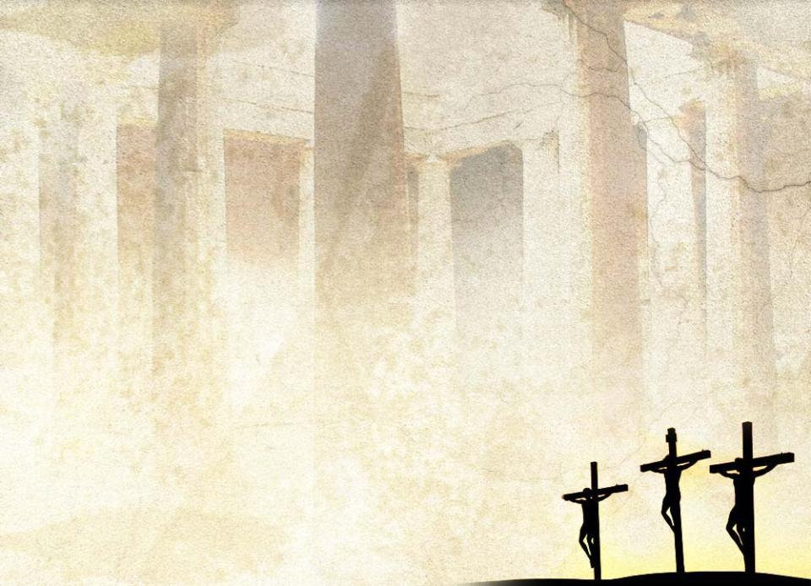
In a special way, Jesus’ authority was shown in His freedom to give His life as a sacrifice for us.
“No one takes it [my life] from me, but I lay it down of my own accord. I have authority to lay it down and authority to take it up again.” (John 10:18 NIV)

Slide 29
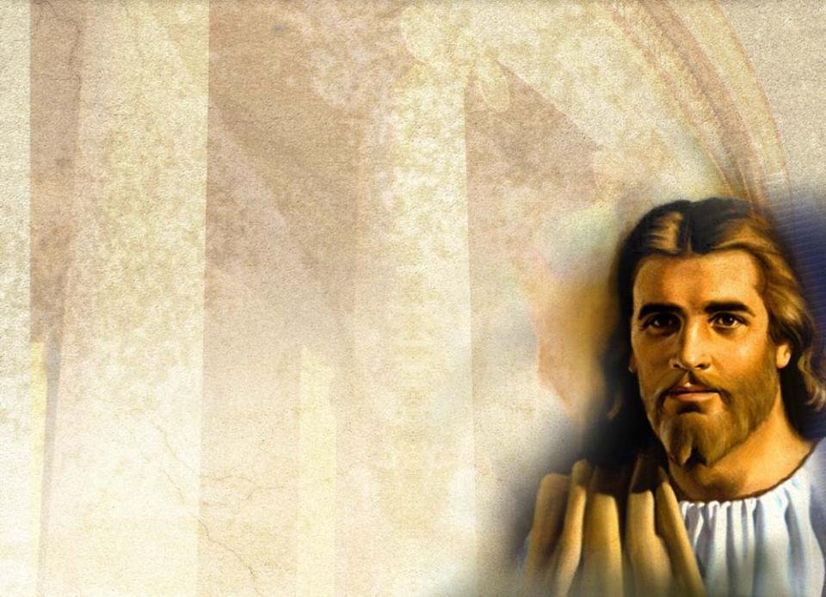
Our understanding of the divine authority in the life of Christ helps us understand
the nature of ecclesiastical authority
how that authority should
be used

Slide 30

III. Understanding the Proper Use and the Limits of Ecclesiastical Authority
A. Ecclesiastical Authority: Sources and Nature
The question of ecclesiastical authority—
its nature,
how it is expressed,
recognition of church authority, and
subjection to it—
is one of the most challenging issues the Adventist Church faces.

Slide 31

Ecclesiology is grounded in
the concept of authority
its recognition in the life of the church
Christ endowed His church with authority.
¹⁹“I will give you the keys of the kingdom of heaven; whatever you bind on earth will be bound in heaven, and whatever you loose on earth will be loosed in heaven.” Matt 16:19 (NIV)
© It Is Written

Slide 32
The “entrusted” dimension of ecclesiastical authority
is of major importance in the community of believers.
is directly related to the Lordship of Christ over the church.
should not be arbitrarily restricted to a limited group of individuals.
should be a basic consideration in any discussion of the nature of ecclesiastical authority.

Slide 33
God’s authority cannot be separated from its embodiment in the Bible.
He continues to reveal Himself through His word.

Slide 34

The Bible is
the objective record of the
authority of God
the source to
define and
understand
ecclesiastical
authority

Slide 35

The role of the Spirit is relevant for the topic of church authority.
The authority of the Spirit
is revealed through the
message of Scripture.
Any claim of a manifestation
of the Spirit is to be tested by
the witness of Scripture.

Slide 36

The Spirit,
the Scripture,
the world community of believers
work together in the exercise
of ecclesiastical authority.

Slide 37

Ellen White’s “writings are a continuing and authoritative source of truth which provide for the church comfort, guidance, instruction, and correction. They also make clear that the Bible is the standard by which all teaching and experience must be tested.” (Fundamental Beliefs of Seventh-day Adventists: 17)

Slide 38

While the Bible defines
ecclesiastical authority
and determines the role
of that authority,
the writings of
Ellen White should be used
to help us understand and
illustrate the use of that
authority in the life of the Adventist Church today.

Slide 39

Scripture calls church members to submit to one another and to church leaders.
²¹Submit to one another out of reverence for Christ.
Eph 5:21 (NIV)
¹⁷Obey your leaders and submit to their authority. They keep watch over you as men who must give an account. Obey them so that their work will be a joy, not a burden . . .
Heb 13:17 (NIV)

Slide 40
When we obediently submit to others, we recognize
Christ as our Lord
that He is Lord over the church
Ecclesiastical authority
is dependent on the authority of Christ within the church.
defines and determines the church’s message and mission.
preserves the church in the midst of its conflict against opposing forces.

Slide 41
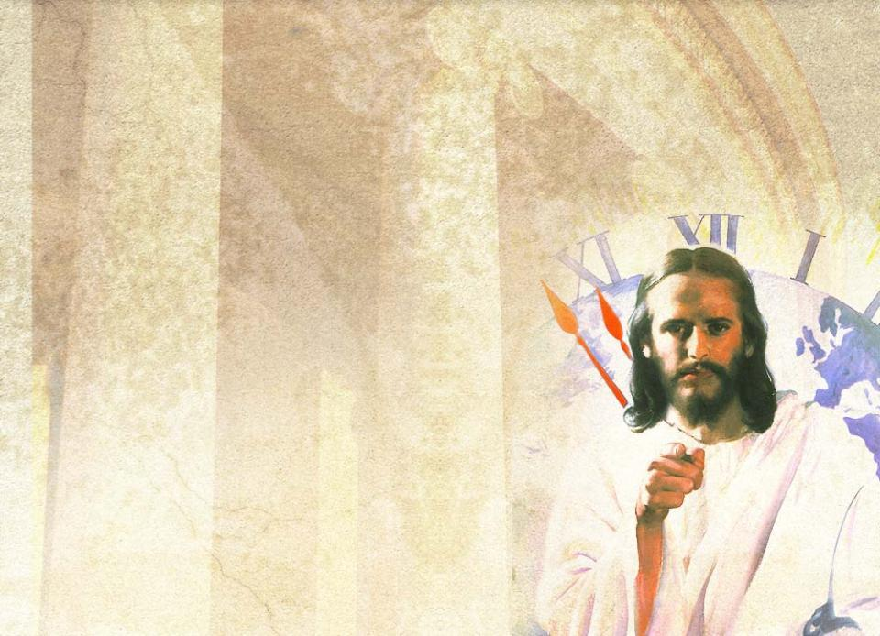
B. Ecclesiastical Authority: Organization and Leadership
Church authority is the freedom
granted by Christ to the
church to work with Him
in fulfilling His mission.
Organization is indispensable
for the church to effectively
use the authority the
Lord entrusted to it.

Slide 42
Spiritual gifts help organize the church to build it up and enable it to fulfill its mission.
¹¹It was he who gave some to be apostles, some to be prophets, some to be evangelists, and some to be pastors and teachers, ¹²to prepare God’s people for works of service, so that the body of Christ may be built up
¹³until we all reach unity in the faith and in the knowledge of the Son of God and become mature, attaining to the whole measure of the fullness of Christ.
Eph 4:11-13 (NIV)

Slide 43
Members exercise church authority through delegates.
Delegates gather to make decisions on behalf of the whole church.
The Bible set the pattern for delegated authority in the early church in Acts 15.
These delegates are the appointed leaders of the church.

Slide 44


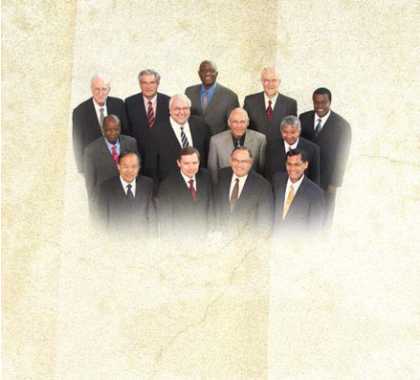

Appointed leaders should use their delegated authority to help the church to realize its mission.
The community of believers delegates authority, but does not surrender it.
delegated
authority
Appointed Church Leaders
World Church
The world church may withdraw this delegated authority.

Slide 45
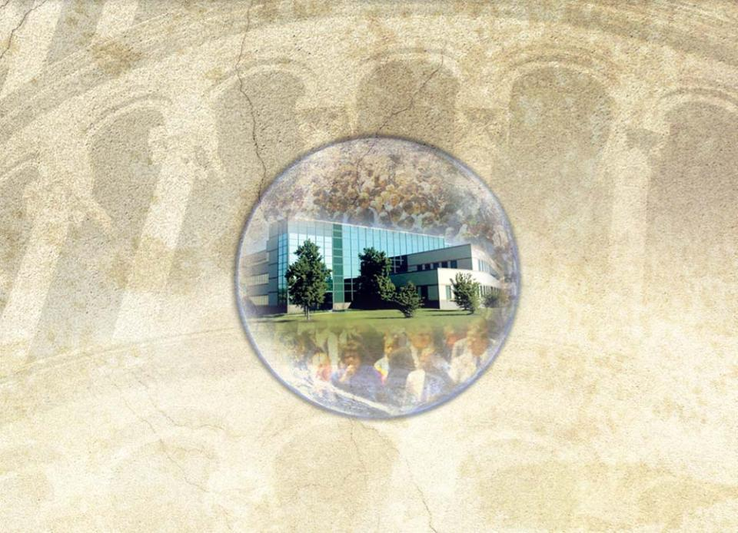






Adventists see ecclesiastical authority as diffused throughout the world church.
It has been delegated to leaders in local
fields and congregations.

Slide 46
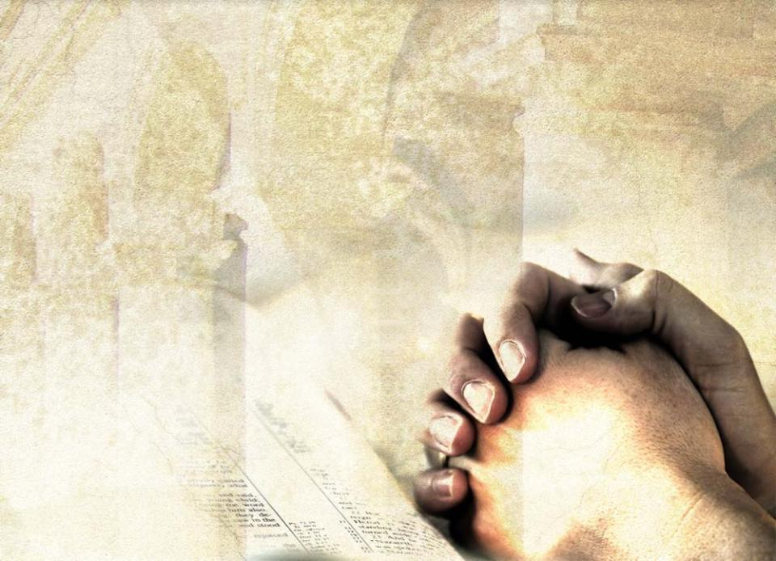
The proper tendency among
leaders is to work through
consensus.
This takes place through
study of Scripture
and the work of the
Spirit in leading
the church into
all truth.

Slide 47
Local congregations need to realize
that they participate in the fullness
of the church as long as they
identify themselves with the
of the global church.
This global perspective is essential
for the proper function of the church.
MESSAGE
MISSION
UNITY
WARNING: while you are free to copy and translate the text of the content of this DVD for training purposes within the Seventh-day Adventist Church, illustrations are owned by various entities that have provided us limited use rights. DO NOT COPY OR USE THE ILLUSTRATIONS WITHOUT OBTAINING LICENSES AND PERMISSION TO DO SO IN ADVANCE.

