Slide 1
Designing Leadership Development
Erich Baumgartner
Dept of Leadership & Educ Administration
Andrews University

Slide 2
Why Develop Leaders?
Because the church is growing
Because the church is not growing
“. . . is a person with a God-given capacity and a God-given responsibility to influence God’s people towards the fulfillment of His purposes.” (J. R. Clinton, 1987, The Making of a Leader)
Notes:
Where the church is growing, leaders are needed to support the growth of the church
Where the church is not growing, often due to difficult contextual factors, skillful leaders are needed to help develop innovative and forward-looking missional strategies.
So what is a leader? Biblically speaking, a Christian leader can be simply be described as “a person with a God-given capacity and a God-given responsibility to influence God’s people towards the fulfillment of His purposes.” Notice that this definition is not bound to a particular position or role or gender.
God-given capacity – the concept here is leadership as both “giftedness” – whether natural abilities or supernatural gifts, traits a person might be born with or competencies developed through experience and learning.
God-given responsibility – the concept here is that the ultimate responsibility of a person is to God who seeks to reach people with the gospel to develop mature disciples that will glorify His name before mankind.
Influence – this understanding underlines that leadership affects relationships, situations, and organizations. It also should help us pause for a moment to remember one of the key reasons for leadership development: to help emerging leaders to become conscious of how they influence others. Parker Palmer expresses this need forcefully.

Slide 3
A Leader is . . .
A person who has an unusual degree of power to create the conditions under which other people must live and move and have their being — conditions that can either be as illuminating as heaven or as shadowy as hell. A leader is a person who must take special responsibility for what’s going on inside him- or herself, inside his or her consciousness, lest the act of leadership create more harm than good.”
Parker Palmer, Leading From Within,1990, p. 7.
Notes:
What Palmer highlights here is the power of leaders to create an environment where people either thrive and can live fully as human beings or where they live as if under a spell of death. In some way, leaders participate in a real way in the Great Controversy between heaven and hell. It is interesting to analyze the physical, emotional, and spiritual effects of the ministry of Jesus while he was here on earth. Notice how Ellen White describes the results of his life-restoring miracles and his life-giving message:
“During His ministry Jesus devoted more time to healing the sick than to preaching. His miracles testified to the truth of His words, that He came not to destroy but to save. His righteousness went before Him, and the glory of the Lord was His rearward. Wherever He went, the tidings of His mercy preceded Him. Where He had passed, the objects of His compassion were rejoicing in health, and making trial of their new-found powers. Crowds were collecting around them to hear from their lips the works that the Lord had wrought. His voice was the first sound that many had ever heard, His name the first word they had ever spoken, His face the first they had ever looked upon. Why should they not love Jesus, and sound His praise? As He passed through the towns and cities He was like a vital current, diffusing life and joy wherever He went. {DA 350.3}
The followers of Christ are to labor as He did.”
What is the effect of a leader that creates conditions “as illuminating as heaven”? Are we not all products of such leaders – leaders who came into our lives and encouraged us, challenged us to listen to the call of God. Somehow their invitation to serve in the church became to us a path into ministry and leadership. We are here because they took their god-given calling seriously to help emerging leaders find their voice and calling. They were light to us.
We also bear the scars of the shadows of hell, dark memories of leaders who overpowered others with their need for power and control, to triumph at the expense of others.
So it is good to remember before we talk about how to develop leaders that there is a need for any leadership development program to somehow enable leaders to come face to face with who they truly are. True leadership development starts with self-awareness. Parker Palmer here describes a dimensions of leadership which I have simply termed the Q-factor of leadership (Q = quality). Let’s see for a few moments how this dimension relates to the growth of the church (next slide).

Slide 4
Growth Configuration Factors
There has to be a balance between
Membership growth
Extension of the leadership base
Improvement of the quality of leadership
1.
3.
2.
Notes:
Picture these three dimensions as the three edges of a triangle. The proportions of these three edges tell us something about the health of the church.

Slide 5
Growth Configuration Factors
1. Membership Growth
3. LS Q Factor
2. Leadership Base
Notes:
I call these three edges the growth configuration factors. The following slides try to explore some scenarios depicted by various proportions of the three edges (1) growth in the number of members, (2) growth in the number of leaders, and (3) the quality of available leaders.

Slide 6
Growth Configuration Factors Explosive Precarious Growth
++
+ –
+ –
Notes:
What does this triangle tell you about the situation of the church in this field?
Growth seems to be outgrowing the leadership base, most likely due to fast growth. If it continues churches may not be able to deal with the tensions created by leaderless crowds. The Apostles faced such a situation in the early part of Acts (see chapter 6). Barnabas wisely brought in help in Antioch when he faced a similar growth explosion there. Paul was brought into the ministry there to help Barnabas cope with exploding membership growth. In Paul he also raised the level of leadership strengthening the church. Ultimately it led to the greatest expansion of the earliest church and resulted in the gospel of Christ being spread to the Roman Empire in a single generation.

Slide 7
Growth Configuration Factors Old Slow Growth
– –
+ –
+ –
Notes:
What does this triangle tell us about the health of the church?
The backward leaning tells us that the membership is stagnating, even declining. In the West we are suffering the effects of such a situation.

Slide 8
Growth Configuration Factors Solid, But Slow Growth
+ +
+ –
+ –

Slide 9
Growth Configuration Factors Fast, Sustainable Growth
+ –
+ +
+ –

Slide 10
Growth Configuration Factors Balanced Growth
+ +
+ +
+ +
Notes:
The perfect balance may not exist and may not even be desirable. But it illustrates the need for the three edges to be in some healthy relationship to one another.
But what do we mean by a healthy leadership base? Let’s take a look at the types of leaders needed in a growing church.

Slide 11
Types of Leaders
Type 1: Small group/ministry
Type 2: Coordinator of group systems
Type 3: Congregation/district leader
Type 4: Regional/national
Type 5: International
Notes:
Which of these five types of leaders have the most intensive contact with the harvest field? Type 1 and 2.
Which of these five types of leaders exert the most extensive influence? Type 4 and 5.

Slide 12
Five types of leaders
Type 1 | Small group or ministry | Intensive, face to face
Type 2 | Coordinator | Intensive, direct and indirect
Type 3 | Pastor | Less intensive, direct and indirect
Type 4 | Region | Extensive, mostly indirect
Type 5 | International context | Extensive, mostly indirect
Notes:
In one way we might picture the church structure as a support structure to facilitate the harvest. A harvest perspective would suggest that higher levels of leadership exist to support the key unit of the harvest force: the level 1 ministries and groups that bring in the harvest and turn god-far people into fully mature disciples of Christ.
This insight might also help us understand some of the tensions we face when evangelism is largely defined as public evangelism. When the public evangelist moves on, he often leaves a crowd of converts that are not yet fully integrated into the life sustaining organism of the church. The multiplication of groups and ministries is thus a vital need for the retention of new members which underlines again the need for leadership development. Where this function is neglected we risk condemnation by the Lord of the Harvest that we are trying to build a tower without having calculated the cost of building properly.

Slide 13
Five types of leaders
Type 1 | Small group or ministry | Intensive, face to face
Type 2 | Group of grs Coordinator | Intensive, direct and indirect
Type 3 | Pastor | Less intensive, direct and indirect
Type 4 | Region | Extensive, mostly indirect
Type 5 | International context | Extensive, mostly indirect
Notes:
Type 1 and 2 leaders are crucial to organic church growth:
Reaching out
Integrating new members
The most neglected function of small groups, however, is often the multiplication of new leaders.
It is interesting that Jesus in his own ministry created the foundation for the multiplication of the church that would outlast his own life on earth. He invested heavily in the development of his disciples the future leaders of the church. His example is instructive because he accomplished all that without formal institutions, buildings, and organization. He obviously knew something about leadership development and we should invest more study to ponder how he did it. The most interesting aspect for me is that Jesus calls attention to the fact that he came as a servant leader and expected us to follow his footsteps (Mk 10:35-45).
As we think about how to develop servant leaders of all five types we need to ask what are the best ways to approach leadership development.

Slide 14
A Clarifying Question
How do we develop different types of leaders?
Thesis:
Different types of leaders have different needs

Slide 15
Three Types of Education
Formal: classroom, diploma, degree (e.g. BA in Theology)
Nonformal: short-term, individualized or group training for a purpose (e.g. church growth seminar)
Informal: what we learn by absorption from someone modeling behaviors and attitudes, life-related (father modeling honesty or integrity)
Each model can be helpful, but each has different strengths and is needed in different proportions.
Notes:
Note that all three models have strengths and weaknesses and different costs. Formal is most expensive, inflormal least expensive and readily available. Non-formal is somewhere in between and dependent on the availability of skillful instructors. But note that in both, formal and nonformal education, instructors not only teach what they know or can do – but informally by what they do and model. Jesus’ teaching was so powerful because of what he modeled, not only because of what he verbally taught. Notice that each model does bring unique strengths to the leadership development context.

Slide 16
Three Types of Education
Knowledge
Formal
Structured Planned Staffed Financed
Stable, Based on Tradition
Values
Skills
Informal
Functional, Arising from Need
Nonformal
Notes:
Read this slide by looking at shared strengths of each type of education adjacent to each other. The line to the opposite pole indicates a possible continuum. For instance:
Both formal and nonformal education are planned and structured, while informal is unstructured and often incidental.
Both informal and nonformal are very functional arising out of a need, while formal education is often following a basic cannon of knowledge that may not fit the needs of a situation at all. The challenge for formal education is in fact to be relevant to contextual needs.
Paradoxically, the strengths of both informal and formal education is that they preserve important knowlede despite of the variations of situations and thus serve to preserve important knowledge and values that shape the identity of communities.

Slide 17
Different Strengths
Formal Education
Knowledge (Knowing Dimension)
Nonformal Education
Skills (Doing Dimension)
Informal Edcuation
Values (Being Dimension)
Use the strengths of each model in designing leadership development programs targeted to different types of leaders

Slide 18
Why Most Programs Don’t Work
Too optimistic about the ability of people to change
Too naïve about the ability of organizational change

Slide 19
Cognitive & Emotional
Cognitive Change:
Ideas, concepts, intellectual, words
Can change in a short time
Emotional Change:
Habits, attitudes, values, feelings associated
Anchored deeply, change slowly

Slide 20
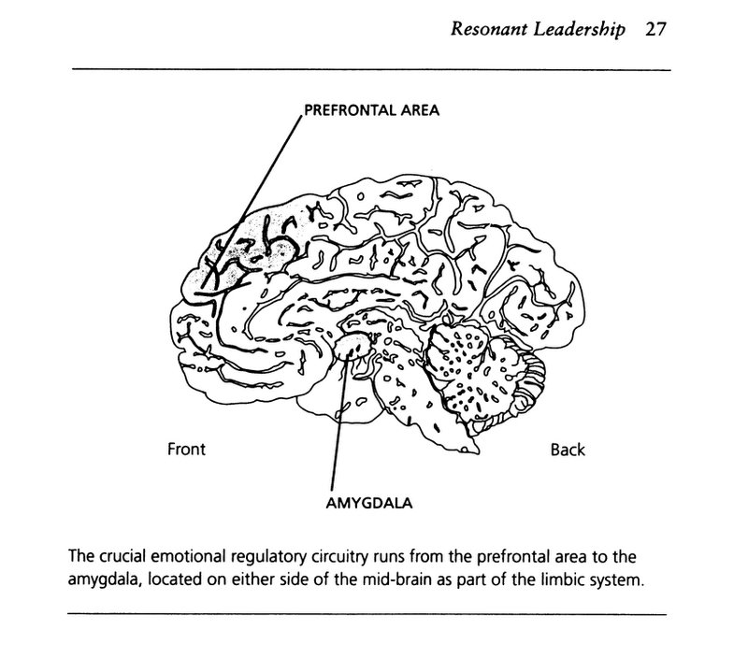
The Human Brain
From Goleman: Primal Leadership
Notes:
The processing of ideas is located in the prefrontal area of the brain. This part of the brain allows the fast intentional change of ideas and concepts.
Habits of the mind and heart are anchored more deeply in the amygdala. They change slowly and only when replaced by new habits. Goleman is one of the authors who has made us aware of the importance of Emotional Intelligence.

Slide 21
Double (Triple) Loop Learning
Problem
Solution
Underlying Cause
Organizational Culture & Mindset
Notes:
A related concept that needs to be taken into account in designing leadership development programs is the concept of Double Loop Learning.

Slide 22
Developing Leadership Capacity
Individual level
Empowering problem solving
Organizational structure level
Finding structural solutions
Organizational culture level
Changing the culture
Difficulty 1
Difficulty 2
Difficulty 3

Slide 23
Traditional Versus Transformational Education
Traditional
Transformational
Going to school
Students are passive recipients
Teacher is the expert
Transmission of knowledge
Knowledge is the basis for doing
Evaluation is based on knowing NOT doing
Learning in many settings
Students are active learners
Teacher facilitates learning
Experiential learning cycle
Knowing integrated with doing
Evaluation is based on doing
Notes:
Most traditional leadership training models are based on a dichotomy between theory and practice. Research shows that this is not an effective way to train leaders. Leaders today face a world of complexity and in constant change. In recent years adult education models have revolutionized educational approaches.
The Andrews University Leadership Program uses a transformational approach to education that uses the work context of the participant as a laboratory for applying new skills and knowledge. The theoretical model behind this approach is Kolb’s Experiential Learning Cycle (next slide).

Slide 24
Experiential Learning Cycle
Experience
Reflection
Theory
Experimentation
Kolb, 1987
Notes:
The Kolb Learning Cycle is one of the most powerful theoretical models for leadership development. It can be applied at all levels of an organization.
Leaders do not automatically learn from experience. We do many things the way we have always done them. Often we complain that we are not as effective as we would like to be. Adults learn from experience when they engage in reflecting on their experience, compare their experience with others (by reading research/theory on the topic), that leads to experimenting with new behaviors. The experiment then becomes the new experience – starting the learning cycle over again.
Most type 4-5 leaders can benefit enormously by being led to reflect on their experience to learn from it. This model is especially fitted for use in nonformal programs. The Andrews Leadership Program has proved to the world of academia that it can be used very effectively in doctoral leadership education. The Andrews Program uses competencies instead of courses as a bases for developing highly effective leadership professionals. It has now graduated over 100 PhDs that work at all levels of organizations ranging from the realm of church, education, military, government, business, and non-profit sectors.

Slide 25
Leadership Training
Steps
Theory
Model
Practice
Coach
Know Do Teach
80% 5-15% 5%
80% 5-15% 5%
80+% 80% 5-15%
80+% 80% 80%
Notes:
What does research say about the effectiveness of different approaches to teaching skills? The reason why leadership training does not produce leaders is that the skills of leadership are best learned by doing them in actual life, trying and practicing new skills until they become solid habits and that means that you need a coach that looks you over the shoulders to guide you until you have learned the skill well enough that you can practice it automatically.
What do we want to accomplish in our training programs? Keep in mind three levels of outcomes:
(1) Know level: Knowledge
(2) Do level: Ability to apply the skill
(3) Teach level: this is the level of reproduction
This model shows the levels of effectiveness of training approaches using four steps of training. Notice that only the last level shows a high level of effectiveness of reproduction. The implication of this model are extremely important. In the Andrews Leadership program we use study groups meeting monthly (often without instructor) to serve as peer coaches to each other. When study groups work well actual learning soars. When study groups do not work well training programs suffer in effectiveness.

Slide 26
For Further Information
Contact:
Erich Baumgartner
Andrews Leadership Program
Berrien Springs, MI 49103
269.471.25233
baumgart@andrews.edu
www.andrews.edu/leadership

