Slide 1


A LEADERSHIP WORKSHOP
Based on the Collected Papers
from the Leadership Symposium
General Conference Session
July 3-7, 2005

Slide 2
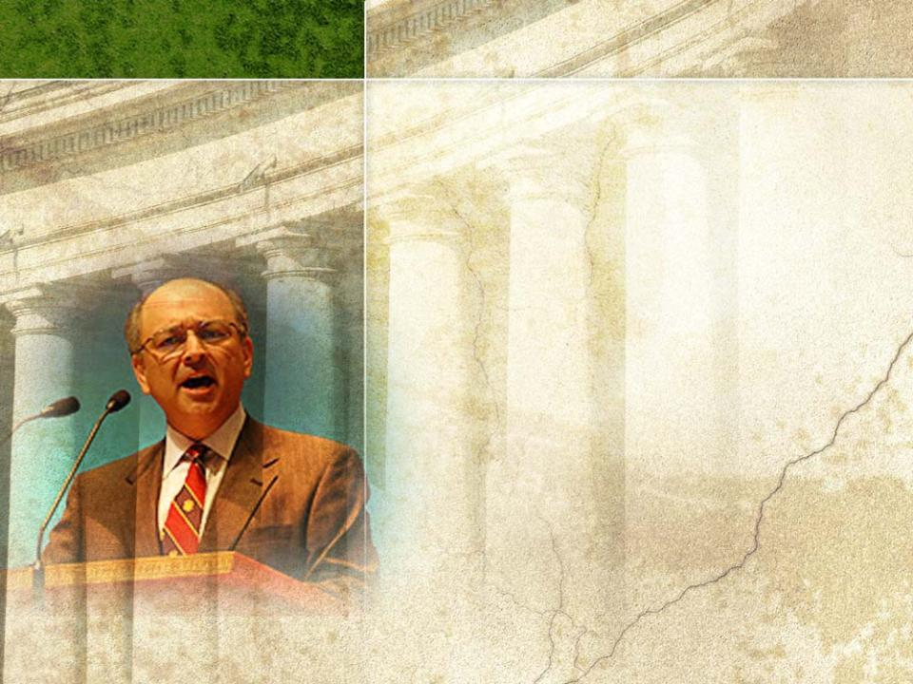
SESSION three
Acting with Responsibility: Aspirations of a Servant Along Pathways of Governance–
PART 2
Based on the Presentation by
Ted L. Ramirez
Co-chair, Venable Washington Health Care Practice

Slide 3

Session 3 will address the
following questions:
1
Why should we study governance principles?
2
What are the main areas of responsibility for governors?
3
How can governors minimize conflicts of interest?
4
How can church leaders improve the quality of
governance for their organizations?
5
What are some of the basic building blocks governors
should consider?
6
What are some unresolved issues that keep us from
reaching our governance aspirations?

Slide 4

7
How can we resolve tensions among competing values,
standards, and goals?
8
How can we resolve the issue of learning curves in
governance?
9
How can we deal with governance disabilities and
dysfunctions?
10
What are the imperatives of responsible governance?
11
Describe governance bodies that act with responsibility.
12
How can we as individuals improve our governance
practices?

Slide 5

IV. Opportunities, Resources, and Human Limitations (continued)
Principles and Evolving Standards
Core principles that Adventists believe and teach:
God so loved the world that He gave His
only Son to save it. (John 3:16)
We are saved by grace, and not from
ourselves. (Eph 2:8,9)
We are headed to a place where we will
serve and worship God. (Rev 22:3,4,9)

Slide 6

Occasional reviews of governance
principles will help us
revisit, strengthen, and
sharpen our capacity
to serve.
Responsible leaders and governors
look for the best practices
seek formal training in these practices
share these practices throughout the church
have an unquenchable thirst for learning
listen eagerly for change

Slide 7

Leaders should choose practices that are right for their specific organizations.
Responsible governors.
do not use external practices
exclusively to dictate the practices
of their organizations
Rather they
test and confirm their organization’s system of governance and action
examine each recommended practice to understand its ethical, legal, and operational reasons
gage the potential impact of the proposed practice upon the organization and its people

Slide 8

Privilege and responsibility are parts of an inseparable continuum of church leadership and governance.

Slide 9

Accountability is a two-way street.
hold others accountable.
GOVERNORS
are accountable to others.
Management
day-to-day
operation
of an
organization
Governance
general
oversight
of an
organization
Governance and management are not mutually exclusive; their functions overlap.

Slide 10

Leaders and governors must
improve our understanding of the terms “governance” and “management”
clarify what we expect of one another
recognize our responsibility to discuss governance issues
realize that discussions about governance are as important as those about mission and operation
develop an organizational culture that honors discussion
Continued contributions of money, loyalty, and personal time from our stakeholders require that we develop such a culture.

Slide 11

Responsible governors in a healthy organization must consider these questions in assessing the standards and objectives of church governance:
What should governance be?
What are the obligations of those who have received the call to service in governance?
Ensuring the viability and ethical integrity of an organization are among the most crucial tasks of governors.

Slide 12

Governors are protectors. They must
protect the organization from
external threats
promote a safe and ethical
working environment
ensure that leaders have access to
competent internal support
provide leaders with external advisors
grow and maintain the organization’s
mission, resources, and quality
Governors of an organization
must share these responsibilities
with their leaders.

Slide 13

Conflicts of Interest:
Complex challenges to boards
Examples of conflicts of interest:
1
A board member operates a business from which the organization purchases supplies.
2
A board member owns stock in a company with
which the organization does business.
3
The CEO of one organization serves on the board of another, both of which are competing for scarce resources provided by the parent organization of both.
4
A board is discussing the hiring of a board
member’s relative.

Slide 14
Virtually no church organization, committee, or board can be free from conflicts of interest.
Responsible governors
will err on the side of overdisclosing when they perceive that they have a potential conflict of interest,
will abstain from voting on decisions in which they are conflicted,
will recuse themselves from discussions of issues in which they have a conflict
of interest.

Slide 15
Managing conflicts of interest.
Leaders must not
mismanage or overreact to a conflict of interest,
ignore the conflict of interest.
Assessing and managing conflicts of interest for church organizations include
Developing systems and procedures for dealing with conflicts
Fostering a culture of calm transparency
Being aware of conflict
Disclosing potential conflict
Measuring the magnitude of conflict
Reacting to conflict in a balanced way
Recording abstentions and recusals for conflicted governors
Avoiding surprises
Identifying and avoiding suspicion and fear

Slide 16

Crucial areas of responsibility for a governing body include
being aware of its specific nature and function
determining what its nature and function
should become
developing and maintaining governance
systems including
  regular reassessment of its nature and function
  potential alterations and improvements

Slide 17

Sorting Values: Responsible
leaders and governors will sort
through the organizational
principles and standards that
best promote their group goals.
They will
find methods, models, resources, and “gurus” to get things done.
use these resources wisely.
encourage their boards to experiment with those alternatives that best fit the needs of their organization.

Slide 18

In using these governance resources, leaders will counsel their governors to
Select a method or two at a time to read and learn about.
Recognize that any method or writer may offer useful contributions.
Remember that all methods contain flaws or unresolved points.
Avoid undue attachment to any single system of governance.
Start talking with their officers and board or committee … patiently.
Understand that the road to responsible governance is long.
Avoid strong opinions on things they don’t fully understand.

Slide 19

The Focus of Governance
Governance will always be complex, difficult work.
The focus of this work should point to our fundamental purpose:
renew our missions
improve our
effectiveness in
accomplishing the
missions of our
organizations

Slide 20

Building Blocks to Develop Effective
Governance in Church Organizations
confronting
issues
risk
perseverance
structure &
processes
relation-
ships
submission
Commun-
ication
clarity &
focus
evaluation
work ethic/
role models
knowledge
bias for
action
courage &
vulnerability
truth
faith &
trust
mission
quality
resources
values
responsibility
creativity

Slide 21

Biblical Counsel for Governors
⁶Humble yourselves, therefore, under God's mighty hand, that he may lift you up in due time.
⁷Cast all your anxiety on him because he cares for you.
⁸Be self-controlled and alert. Your enemy the devil prowls around like a roaring lion looking for someone to devour.
⁹Resist him, standing firm in the faith, because you know that your brothers through-out the world are undergoing the same kind of sufferings.
¹⁰And the God of all grace, who called you to his eternal glory in Christ, after you have suffered a little while, will himself restore you and make you strong, firm and steadfast.
1 Pet 5:6-10 (NIV)

Slide 22

V. Points Unresolved
We may not realize many of our hopes, dreams, and plans in governance due to
forces and circumstances of our human condition
the continuing state of war in the Great Controversy
Some of the unresolved points that may keep us from reaching our governance aspirations follow.

Slide 23

Tension among the Essential,
Necessary, Good, and Useful
Areas of tension and
incompatibility:
Competing
values
principles
standards
goals

Slide 24
Points of tension among competing factors:
Gospel mission and its interpretation
“Transparency:” what it means and
how we achieve it
Civil law and regulatory compliance
Divergent management principles and styles
Governors who are unclear about the
church mission
Organizational procedures and traditions
Alternative approaches to governance mechanisms

Slide 25

Points of tension among competing factors (continued):
Unclear standards of duty
Confused zones of action, responsibility, and boundaries
Priesthood of all believers—everyone feels “empowered”
Global multi-organization friction, confusion, and blaming

Slide 26

Disagreement among leaders and governors over competing values, standards, principles,
and goals requires
time, prayer and extended discussions
to resolve or learn to live
with our differences and
to galvanize our
effectiveness.

Slide 27

Limited Resources
Resources often seem in
short supply.
Many are needed to
develop and bring to life
all the dreams we see,
including
time, money, people and skills, opportunity, training.
Some are needed to keep our
organizations on track:
credibility and understanding,
teamwork, perseverance.

Slide 28

Learning Curves
Time, training, and discussion are needed for the following areas of responsibility:
1
Financial statements and reports
2
Executive management reports
3
Calibrating the committee system
4
Operating history and current realities
5
External and denominational forces

Slide 29

6
What to change and what to keep
We are a church not a museum.
7
Building and preserving relationships
God risked all the treasure of heaven to restore our relationship with Him.
What are we investing in our horizontal relationships with one another?

Slide 30

8
Overcoming suspicion and misunderstanding
Jesus’ last recorded prayer in the upper room
focused on trust and unity.
²²I have given them the glory that you gave me, that they may be one as we are one: ²³I in them and you in me. May they be brought to complete unity to let the world know that you
sent me and have loved them even as you have loved me…
²⁶I have made you known to them,...in order that the love you have for me may be in them…
John 17:22-23, 26 (NIV)
How great a priority is unity
for us who claim to follow Him?

Slide 31

Governance Disabilities and
Dysfunctions
These dysfunctions can
frustrate even the best leadership
slow down constructive decision processes
disrupt unity, communication, and action
Examples of dysfunctional people:
1
Those who openly ridicule leaders as Shimei ridiculed David when he fled from Absalom
2
Those set in their ways as BalaamNot even a talking donkey could get through to him.

Slide 32

3
Those who use e-mail like scud missiles to make a point
Do they care where their “payload” lands or whom it injures?
4
“Sheep in wolves’ clothing:”
organizations that talk and act tougher than their hearts and the Spirit are leading

Slide 33

5
Self-appointed “watch dogs” or “guardians of the Church”
with teeth that cause far more damage than any contribution to Christian oversight or responsibility
6
One on a “lone wolf” mission
who tries to “fix” things on his own without the authority of the organization

Slide 34

“Acting with responsibility” with such dysfunctional behavior involves
timely, and loving correction
remembering that our authority is not personal; it derives from our connection to the body
we serve
Leaders who act with
responsibility remember
The safest time for a governing body is during the meeting.
Governors are most dangerous and
inflict most damage
between meetings.

Slide 35

The essential point that challenges us:
Will we determine to act with responsibility as we serve our church and pursue its mission?
Doing so will require
daily dying to self
resolving to “press together”
in unity
recognizing God’s strength
through our diversity
We stand together in Christ because He created us with differences and has chosen to make us one with God.

Slide 36

This side of heaven
our leadership styles
will differ
our methods will vary
our policies won’t be
perfect
we will need forgiveness
and restoration
The mission and reach of the church have exploded beyond our capacity to “administer.”

Slide 37

In spite of these unresolved points, God is able to
instruct
empower
unify
His people and His leaders for
His mission.
The Son has asked it; the Father will deliver.

Slide 38

Counsel From the Pen of Inspiration
We want to press together. O, how many times when I have seemed to be in the presence of God and holy angels, I have heard the angel voice saying, “Press together, press together, press together. Do not let Satan cast his hellish shadow between brethren. Press together; in unity there is strength.”
I repeat the message to you. As you go to your homes, be determined that you will press together; seek God with all the heart,
and you will find Him, and the love
of Christ, that passeth understanding,
will come into your hearts and lives.
(GC Bulletin, April 13, 1891, Par. 34, 35)

Slide 39

¹Then the angel showed me the river
of the water of life, as clear as crystal, flowing from the throne of God and of the Lamb ²down the middle of the great street of the city. On each side of the river stood the tree of life, bearing twelve crops of fruit, yielding its fruit every month.
And the leaves of the tree are for the healing of the nations.

Slide 40

³No longer will there be any curse. The throne of God and of the Lamb will be in the city, and his servants will serve him. ⁴They will see his face, and his name will be on their foreheads.
⁵There will be no more night. They will not need the light of a lamp or the light of the sun, for the Lord God will give them light. And they will reign for ever and ever. Rev 22:1-5 (NIV)

Slide 41

VI. Ultimate Vision
Improving the
effectiveness of our organizations, boards,
and committees
requires reflection and
change that begins
with each person.
Change must start with
the person in the mirror.

Slide 42

The Ultimate Job Description
When we reach heaven, our job descriptions will be to serve and worship God.
In our work together in
the church, God gives
us a special privilege:
to practice and prepare
for that position while
we serve and worship
Him here.

Slide 43

Imperatives of Responsibility in Governance
The church wants governing bodies that
1
Recognize our responsibility for leadership and exercise it.
2
Articulate and promote the organization’s mission and values.
3
Manage, delegate, and set sound policy without micromanagement.
4
Trust, empower, and support those we appoint as
governors and leaders.
5
Develop and protect a culture of learning and collaboration.

Slide 44

6Develop a culture and traditions of informed civility.
Remaining civil when someone challenges
our dearly held “truths” requires that we
trust God long enough to examine all the evidence
ask, “Why has God led me into contact
with this person or situation?”

Slide 45

7
Pursue trust, forgiveness, and accountability.
8
Recognize that grace is not just spiritual; it’s
“good business” too.
9
Respect, nurture, and challenge our leaders and officers.
10
Encourage variety in the background and development
of governors.
11
Embrace diversity as a strategic strength.
12
Respect the boundaries of friendship, church membership, and corporate governance.

Slide 46

Governing Bodies That Act with Responsibility
The best governing bodies will
develop and display
timely action
informed analysis
effective internal and external
accountability
proactive communication
fair, thorough deliberations
orderly, peaceful, and
productive processes
effective use of time
balanced understanding of risk
the will to get something done
perseverance in trust and unity

Slide 47

Individual Aspirations
What kind of leaders do we, as individuals, want to become?
Suggestions that might help in our continuing education as leaders:
Take a fresh look at yourself, often;
then step back and laugh a bit.
As you analyze a situation,
try to connect the dots
in straight, short lines.

Slide 48
Persevere; don’t quit on your church, your fellow workers or yourself . . . ever.
Don’t give up on anyone else.
Remember the “Elijah Rule;” the problem and potential solutions belong to God.
Avoid boxing yourself into entrenched positions on complex issues.
Don’t pretend to understand if you’re not fairly certain that you do.

Slide 49
Even if you think you understand, stay humble; you might be wrong.
Prefer the good solution over searching for the perfect one.
Relate to your fellow leaders and governors in respect, nurture, and challenge; use all three together.
Make room in your heart and mind for new information and people.
Don’t fear to unlearn something that no longer serves a purpose.

Slide 50

Unify
Act
Communicate

Slide 51
Unity in Diversity
Philadelphia, July 4, 1776 Birth of the United States
Although John Dickerson disagreed with the vote for independence in the Continental Congress, when the delegates approved the Declaration of Independence, he led the first troops from Philadelphia to defend New Jersey against the British.

Slide 52

In John Dickerson’s case, “acting with responsibility” meant
withdrawing from his colony’s delegation
so that they could make a decision he
didn’t approve,
supporting the majority decision, even though he didn’t agree with that decision,
risking his life to defend that decision.
Are we willing to risk our lives or careers to support and live for the body of Christ?
Jesus has asked us to do this.
He was the supreme Example.

Slide 53

When we disagree with others in committee discussions, let us
wrestle with passion in support of our convictions
embrace our opponent when the decision has
been made
support the action decided upon by the body

Slide 54

“Acting with responsibility” symbolizes the paradox of unity and diversity.

Slide 55
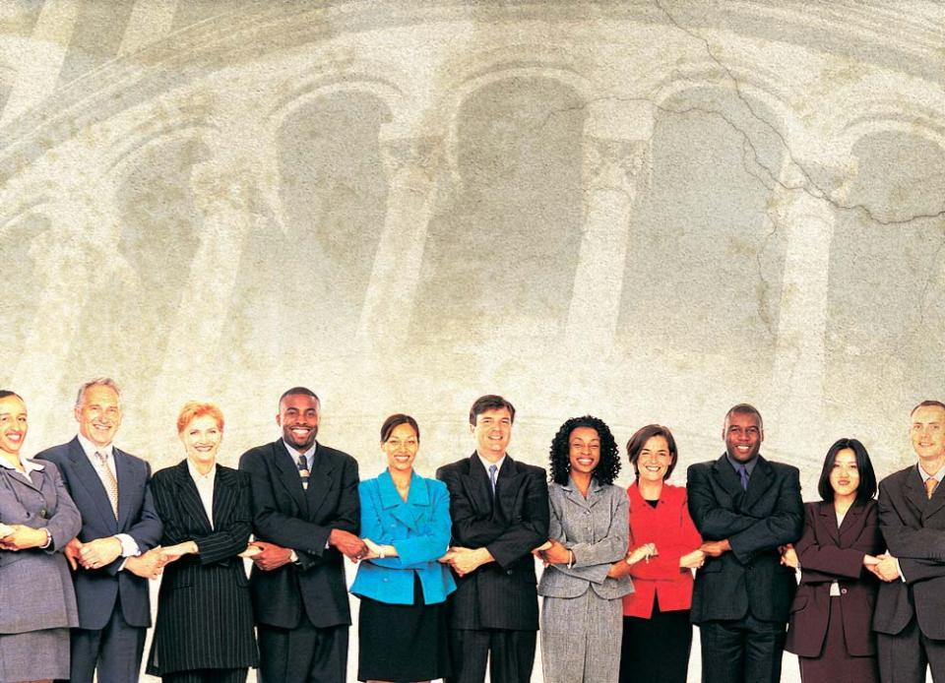
Our Prayer:
May this workshop on Adventist leadership and the fellowship of the Holy Spirit lead us to desire to “act with responsibility” as we serve our church and the millions who depend on our faithfulness to mission.
WARNING: while you are free to copy and translate the text of the content of this DVD for training purposes within the Seventh-day Adventist Church, illustrations are owned by various entities that have provided us limited use rights. DO NOT COPY OR USE THE ILLUSTRATIONS WITHOUT OBTAINING LICENSES AND PERMISSION TO DO SO IN ADVANCE.

