Slide 1


A LEADERSHIP WORKSHOP
Based on the Collected Papers
from the Leadership Symposium
General Conference Session
July 3-7, 2005

Slide 2
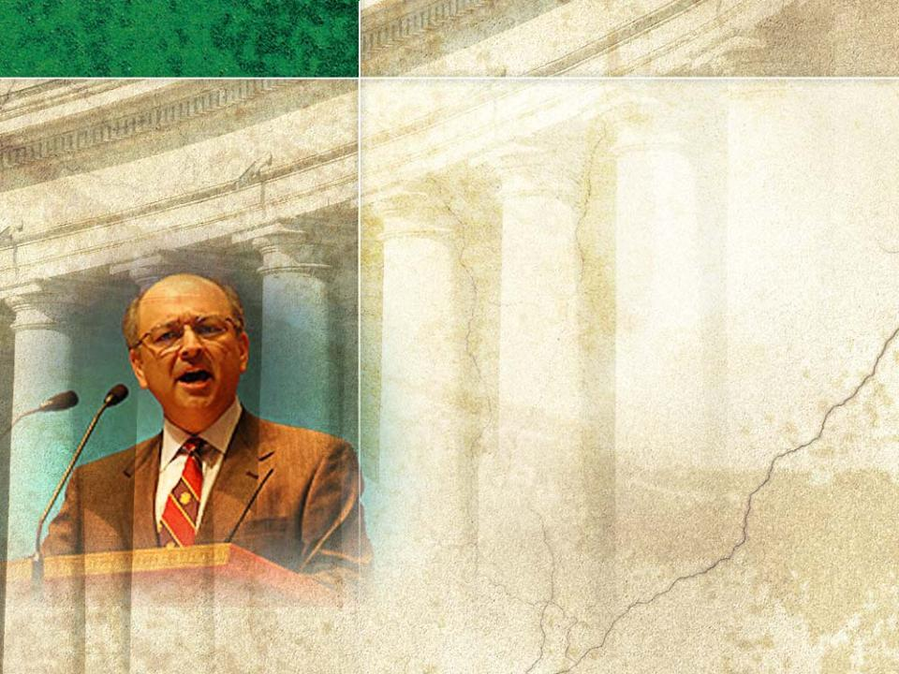
SESSION two
Acting with Responsibility: Aspirations of a Servant Along Pathways of Governance–
PART 1
Based on the Presentation by
Ted L. Ramirez
Co-chair, Venable Washington Health Care Practice

Slide 3

I. Summary of Themes
Sessions 2 and 3 will explore
1
How we as leaders act “with responsibility” in a relentlessly irresponsible world.
2
What vision we use to set our reference points for acting “with responsibility.” How we recognize and respond to irresponsible behavior.
3
How well we foster a consistent sense of “responsibility” within our church and keep irresponsible behavior outside the church.
4
How we can accomplish this among our leadership of lay members and clergy.

Slide 4

Session 2 will address the
following questions:
1What does “acting with responsibility” involve?
2
How can we do this effectively?
3
How does “acting with responsibility” relate to church governance?
4
Why do we need to examine the questions
a. To whom and to what are we responsible?
b. For whom and for what are we responsible?
5Why may failure to disagree in certain situations be acting irresponsibly?

Slide 5

6
What is the difference between transactional
and relational service?
7
Why should we be energized in our service for God?
8
What factors will “acting with responsibility” lead us to balance?
9
Why did Elijah flee when he had every reason to stand his ground? How are we like him?
10
How should we relate to our fellow workers in God’s cause?
11
What are some of the negative governance practices that students in our global classrooms have learned?

Slide 6
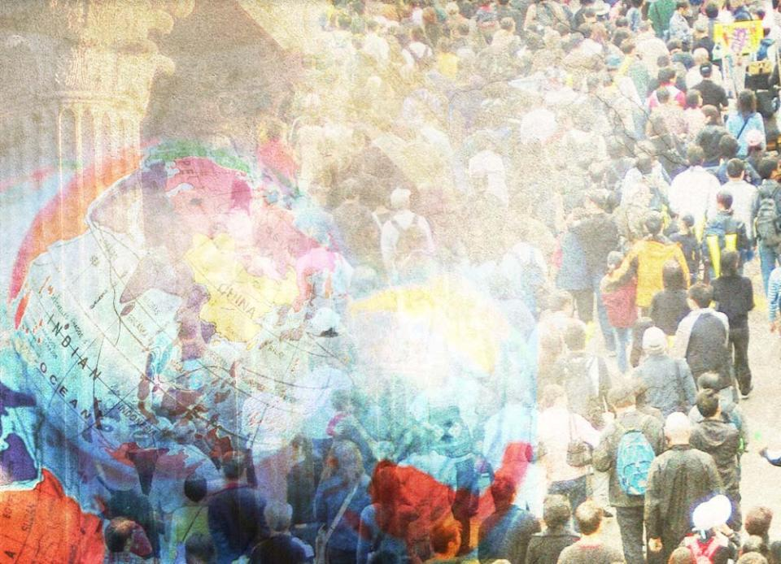
The Adventist Church
17 million church & SS members
$1.8 billion in annual giving
5,600 schools & colleges
in 203 countries of the world

Slide 7

In this rapidly growing church, we have outgrown our practices to administer
what we do and
how we serve.
Our unity and leadership effectiveness depend less on things or facts we “know” or used to know and more on our willingness to know and trust God in the present tense.

Slide 8
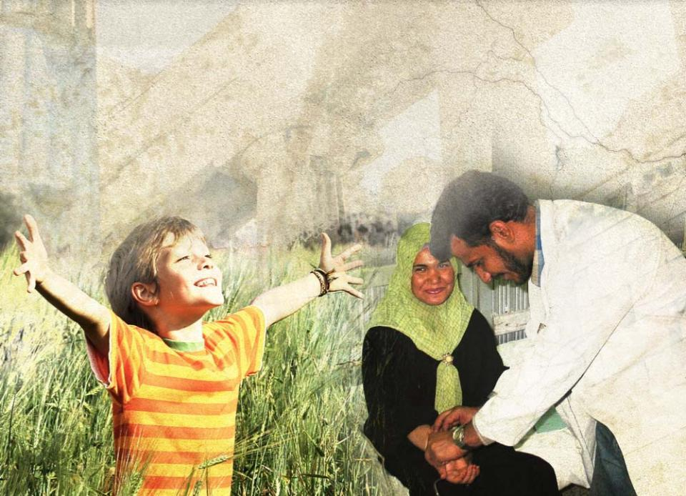
“Acting with responsibility” includes
thinking, worshipping, and serving in new ways.

Slide 9

These flow in a cycle of productive thought consisting of three actions:
Unify
Act
Communicate

Slide 10
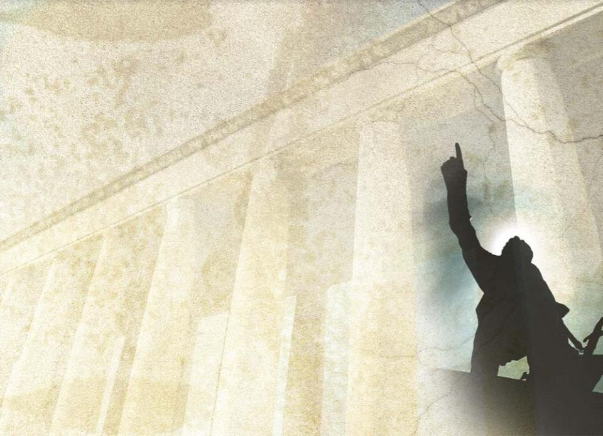
Our “spiritual DNA” is that of explorers and pioneers.
As we rediscover this heritage, we
listen for the fresh voice of God
step into change with confidence
focus upon the great themes and
goals that draw us together at the approaching fulfillment of Earth’s redemption

Slide 11
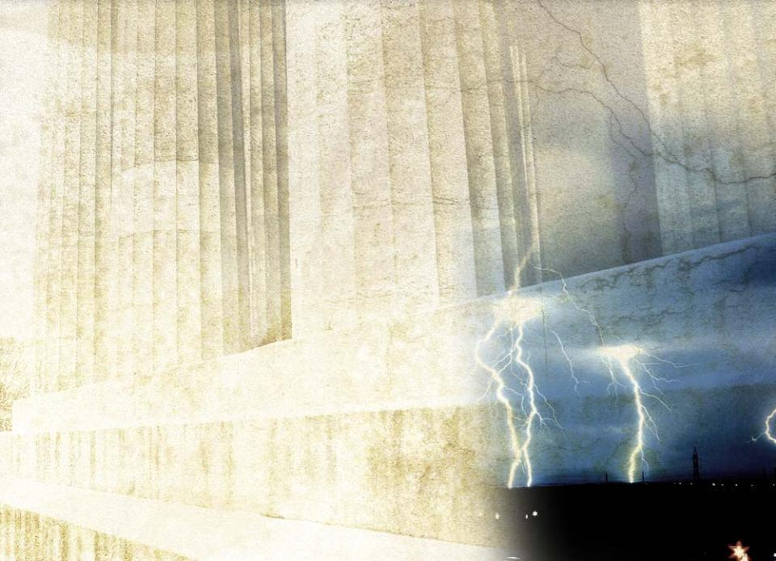
As apocalyptic thunderstorms break around us, we can enjoy the ionized air the lightning produces.
We should
refresh our senses with our biblical
reasons for being
welcome the experience and
scholarship available to us
This may bump into some
of our most cherished
preferences.

Slide 12
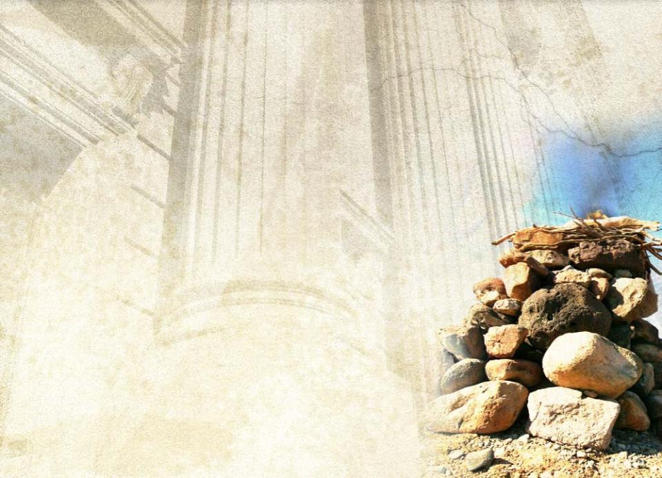
We and the organizations that comprise our church are called
to be living sacrifices
to place “all on the altar”
To “act with responsibility”
is to learn and
serve in joy.

Slide 13
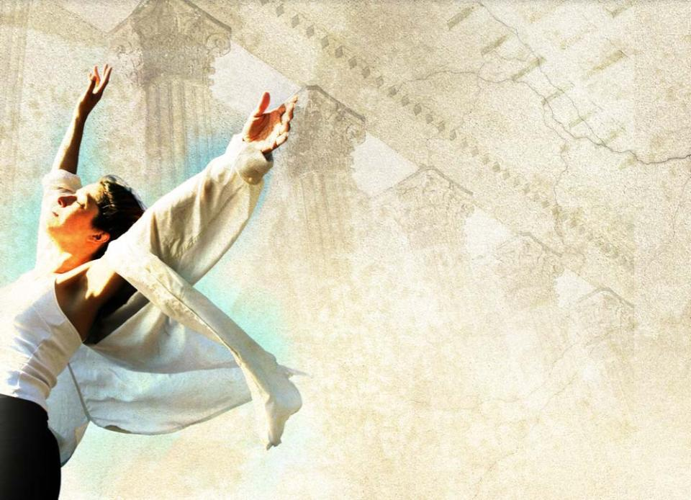
Our position descriptions for
what we will do in heaven are clear:
We will serve and worship God.

Slide 14
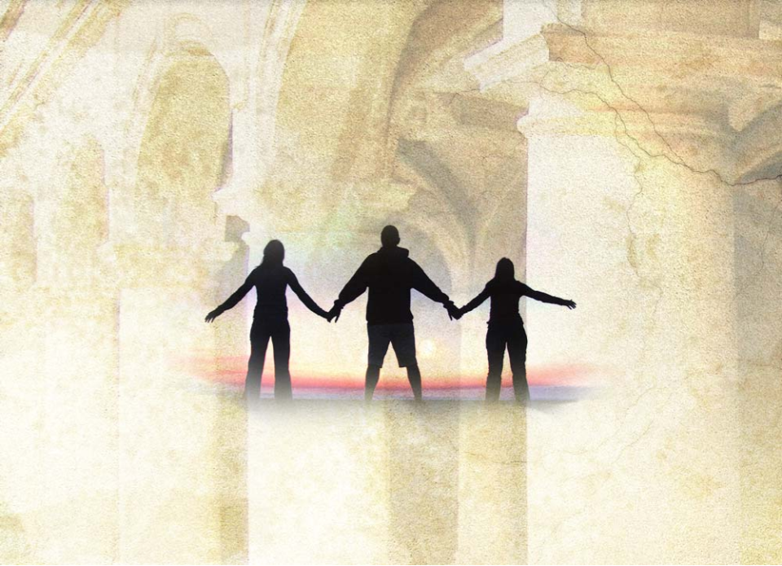
God is more concerned
that we be involved in right relationships
than that we think the right thoughts and do the right things.
Right relationships produce right thoughts and actions.

Slide 15

II. Opening Considerations
Governance represents the fundamental issue in the Great Controversy between God and Satan.
Governance in the Great Controversy
hinges on relationships
involves our personal and collective missions
This spiritual war has
disrupted our joy and relationship with Christ
spawned questions about “God’s will”
God calls us to restore both the relationship and the joy.

Slide 16

Our “Church”
DIVISIONS
ECD • EUD • ESD • IAD • NAD • NSD
SAD • SPD • SID • SUD • SSD • TED • WAD
SCHOOLS
Colleges
Universities
DEPARTMENTS
Ministries
Agencies
HOSPITALS
Clinics
MEDIA CENTERS
PUBLISHING HOUSES
Our church owes its entire mission and allegiance to God.

Slide 17

God has called us to serve the needs of
the human family He placed on earth.
The distinguishing marks of God’s disciples include
love for one another and
a commitment to “obey God’s commandments and remain faithful
to Jesus.”
These experiences of love,
obedience, and faithfulness
lead to lives and acts of grace
while we come to comprehend
God’s completed work at Calvary.

Slide 18

Love and faithfulness reveal to us
what we are to do and who we are to be.
The guide-stars of “doing” and “being” lead us to act with “responsibility.”

Slide 19

Biblical “responsibility” rings in
tones of joy and privilege.
“Responsibility” embraces duty and accountability.
How can we build a church culture that feeds and grows persons who bring joy and excitement to our responsibilities?

Slide 20
Responsibility embraces
Responsibility involves the authority an organization grants its members and leaders.
In doing and being everything God has called us to be we must act and desire to act with responsibility.
joy -
privilege -
duty -
accountability.

Slide 21
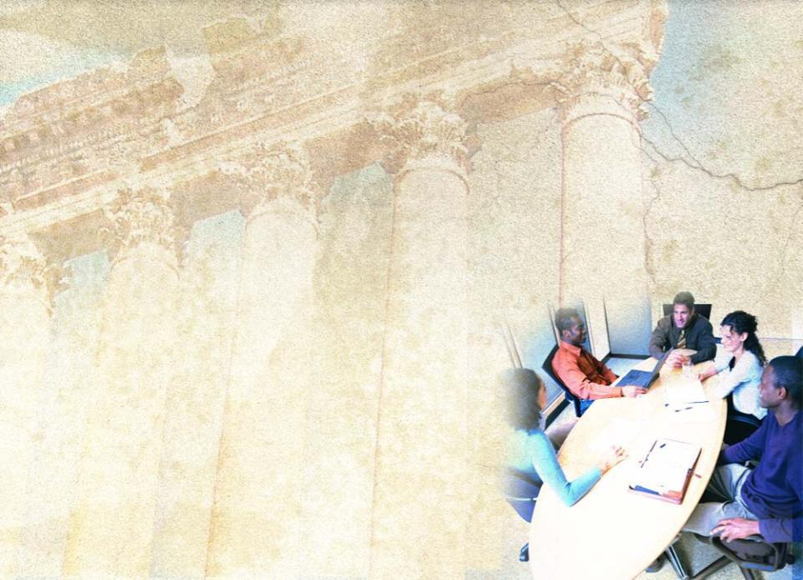
The situations in which we reach
decisions as leaders in our churches and institutions may appear joyful and clear or may seem clouded with division and uncertainty.
Regardless of circumstances, God
has not abandoned us to
uncertainty and fear
sustains our collaboration
with Him
is fully invested
spares nothing to support
our efforts

Slide 22

Questions as lamps to guide in
examining the relationships of responsibility
To whom and to what are we responsible?
For whom and for what are we responsible?
Examining these questions may
reveal principles to bind us together
help us discover common views
reveal responsible practices that
convey Christ’s love

Slide 23
Unity in DiversityPhiladelphia, July 4, 1776, Birth of the United States
John Dickerson, in his love and passion to act with responsibility, lead the debate against signing the Declaration of Independence.
But when the delegates approved that Declaration, he led the first troops from Philadelphia to defend New Jersey against the British.

Slide 24

People of responsibility may
be at opposing points
be acting with responsibility when they express their disagreement responsibly
and thoughtfully
even be irresponsible when
they fail to disagree

Slide 25
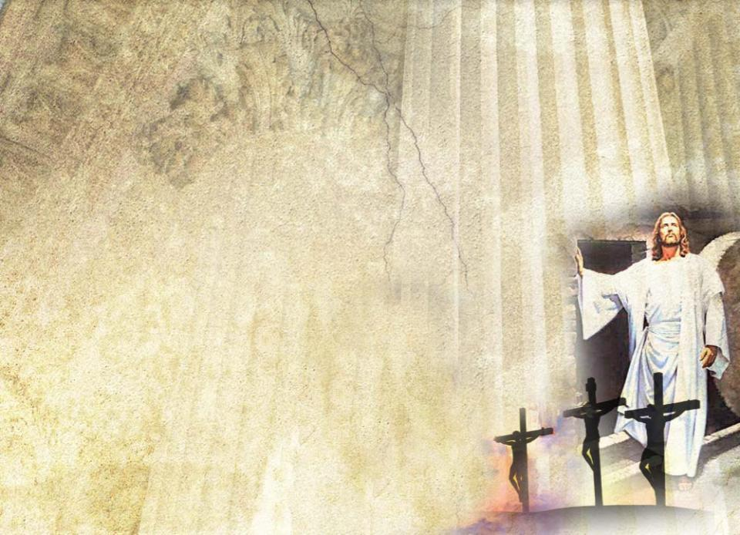
Why do we
move forward, even when we disagree?
continue to serve together?
wrestle through conflict and division?
Because of the promises
of God and the privilege
to share the Greatest
Story ever told.

Slide 26

III. God’s Promises and Invitation to Service
²¹“Not everyone who says to me, ‘Lord, Lord,’ will enter the kingdom of heaven, but only he who does the will of my Father who is in heaven. ²²Many will say to me on that day, ‘Lord, Lord, did we not prophesy in your
name, and in your name drive out demons and perform many miracles?’ ²³Then
I will tell them plainly, ‘I never knew you. Away from me you evildoers!’”
Matt 7:21-23 (NIV)

Slide 27
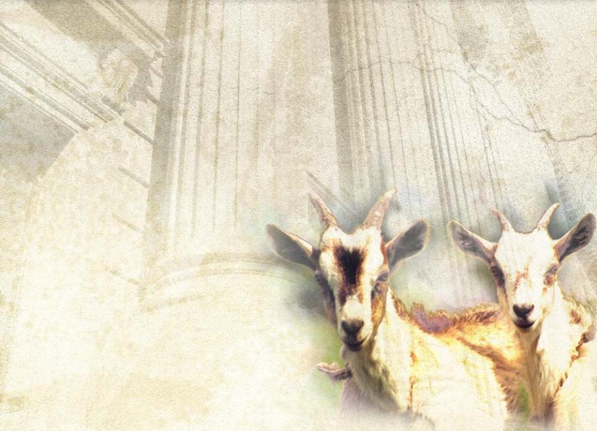
The goats, to whom Jesus says,
“I never knew you,”
thought that they had acted with responsibility
had driven out demons and
performed miracles
had outperformed
us all in terms
of good deeds
“deserved” to get
into the kingdom
But the Lord said,
“I never knew you.”

Slide 28
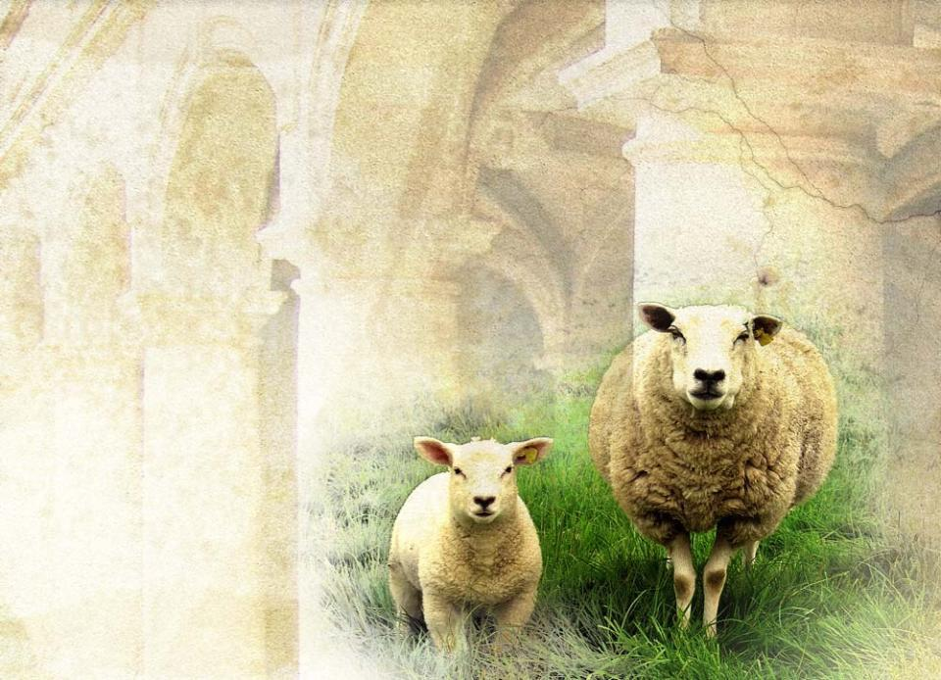
The sheep in Matthew 25
could not remember their good deeds
asked, “Lord, when did we see
you hungry and feed you,
or thirsty and give you
something to drink?”
(verse 37)

Slide 29
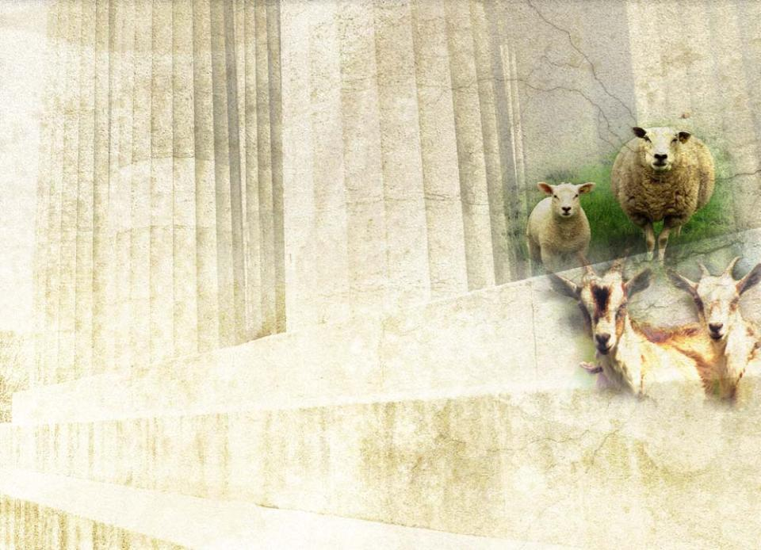
What is the difference between the sheep and the goats?
Both handled responsibility.
The goats performed their
great deeds as transactions,
in order to “earn” salvation.
The sheep performed their deeds
in the context of relationships.

Slide 30
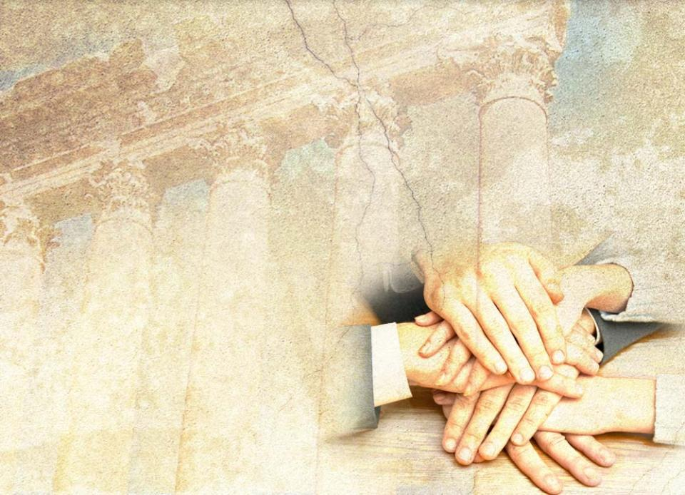
For Jesus to know us requires that we have a relationship with Him.
“Acting with responsibility”
involves behavior and attitudes that are more relational
than transactional
emphasizes
attitude over
accomplishments

Slide 31
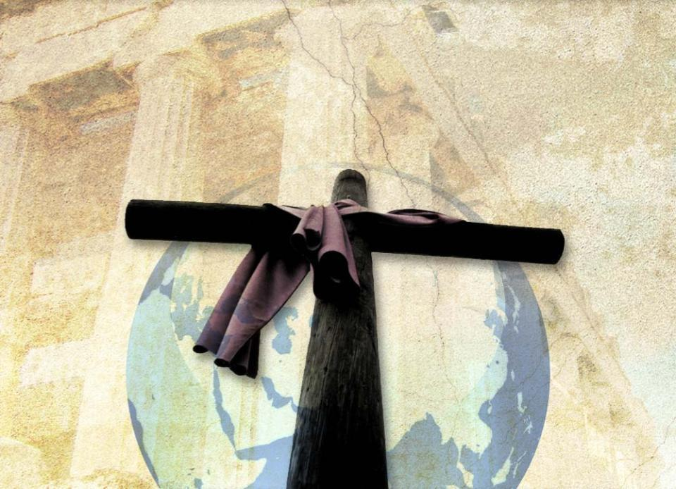
Our church holds responsibilities in the global mission of redemption.

Slide 32

Uniting with heavenly agencies for the redemption of the human family will energize our responsibility.
For fulfilling this mission, God
promises power
converts weakness
to strength
empowers us with
the gospel
enables us to change the world now
We are to ask and know that He walks with us always.

Slide 33
Our service and interaction
as leaders
do not always result in satisfaction
often involve differing viewpoints
include mistakes and disappointments as well as joy
and celebration
Despite these tests of patience, responsible, committed leaders function in the present.

Slide 34

Responsibility balances
patience
with
persistence

Slide 35
and
short-term recognition
of urgent needs before us
long-term commitment
with

Slide 36

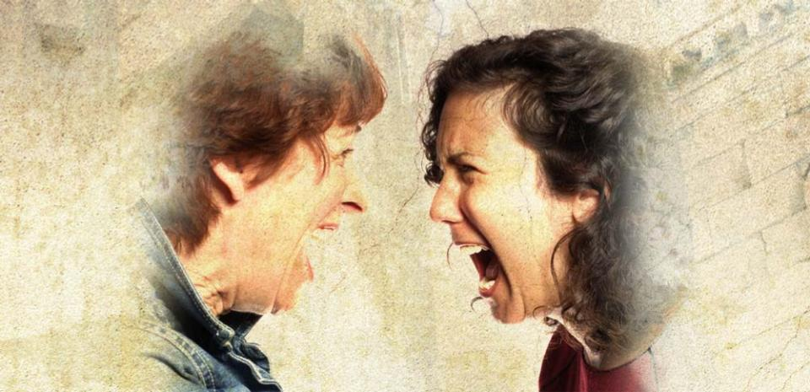
God does not want His promises and opportunities to be squandered while we bicker over roadmaps and plans.

Slide 37

Effective managers “have a bias
for action.”
The Psalmist agrees:
¹Blessed is the man who does not walk in the counsel of the wicked or stand in the way of sinners or sit in the seat of mockers.
²But his delight is in the law of the LORD, and on his law he meditates day and night.
³He is like a tree planted by streams of water, which yields its fruit in season and whose leaf does not wither. Whatever he does prospers.
Ps 1:1-3 (NIV)

Slide 38
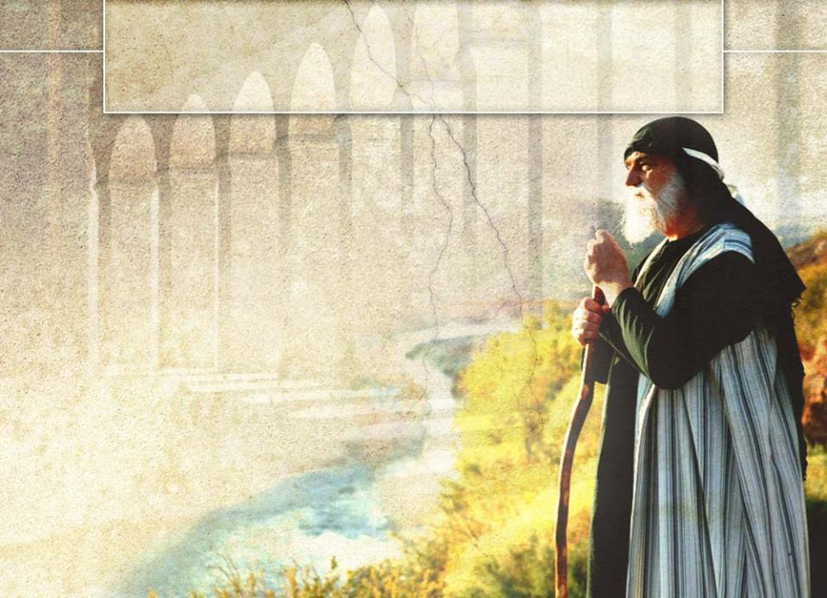
IV. Opportunities, Resources and Human Limitations
Many heroes of the Bible
and of history have
© 2005. Vervent Productions
weighed their opportunities and resources
confronted their limitations to serve God with integrity
Elijah’s experience shows the full range of joy to desperation in the leadership process.

Slide 39

³⁶At the time of sacrifice, the prophet Elijah stepped forward and prayed, “O LORD God of Abraham, Isaac and Israel, let it be known today that you are God in Israel and that I am your servant and have done all these things
at your command. . . .”
³⁸Then the fire of the LORD fell and burned up the sacrifice, the wood, the stones and the soil, and also licked up the water in the trench.
I Kgs 18:36,38 (NIV)
²So Jezebel sent a messenger to Elijah to say, “May the gods deal with me, be it
ever so severely, if by this time tomorrow I do not make your life like that of one of them."
³Elijah was afraid and ran for his life. When he came to Beersheba in Judah, he left his servant there, ⁴while he himself went a day's journey into the desert. He came to a broom tree, sat down under it and prayed that he might die. . .
I Kgs 19:2-4 (NIV)

Slide 40
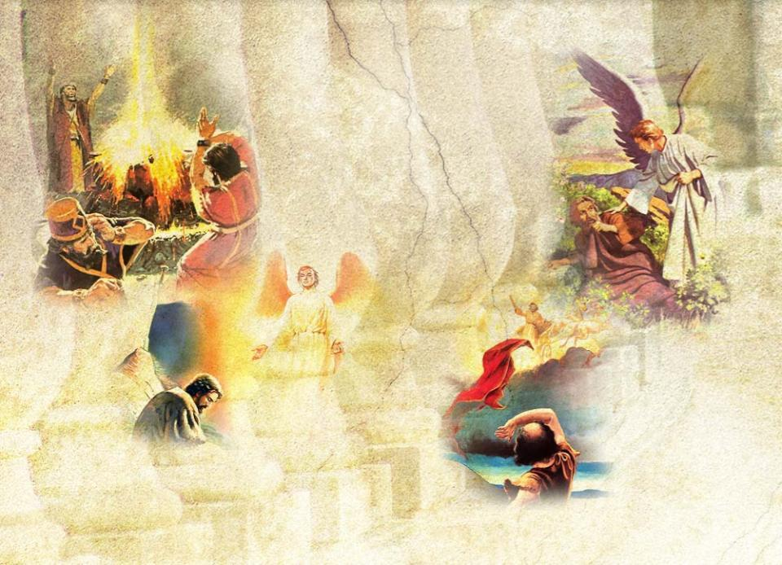
Vignettes in the Service of Elijah
Victory on Carmel
Desperation in the desert
Reempowered at Horeb
Final victory
When was Elijah acting responsibly?

Slide 41
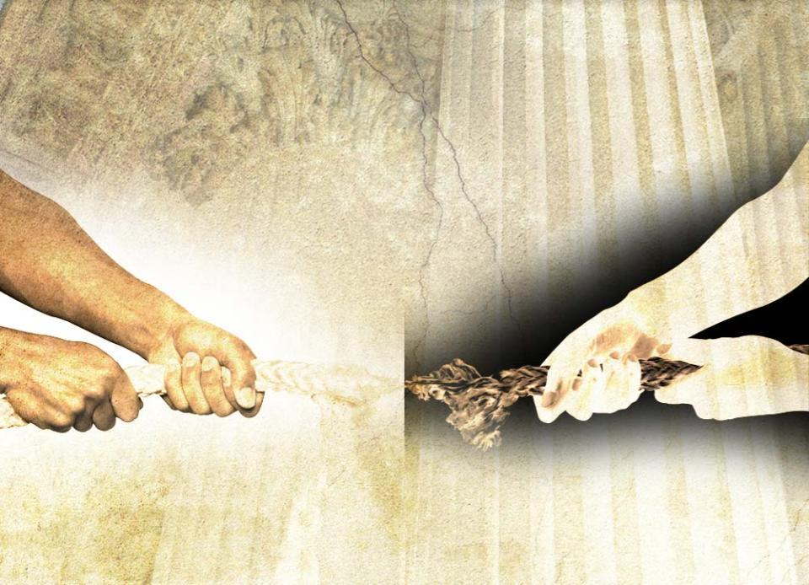
ELIJAH, physically, emotionally, and spiritually exhausted, forgot
that the battle was not Elijah versus Jezebel.
The battle was
God versus evil.

Slide 42

Like Elijah, our problems stem from
poor relationships with God
pride
missed opportunities
disconnection from the Power Source
delusions of success
separation from grace
legalism

Slide 43
How Do We Treat Our Leaders? Pastors? Teachers? When opportunities and resources fade—Do we
recognize our responsibility to support them?
enable their participation in retreats and sabbaticals?
react with healing when they break down under the load?
or do we
squander our investment and strip-mine them and their gifts?
“solve” the problem by arranging for their resignations or reassignments?

Slide 44
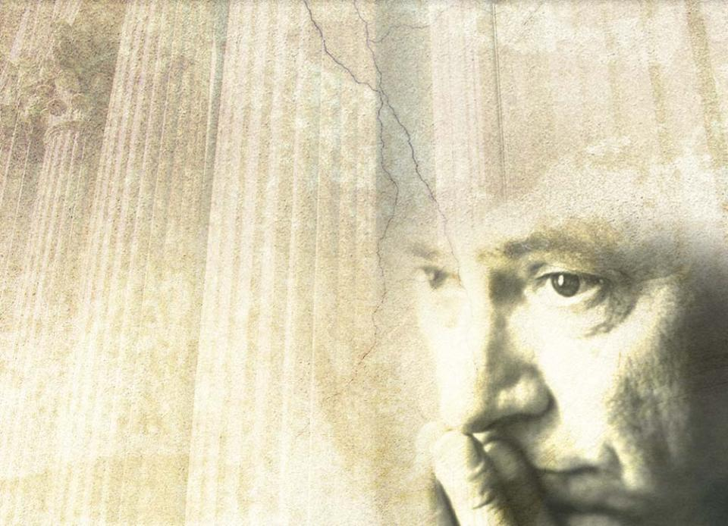
The process of choosing to seize opportunities and resources and to rise above human limitations can be lonely.
This process may resolve itself for gain or loss through
prayer
an encouraging
consultation with
fellow workers
instinctive decisions
that we can’t explain

Slide 45
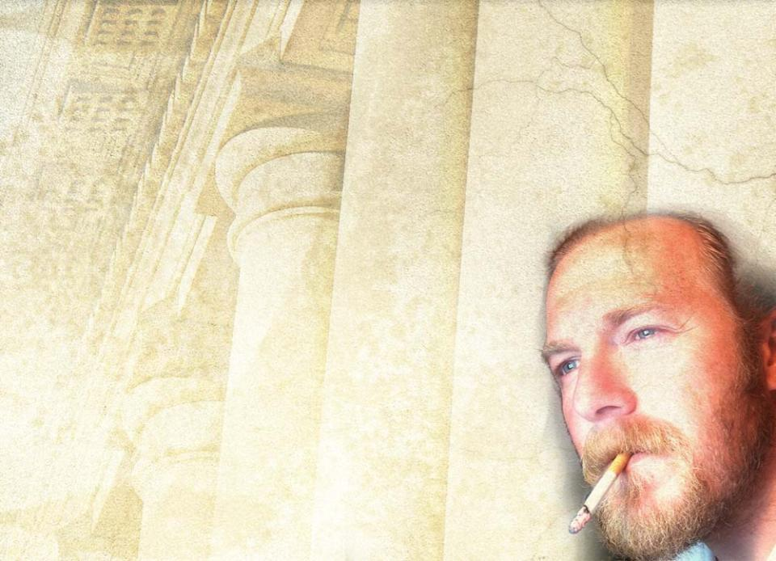
On her way home late one evening, Laura had a difficult choice to make: should she snub a smoker in the entrance to her apartment building, or walk near him? As a Christian, she chose to walk near the smoker and be friendly.
When the access code to her
building wouldn’t work, the
smoker used his security card
to let her in. Laura thanked him,
and entered the building.
She recognized that she had done
the right thing in seeing the smoker
as a child of God.

Slide 46
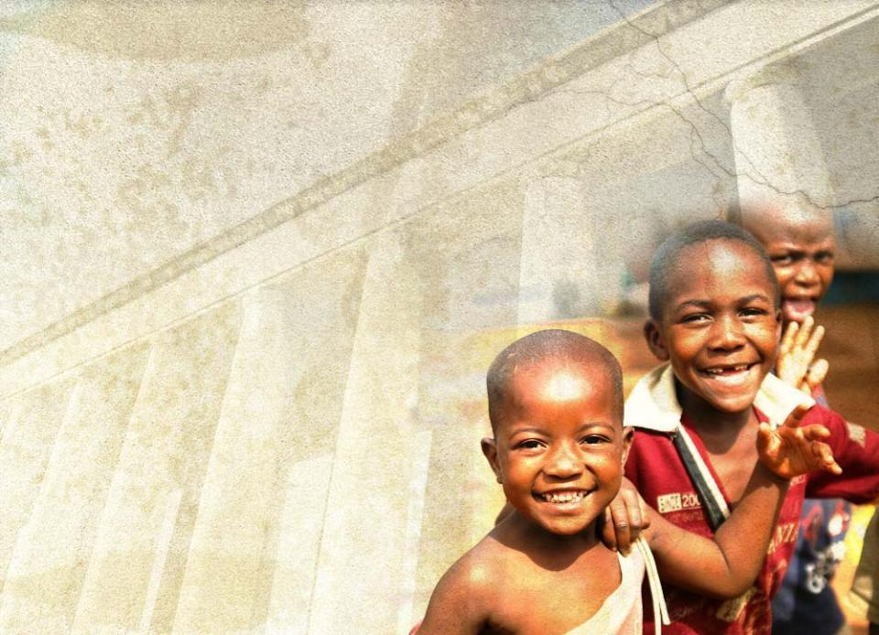
To whom we are responsible? Who is our neighbor?
The biblical imperative is clear:
We are not responsible
solely for ourselves
solely to our preferences and traditions
We are responsible
to God
for His children
We are ambassadors of
reconciliation to reveal
who God is and
how God acts.

Slide 47

As church leaders serving together
Whom and what do we see?
Do we see ourselves among fellow laborers as a “priesthood” of “holy” believers?
Do we sense our dependence upon them?
Are we accountable to them, responsible for them?
How do we act responsibly toward them?
How do we balance our responsibility toward them with our obligations to God and for our church?
When they act irresponsibly, what ethics and responses do we use?

Slide 48
Unless we act “with responsibility,” as did Laura, we will fail
to see and hear the people and
opportunities God brings us each
day and
to use the resources He provides.
How often do we pray for new projects and the necessary resources, but stand blind and deaf to those before us?

Slide 49
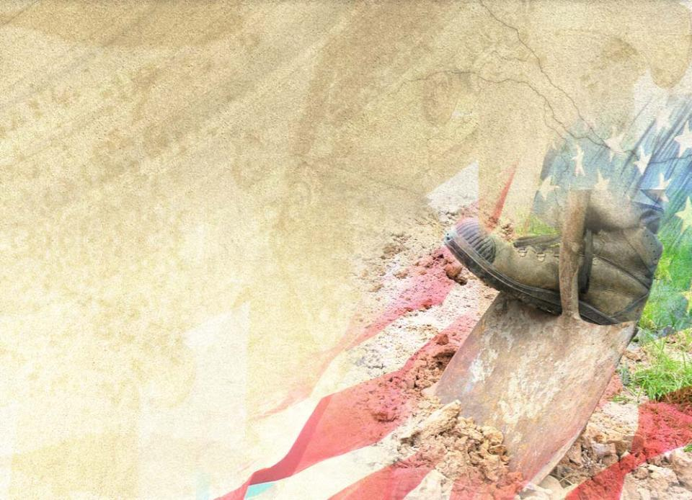
Have we in America and in the church buried the true gospel under false gospels?
culture
economics & finances
politics
parliamentary maneuvers

Slide 50
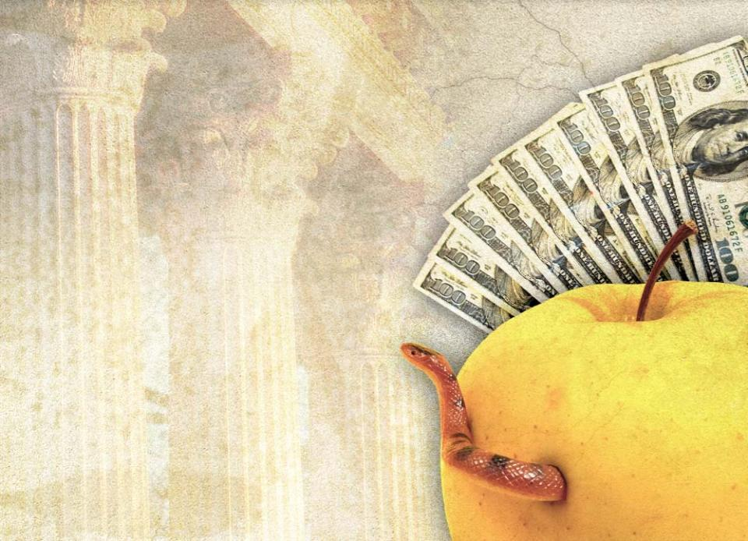
Deceptions to Avoid:
power
money
influence
dignity
self-preservation
These and other
deceptions can
affect the church
corrupt expectations
corrupt relationships

Slide 51

What have students in our global classroom learned?
Our giving and healing, powerful teaching and preaching, Religious Liberty ministries, ADRA, Global Mission, and Community Services
or
The importance of money, power, titles, influence, political shrewdness, and favoritism
Paraphrasing the words of Isaiah to King Hezekiah: “What have they seen in our house?”
Have they learned the implications of the adage, “It’s who you know (not what you know or do) that counts”?

Slide 52
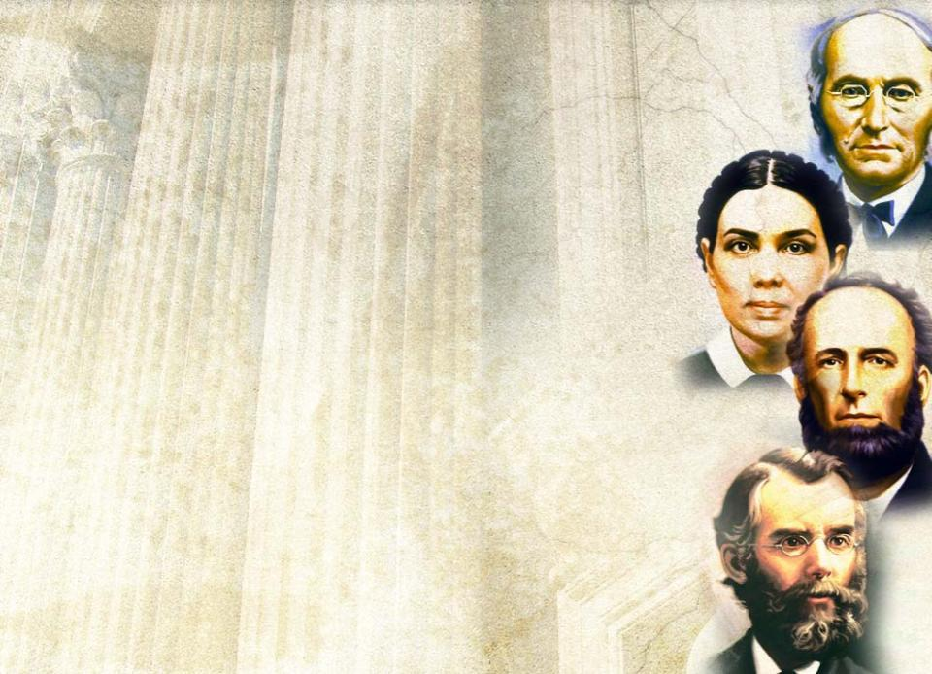
Other lessons they have learned include
premeditated parliamentary maneuvers
character assassinations
use of selective Biblical quotations
misuse of the writings of Ellen White
and other Adventist pioneers
These Adventist pioneers
lived exciting ministries
risked and sacrificed in their love for Jesus
As their spiritual descendants, we will risk who we are as we pursue our responsibilities in the plan of redemption.

Slide 53
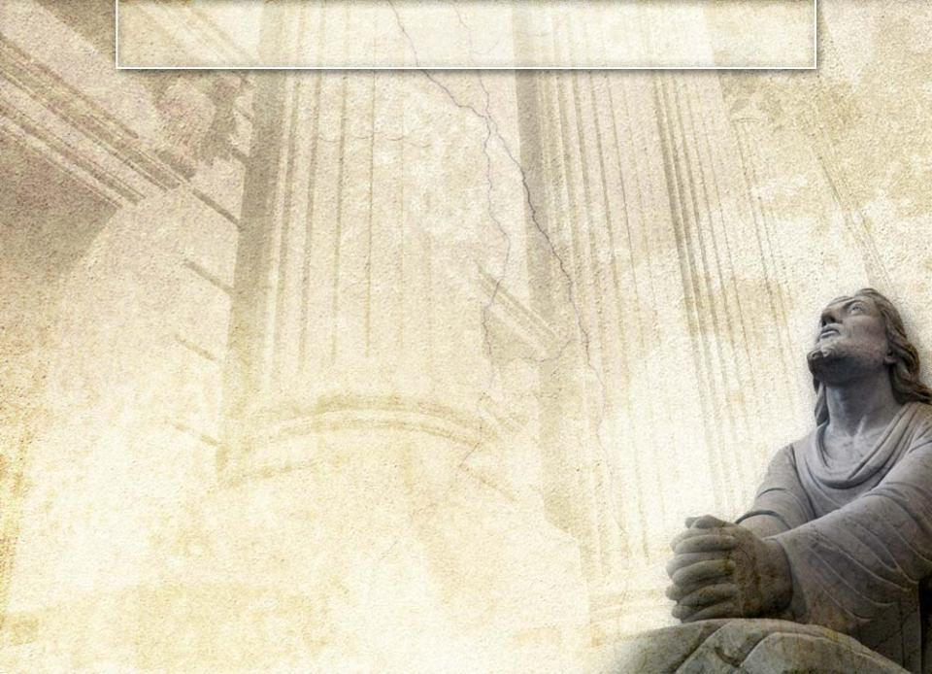
Our Gospel Mission
Even Jesus sought reassurance and confirmation of His mission when He risked all in Gethsemane for us.
As the Great Controversy rages, God’s cause and mission need
sacrifice by us
our all on the altar
God’s blessing on that sacrifice

Slide 54

We have been given the
ministry of reconciliation.
¹⁷Therefore, if anyone
is in Christ, he is a new creation; the old has
gone, the new has come!
¹⁸All this is from God, who reconciled us to himself through Christ and gave us the ministry
of reconciliation: ¹⁹that God was reconciling the world to himself in Christ, not counting men's sins against them. And he has committed to us the message of reconciliation.
²⁰We are therefore Christ's ambassadors, as though God were making his appeal through us. We implore you on Christ's behalf: Be reconciled to God.
²¹God made him who had no sin to be sin for us, so that in him we might become the righteousness of God.
2 Cor 5:17-21 (NIV)

Slide 55

We are to worship God, not an element, tradition, or asset of
the church.
⁸I, John, am the one who heard and saw these things. And when I had heard and seen them, I fell down to worship at the feet of the angel who had been showing them to me.
⁹But he said to me, "Do not do it! I am a fellow servant with you and with your brothers the prophets and of all who keep the words of this book. Worship God!”
Rev 22:8-9 (NIV)
WARNING: while you are free to copy and translate the text of the content of this DVD for training purposes within the Seventh-day Adventist Church, illustrations are owned by various entities that have provided us limited use rights. DO NOT COPY OR USE THE ILLUSTRATIONS WITHOUT OBTAINING LICENSES AND PERMISSION TO DO SO IN ADVANCE.

