Slide 1
The Down Path
The Path to Leadership as Service
Stanley Patterson, Ph.D.
Global Leadership Summit, Bali, January 29-31, 2013

Slide 2
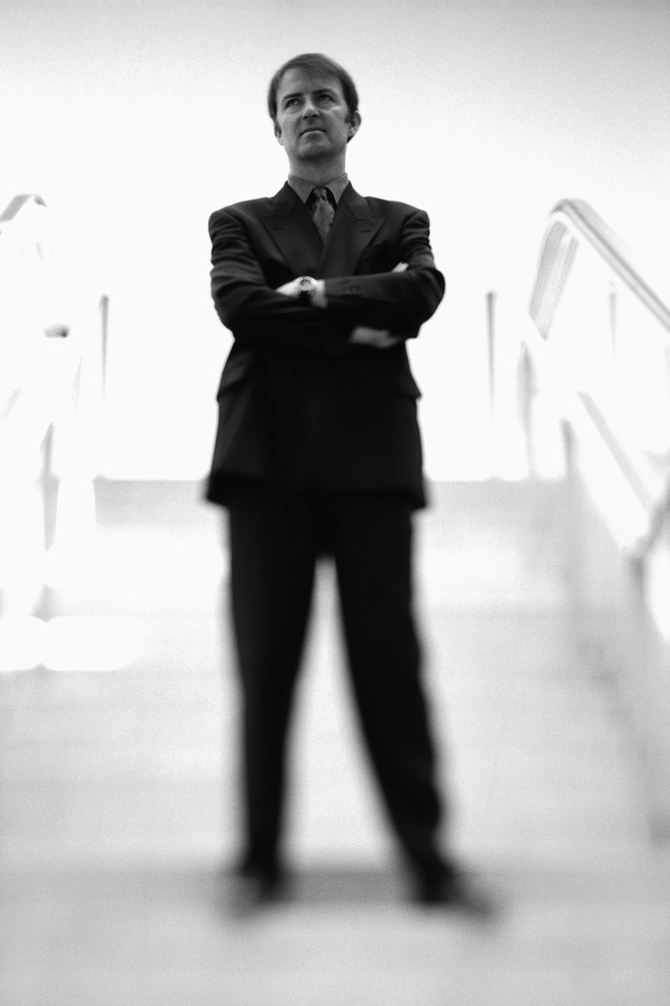
Presentation Title
Up the Down Stairway. Bel Kaufman (1965)
Mindless Rule?
Purposeful Command?

Slide 3
Spiritual Leadership
Bible is the defining standard
Culture influences leadership behavior
Culture should not determine leadership behavior
Spiritual Laws govern spiritual behavior
Casual observer will likely question these principles
Why go down when it seems natural to go up?

Slide 4
Metaphors
The Mountain of the Lord (Is 14; Ez 28)
The Up Path
The Down Path

Slide 5
Contrasting Biblical Models
Up the Down path The Down Path
Power
(Eze 28; Isa 14)
(John 15:15)
The Manger
Ascendant;
Dominance Oriented
Descendant;
Incarnational
The Ladder
Service

Slide 6
Up the Down Path I
¹³ For you have said in your heart:
‘I will ascend into heaven,
I will exalt my throne above the stars of God;
I will also sit on the mount of the congregation
On the farthest sides of the north;
¹⁴ I will ascend above the heights of the clouds,
I will be like the Most High.’
The New King James Version. 1982 (Is 14:12–14). Nashville: Thomas Nelson.

Slide 7
The Ascendant Model
Egocentric upward focus
revealed in the use of the first person singular by the speaker, Lucifer (vs. 12).
Goals are not authorized
Not ordained to such lofty achievements
Covets a position and a role to which he was never called
Lucifer climbed the ladder of his dreams and from that ladder he fell with tragic results.

Slide 8
(Isaiah 14 context)
¹² “How you are fallen from heaven,
O Lucifer, son of the morning!
How you are cut down to the ground,
You who weakened the nations!
¹⁵ Yet you shall be brought down to Sheol,
To the lowest depths of the Pit.
¹⁶ “Those who see you will gaze at you,
And consider you, saying:
‘Is this the man who made the earth tremble,
Who shook kingdoms,
¹⁷ Who made the world as a wilderness
And destroyed its cities,
Who did not open the house of his prisoners?’

Slide 9
(Isaiah 14 context continued)
¹⁸ “All the kings of the nations,
All of them, sleep in glory,
Everyone in his own house;
¹⁹ But you are cast out of your grave
Like an abominable branch,
Like the garment of those who are slain,
Thrust through with a sword,
Who go down to the stones of the pit,
Like a corpse trodden underfoot.
²⁰ You will not be joined with them in burial,
Because you have destroyed your land
And slain your people.
The New King James Version. 1982 (Is 14:12, 15–20). Nashville: Thomas Nelson.

Slide 10
Up the Down Path II
¹² “Son of man, take up a lamentation for the king of Tyre, and say to him, ‘Thus says the Lord God:
“You were the seal of perfection,
Full of wisdom and perfect in beauty.
¹³ You were in Eden, the garden of God;
Every precious stone was your covering:
The sardius, topaz, and diamond,
Beryl, onyx, and jasper,
Sapphire, turquoise, and emerald with gold.
The workmanship of your timbrels and pipes
Was prepared for you on the day you were created.

Slide 11
(Ezekiel 28 continued)
¹⁴ “You were the anointed cherub who covers;
I established you;
You were on the holy mountain of God;
You walked back and forth in the midst of fiery stones.
¹⁵ You were perfect in your ways from the day you were created,
Till iniquity was found in you.
¹⁶ “By the abundance of your trading
You became filled with violence within,
And you sinned;

Slide 12
(Ezekiel 28 continued)
Therefore I cast you as a profane thing
Out of the mountain of God;
And I destroyed you, O covering cherub,
From the midst of the fiery stones.
¹⁷ “Your heart was lifted up because of your beauty;
You corrupted your wisdom for the sake of your splendor;
I cast you to the ground,
I laid you before kings,
That they might gaze at you.

Slide 13
(Ezekiel 28 continued)
¹⁸ “You defiled your sanctuaries
By the multitude of your iniquities,
By the iniquity of your trading;
Therefore I brought fire from your midst;
It devoured you,
And I turned you to ashes upon the earth
In the sight of all who saw you.
¹⁹ All who knew you among the peoples are astonished at you;
You have become a horror,
And shall be no more forever.” ’
The New King James Version. 1982 (Eze 28:12–19). Nashville: Thomas Nelson.

Slide 14
Elements of the Ascendant Model
The setting for both Isaiah’s and Ezekiel’s depiction of prideful self-promotion and ascendant behavior is the “mountain of the Lord” (Is 14:13, Eze 28:14).
In both narratives the offender covets position and glory that were not his own and in both cases the consequences are tragic.
The goal of this model of rulership or leadership is dominance while coercion is considered fair play as a means to achieve that end.

Slide 15
Dominance-based Leadership is Sin
We must remember though that there are universal spiritual rules that govern issues of position and glory—in both of these biblical passages the characters assume an ascendant attitude inconsistent with divine laws that govern the universe.

Slide 16
Down the Down Path
So what is the purpose of the “down path”?
Mount of the Lord
The dwelling place of God is on its heights.
“Word was with God and the Word was God” (John 1:1).
“the Word became flesh” (John 1:14).

Slide 17
(Continued)
Emmanuel – “God with us.”
not by requiring us to ascend the Mount but by coming down to serve our transformational needs.
He dwelled with us (John 1:14)
He ate with us—even with tax collectors and prostitutes (Matt 21:32)
His preferred relationship was “friend” rather than “Master” (John 15:15).
He came down to serve! (Matt 20:28)

Slide 18
The Incarnational Model
Jesus modeled the behavior of the down path—He emptied himself (Phil 2:7).
87.70 κενόω^{b}: to completely remove or eliminate elements of high status or rank by eliminating all privileges or prerogatives associated with such status or rank—‘to empty oneself, to divest oneself of position.’ ἑαυτὸν ἐκένωσεν ‘he emptied himself’ Php 2:7.
Louw, J. P., and Eugene A. Nida. Greek-English Lexicon of the New Testament : Based on Semantic Domains. 2nd ed. 2 vols. Vol. 1, New York: United Bible Societies, 1989.

Slide 19
Descending to Serve
He sat down and taught them (Jn 8:2);
He leaned down and healed them (Mt 15:30);
He leaned down to place his healing hand upon the little girl (Mk 5:32);
He came down and healed (Luke 6:17);
He cast forth the demon from the child at his feet (Lk 9:42);
Zacchaeus was called down to be with Jesus (Lk 19:5);
He sat down with the Samaritan woman at the well (Jn 4:6);
He stooped down to write the words that delivered the woman taken in adultery (Jn 8:6);
Jesus looked down upon the paralyzed man and offered to heal him (Jn 5:6);
He reached down to mix saliva with clay and anointed the blind man and he gained his sight (Jn 9:6).

Slide 20
Contrasting Biblical Models
Up the Down path The Down Path
Power
(Eze 28; Isa 14)
(John 15:15)
The Manger
Ascendant;
Dominance Oriented
Descendant;
Incarnational
The Ladder
Service

Slide 21
Laws that Govern Leadership
law of love—love of God and fellowman (Mt 22:37-40)
avoid selfish ambition and consider others before self (Phil 2:3)
bear the fruit of the Spirit (Gal 5:22-23)
apply the “golden rule” (Lk 6:31)
No “lording it over others” (Mt 20:25, 26)

Slide 22
The Primacy of Love
Love is the motivator that urges us to descend to serve while all that we are apart from Christ urges us up the down path in pursuit of dominance and self-glorification.

Slide 23
The Glorious Irony
“To him who overcomes I will grant to sit with Me on My throne, as I also overcame and sat down with My Father on His throne.”
Revelation 3:21 (NKJV)
Those who take the down path to service will occupy the throne where Lucifer hoped to rest.

Slide 24
Our Choice—Up or Down
Our actions will either be up or down, generative or destructive, loving or uncaring. By God’s grace and in the power of the Holy Spirit we may travel down the down path as we follow the footsteps of Jesus.

