Slide 1


A LEADERSHIP WORKSHOP
Based on the Collected Papers
from the Leadership Symposium
General Conference Session
July 3-7, 2005

Slide 2

SESSION eight
Profiling Adventist Leadership:
Responsiveness to Diversity – PART 1
Based on the Presentation by
Leslie N. Pollard
Vice President for Diversity,
Loma Linda University
Adventist Health Sciences Center

Slide 3

Session 8 will address the
following questions:
1
Why do Adventist leaders need to be competent in the area of diversity?
2
Define the terms “diversity,” “diversity competency,” “cultural competence.”
3
What types of diversity do we have in the Adventist Church?

Slide 4

4
How are leaders to promote unity in the church?
5
How could Paul say, “to the Jews I became AS a Jew,” when he actually was a Jew?
6
How did conversion change Paul’s value system in reference to diversity?
7
When Paul states that he “became AS a Jew,” what is he emphasizing?

Slide 5

I. Introduction
Responsiveness to diversity is immensely important in a global church.
A description of Embracing Diversity
explains why this issue is important.
“Today we must have the savvy and
flexibility to function in a multicultural
context, with sensitivity to local
customs, ideals, and taboos. . .
“This book will help you to see through
other eyes and suggest new ways to
reach the hearts of those who do not
think like you do.”

Slide 6

Loma Linda University
takes diversity seriously.

Slide 7

Leaders at Loma Linda believe that to effectively continue the healing and teaching ministry of Jesus, they must
prepare students for service in a diverse world
facilitate culturally competent care of patients
create a harmonious, inclusive, and welcoming workplace culture for every employee
They seek to fulfill the mission of Jesus through
diversity education
conferences and in-services
international service
learning agreements
intentionality in recruitment
activities

Slide 8
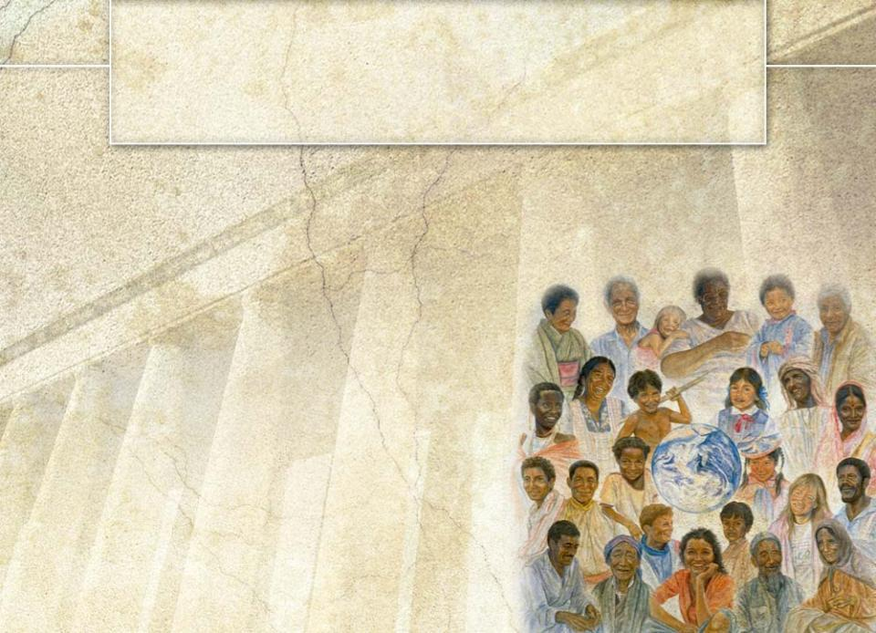
II. Why Leadership Competency in the Area of Diversity Is Important
Technical, conceptual, and interpersonal
skills are mission critical for leadership
in the 21st Century.
In a multinational, global
church, no leadership skill
is more important than
competency in the area
of diversity.
Reasons for its
importance follow.

Slide 9

Adventist Church
Demographics
The Adventist Church:
13+ million members
In 203 countries
of the world

Slide 10

This membership is spread around
the globe in thirteen world divisions.
East-Central Africa
Euro-Africa
Euro-Asia
Inter-American
North American
Northern Asia-Pacific
South American
South Pacific
Southern Africa-
Indian Ocean
Southern Asia
Southern Asia-Pacific
Trans-European
West-Central Africa

Slide 11

Global communications and travel have reduced our
church to a global village.
Leaders who formerly had
little contact with each other
now interact electronically
on a regular basis.
© It Is Written

Slide 12
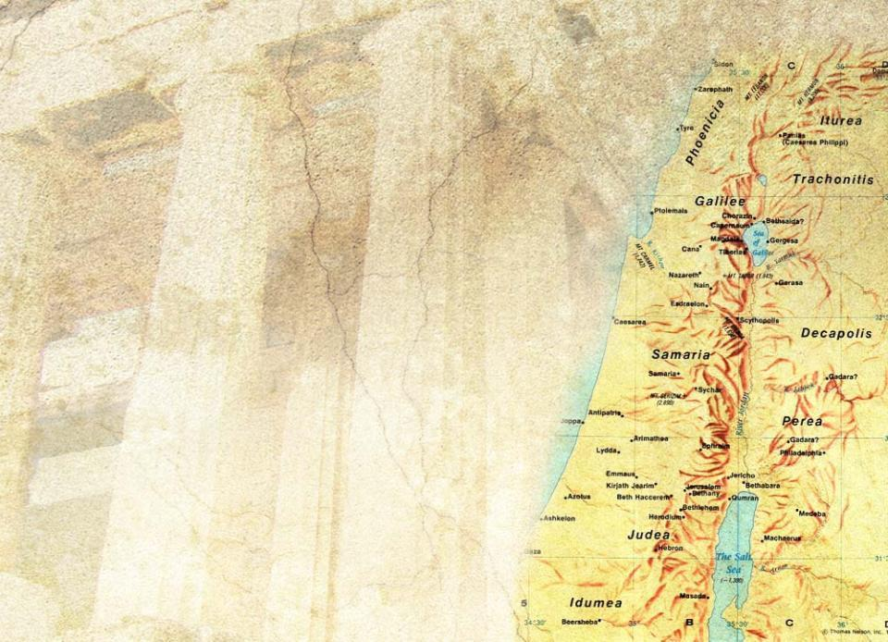


Jesus’ Ministry Reveals a
Cross-Cultural Trajectory
1–His ministry reflected
a geographical trajectory.
He ministered in Samaria,
a region many Jews
avoided. (John 4)
He ministered in
the region of
Tyre and Sidon. (Matt 15)

Slide 13
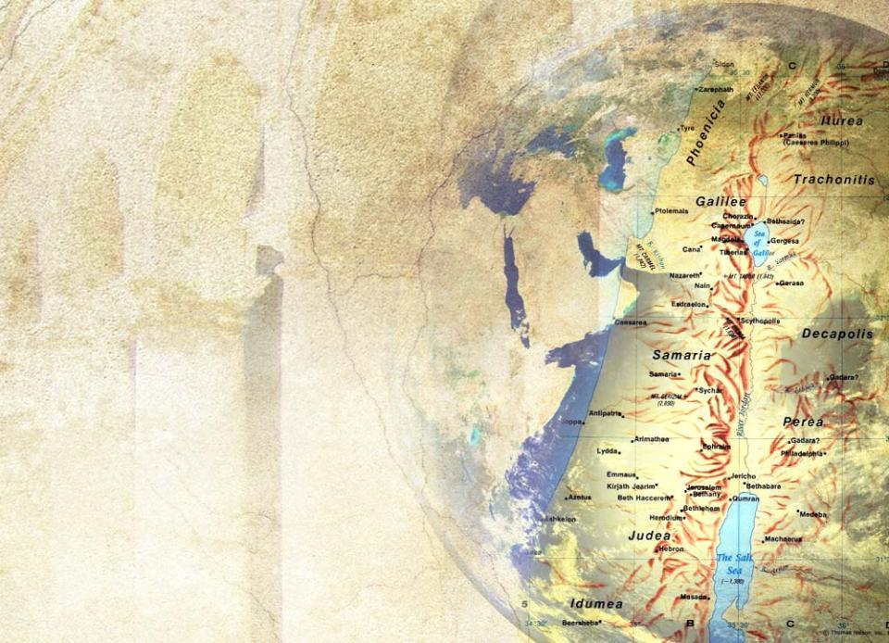








He told His disciples to
spread the Gospel from
Jerusalem
to Judea
to Samaria
“to the ends
of the earth”
(Acts 1:8 NIV)

Slide 14
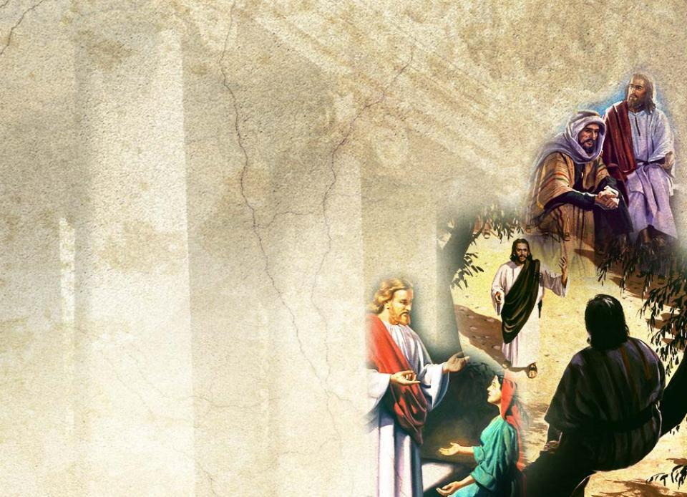
2–Jesus’ ministry demonstrated a sociological trajectory.
It encompassed all classes
of people
the proud Pharisee
Nicodemus,
tax gatherers,
prostitutes and
sinners

Slide 15

3–His ministry moved from ethnocentric exclusivity to ethnic inclusivity.
He healed scores of Jews. But His miracles included
the Canaanite woman’s daughter (Matt 15)
the Roman centurion’s servant (Matt 8)
the Capernaum official’s son (John 4)
the Samaritan leper (Luke 17)

Slide 16
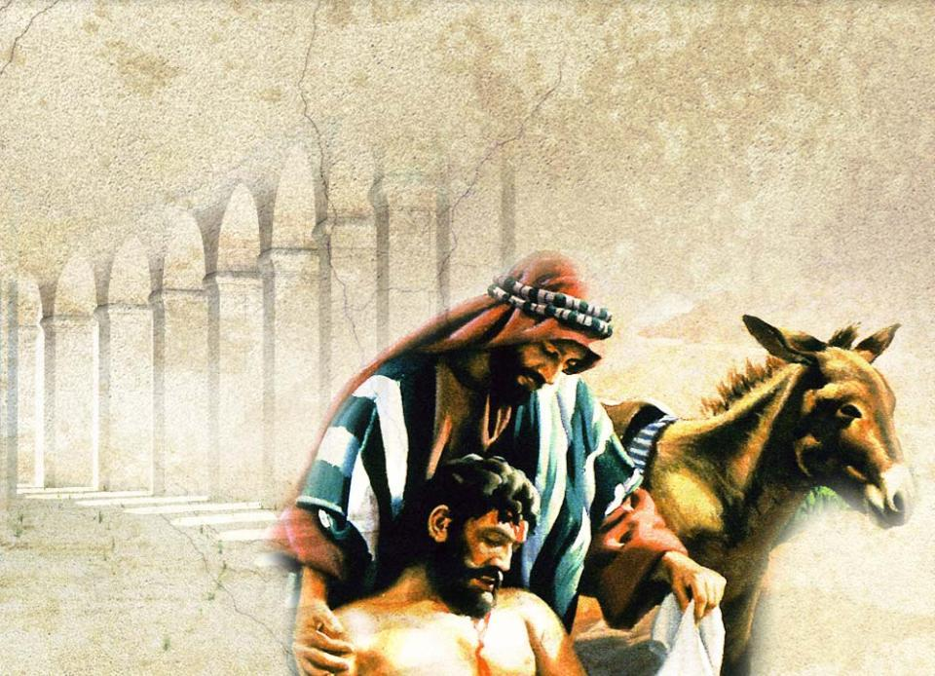
One of His best-loved parables memorialized a Samaritan businessman who was a good neighbor. (Luke 15)

Slide 17
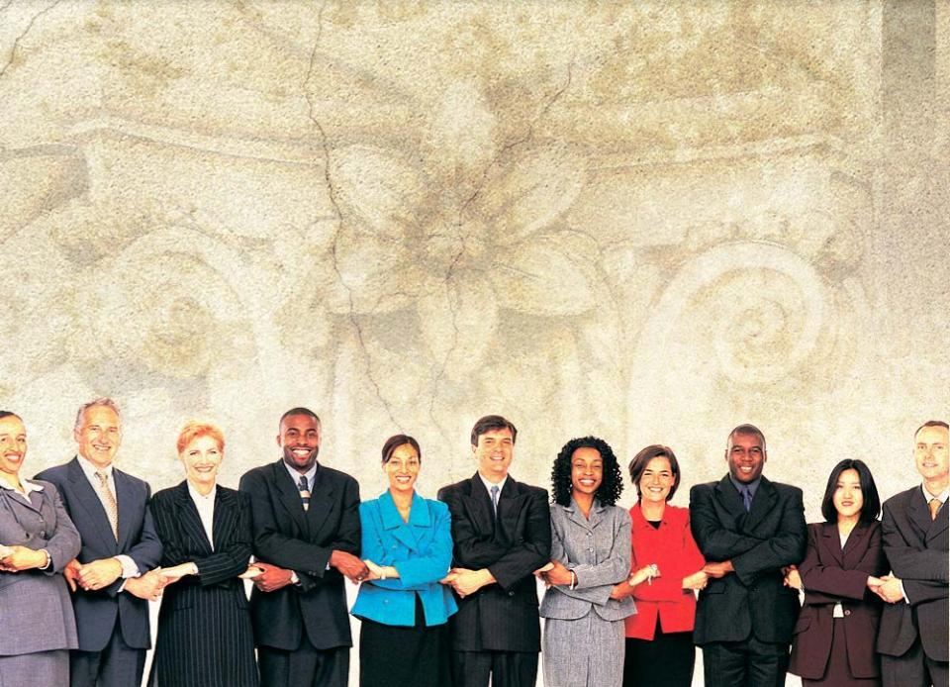
The Bible and the Spirit of Prophecy emphasize that the church must continue the healing, teaching, and preaching ministry of Jesus.
Faithful church leaders will reflect the same cross-cultural trajectories that Jesus’ ministry revealed.

Slide 18

The Mission of the
Adventist Church
⁶Then I saw another angel flying in midair, and he had the eternal gospel to proclaim to those who live on the earth—to every nation, tribe, language and people. Rev 14:6 (NIV)

Slide 19

This global mission requires leadership that
functions locally in its service arena, and
is global in its outlook.

Slide 20
The questions for leaders become
1
How and why will we respond to diversity that defines the people groups we lead?
2
How can we guarantee that our influence capital is spent
advancing mission rather
than impeding it?

Slide 21

III. Definition of Terms
Diversity:
biophysical,
social,
cultural,
national,
historical
MARKERS
that groups use
to identify themselves as a distinguished group and
to distinguish themselves from other groups

Slide 22
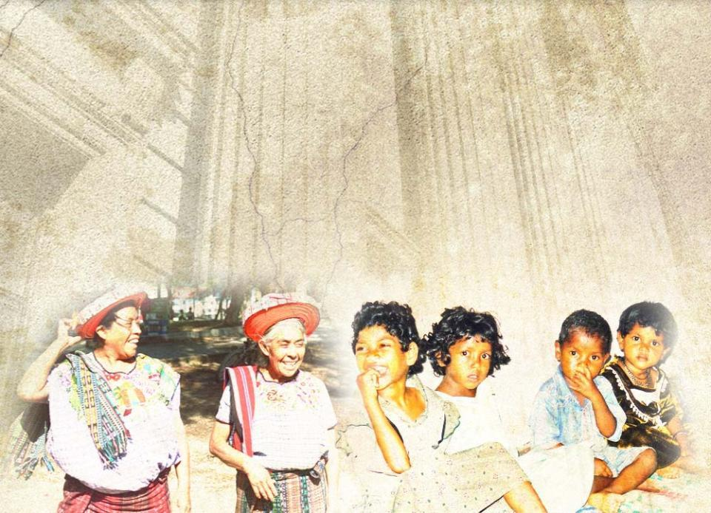
In our world church we
have national diversity.
Sri Lankan
Bangladeshi
Myanmar

Slide 23
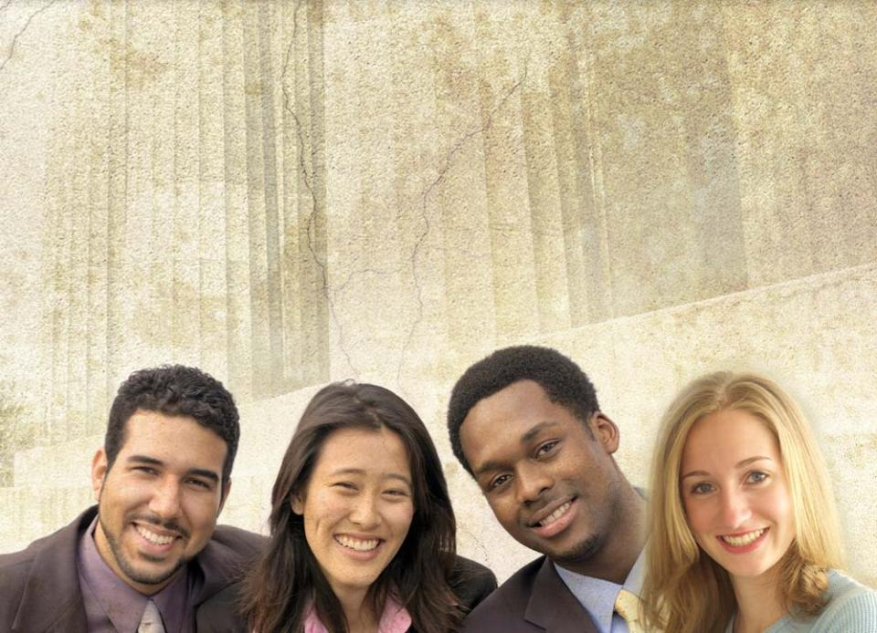
We have racial diversity.
Hispanic
Asian
African
Caucasian

Slide 24
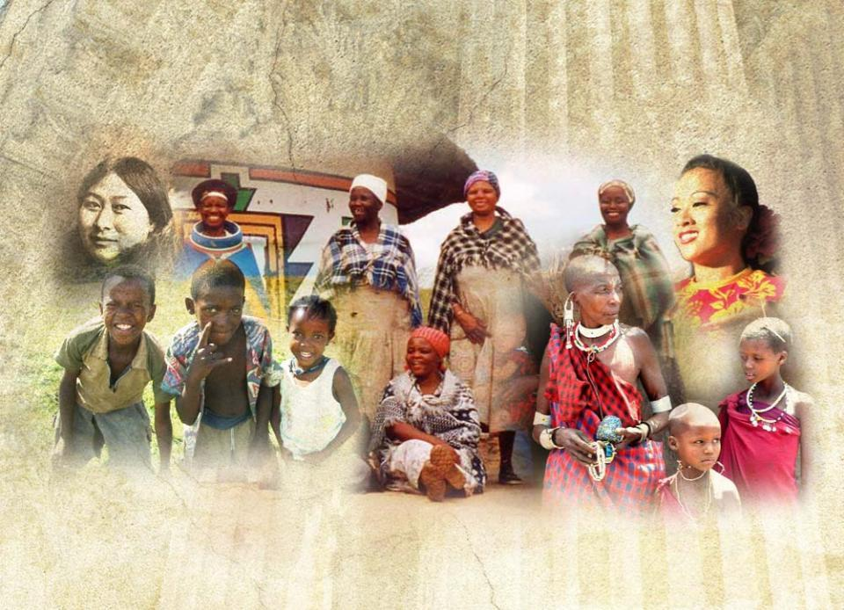
We have ethnic diversity.
Inuit
Ndebele
Samoan
Xhosa
Yoruba
Masai

Slide 25
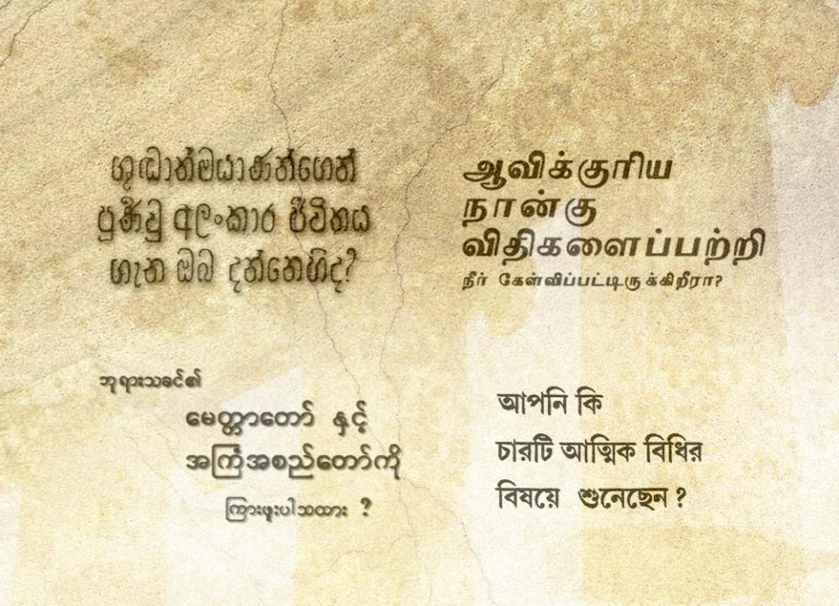
There is linguistic diversity.
The Four Spiritual Laws in
Sinhalese
Tamil
Myanmar
Bangla (Bengali)

Slide 26

We have the earliest and original diversity—gender diversity.

Slide 27


National
Racial
DIVERSITY
Gender
Ethnic
Linguistic
Each of these forms of diversity is an important social marker.
Notes:
Presentation copy

Slide 28

Diversity Competency: the
knowledge
attitude
skill
used by a leader to effectively serve and lead a diverse constituency, institution, or organization.
Cultural Competence: “the ability
of a system, agency, or individual
to respond to the unique needs of populations whose cultures are different from that of the dominant
or ‘mainstream’ society.”

Slide 29
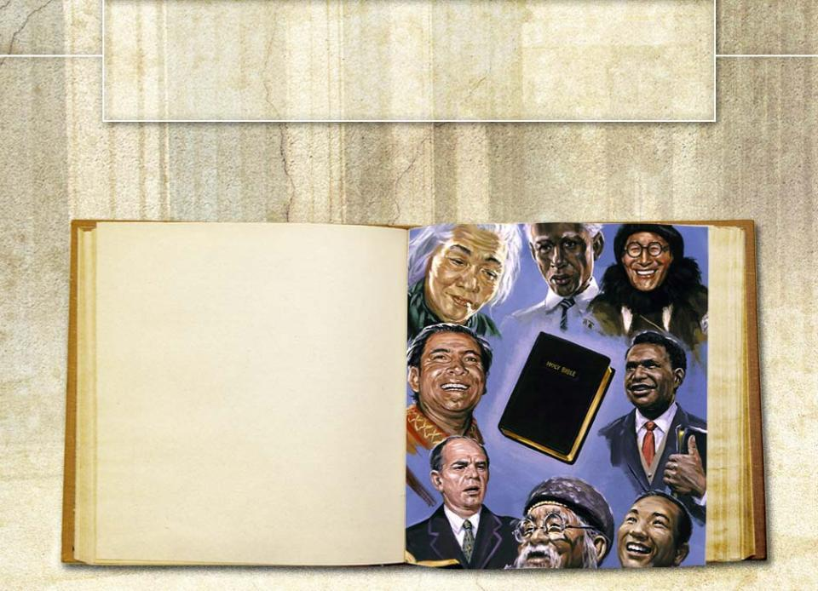
IV. How Should Christian Leaders Respond to Diversity?
Scripture provides the answer to this question.
²⁷for all of you who were baptized into Christ have been clothed with Christ. ²⁸There is neither Jew nor Greek, slave nor free, male nor female, for you are all one in Christ Jesus.
Gal 3:27,28 (NIV)

Slide 30

Leaders Must Affirm the Essential Unity of the Church.
This passage in Galatians calls leaders to promote oneness in
mission
fellowship
service
purpose
The passage also raises a related question:
If we are one in Christ, how should we respond to diversity differences?

Slide 31

Based on this passage, a leader may say
1–“There is no such thing as difference.” or
2–“I don’t see color (class, race, nationality, gender), I see people;” the difference does not matter because we are all one in Christ.
Each of these positions
will lessen our leadership effectiveness
is anti-diversity competency
Paul helps answer the question of what-do-we-do-with-differences.

Slide 32

Paul’s Response to Diversity
Paul shows by word and example the appropriate response to
racial
national
cultural
gender
ethnic
diversity.
© 2005. Vervent Productions

Slide 33

The text below gives us a window on Paul’s thinking about diversity competency.
¹⁹Though I am free and belong to no man, I make myself a slave to everyone, to win as many as possible. ²⁰To the Jews I became like a Jew, to win the Jews. To those under the law I became like one under the law (though I myself am not under the law), so as to win those under the law. ²¹To those not having the law I became like one not having the law (though I
am not free from God’s law but am under Christ’s law), so as to win those not having the law. ²²To the weak I became weak, to win the weak. I have become all things to all men so that by all possible means I might save some. ²³I do all this for the sake of the gospel, that I might share in its blessings.
I Cor 9:19-23 (NIV)

Slide 34

In this section of I Corinthians, Paul
defends his apostleship against attack
bridles the freedom of the strong but insensitive Corinthians
launches a discussion of his
ministry and why it is effective
clinches his argument by
explaining how he relates
to differences
© 2005. Vervent Productions

Slide 35

How could Paul say, “to the Jews I became AS a Jew,” when he actually was a Jew?
Paul served within multiple cultures.
He took up this task because he
was bound to Christ. (I Cor 9:1)
He was spiritually free.
He had not accepted any compensation from the Corinthians. (I Cor 9:11-15)
He was psychologically free.

Slide 36

Spiritual and psychological freedom released Paul from
his old identity anchors:
sinner
male
Jew
Pharisee

Slide 37

Diversity competency requires spiritual and psychological freedom.
Paul’s freedom is grounded in a new experience.
“If any one is in Christ, he is a new creation.” (II Cor 5:17 NIV)
This means that Paul
can no longer be Judeo-centric and
no longer considers himself a Jew in terms of
  primary values
  commitment
  allegiance

Slide 38

By asserting that he became “AS” a Jew, Paul
implies that he no longer considers
himself primarily or exclusively a Jew
projects the freedom of his new
self-understanding
declares his independence from limiting
  prejudices
  preconceptions
  presuppositions
of his ethnocentric past.

Slide 39

Paul was clearly Jewish,
as he himself testified.
¹. . . I am an Israelite myself, a descendant of Abraham, from the tribe of Benjamin. Rom 11:1 (NIV)
⁵circumcised on the eighth day, of the people of Israel, of the tribe of Benjamin, a Hebrew of the Hebrews; in regard to the law, a Pharisee; ⁶as for zeal, perse-cuting the church; as for legalistic righteous-ness, faultless. Phil 3:5,6 (NIV)
© 2005. Vervent Productions

Slide 40

In stating that he became AS a Jew, Paul is emphasizing that
he has experienced a transformation of his primary identify
he is a new creature with a new identity priority
he will not be a slave to the identity politics of either his times or his culture of origin
This is the key to effective leadership in diversity.
One can lead in diversity only if he/she is internally freed from the prison of identity politics.

Slide 41

Diversity Problems in the Early Church
Unlike Paul, Peter
vacillated between freedom in Christ and political expediency
showed a kind of racial and
ethnic captivity
© 2005. Vervent Productions

Slide 42
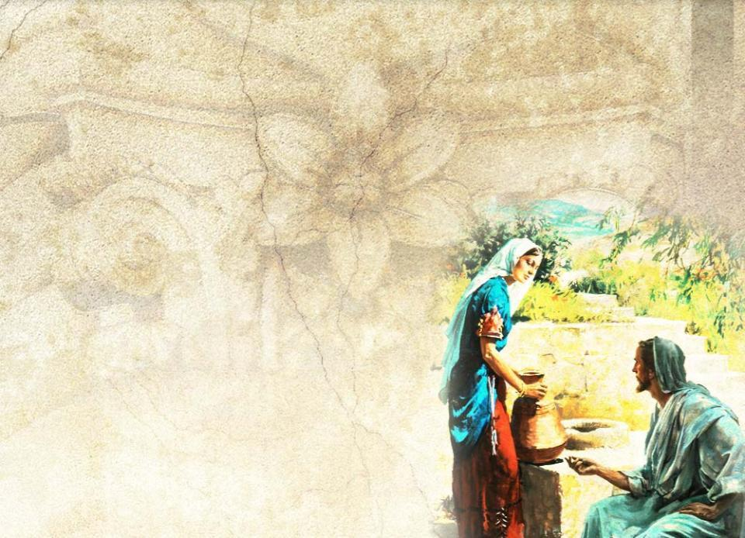
Scripture shows that the early church family was diversity challenged.
The parable of the Good Samaritan challenged Jewish prejudice.
(Luke 10:30-37)
The disciples were
surprised to find Jesus
talking to one who was
both a woman and a
Samaritan. (John 4:1-29)

Slide 43

God had to send a vision to Peter to show him that he should not call any person unclean. (Acts 10:17-29)
Converted Pharisees insisted that Gentile Christians must
be circumcised and follow
Mosaic laws. (Acts 15:5-10)

Slide 44
Peter quit associating with Gentile Christians because he feared Christian legalists from Jerusalem. (Gal 2:7-14)
Gentiles were looked down upon and called “the uncircumcised ones” by Jews. (Eph 2:11-19)
Before his conversion, Paul, the preeminent Jew, persecuted Christians. (Acts 8:1-3; 9:1,2)
Jewish Christians looked down on their Gentile brethren.
Even Barnabas, who conducted the first missionary work among Gentiles with Paul, withdrew from fellowship with them.
(Gal 2:11-13)

Slide 45

Conversion Changed Paul’s Response to Diversity
At Damascus, Paul received
an identify transplant.
His encounter with the risen Christ
deconstructed his inherited identity
replaced it with another primary identity

Slide 46


When Paul became a new creature in Christ
perceptions of the world,
perceptions of society,
priorities,
ambitions,
criteria of perception
NEW
separated Paul from his former identity.

Slide 47
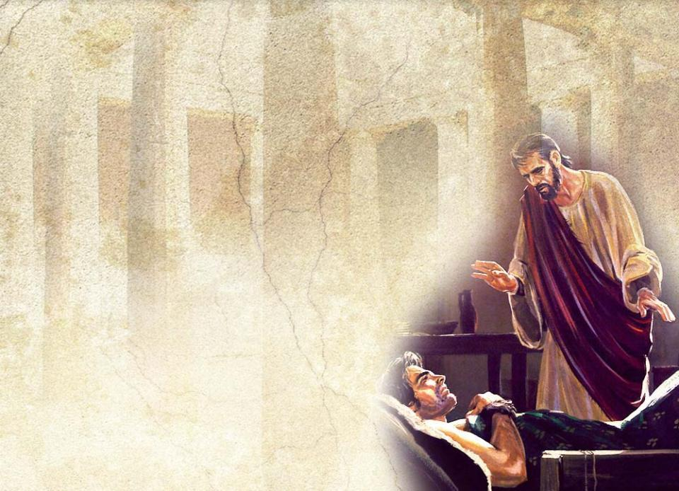
In our next session, we will examine three changes that
marked the new Paul
should mark us as leaders in
God’s new faith community
WARNING: while you are free to copy and translate the text of the content of this DVD for training purposes within the Seventh-day Adventist Church, illustrations are owned by various entities that have provided us limited use rights. DO NOT COPY OR USE THE ILLUSTRATIONS WITHOUT OBTAINING LICENSES AND PERMISSION TO DO SO IN ADVANCE.

