Slide 2
Leadership Skills for New Appointees: What New Leaders Need to Know
Niels-Erik Andreasen Global Leadership Summit—February 9-11, 2016 Jerusalem, Israel

Slide 3
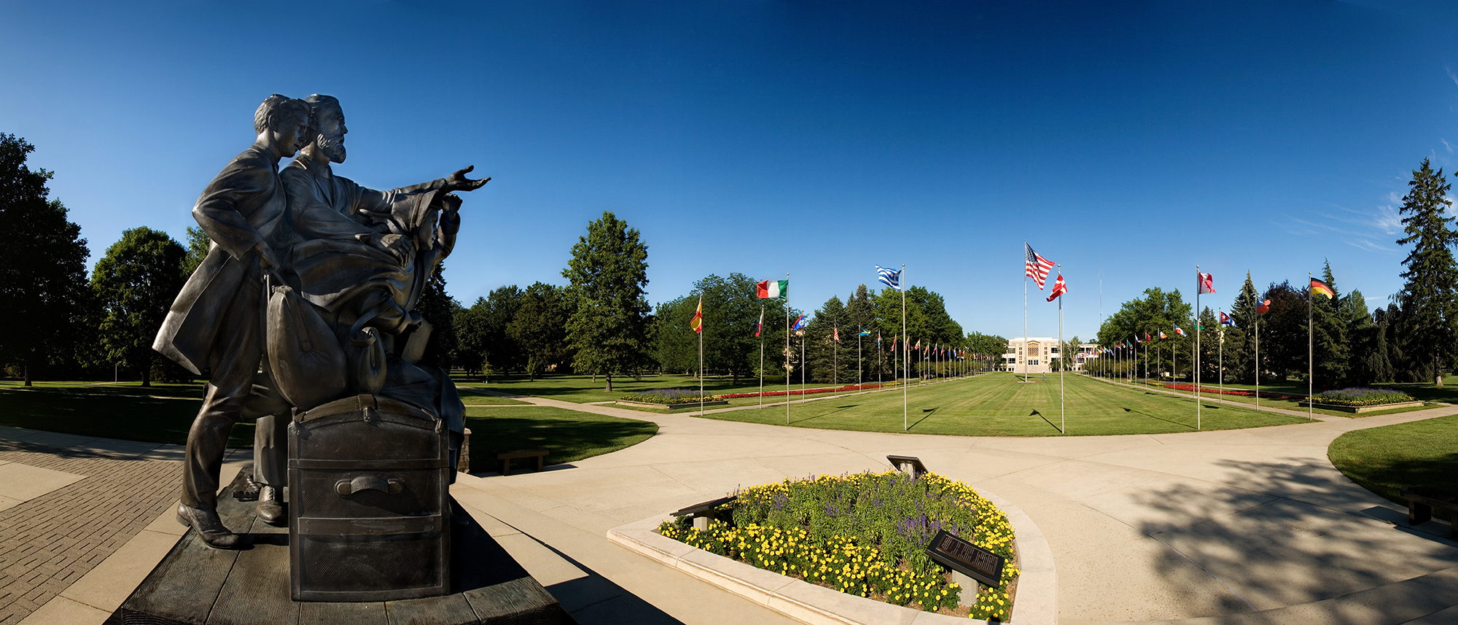

Slide 5
A few ground rules for new leaders
Do not be a copycat leader, be yourself.
Remember David and Goliath: "Fight" in your own armor.
Prepare for leadership, it does not just happen.
Remember young king Solomon: "I am but a child."
Stay humble: Pride goes before the fall.
Remember king Nebuchadnezzar: “Is this not the great city I have built."

Slide 6
A few ground rules for new leaders
Resist the temptations of leadership: Perks and recognition cloud judgment.
Remember Lemuel's mother: "Do not spend time on what ruins kings."

Slide 7
QUESTION I. Core leadership values: What does the new leader bring to the position?

Slide 8
Core leadership values: What does the new leader bring?
Text: "But one thing I do: Forgetting what is behind and straining toward what is ahead, I press toward the goal to win the prize for which God has called me heavenward in Christ Jesus." (Phil 3:13)
Note: The leader brings specific personal traits and core values to the new position. They can be honed, developed, matured. But in the end they become associated with the leader, more than with the position. They are personal values—what defines the leader deep inside—when no one is looking. There is no single set of core values for every leader, but the core values of each must fit the position to which the leader is called.

Slide 9
Illustration: Core values of GC presidents I have known
Reuben R. Figuhr: The planner
(1954-1966)
Robert H. Pierson: The pastor
(1966-1979)

Slide 10
Illustration: Core values of GC presidents I have known
Neal C. Wilson: The administrator
(1979-1990)
Robert S. Folkenberg: The communicator
(1990-1999)

Slide 11
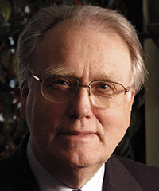
Illustration: Core values of GC presidents I have known
Jan Paulsen: The mission-theologian
(1999-2010)
Ted N.C. Wilson: The reformer
(2010- )

Slide 12
How are a leader’s core values formed? It is a lifelong process.
Home and upbringing
Schooling and education
Work and colleagues
Personal response to life’s challenges and opportunities.

Slide 13
Illustration: Winston S. Churchill (1874-1965)
The second son of an earl, father English, mother American, military education, soldier and adventurer, brave and foolhardy, romantic, politician, period of depression, writer, government service, Lord of Admiralty, prime minister, war leader, peace time leader (did he ever learn when to quit?). What were his core values? Preserving and protecting human freedom and dignity—western civilization!

Slide 14
Illustration: Aung San Sue Kyi (1945- )
Born in Burma (Myanmar) into a prominent family, educated in India, Oxford and London, formed a strong desire to introduce democratic principles into her country. For this she was kept under house arrest by the military for more than 15 years. During these years in isolation her English-born husband Michael died from cancer and two sons Alexander and Kim grew up far away.

Slide 15
Illustration: Aung San Sue Kyi (1945- )
She received multiple international honors for her leadership, including the Nobel Prize which she was unable to accept until the end of her house arrest. Her National League for Democracy won a major victory (Nov, 2015), but Sue Kyi is prevented from serving as head of government because her two sons are foreign nationals. Her core values: Freedom and democracy for Myanmar.

Slide 16
CONCLUSION: Core values do more for effective leadership than almost anything else, including intelligence, education, experience and natural talents.

Slide 17
QUESTION II. New wineskin for new wine: how does the new leader bring renewal?

Slide 18
New wineskin for new wine: how does the new leader bring renewal?
Text: Jesus said: "And no one pours new wine into old wineskins. If he does, the wine will burst the skins, and both the wine and the wineskins will be ruined. No, he pours new wine into new wineskins" (Mark 2:22)
Note: The new leader first examines the existing ways of doing things, established policies, previous practices, standard procedures, expected outcomes. Then proceeds to assess what might happen with a new and more effective way of leading. What are the risks and opportunities? How much leeway does the organization allow for change, how much of a "dare" by the new leader is too much? What new approaches (new wine) should be considered? Can the organization (wineskins) cope? What are the limits to renewal without destroying what is? Are there costs?

Slide 19
ILLUSTRATIONS: Two leaders who were forced to use new wineskins for their new wine.

Slide 20
Stephen Jobs (1955-2011) The inventor of Apple products
Macintosh 128k (1984)
MacBook (2015)
9-inch black and white screen with 512 x 342 resolution
Motorola 68000 8 MHz processor
128 KB RAM
400 KB storage via 3.5” floppy disks
15.4‑inch (diagonal) LED‑backlit Retina display
2.2GHz, 2.5GHz, or 2.8GHz quad‑core Intel Core i7 processor Turbo Boost up to 4.0GHz
Up to 9 hours battery life
Up to 1TB flash storage

Slide 21
New wineskin for new wine: how does the new leader bring renewal?
Note: Steve Jobs and Steve Wozniak invented the highly successful Mac computer in Steve's family garage. His drive for renewal frightened his managers, and he was let go. Sought to introduce a new product, “Next,” mostly unsuccessfully. Apple was failing. Returned to Apple and developed a series of startling new products: iPhone, iPod, iPad, iMac, Macbook etc. Lesson: Old wineskins like old companies and products can burst when filled with new wine. That can cost your job—new leadership holds risks! But risks can be calculated, new wineskins can be introduced, prayerfully and thoughtfully, and renewal can take place.

Slide 22
H.M.S. Richards (1894-1985) The founder of media ministry
Radio studio (1929)
South American Division (2015)
Media ministry: 24/7 radio/TV broadcasts throughout South America

Slide 23
New wineskin for new wine: how does the new leader bring renewal?
Note: Richards began as a traditional evangelist preaching in tents. Wanted to reach more people and thought about radio broad casting, though the radio was frowned upon among church leaders and members at the time. He proceeded anyway broadcasting from his garage in Glendale, California. Why does radical renewal always begin in people's garages or basements!! Added music to his preaching (King's Heralds, and Del Decker). Shortened his programs to 18 minutes, including music and announcements. And the world listened. Led to the California media center the Adventist World Radio, and multiple Adventist media centers. Lesson: new directions will likely meet with opposition, the leader may be alone, until a new wineskin is provided for the new wine.

Slide 24
CONCLUSION: New ideas and directions (new wine) can be threatening to the establishment until organizational renewal (new wineskins) are provided. Do not pour new wine into old wine skins! Renew the wine skins first, then pour the new wine in. There are risks associated with renewal, but there are greater risks associated with status quo.

Slide 25
QUESTION III. New directions in leadership: how do leaders come upon them?

Slide 26
New directions in leadership: how do leaders come upon them?
Text: What eye has not seen, no ear heard, no mind has conceived, (that is) what God has prepared for those who love him" (1 Cor 2:9)
Note: To capture what is truly new and promising in leadership, the new leader puts on hold standard practices that take most leaders hostage and keeps them from finding renewal in their new roles. How to break out of that captivity? The answer is imagination, enabling the leader to see what no eye has seen, no ear heard, no mind conceived. The truly new leader becomes an artist—a visionary!

Slide 27
ILLUSTRATION: Two leaders who began with imagination as artists do.

Slide 28
Rembrandt van Rijn (1606-1669) The portrait of a young man/Jesus
Notes: 17th century Holland. The reformation has swept through northern Europe, the Bible is translated, the church is stripped of saints and relics, the Latin mass is out, preaching in the vernacular is in. Church walls are whitewashed, images are out. What was Jesus really like, and what did Jesus look like? What kind of person was he? Rembrandt read the word of the gospels to let his imagination capture Jesus in the gospels.

Slide 29
Rembrandt van Rijn (1606-1669) The portrait of a young man/Jesus
Then he sent for young men from the Jewish ghetto in Amsterdam—the descendants of Jewish families who had fled the inquisition in Spain.
This artist's imagination, led to a more real, human, image of Jesus (than the Italian renaissance painters had ever produced), and that made the artist a leader in a new protestant understanding of "a real" Jesus by using his sanctified imagination. No one else could see it until he led the way.

Slide 30
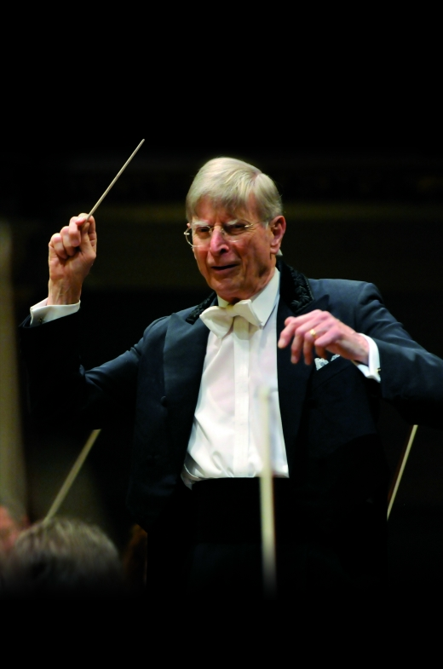
Herbert Blomstedt (1927- ) Conductor and artistic director
Notes: Born into a Swedish Adventist pastor's family with early gifts in music. Became director of symphonies in Sweden, Norway, Denmark, Germany (Dresden; Leipzig), USA (San Francisco), et al. Attributes his longevity and vitality to the Adventist lifestyle and to his spiritual nurture through music. Interpreter of the classical European composers by disclosing the spiritual quality of their music.

Slide 31
Herbert Blomstedt (1927- ) Conductor and artistic director
As an artist Blomstedt hears without the sound of instruments that which others can only hear with them. That makes him a leader in music, worship, devotion, piety, witnessing, community spirituality—all these bring renewal through sanctified imagination, or vision as the Bible calls it. Blomstedt leads by sharing a spiritual approach to the performance of music.

Slide 32
CONCLUSION: Sanctified imagination may seem a strange quality of a new leader but it is in fact a gift from God, who gives his leaders that gift, generally called "vision" in the Bible before he sends them to lead his people. Imagination enables the leader to make a leap from “what is” to “what can be.” There is no natural connection between the two—no evolution from one to the the other. Only imagination can take the leader to “what can be.”

Slide 33
Think of some visionary leaders in Scripture:
Abraham imagined (saw) a new city though he lived in tents
Moses saw the land of milk and honey, though he lived in a desert.
David saw a new kingdom though the Jebusites were in control of its capital.
Isaiah saw the coming king the year the king died.
Zachariah saw the faithful city (New Jerusalem) where children could play in peace and their grandparents watch them in safety during the Persian occupation.
They were like artists (visionaries). That made them new leaders.

Slide 34
QUESTION IV. Leading responsibly: what is leadership responsibility?

Slide 35
Leading responsibly: what is leadership responsibility?
Text: John 21: 15-16 "When they had finished breakfast Jesus said to Simon Peter, “Simon, son of John, do you love me more than these?” He said to him, "Yes Lord; you know that I love you.” He said to him, "Feed my lambs."

Slide 36
Leading responsibly: what is leadership responsibility?
Note: Passion, core values, willingness to take risks, imagining new possibilities are important characteristics of good leaders. But taking responsibility is an essential trait. The leader bears the ultimate responsibility for the organization, the communities it serves, the people who work within it and their dependents. More importantly, the leader is responsible for the cause the organization serves, its reputation, the good it is called to do, its place in history, its integrity. That is the greatest burden of leadership.

Slide 37
ILLUSTRATION: Responsible leaders

Slide 38
Siegfried H. Horn (1908-1993) Biblical archaeologist
Note: German-born pastor missionary to Indonesia. Imprisoned by the Dutch authorities in WWII. Spent his prison years preparing for his future studies (Walla Walla, Andrews, University of Chicago) in Egyptology. Became a seminary professor and field archaeologist at Shechem, and later Heshban. Horn was a walking encyclopedia on the Near Eastern archaeology and the background of the Bible, yet as a minister in the Adventist church he took responsibility for discovering and sharing evidence in support of his church's teaching and belief.

Slide 39
Siegfried H. Horn (1908-1993) Biblical archaeologist
Horn's responsibility: to eschew sensationalism and fantastic claims, and to provide accurate, reliable information about the Bible, its history, and its message.

Slide 40
W.H. Anderson (1908-1993) Missionary in South Africa, Rhodesia and Zambia
W.H. Anderson attended but did not graduate from Battle Creek College/Andrews. Instead he and his wife became frontier missionaries in South Africa, then Rhodesia and what is now Zambia. He traveled by oxcart and established mission stations that exist to this day. He lost his wife to black water fever, but never flinched in his duties. When faced with illness and death all around, and even when encouraged to return home, he stayed and wrote, “Send more missionaries, to replace those who died.” Andersen's responsibility: to press the Adventist message into the heart of Africa in the face of all odds.

Slide 41
Leona G. Running (1916-2014) Woman teacher in a man’s world
L.G. Running graduated from Andrews and became a secretary to several church officials. They took advantage of her secretarial, editorial and writing skills to advance the church's cause, but did not seek to advance her status until S.H. Horn, noticing her language abilities persuaded her to study ancient Near Eastern languages and literature (Syriac) with W.F. Albright in John Hopkins. That equipped her to teach and enabled her to conclude her career as the only woman seminary teacher in the Adventist church for decades.

Slide 42
Leona G. Running (1916-2014) Woman teacher in a man’s world
She fulfilled her teaching responsibilities in a male-dominated seminary with unflinching loyalty to her church. Running's responsibility: to enable pastors to read the Scriptures in the language God chose for their composition, and indirectly to pave the way for women to serve the church at the most responsible point in ministry where the mind of God and the mind of the pastor meet.

Slide 43
CONCLUSION: The new leader will discover and hone his or her core values; identify new wineskins for new ideas and directions in leadership; use sanctified imagination to gain brand new and creative insights that others have missed; and take personal responsibility for the organization being led, it's mission and all those associated with it.

