Slide 1


Effective Seventh-day Adventist Leaders’
General Conference of Seventh-day Adventists
Office of Global Leadership Development
Prepared by: Lowell C Cooper
January 2010

Slide 2

Legal Notice and Terms of Use
Copyright 2010 by the General Conference of Seventh-day Adventists®. All rights reserved. The information is provided for training purposes only and is not intended nor should it be used as legal counsel. This program may not be used or reformulated for any commercial purposes; neither shall it be published by any person or agency other than an official organizational unit of the Seventh-day Adventist® Church, unless prior written authorization is obtained from the General Conference of Seventh-day Adventists® Office of Global Leadership Development. Subject to the foregoing terms, unlimited permission to copy or use this program is hereby granted upon inclusion of the copyright notice above. “Seventh-day Adventist” and “Adventist” are registered trademarks of the General Conference of Seventh-day Adventists® and may not be used by non-Seventh-day Adventist entities without prior written authorization from the General Conference. Use of all or any part of this program constitutes acceptance by the User of these terms.

Slide 3
Instructions to presenters:
Slides #6 through #11contain words that are underlined.
Clicking on an underlined word will advance the program to a slide that expands/explains the concept more fully.
To return to the slide that contained the underlined word, click on the return arrow in the lower right-hand corner of the slide.

Slide 4
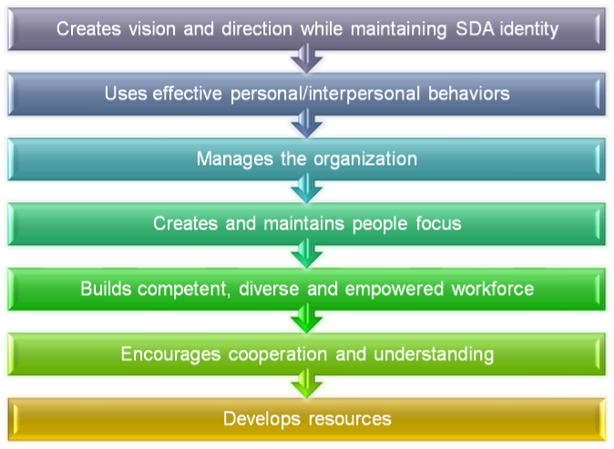
Core Competencies

Slide 5
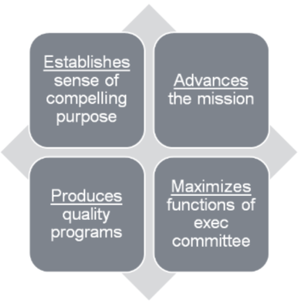
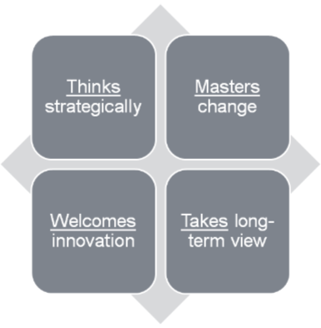
Creates vision/direction while maintaining SDA identity

Slide 6
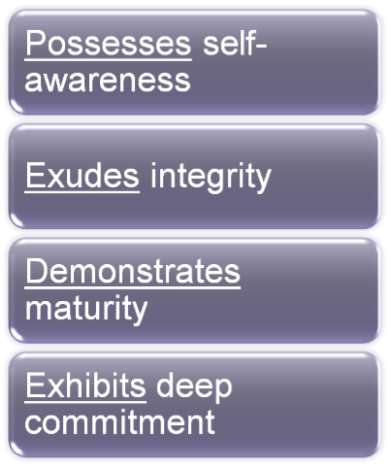
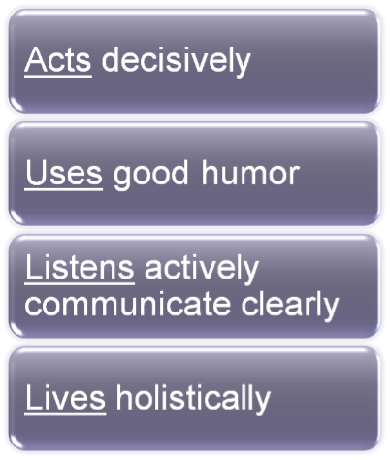
Uses effective behaviors

Slide 7
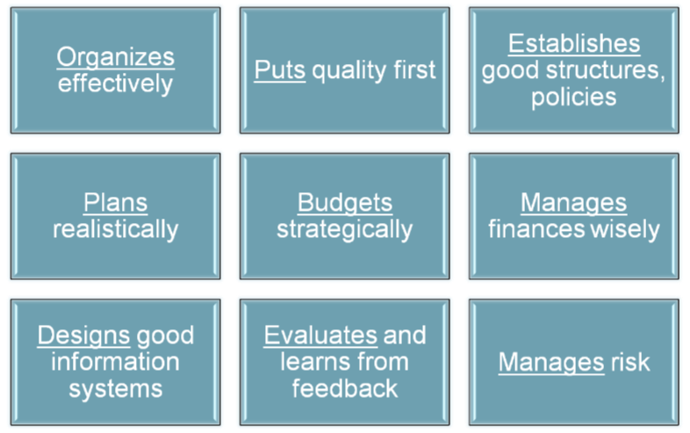
Manages the organization

Slide 8
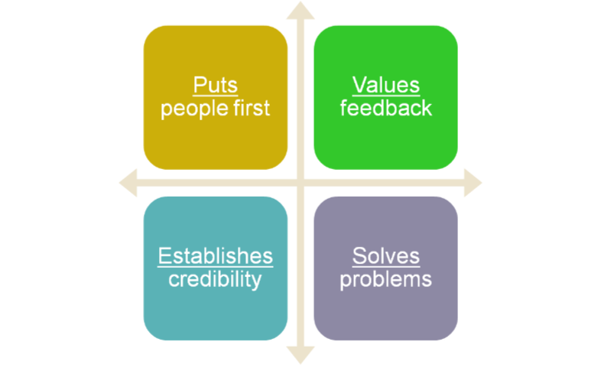
Creates/maintains people focus

Slide 9
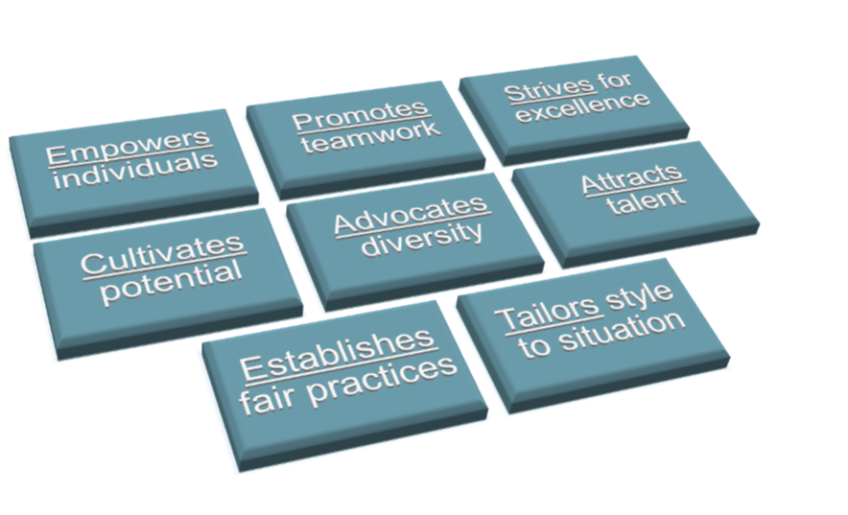
Builds empowered workforce

Slide 10







Cooperation & understanding
Fosters collabor-ation
Promotes mutual under-standing
Resolves conflict construct-ively
Masters use of media
Builds commun-ity
Engenders peer rapport
Practices good PR

Slide 11
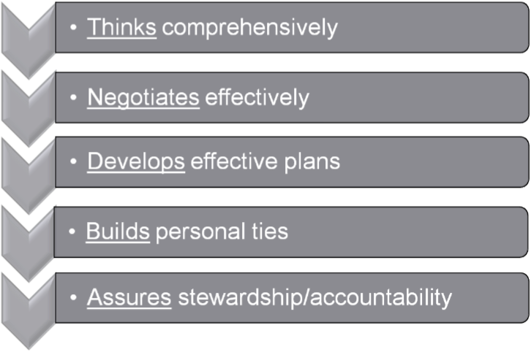
Develops resources

Slide 12

Establishes sense of purpose
creates and communicates a compelling sense of organizational purpose
articulates mission in a manner that inspires heart and spirit of members
cultivates shared goals and rallies support for those goals
preserves denominational identity and relationships

Slide 13
Advances the mission
builds a mission-driven organizational culture
articulates/espouses guiding philosophy and core values supporting mission
focuses attention and resources on strategies employed to uphold mission

Slide 14
Produces quality programs
ensures that sound programs and services are developed/aligned to achieve mission
establishes priorities to guide programs
directs resources to priorities

Slide 15
Maximizes exec committee
constructs exec comm membership to create strong mix of talents, expertise and representation needed to meet current and emerging needs
involves the executive committee in setting direction
clarifies and reinforces division of roles and responsibilities between executive committee and administration.

Slide 16
Thinks strategically
Senses trends impacting the organization’s future environment
Dares to think big and is willing to stretch the organization
Sees the possibilities inherent in new ideas, practices and services
Positions organization to benefit from new opportunities

Slide 17
Masters change
Anticipates, initiates and responds well to change
Views change as opportunity
Manages the organization's understanding of change
Builds commitment for tough choices to cope with change

Slide 18
Welcomes innovation
Commits to continuous innovation and improvement
Exhibits keen judgment about which creative ideas/suggestions will work
Fosters creativity of others
Facilitates effective brainstorming

Slide 19
Takes long-term view
Focuses primarily on long-term solutions instead of "quick fixes“
Perseveres
Maintains clear sense of purpose and direction over time

Slide 20
Possesses self-awareness
Knows personal strengths/weaknesses
Values self-understanding
Solicits feedback/coaching from others
Actively works on personal growth and development
Acquires new skills and abilities to meet the demands of changing situations

Slide 21
Exudes integrity
Engenders trust in others through direct and truthful interactions
Keeps confidences
Honors commitments
Trusts others, performs with integrity
Interacts in a forthright manner
Acts consistently on ethical set of core values

Slide 22
Demonstrates maturity
Accepts accountability for own behavior
Learns from personal mistakes
Acknowledges own contribution to a problem
Acts swiftly to accept responsibility and correct errors

Slide 23
Exhibits deep commitment
Demonstrates passionate commitment to the organization
Projects devotion to achieving the goals of the organization

Slide 24
Acts decisively
Makes good decisions
Encourages lively debate and diverse opinions to improve quality of decision-making
Acts even without total information
Accepts responsibility for decisions.

Slide 25
Uses good humor
Possesses a positive and constructive sense of humor
Laughs at himself/herself and others
Uses humor appropriately

Slide 26
Listens/communicates well
Listens actively and genuinely
Resists dominating discussions
Makes others comfortable to talk
Possesses patience to "hear people out“
Restates other’s opinions accurately
Expresses self clearly
Minimizes status barriers

Slide 27
Lives holistically
Practices a conscious and healthy balance between work and personal life regardless of ambitions
Models this balance for others

Slide 28
Organizes effectively
Possesses superior organizing ability
Marshals resources to get things done
Lays out work in a well-planned way
Delegates responsibilities/tasks clearly

Slide 29
Puts quality first
Establishes environment and processes leading to continuous improvement
Understands total-quality concepts and techniques and leads organization in implementing them

Slide 30
Structures the system
Structures the organization to achieve integration, cooperation and efficiency
Establishes appropriate policies, practices and procedures to ensure coordination among all parties
Fine-tunes on a regular basis

Slide 31
Plans realistically
Develops short- and long-range plans that are comprehensive, realistic and effective in meeting goals
Integrates planning efforts across work units
Institutes ways of translating agency plans into targets and standards which guide the work of each employee

Slide 32
Budgets strategically
Manages the budgeting process so that resources are devoted to top priorities
Develops realistic budgets that can be responsive to changing circumstances
Involves board and staff in budget process to ensure their understanding of and commitment to budget allocations and constraints

Slide 33
Manages finances soundly
Institutes sound accounting, investment, property management, financial control and reporting policies and procedures
Anticipates financial challenges and works with others to select and implement successful ways to meet the circumstances

Slide 34
Designs good info system
Creates effective management information systems to monitor the status of people, programs and resources
Establishes effective processes for storing, retrieving and updating information to support the organization’s functioning
makes appropriate use of technology

Slide 35
Evaluates efforts
Knows what to measure and how to measure it
Defines both quantitative and qualitative measures of the organization's success
Gives and receives feedback on the quality of products and services
Uses data for improvement; documents and evaluates results
communicates results effectively

Slide 36
Manages risk well
Ensures sound risk management
Establishes necessary policies, practices and procedures to prevent and/or respond to safety and legal issues
Stays abreast of laws affecting nonprofit operations

Slide 37
Puts people first
Builds an organization that cares about the people it serves
Respects individuals
Ensures that services are provided to effectively respond to cultural, ethnic and socioeconomic diversity in the community served

Slide 38
Values feedback
Encourages and listens to member feedback
Uses this feedback to improve the organization's management and services

Slide 39
Establishes credibility
Establishes and maintains effective communications and relationships with members
Gains their belief in the organization.

Slide 40
Solves problems
Acts swiftly to solve problems
Responds to client in a timely manner

Slide 41
Empowers the individual
Encourages and empowers others to succeed
Shares both responsibility and accountability
Supports employees to take responsible risks
Creates a blame-free environment

Slide 42
Promotes teamwork
Fosters esprit de corps
Encourages formal and informal cooperation
Assembles effective teams
Knows when to use teams
Inspires others to create teams

Slide 43
Strives for excellence
Creates a passion for excellence in others
Elevates morale by making everyone feel their work is important and recognizing their contributions
Rewards achievement and superior performance
Celebrates accomplishment

Slide 44
Cultivates potential
Coaches and develops others
Builds commitment to a learning environment
Assesses and communicates the strengths and development needs of employees
Provides growth opportunities
Helps others discover and fulfill their potential; shares expertise.

Slide 45
Advocates diversity
Values diversity at all levels of the organization
Sees the organization benefiting from diversity in experience, background and perspective
Hires variety and diversity
Ensures equal and fair treatment of others

Slide 46
Attracts talent
Seeks and hires strong and talented staff
Assembles appropriate mix of styles and skills among staff
Assesses staff performance accurately and regularly

Slide 47
Establishes fair practices
Sets appropriate human resource policies and procedures including equitable approaches to compensation and benefits
Knows and observes personnel rules and regulations
Sees that all employees receive regular and candid performance reviews

Slide 48
Tailors leadership style
Makes appropriate choices between directing, coaching, supporting and delegating as the situation warrants and as the needs of employees change
Operates with openness and receptivity to employees' feedback on how to better lead the organization

Slide 49
Promotes understanding
Understands member/community concerns accurately
Moves adeptly in complex political and social circles
Maintains sensitivity or how people and organizations function
Gets things done through formal and informal channels
Builds rapport with key players

Slide 50
Builds community
Commits to building community and interdependence
Promotes effective relations among diverse racial, ethnic, political and socioeconomic groups

Slide 51
Masters use of media
Presents information to the media in a highly skilled fashion
Responds effectively to challenging questions
Provides responses in proper format for each medium
Creates personal networks and maintains good relations with key media players

Slide 52
Practices good PR
Knows how to develop and implement an effective public relations strategy to foster widespread understanding and support of the organization's programs and activities
Uses public relations to establish and maintain the organization's credibility
Exercises superior oral and written skills

Slide 53
Fosters collaboration
Encourages cooperation and collaboration with other organizations
Seeks ways to improve services and/or reduce costs through cooperative efforts
Shares expertise with others to achieve partnerships
Organizes and operates partnerships effectively

Slide 54
Engenders peer rapport
Values/builds peer relationships based on respect, trust and mutual support
Pushes for the common good while representing his /her organizations interests
Acts with fairness toward other groups

Slide 55
Resolves conflicts
Promotes win-win solutions
Negotiates conflict effectively among different constituencies and interest groups
Bargains with competing interests in a fair and skillful manner

Slide 56
Thinks comprehensively
Understands fully the resources required for the agency’s operational and capital purposes and the array of public and private resources suitable to meet those needs

Slide 57
Negotiates effectively
Maintains integrity of the organization’s mission, values and programs while helping funding sources achieve their aims
Views relationship with funders as a partnership involving mutual reciprocity

Slide 58
Develops effective plans
Develops effective short-term and long-term strategies for obtaining the appropriate mix of resources needed

Slide 59
Builds personal ties
Engenders the trust and respect of donors and those heading key sources of support
Cultivates future support by developing personal relations with potential donors
Maintains good relationships and communications with donors

Slide 60
Assures stewardship
Establishes routine processes to support fundraising, marketing and documentation of compliances with requirements of all funders and donors
Maintains accountability
Uses contributions as they were intended to be used
Ensures ethical behavior in all aspects of resource development

