Slide 1
Financial Audits
Towards accountability and credibility in leadership
General Conference of Seventh-day Adventists
Office of Global Leadership Development
Prepared by: Lowell C Cooper
January 2010

Slide 2
Legal Notice and Terms of Use
Copyright 2010 by the General Conference of Seventh-day Adventists®. All rights reserved. The information is provided for training purposes only and is not intended nor should it be used as legal counsel. This program may not be used or reformulated for any commercial purposes; neither shall it be published by any person or agency other than an official organizational unit of the Seventh-day Adventist® Church, unless prior written authorization is obtained from the General Conference of Seventh-day Adventists® Office of Global Leadership Development. Subject to the foregoing terms, unlimited permission to copy or use this program is hereby granted upon inclusion of the copyright notice above. “Seventh-day Adventist” and “Adventist” are registered trademarks of the General Conference of Seventh-day Adventists® and may not be used by non-Seventh-day Adventist entities without prior written authorization from the General Conference. Use of all or any part of this program constitutes acceptance by the User of these terms.

Slide 3
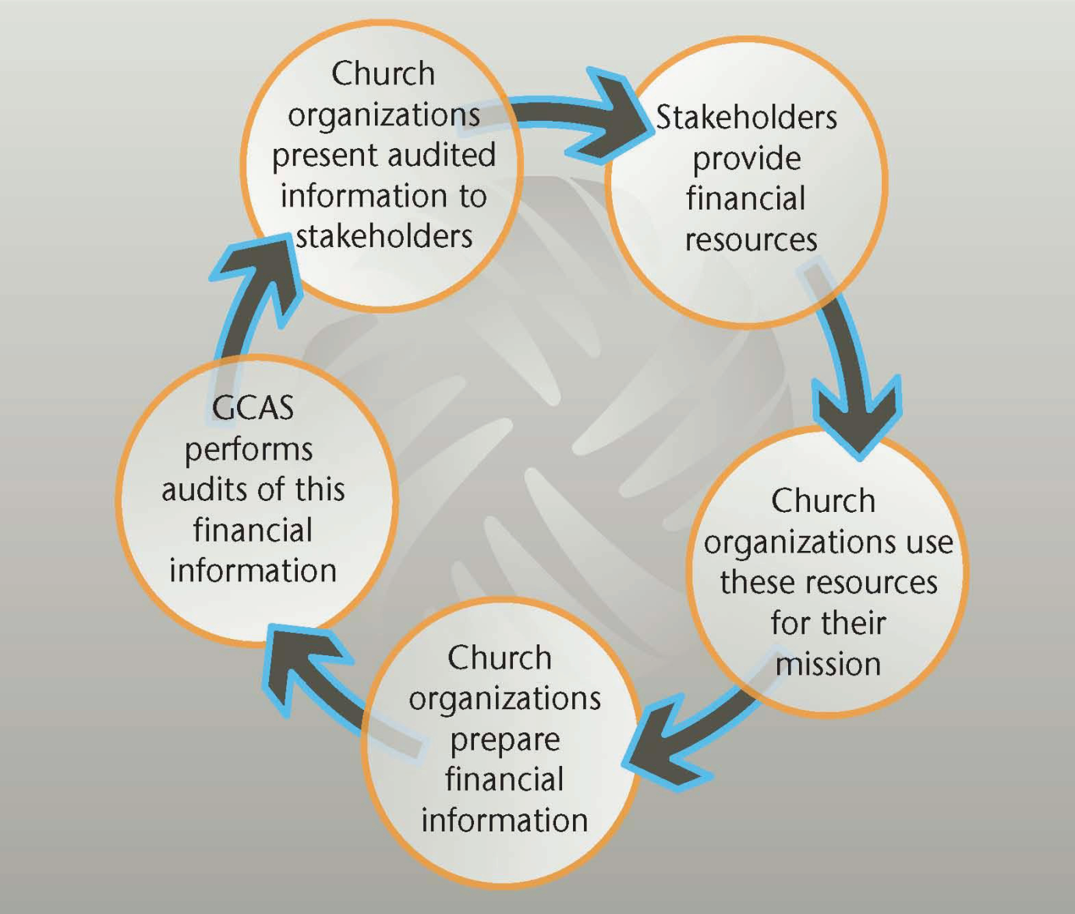
The Credibility Cycle

Slide 4
The purpose of conducting financial audits is to enhance the credibility of financial information prepared and presented by Church organizations.
When this credibility cycle functions at its optimum, it increases the confidence and trust of Church members that their leaders are being faithful stewards of God’s resources.

Slide 5
A financial audit is the examination by an auditor, in accordance with generally accepted auditing standards, of the assertions of management as embodied in its financial statements, to enable the auditor either to express or to disclaim an opinion on the fairness with which the financial statements present the entity's financial position, results of operations, and cash flows in accordance with generally accepted accounting principles.

Slide 6
Management’s responsibilities
Proper recording of transactions to permit preparation of financial statements in conformity with reporting standards.
Maintain appropriate internal controls.
Prepare financial statements.
Provide information as need to the auditor
Ensure compliance with laws and policies

Slide 7
Categories of Auditor Opinions:
Standard or Unqualified
Qualified
Adverse
Disclaimer

Slide 8
#1 Standard/Unqualified Opinion
The auditor concludes that the overall financial statements are fairly represented since the financial reporting system and audit process meet five standard conditions.

Slide 9
#1 Standard/Unqualified Opinion
Five conditions:
All statements (balance sheet, income statement, retained earnings, cash flows) are included in the financial statements.
Three general standards of auditing have been followed in the audit engagement.
Auditor must have adequate technical training and proficiency
Auditor must maintain independence in mental attitude in all matters related to the audit.
Auditor must use due professional care during the performance of the audit and the preparation of the report.

Slide 10
#1 Standard/Unqualified Opinion
Five conditions:
All statements (balance sheet, income statement, retained earnings, cash flows) are included in the financial statements.
Three general standards of auditing have been followed in the audit engagement.
Sufficient appropriate evidence preserved.
Financial statements comply with financial reporting standards.
No circumstances requiring modification of report.

Slide 11
#2 Qualified Opinion
The auditor concludes that the overall financial statements are fairly represented, but the scope of the audit has been materially restricted or generally accepted accounting principles were not followed in preparing the financial statements.

Slide 12
#3 Adverse Opinion
The auditor concludes that the financial statements are not fairly presented.

Slide 13
#4 Disclaimer Opinion
The auditor concludes that he or she is unable to form an opinion as to whether the financial statements are fairly presented, or he or she is not independent.

Slide 14
Policy Compliance Reports
Standard Report
Non-standard report
The report does not mention any instances of non-compliance with denominational policy.
The report does mention instances of non-compliance with denominational policy.

Slide 15
Management Assertions: (w.e.f. 2009 audits)
Financial controls
Financial Audit Review Committee
Funds borrowed from church members
Conflict of interest declarations
Working capital
Contributions to retirement funds up to date
Insurance coverage in harmony with policy

Slide 16
Management Assertions: (contd)
Formation of new legal corporations
Investments and securities
Split-interest agreements
Debt and other liabilities
Revenue
Payroll

Slide 17
What is fraud?
Misstatement of financial statements
intentional misstatement or misleading disclosure
misappropriation of assets
Fraud, unlike error, is intentional and usually involves concealment of facts

Slide 18
Environment factors for fraud
Incentive or pressure provides motivation
Attitude or rationalization that permits dishonesty
Opportunity (ineffective controls or management ability to override controls)

Slide 19
Incentives or pressure
High personal debt
Significant personal losses
Inadequate income
Living beyond means
Bribery
Perception of unfair treatment by employer
Job frustration
Strong social pressure for financial success

Slide 20
Opportunities for fraud
Familiar with procedures/exploit gaps
Rapid turnover of employees
Constantly operating under crisis conditions
Lack of security and internal controls
Absence of mandatory vacations
Ineffective supervision

Slide 21
Auditor’s Opinion—global summary 2008
Most frequent reasons for a Qualified Opinion:
Assets not recorded on financial statements
State of the accounting records
Unable to obtain sufficient appropriate audit evidence
Unable to verify numerous outstanding items on account reconciliations
Inadequate provision for bad debts

Slide 22
Auditor’s Opinion—global summary 2008
Most frequent Working Policy violations:
Missing or improperly constituted Financial Audit Review Committee
Inappropriate use of tithe and ingathering funds
Missing Conflict of Interest Statements
Adequacy of insurance coverage
Local Church reviews not performed
Employee service records not updated and signed
Monthly financial statements not prepared and presented
Investments made in instruments not allowed
New corporations formed without approval

Slide 23
Auditor’s Opinion—global summary 2008
Most frequent Internal Control deficiencies:
Management Override
Inadequate segregation of duties
Insufficient understanding of accounting principles
Inadequate oversight of financial reporting system
Opening of unauthorized bank accounts
Bank and inter-organizational accounts not reconciled
Tithe reporting from local churches not monitored
Lack of authorizations for transactions

Slide 24
Processing audit information:
Auditor’s communications:
The audited financial statements
Auditor’s opinion on the financial statements
Audit Communication Letter (formerly “Letter to Management”)
Report on policy compliance testing
Management’s response to “Letter to management”
Review of all information by Audit Review Committee
Report by ARC to Board/Executive Committee
Summary report to Constituency meeting

Slide 25
Purpose of auditing
The objective is to provide administrators and governing boards within the scope of the audit an assurance on financial and nonfinancial information and its compliance with applicable professional standards, denominational policy and external regulations.

Slide 26
Administrator attitude towards auditing
Administrators should view auditors as allies rather than adversaries.
An ‘unqualified’ or ‘clean’ audit report helps the board/executive committee/constituency to have confidence in the integrity and competence of administration.

Slide 27
Time for questions/comments.

