Slide 1
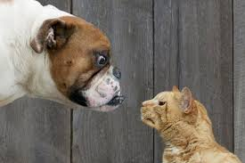
Dealing with Diversity and Differences
Conflict and Peacemaking
Using Christian Principles

Slide 2
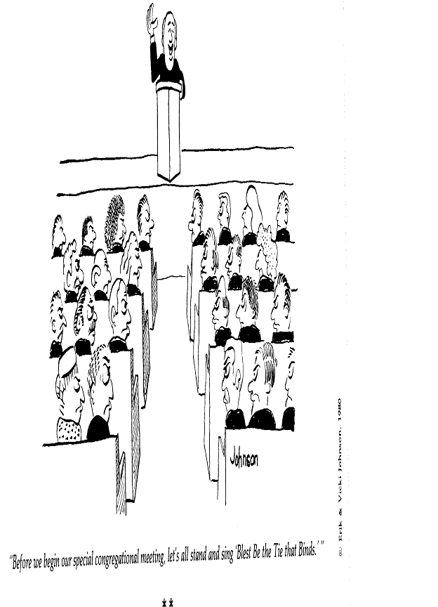
Are all differences bad?

Slide 3
But Where Does the Sin Lie?
Ephesians 4:29-32 Note the types of things listed.
A new paradigm:
Sinful Behavior
Conflict
Differences, but Controlled
KEY THOUGHT: Conflict in itself is not sinful or bad; it is the reactions (behavior, attitudes, thoughts) that result from conflict that determine whether it is sinful or not.
Compare to stress.
Compare to a disability.

Slide 4
Stages / Levels of Conflict
Stages and levels of conflict
Conflict
Tension Development - Problems to solve
Role Dilemma – Disagreement
Injustice Collecting - Contest
Negative Confrontation - Fight/Flight
Unresolvable - Intractable Situations
Intervention
Adjustments

Slide 5
Types of Conflict
Types according to the nature of the differences
Substantive Issues
Facts
Methods and Policies
Goals and Purposes
Values and Traditions
Communication Conflicts
Attitudinal Conflicts
Emotional Conflicts
Antagonistic Conflicts

Slide 6
Dealing with Differences
Particularly in the area of church matters
Including beliefs and values

Slide 7
Pillars of our Faith
“There are the main pillars of our faith, subjects which are of vital interest, the Sabbath, the keeping of the commandments of God. Speculative ideas should not be agitated; for there are peculiar minds that love to get some point that others do not accept, and argue and attract everything to that one point, urging that point, magnifying that point, when it is really a matter which is not of vital importance, and will be understood differently. Twice I have been shown that everything of a character to cause our brethren to be diverted from the very points now essential for this time, should be kept in the background.” {CW 77.1}

Slide 8
False Tests
“Some had been bringing in false tests, and had made their own ideas and notions a criterion, magnifying matters of little importance into tests of Christian fellowship, and binding heavy burdens upon others. Thus a spirit of criticism, fault-finding, and dissension had come in, which had been a great injury to the church. And the impression was given to unbelievers that Sabbathkeeping Adventists were a set of fanatics and extremists, and that their peculiar faith rendered them unkind, uncourteous, and really unchristian in character. Thus the course of a few extremists prevented the influence of the truth from reaching the people.” {Ev 215.3}

Slide 9
Old Landmarks
“The passing of the time in 1844 was a period of great events, opening to our astonished eyes the cleansing of the sanctuary transpiring in heaven, and having decided relation to God’s people upon the earth, [also] the first and second angels’ messages and the third, unfurling the banner on which was inscribed, “The commandments of God and the faith of Jesus.” One of the landmarks under this message was the temple of God, seen by His truth-loving people in heaven, and the ark containing the law of God. The light of the Sabbath of the fourth commandment flashed its strong rays in the pathway of the transgressors of God’s law. The nonimmortality of the wicked is an old landmark. I can call to mind nothing more that can come under the head of the old landmarks.” CW 30

Slide 10
Different Interpretations of Scripture
“Christ prayed that His disciples might be one, even as He and His Father are one. In what does this unity consist? That oneness does not consist in everyone having the same disposition, the very same temperament, that makes all run in the very same channel. All do not possess the same degree of intelligence. All have not the same experience. In a church there are different gifts and varied experiences. In temporal matters there is a great variety of ways of management, and yet none of these variations in manner of labor, in exercise of gifts, need to create dissension and discord and disunion. 15MR 149.2

Slide 11
Different Interpretations of Scripture, continued
“One man may be conversant with the Scriptures, and some particular portion of the Scripture is especially appreciated by him because he has seen it in a certain striking light; another sees another portion as very important; and thus one and another presents -the very points to the people that appear of highest value. This is all in the order of God. One man blunders in his interpretation of some portion of the Scripture, but shall this cause diversity and disunion? God forbid. We cannot then take a position that the unity of the church consists in viewing every text of Scripture in the very same shade of light.” Manuscript Releases, 15:149.

Slide 12
Resolving or Managing Conflict
Conflict resolution – problem cleared up.
Conflict management – matter is contained.
A problem can be solved,
but a condition must be managed.

Slide 13
Resolving or Managing Conflict
Problem – a difference between an expectation and actual performance.
Condition – a state of variation from a norm.
Expectation
Difference
Performance
Norm

Slide 14
Acts 15:1-35
The Degree of Conflict
Vs 2 The conflict was a “sharp dispute and debate”
They appealed to the wider group of church leaders
Not an independent decision
But a group decision
Like Matt 18 “tell it to the church”

Slide 15
Acts 15:1-35
They moved toward consensus.
Each one spoke
A common theme began to be recognized.
James summarized and offered a proposal. Vs 13-19
“Having come to one accord” (vs 25) – consensus
“It seemed good to the Holy Spirit and to us” (vs 28)
Then they celebrated and worshipped (vs 31-33)

Slide 16
Acts 15:1-35
Methods and approach.
Vs. 6 Differing parties got together.
Vs. 7 They recognized the action of God in human life.
They accepted that as authority.
Then they formed a theology.
And found Scripture to support it. Vss. 15-18
Vs 12 Used an orderly process; gave freedom to speak; “the assembly kept silent;” they listened.
Peter spoke (vs 7); Paul & Barnabas (vs 12); James (vs 13)

Slide 17
Acts 15:1-35
Communicated the results in a letter, (vs 20, 23)
Sent the letter with people who were present to vouch for the letter.
An example of Conflict Resolution

Slide 18
Acts 15:36-41
Degree of Conflict
Vs 39 “A sharp disagreement”
(Close relationships often result in the sharpest conflict.)
Methods and approach.
Separated from each other
Agreed to disagree
Apparently contained their behaviors. See vs 40 “commended by the brothers to the grace of the Lord.”

Slide 19
Acts 15:36-41
Results
God used it for a blessing -- two missionary journeys instead of one.
An example of management
Later apparently resolved – Col 4:10; 2 Tim 4:11

Slide 20
Living With Diversity
Clarify the absolutely necessary boundaries for your group in beliefs and practices.
Don’t create tests of fellowship over things are not core essentials or absolutely Scriptural.
Agree to disagree on non-essentials.
If parties do not forcefully promote their views, and not create division, much more diversity can be tolerated. Attitudes are key.

Slide 21
Living with Diversity
Talk about diversity and give people permission to see things differently.
Be fair and inclusive with people of different views.
If a person is divisive and the issues are important, separation may be the only alternative.

Slide 22
Options
Attempt Agreement -- Reconcile differences
Attempt Compromise
Learn to live with diversity for the sake of the more central values.
Agree to disagree – manage the conflict
Separate from each other

Slide 23
CHAIRING TENSE MEETINGS
Create a climate of openness and friendliness.
Give an opening speech on process to set the climate.
The power of suggestion will influence behavior.
The speech is like an implied contract with the people.
Content of that speech:
Name the fact that there are differences.
Give permission to see things differently.
Point out the difference between conflict and sinful reactions to conflict.
Assure them of fairness and giving everyone a chance to speak.
Envision Christian approaches of mutual respect and courtesy.

Slide 24
Chairing Tense Meetings, cont.
Includes careful listening to one another.
Give people permission to influence one another, but in open, above-board ways.
Ask for agreement on some rules of process.
One person speak at a time.
A time limit on speaking.
No interruptions.
Keep volume down and speak in calm, Christian tones.
Chair’s right to intervene if we slip on the rules.

Slide 25
Sample speech
“Tonight we have some things to discuss in this meeting that involve differences of opinion. It is o.k. to see things differently. The differences are not the problem. Only if we react in unchristian ways does it become a problem. This means we will not want to attribute motives to others, or be critical or sarcastic, or make accusations. We will give everybody a chance to speak. We want to hear what you have to say. We may learn something. Try to convince us. But we will do it in calm, friendly ways, above board. We want to be open about the issues and listen carefully to each other. In order to do this we ought to have some rules to guide our process and discussion. (Repeat rules) Are these guidelines what you would like to follow?”

Slide 26
“Blessed are the peacemakers, for they shall be called sons of God.”
Matthew 5:9

