Slide 1


Barry Gane PhD
(Thank You Wayne French DMin)
4/12/2010
Notes:
Personal story about Roger Rietze and his influence on my life.
Ask for hands up of those who know that they have had a person that has had a great influence upon their life – especially when they were adolescents.
80% is normal and 80% can name that person.
Tell their stories

Slide 2

Whatever shapes the future takes . . . the men and women who guide . . . organizations will be different leaders than the ones we have become used to. They will be maestros not masters; coaches not commanders. Coaching will become the model for leaders in the future. Coaches teach, mentor, and empower. I am certain that leadership can be learned and that terrific coaches . . . facilitate learning. Warren Bennis
Warren Bennis cited in Gary R. Collins, Helping Others Turn Potential Into Reality: Christian Coaching Colorado Springs, CO.: NavPress, 2001.
4/12/2010

Slide 3

James Belasco believes
“Coaching is destined to be the leadership approach of the twenty-first century.”
Gary R. Collins, Helping Others Turn Potential Into Reality: Christian Coaching Colorado Springs, CO.: NavPress, 2001.
4/12/2010

Slide 4

Coaching:
is a collaborative partnership between the coach and person being coached.
involves dialogue rather than advice giving, discipline, or therapy.
is built on trust, integrity, self-discipline, and accountability.
is results-oriented, focused on reaching goals.
discusses weaknesses and obstacles but emphasizes strengths and positive changes.
assumes that people are resourceful and able to set goals and reach them.
4/12/2010

Slide 5

Coaching:
lets person being coached ‘define and move toward their goals with God’s help and the coach’s guidance.
helps people reach their peak performance.
assumes that life is integrated: We can’t assume that someone’s work, family life, personal history, spirituality, or lifestyle can be put into neat but separate compartments.
embraces change as something that is always occurring, sometimes confusing, often positive, and usually growth producing.
4/12/2010

Slide 6

"Coaching is not a spectator sport. A productive coaching relationship begins with two people with fires in their bellies: one who wants desperately to move forward and another who yearns to help that person make the journey."
Belasco, J.A., Coaching for Leadership. San Francisco: Jossey-Bass, 2000.
4/12/2010

Slide 7

reduced feelings of isolation
reduced stress and frustration / therapeutic benefits
increased confidence and self-esteem
the opportunity to reflect on the new role
an accelerated rate of learning
professional growth
improved personal skills, including communication / political skills
improved technical expertise / problem analysis
support in relinquishing any previous professional identity
friendship
4/12/2010

Slide 8

Mentoring is a dynamic, intentional relationship of trust where one person enables another to maximise the Grace of God in their life and service.
4/12/2010

Slide 9

In Homer's Odessey, the Greek warrior Odysseus leaves his wife and his young son, Telemarchus, at home while he journeys to fight in the Trojan War. To ensure that his son is adequately cared for, Odysseus appoints a teacher named Mentor to tutor the boy and act as a guardian and friend while he is way.
4/12/2010
Notes:
In Homer's Odyssey, the Greek warrior Odysseus leaves his wife and his young son, Telemarchus, at home while he journeys to fight in the Trojan War. To ensure that his son is adequately cared for, Odysseus appoints a teacher named Mentor to tutor the boy and act as a guardian and friend while he is away. The siege of Troy lasts ten years, and it takes Odysseus another ten years to find his way home. When he finally does return, he finds that Telemarchus has developed into a fine young man, thanks to the faithful tutelage of Mentor. This 3000-year-old story, gives us the modern term ‘mentor’ to describe a close, trusted, experienced counselor and guide.[1]
[1] Ibid,.65.
Youth live in a time when they are constantly separated from adults. Even in school they are segregated into their age categories to be taught by one adult per 30 students. Many juniors and adolescents are called “latchkey kids” as stated in chapter one. They live their lives entertained by electronica but unsupervised by adult family. To further complicate this, young people today have very little contact with their grandparents or other members of their extended family. This lack of intergenerational contact for young people creates a great need to have adult mentors who will identify and unconditionally love them.

Slide 10
The privilege of having a mentor is to know I do not run alone. Someone is barracking for me
Heb 10:24,25…spur one another on towards love and good deeds…encourage one another
4/12/2010
Notes:
Where Would We Be Without Staupitz?
In a thought-provoking article in Christianity Today, historian Bruce Shelley pointed out that we would not have some of our greatest heroes of church history had there not been mentors who loved and discipled them. Behind the great leaders of the church stood others who, through their lives and teaching, provided instruction. He gives five examples:
Behind Augustine, there was Monica, his mother, a devout Christian and a tireless prayer warrior who prayed for her wandering prodigal until he was at last converted. Augustine later called Monica, his mother, both in the flesh and in the Lord.
Behind Martin Luther was Johann Von. Staupitz, Professor of Bible at the university in Wittenberg. When Luther became an Augustinian monk, Staupitz became his spiritual director and counsellor. “If it had not been for Dr. Staupitz,” Luther later said, “I should have sunk in hell.” It was Staupitz who taught Luther about grace and who directed him into the study of theology.
Behind John Calvin was William Farel, who spurred Calvin on to courage and devotion, and who, when Calvin was dying, left his own sickbed to come from afar to encourage him.
Behind John Wesley was Peter Boehler, who belonged to the Moravians, a group of German Christians who seemed to possess what Wesley seemed to lack-a personal, restful trust in God. It was by following Boehler's counsel that Wesley eventually found his heart “strangely warmed” at a midweek meeting on Aldersgate Street.
Behind William Carey was Andrew Fuller, who had broken with the hyper Calvinistic Baptists of his day and was appealing for people to be converted to Christ. Spurred on by Fuller's evangelistic zeal, Carey asked the logical question, “What about the people beyond our shores? Don't they, too, need the gospel?” The two men became soul-mates in missions, Carey in India, and Fuller, his mentor and supporter, cheering from the stands back home.

Slide 11

Jesus and Disciple
Jethro and Moses
Moses and Joshua
Samuel and David
Jonathan and David
Elijah and Elisha
Paul and Barnabus
Paul and Timothy
Eunice and Lois
4/12/2010
Notes:
PERSONAL REFLECTION
1. What inspires you most about Jesus?
2. What are a few things to guide you in your mentoring from the model Jesus provides for us?
3. Choose one of the Old Testament examples of mentoring. What can we learn from the way that was done?
4. Read both of Paul's letters to Timothy. List the major areas in which Paul helped this young leader.
5.What changes do you need to make for you to be a better model to those you seek to help?
GROUP WORK
1 . Allow group members to tell briefly what inspires them about Jesus.
2. Use your work on the Old Testament examples to add to the above.

Slide 12

Of 400 leaders in the Bible only 100 finished well.
10,000 ex-pastors of different denominations in Australia! (Rowland Croucher, - John Mark Ministries in Melbourne Research)
4/12/2010

Slide 13
Pressure of Public Life
Compulsive competitive behavior
Irresistible forces of power(pride), wealth(greed), sex(lust).
Few meaningful relationships
Neglect of friends, spouse and family
Cynical spirit of Today’s media and society
Little or no intimacy with Christ
Difficulty in breaking one’s isolation and becoming transparent and vulnerable even within a caring group.
4/12/2010
Notes:
Adolescent Isolation
Youth live in a time when they are constantly separated from adults. Even in school they are segregated into their age categories to be taught by one adult per 30 students.
Many juniors and adolescents are called “latchkey kids” as stated in chapter one. They live their lives entertained by electronica but unsupervised by adult family. To further complicate this, young people today have very little contact with their grandparents or other members of their extended family. This lack of intergenerational contact for young people creates a great need to have adult mentors who will identify and unconditionally love them.
Mark DeVries in his book Family Based Youth Ministry looks at this change that has occurred to western families and discusses the isolation that has occurred by parents and adults towards adolescents. He says:
“Teenagers are increasingly isolated from the adult world. And even when young people are “with” adults, it is usually in a large setting in which the teenagers are being entertained, informed or directed by those adults, leaving little opportunity for the dialogue and collaboration required for youth to learn adult values.”
[Mark DeVries, Family Based Youth Ministry, (Downers Grove: InterVarsity Press, 1994), 36, 37.]

Slide 14

Who do you look back to?
Who made a real impact on your early professional life?
4/12/2010

Slide 15

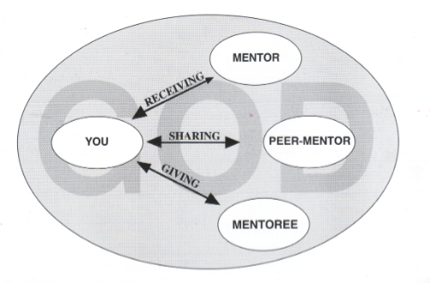
It is important for the President to find either a personal coach or a mentor
A President will draw strength from the sharing in a peer-mentor relationship
A President can achieve much by becoming a mentor to a fellow worker
4/12/2010

Slide 16

To those upon whom God has bestowed many talents, I am instructed to say: Help the inexperienced; discourage them not. Take them into your confidence; give them fatherly counsel, teaching them as you would teach students in a school. Watch not for their mistakes, but recognize their undeveloped talents, and train them to make a right use of these powers. Instruct them with all patience, encouraging them to go forward and• to do an important work. Instead of keeping them engaged in doing things of minor importance, give them an opportunity to obtain an experience by which they may develop into trustworthy workers. Much will thus be gained to the cause of God.
Those placed in positions of responsibility should patiently seek to make others familiar with all parts of the work. This will reveal that they do not desire to be first, but that they are glad to have others become acquainted with details, and to become as efficient as they are. Those who faithfully fulfill their duty in this respect, will, in time, have standing by their side a large number of intelligent workers whom they have trained. Should they shape matters in accordance with narrow, selfish conceptions, they would stand almost alone. E. G. White ,Review and Herald, December 4, 1904.
4/12/2010

Slide 17

If in their ministry those whom we teach develop an energy and an intelligence even superior to that which we possess, we should be led to rejoice over the privilege of having a part in the work of training them. But there is danger that some in positions of responsibility as teachers and leaders, will act as if talent and ability have been given to them only, and that they must do all the work in order to make sure that it is done aright. They are liable to find fault with everything not originated by themselves. A great amount of talent is lost to the cause of God because many laborers, desiring to be first, are willing to lead, but never to follow. Although they closely scrutinize and criticize all that any one else does, they are in-danger of regarding that which goes forth from their hands as perfect—
E. G. White, Review and Herald, December 4, 1904.
4/12/2010

Slide 18

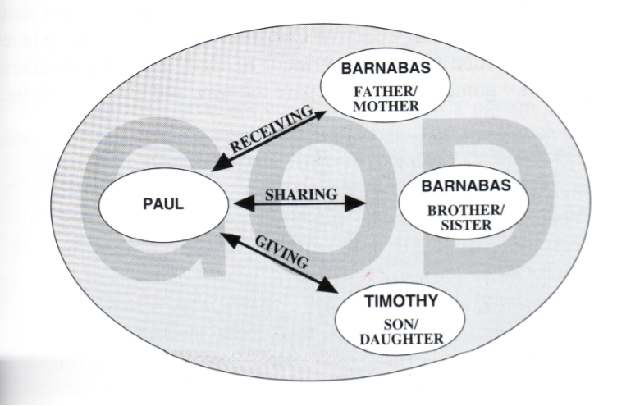
4/12/2010

Slide 19

Eccl 4:9-12.
Begin with a friend
Set aside regular times to be together
Maximise your time together
Seek to be transparent with each other
Focus on major areas where we can stray
Ask good questions
Be mutually accountable
Show mutual respect
Pray together
Have fun together
Arrange special times together
4/12/2010

Slide 20

Regular communication is important.
Let the mentee lead the conversation and encourage him or her to think the issue through.
ALL Communication MUST BE strictly confidential.
4/12/2010
Notes:
Do not preach.
Regular communication is important.
In order to monitor the mentor/mentee relationship, we ask that you design a follow-up form, as well as choose someone, preferably an elder, to coordinate this program. You must complete brief bi-weekly reports, and send them to the designated mentor coordinator at least once monthly. The Coordinator will also call you periodically to help in any way possible.
Let the mentee lead the conversation and encourage him or her to think the issue through. Ask questions like: "What do you think would happen?" or "How would this affect your life?" Share your own experiences (within limits ... try not to rehearse past sins).
Suggest that the two of you find additional sources of information. Do not try to be a counsellor unless you have been professionally trained. Recommend professional counselling as provided by the pastor or professionally trained counsellor, when your mentee needs their service.
ALL Communication MUST BE strictly confidential.
In order to develop the type of relationship in which you can be effective, you must first be perceived as trustworthy. The only exception to this is if you feel that the mentee is being physically abused, neglected or is involved in a life-threatening activity. Report this act at once to the designated mentor coordinator who will take appropriate action.
Keep your promise to your mentee.
These young people are sometimes too familiar with adults who are not consistent in their words or actions. Your role is to demonstrate that adults can and do keep promises. Follow-through is critical to establishing trust. Set up a system for communicating with your mentee. If for some reason you must miss a meeting, notify
your mentee as soon as possible before the meeting. Reschedule immediately. In an emergency situation, you may contact the designated mentor coordinator who will relay the message.
Another alternative is to find a friend who will stand in for you. Make sure that you introduce the mentee to this substitute first and involve him or her in at least one prior activity. Encourage each mentee to become involved in small group activities, prayer, and Bible Study.
Encourage your mentee to keep his or her promises to you.
By scheduling meetings in advance you help the mentee develop a sense of responsibility. Mentees are to be informed of their responsibilities to you and to the program. They will also be instructed in how to contact you should it become necessary to cancel a meeting. If for any reason you suspect there is a problem because of frequent scheduling conflicts, notify the designated mentor coordinator who will find out if a problem exists and take steps to correct it.
Mentees have made a commitment to the program just as you have and we expect them to live up their agreements. The mentor's primary responsibility is to the mentee. You are in this program to supplement a young persons experiences and opportunities.
You are not expected to take on the parental role or undermine parental authority. In order to better understand his or her needs, you may even want to ask the parent(s) what their hopes and dreams are for the child and how they think you can help fulfil those dreams.
You are not encouraged to play "fairy godmother or godfather" to the mentee. You may introduce yourself by letter to meet the mentees parents/ guardians. The object of the problem is to be a friend.
Gifts are strongly discouraged
It is fine to feed the mentee if you deem it appropriate. Birthday or Christmas gifts are permitted. We do not want to encourage competition among mentees for gifts. If your mentee starts asking you for gifts, we ask you to discourage this behaviour. Should it persist, contact the designated mentor coordinator.
What do you do if you or your mentee are not compatible?
Unfortunately, not all matches are on target. If after five to six weeks of consistent activity you and your mentee seem to conflict, it may be necessary to make a change and pray for divine intervention. Please remember that the relationship will take time to establish. Should you experience discomfort with your mentee, please contact the designated mentor coordinator team early. We may be able to help both of you. If not, we will make other arrangements.

Slide 21
Keep your word to your mentee.
Encourage your mentee to keep his or her word to you.
You are not expected to take on the parental role.
Discourage the Mentee from giving you gifts but you may wish to share some resources that you have found helpful.
4/12/2010
Notes:
Keep your promise to your mentee.
These young people are sometimes too familiar with adults who are not consistent in their words or actions. Your role is to demonstrate that adults can and do keep promises. Follow-through is critical to establishing trust.
Encourage your mentee to keep his or her promises to you.
By scheduling meetings in advance you help the mentee develop a sense of responsibility. Mentees have made a commitment to the program just as you have and we expect them to live up their agreements.
You are not expected to take on the parental role or undermine parental authority. In order to better understand his or her needs, you may even want to ask the parent(s) what their hopes and dreams are for the child and how they think you can help fulfil those dreams.
Gifts are strongly discouraged
It is fine to feed the mentee if you deem it appropriate. Birthday or Christmas gifts are permitted. We do not want to encourage competition among mentees for gifts. If your mentee starts asking you for gifts, we ask you to discourage this behaviour. Should it persist, contact the designated mentor coordinator.

Slide 22

Christ centered
Passionate
Relational
Affirming
Trusting and Trustworthy
4/12/2010
Notes:
Christ Centred
This is the foundational quality for Christian mentoring. What is essential for a disciple maker is a life touched and being continually renewed by Jesus Christ. Then ordinary abilities become extraordinary
Jesus said, 'Apart from me you can do nothing' (John 15:5).
Passionate
Passion is what drives us. It is the strong enthusiasm we have for something.
To be really effective in mentoring, we need a passion for it, not to do it because its the flavour of the month or we felt it was the right thing to do.
Although we need a passion to mentor, initially it may be little more than a leaning in that direction as we begin to understand and see the need for mentoring. The enthusiasm, the zeal, may grow as you get involved and see the remarkable difference even an hour or two a month with a mentoree can make.
Relational
Mentors need to be able to establish and maintain relationships. They should know how to develop rapport, to get alongside, to empathise, to help people feel at ease. Love is shown by the way they actively listen. Mentorees are accepted for who they are, not for what they do or don't do. They can inspire and motivate by their attitude and behaviour.
Mentors are interested and concerned about their mentoree's family and friends, and will frequently ask questions about them during regular meetings..
Relational people give the impression they enjoy being with others and they are always out to encourage. Their personal security is such that they can allow the other person their freedom and are not threatened when the other does things better. This quality is not limited to the extroverts. Often the introverted, shy person finds it easier to exercise these traits.
Affirming
Mentors believe in their mentorees and tell them so. They have an ability to discern potential and enable its development by their ongoing commitment, support, affirmation of every genuine effort and by turning failures into learning experiences. They love celebrating their mentorees' successes!
Open and Transparent
Mentors are believable there is integrity in who they are, what they say and what they do. They never seek to come across as superior, paragons of virtue or 'know-it-alls'. They are honest about their failures and weaknesses, as well as their successes. They are growing people who are open to learn from their mentorees - and to tell them when they do! Mentorces find it easy to identify with them.
Mentors know when to ask the tough questions to help their mentorees think frankly about themselves and the way they do things.
Available
It is important that the mentor can be relied upon to meet face to face meetings about every month to six weeks. Mentoring can be done by letter, email and phone between meetings.

Slide 23
Available
Open and Transparent
Prayerful
Self Aware
4/12/2010
Notes:
Relational
Relational people give the impression they enjoy being with others and they are always out to encourage. Their personal security is such that they can allow the other person their freedom and are not threatened when the other does things better. This quality is not limited to the extroverts. Often the introverted, shy person finds it easier to exercise these traits.
Affirming
Mentors believe in their mentorees and tell them so. They have an ability to discern potential and enable its development by their ongoing commitment, support, affirmation of every genuine effort and by turning failures into learning experiences. They love celebrating their mentorees' successes!
Open and Transparent
Mentors are believable there is integrity in who they are, what they say and what they do. They never seek to come across as superior, paragons of virtue or 'know-it-alls'. They are honest about their failures and weaknesses, as well as their successes. They are growing people who are open to learn from their mentorees - and to tell them when they do! Mentorces find it easy to identify with them.
Mentors know when to ask the tough questions to help their mentorees think frankly about themselves and the way they do things.
Available
It is important that the mentor can be relied upon to meet face to face meetings about every month to six weeks. Mentoring can be done by letter, email and phone between meetings.

Slide 24

Draw a horizontal line 0______10
Place an x on how open you are to feedback from others
Draw vertical line 0______10
Place x on how easily you share information about yourself
4/12/2010
Notes:
Firstly, draw a straight horizontal line, numbered from 0 to 10, as- follows:
0_______________________________________ 10
Then place an X on the line to indicate
how open you believe you are to feedback from others,
with 0 representing not being open to feedback at all,
and 10 representing being totally open and receptive, to the point of frequently soliciting feedback about yourself from others.
If, for example, I think that I get quite defensive when others give me feedback (about my performance, personality or behaviour), tending to either disregard what they say or become annoyed, 1 would place an X at 2 or 3 on the line.

Slide 25

0 X 10
0
X
10
4/12/2010
Notes:
Draw vertical line 0 to 10
Place another X on this second line to indicate how easily and freely you share information about yourself with others generally.
If, for example, I think I am an up-front person who volunteers information about myself so that people will know me beyond superficial layers, I'd place an X at around the 8 or 9 point on the line.
Finally, draw two lines to complete the outside of the square, and draw in two other lines to join up the two Xs, as follows. You should end up with one large square, with four areas of differing sizes within it.

Slide 26

Known to Me Not known to me
OPEN | BLIND
HIDDEN | UNKNOWN
Known by Others
Not Known by Others
4/12/2010
Notes:
JOHARI WINDOW
1.The open self: what I am aware of in myself (mannerisms, thoughts, feelings, beliefs, experiences, etc), and which others are also aware of, either because it is obvious or because I have freely shared this information about myself with them.
2. The blind self: those aspects of myself to which I am oblivious but which are (sometimes painfully!) obvious to others. These represent my personal blind spots.
3.The hidden or concealed self: information about myself that I withhold or try to hide from others. Perhaps I came from the sort of family that encouraged a stiff-upper-lip approach to life; or maybe I've been vulnerable in the past and had my trust betrayed, thus causing me now to hold things in. Conversely, some people who have low self-esteem hide their true self behind a mask for fear of rejection.
4. The unknown self: once described as 'the God-only-knows- This is the realm of my hidden potential, the unconscious, and my repressed memories.
What is the Dominant quadrant in your Johari Window configuration?
What might be some of the implications of this as you mentor?

Slide 27

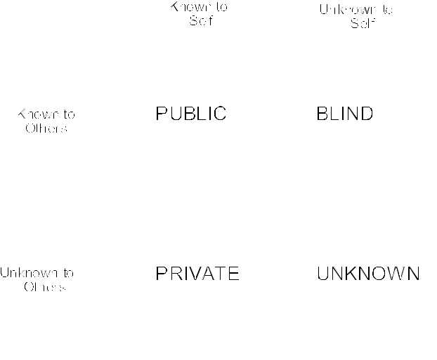
4/12/2010

Slide 28
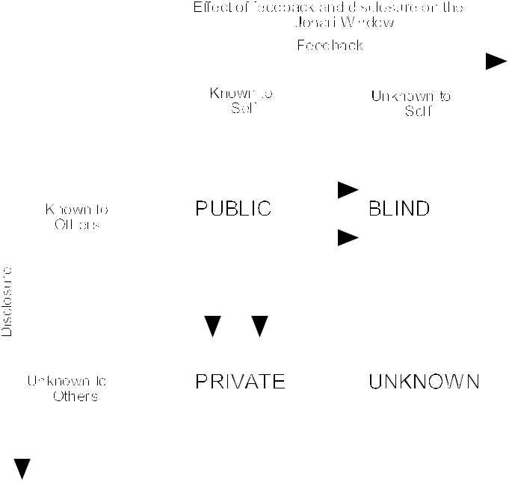
4/12/2010

Slide 29

Carson Pue, Mentoring Leaders: Wisdom for Developing Character, Calling and Competency Grand Rapids, MI.: BakerBooks, 2005.
Gary R. Collins, Helping Others Turn Potential Into Reality: Christian Coaching Colorado Springs, CO.: NavPress, 2001.
4/12/2010

