Slide 1


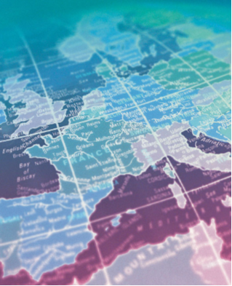

NEW CONFERENCE PRESIDENTS ORIENTATION
Team Building
Barry Gane PhD
with Hal Thomsen Dmin

Slide 2


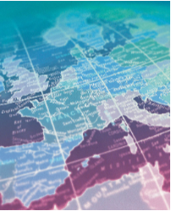
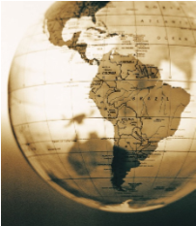
Teamwork is a “Principle-based “ Value
In other words, if you value teamwork, you have to commit to the principles that grow it
You have to sow the right seeds
To build a healthy team, you have to create an extraordinary amount of faith and belief among the team members. A mind set that puts the team first

Slide 3
The purpose of this presentation is to clearly define and explain the 17 “Principles” of effective teamwork
These principles serve as the “fundamental truths” leading to synergistic results
They are constants, non-negotiable laws designed to cultivate trust and foster unity among team members

Slide 4

Each is vital to the health and wellbeing of the team
None can be violated without violating the team

Slide 5
USE THE 17 PRINCIPLES TO:
Build more focus, unity, trust and credibility into your conference
Clarify expectations and guide your team on its mission
Align your people and your systems, generating more accountability and responsibility among team members
Pull together and experience the extraordinary power of the team

Slide 6
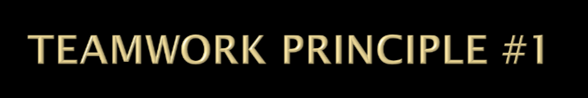
Put the team first
“You can accomplish anything in life, provided that you do not mind who gets the credit.” David McCullough

Slide 7
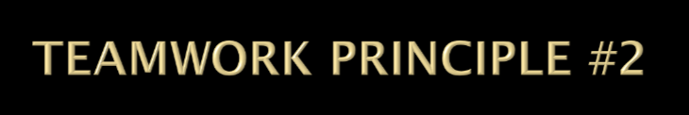
Share team information openly
“The word communication comes from the Latin communico, which means to share”

Slide 8

Be part of the solution
“If we did all the things we are capable of, we would literally astound ourselves.” Thomas Alva Edison

Slide 9

Seek first to understand
“Appreciation is a wonderful thing; it makes what is excellent in others belong to us as well.” Voltaire

Slide 10
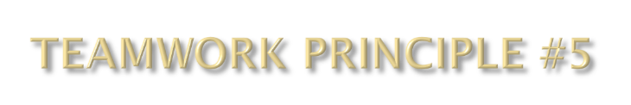
Respect Other Opinions
“ A man’s mind stretched to a new idea never goes back to its original dimensions.” - Oliver Wendell Holmes

Slide 11
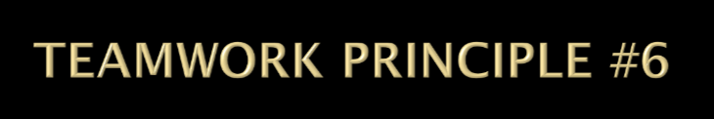
Ask and encourage questions
“The important thing is not to stop questioning. Curiosity has its own reason for existing.” Albert Einstein

Slide 12
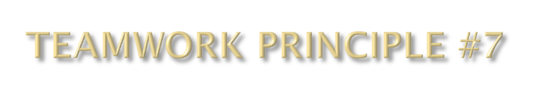
Make rational decisions
“The significant problems we face cannot be solved at the same level of thinking we were at when we created them.” Albert Einstein

Slide 13
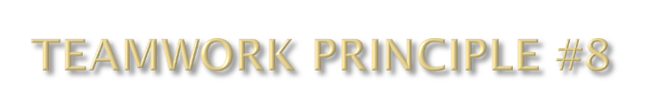
Eliminate internal competition
“Great discoveries and achievements invariably involve the cooperation of many minds.” Alexander Graham Bell

Slide 14
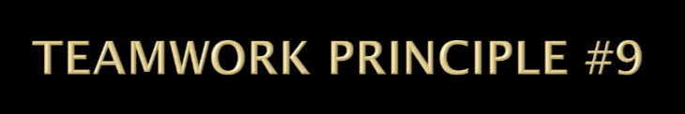
Build trust with integrity
“Things which matter most must never be at the mercy of things which matter least.” Goethe

Slide 15
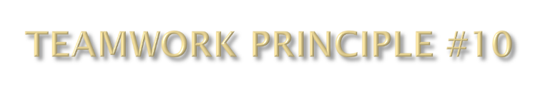
Treat one another with dignity
“What lies behind us and what lies before us are tiny matters compared to what lies within us.” Oliver Wendell Holmes

Slide 16
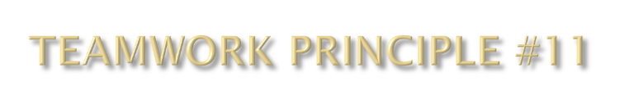
Commit to excellence
“We are what we repeatedly do. Excellence, then is not an act, but a habit.” Aristotle

Slide 17
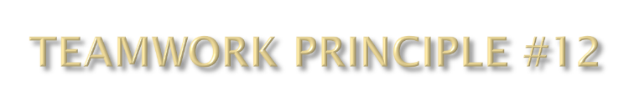
Be accountable for your actions
“Example is not the main thing influencing Others – it is the only thing.” Albert Schweitzer

Slide 18
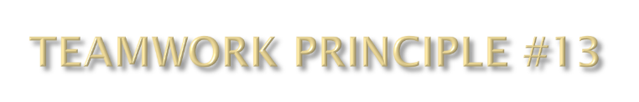
Accept mistakes and learn from them
“Our greatest glory is not in never failing, but in rising up every time we fall.” Ralph Waldo Emerson

Slide 19
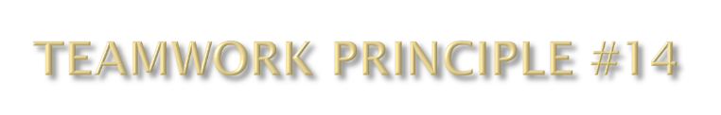
Learn continuously
“I know of no more encouraging fact than the unquestionable ability of man to elevate his life by conscious endeavour.” Henry David Thoreau

Slide 20
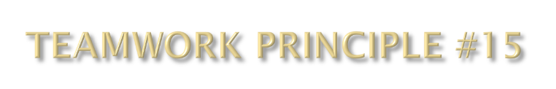
Promote interdependence
“Build for your team a feeling of oneness, of dependence on one another and of strength to be derived by unity.” Vincent Lombardi

Slide 21
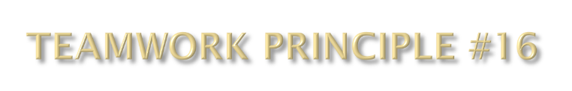
Be patient and persevere
“We will either find a way or make one.” Hannibal

Slide 22
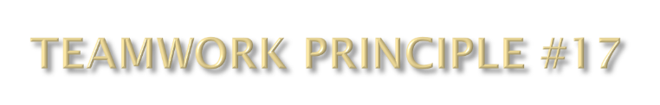
Pull the weeds
“We must cultivate our garden.” - Voltaire

Slide 23
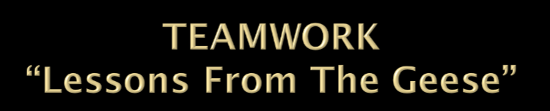
As geese flap their wings, they create an uplift for the birds that follow
By flying in a “V” formation, the whole flock adds 71% greater flying range than if any bird were to fly alone.
“If we share a common direction and a sense of community, we can get where we’re going more quickly and easily because we are traveling on the thrust of one another.”

Slide 24

Whenever a goose falls out of formation, it suddenly feels the drag and resistance of trying to fly alone, and quickly gets back into formation to take advantage of the lifting power of the bird immediately in front.
If we have as much sense as geese, we will stay in formation with those who are headed where we want to go, and we will be willing to accept their help as well as give ours to others.

Slide 25
When the lead goose gets tire, it rotates to the back into formation and another goose flies at the point position
If we take turns doing the hard tasks and sharing leadership as with the geese, we become dependent on each other

Slide 26
The geese in formation honk from behind to encourage those up front to keep up their speed.
If we “honk,” we need to make sure it is encouraging

Slide 27
When a goose gets sick or wounded or is shot down, two geese drop out of formation and follow it down to help and protect it.
They stay with it until it is able to fly again or dies.

Slide 28
If we have as much sense as geese, we too will stand by each other in difficult times, as well as when we are strong
Let us all try to fly in formation and remember to drop back to help those who might need it!

Slide 29

 | TEAM STRUCTURE | TASK ACTIVITY
FORMING | There is anxiety, dependency on a leader, testing to find out the nature of the situation and what behavior is acceptable. | Members find out what the task is, what the rules are, and what methods are appropriate.
STORMING | Conflict between sub-groups, rebellion against the leader, opinions are polarized, resist control by the group, conflicts over intimacy. | Emotional resistance to demands of task.
NORMING | Development of group cohe­sion, norms emerge, resistance overcome and conflicts patched up, mutual support and development of group feeling. | Open exchange of views and feelings; cooperation developed
PERFORMING | Interpersonal problems are resolved, interpersonal structure is the tool of task activity, roles are flexible and functional. | Emergence of solutions to problems, constructive attempts at task completion, energy is now available for effective work; this is the major work period.

Slide 30
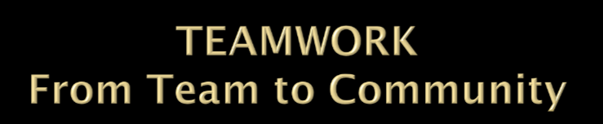
Scott Peck in “A Different Drum” describes what it takes for move team to Community
Pseudocommunity
  Being nice/polite - John 1:35 - 42
Chaos
  Open fighting – Matt. 17 - 20
Emptiness
  Matt. 26:75, Phil. 2:3 - 11
Community
  Acts 2:44, Phil. 2:3 - 11
Notes:
Openness and trust epitomize real community. Problem solving, productivity and ownership of the process now flow. But community has to continue to be maintained. Tuckman’s model sees the effective team as arriving at a phase of Performing - the team members are now cooperating toward a common goal. The successful leader of a team knows that to connect with people in a group, you have to relate to them as individuals. Leadership at this time will offer some direction and continue to work on cohesion.
It is fair to say that there will be movement between the various phases, visits to the past, a desire to return to the niceties of pseudocommunity or the early days of forming. But leadership will provide direction and empowerment. Only secure leaders are capable of truly empowering a team, and the team’s capacity to achieve will be determined by the leader’s willingness and ability to empower them. Great things happen and everyone shares the credit.

