Slide 1


Seventh-day Adventist Officers’
General Conference of Seventh-day Adventists
Office of Global Leadership Development
Prepared by: Lowell C Cooper
January 2010

Slide 2

Legal Notice and Terms of Use
Copyright 2010 by the General Conference of Seventh-day Adventists®. All rights reserved. The information is provided for training purposes only and is not intended nor should it be used as legal counsel. This program may not be used or reformulated for any commercial purposes; neither shall it be published by any person or agency other than an official organizational unit of the Seventh-day Adventist® Church, unless prior written authorization is obtained from the General Conference of Seventh-day Adventists® Office of Global Leadership Development. Subject to the foregoing terms, unlimited permission to copy or use this program is hereby granted upon inclusion of the copyright notice above. “Seventh-day Adventist” and “Adventist” are registered trademarks of the General Conference of Seventh-day Adventists® and may not be used by non-Seventh-day Adventist entities without prior written authorization from the General Conference. Use of all or any part of this program constitutes acceptance by the User of these terms.

Slide 3
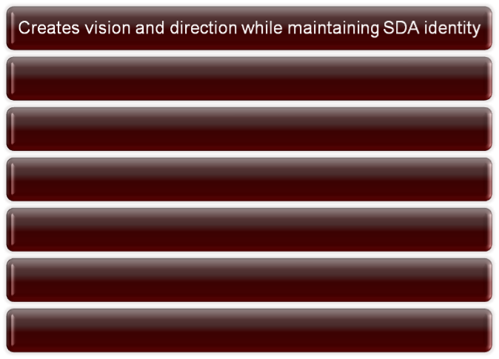
Core Competencies

Slide 4
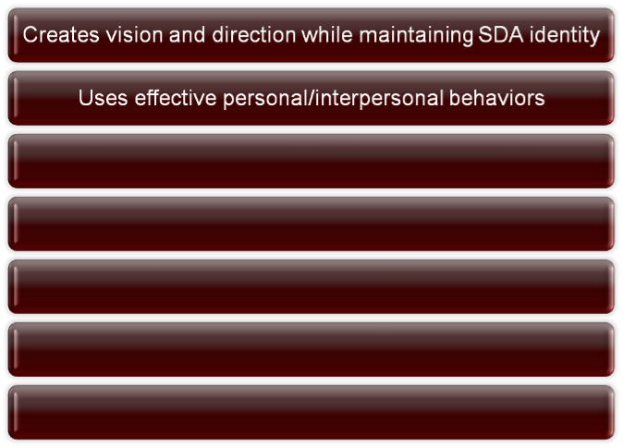
Core Competencies

Slide 5
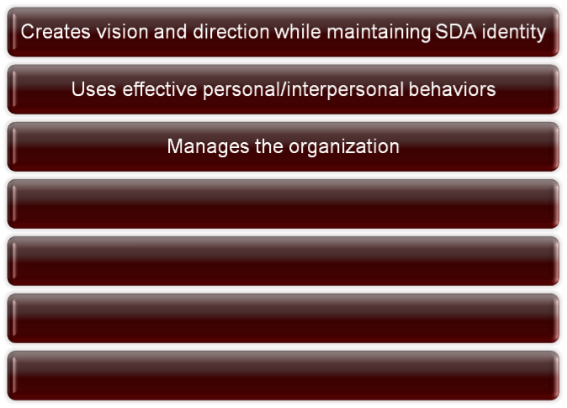
Core Competencies

Slide 6
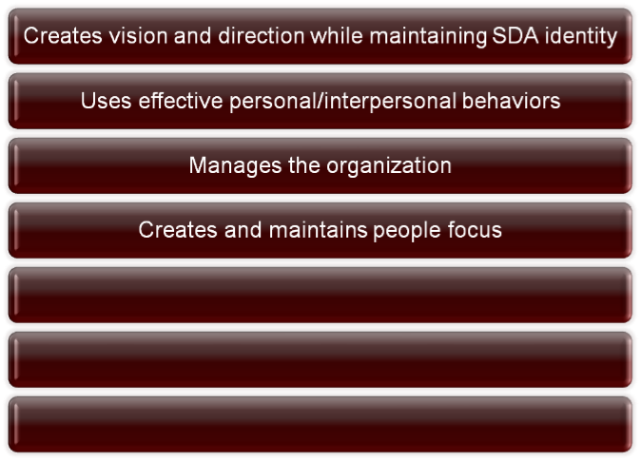
Core Competencies

Slide 7
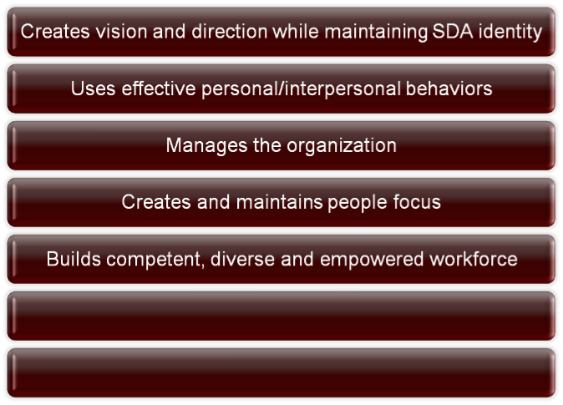
Core Competencies

Slide 8
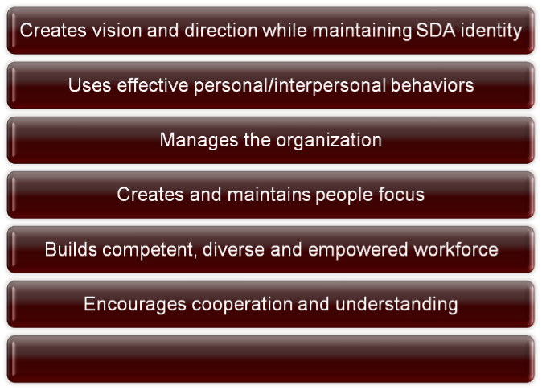
Core Competencies

Slide 9
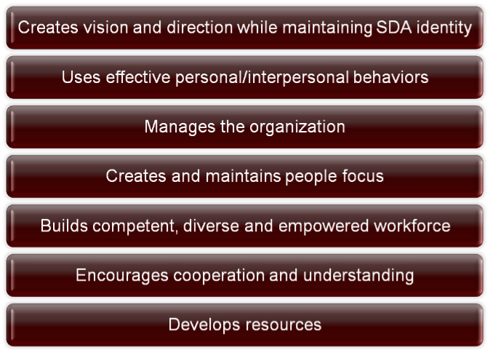
Core Competencies

Slide 10
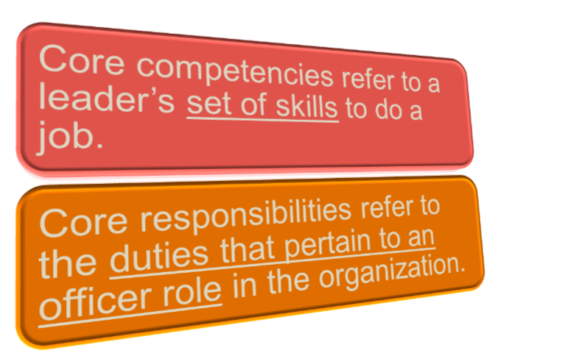

Slide 11
The significance of “office”:
A position of spiritual leadership
A position of administrative function
A position which officially represents the church
A position requiring professional expertise.

Slide 12
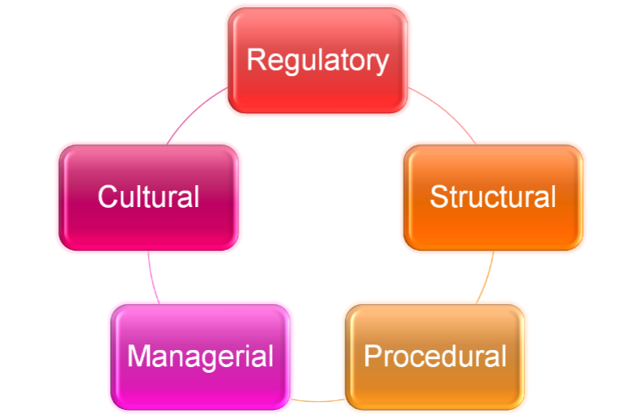
Officers’ core responsibilities:

Slide 13

Maintain legal status (inc./un-inc.)
Compliance with law
Property title and documentation
Permits and authorizations
Building/environmental codes
Official cycle of meetings
Filing of periodic updates
Fulfill contracts/agreements

Slide 14

Maintain denominational relationships
Comply with governance documents
  Constitution and Bylaws
  GC/Div/Union/Conference Working Policy
  Church Manual
  SDA Fundamental Beliefs
Administrative Committee set-up
Well-defined officer responsibilities

Slide 15
Duties of officers:
See model constitution in GC Working Policy D 10 05, Bylaws of Union Conference, Article VI.
The absence of specificity is intentional but it is also the ground for problems in relationships and functions.

Slide 16
Duties of the President:
First officer
Reports to Exec Comm in consultatin with co-officers
Chair of Exec Comm and Constituency Session
Must adhere to policies
Must work in harmony with larger level of organization

Slide 17
Duties of the Secretary:
A co-officer
Reports to Executive Committee after consultation with the President
Vice-chair of Executive Committee
Maintain minutes and provide copies to members
Such other duties as pertain to the office

Slide 18
Duties of the Treasurer:
A co-officer
Reports to Executive Committee after consultation with the President
Receive, safeguard and disburse funds in harmony with Exec Comm actions
Provide financial info to President, Executive Committee and division.

Slide 19
All other duties of shared leadership must be arranged by mutual consent among the officers.
agenda preparation, advice to departments, pastors' reports, legal matters, property maintenance, personnel issues, communication with adjacent levels of organization, counsel to subordinate organizations.

Slide 20

















Slide 21
Developing officer teamwork:
Determine who does what and then preserve and respect boundaries

Slide 22





Slide 23
Developing officer teamwork:
Determine who does what and then preserve and respect boundaries
Set up schedule for officer consultations

Slide 24


Secretary
Although officers have separate areas of responsibility there are some things that need to be done in consultation with fellow officers.
President
Treasurer

Slide 25
Developing officer teamwork:
Determine who does what and then preserve and respect boundaries
Set up schedule for officer consultations
Frequent communication and review
Deal with conflicts internally
Socialize to know each other better and to build respect

Slide 26

Timely documentation of decisions
Timely publication of reports
Regular cycle of exec comm meetings
Employment practices
Records retention system

Slide 27

Supervision/support of field staff
Supervision/support of office staff
Orientation of new employees
Program development/oversight
Evaluation/assessment/accountability
Analysis and strategic planning
Calendar of events continually updated

Slide 28

“Tone-at-the-top” set by officers
Celebrate global and local identity
Service mentality
Pursuit of excellence
Teamwork attitude
Ethical climate: integrity, respect, trust

Slide 29
“Tone-at-the-top” set by officers
Celebrate global and local identity
Service mentality
Pursuit of excellence
Teamwork attitude
Ethical climate: integrity, respect, trust
Manage conflicts of interest
Room for creativity, innovation

Slide 30
Officers’ core responsibilities:

Slide 31
End

