Slide 1
The Spiritual Life of an Administrator by Ted N. C. Wilson

Slide 2
It is essential that an individual working in church administration be connected to God.

Slide 3
Not only do you need God’s
help to do your work well,
God will use you to bless others.

Slide 4
Seventh-day Adventists promote and believe in a balanced
life that includes:
L
I
F
E
mental
physical
social
spiritual

Slide 5
Micah 6:8 gives us some direction:
“He has shown you, O man, what is good; and what does the Lord require of you but to do justly, to love mercy, and to walk humbly with your God?”

Slide 6
Did you catch that?
Do What Is Right.
Do not shirk your duty.
Apply Mercy.
Don’t be so rigid in your duty that you neglect mercy.
Be Humble.
You do not have all the answers.
Remember to rely on Christ.

Slide 7
Paul speaks of the characteristics of a spiritual life in Colossians 1:9-18
“filled with the knowledge of His will”
“walk worthy of the Lord”
“fully please Him”
“be fruitful in every good work”
“increase in the knowledge of God”

Slide 8
A connection with Christ in all you do will have a powerful effect on your influence.

Slide 9
Let’s look at things that affect your spiritual life.

Slide 10
Study of and Literal Belief in the Word of God.
1.

Slide 11
Study the Word daily
Keep to a literal acceptance and understanding
Use the historical-Biblical method of interpreting Scriptures
Preach the Word

Slide 12
2.
Trust in the 28 Fundamental Beliefs.

Slide 13
Trust in the 28 fundamental beliefs
Know the beliefs
Recognize they are based in the Bible
Stand up for the beliefs and support them
Teach them to others
Promote them

Slide 14
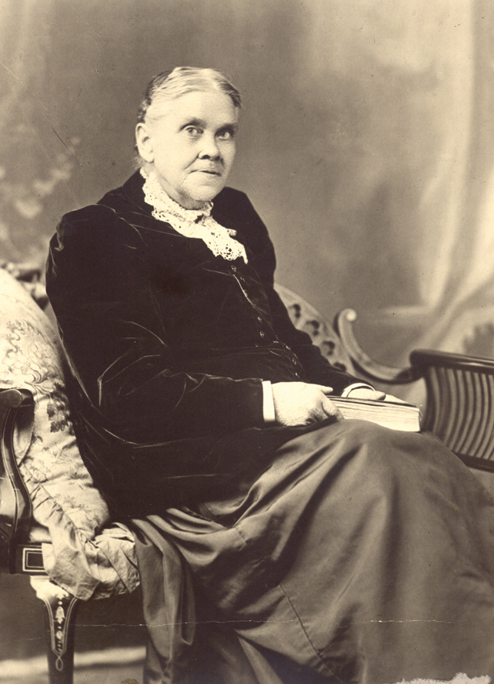
3.
Trust completely
in and study the Spirit of Prophecy.

Slide 15
Accept the Spirit of Prophecy as one of God’s greatest gifts
Read the Spirit of Prophecy daily
Believe in it
Promote it
Use it
Teach it
Support it

Slide 16
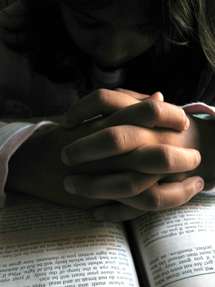
4.
Have an active prayer life.

Slide 17
Pray morning, noon, and night
Ask the Lord for guidance in counseling, chairing committees, working on projects, dealing with problems—every activity of the day
You will not be successful without prayer

Slide 18
5.
Believe in revival and reformation

Slide 19
Recognize we are living in Laodicean times
Be willing to humble yourself before God
Ask your fellow leaders to seek the Holy Spirit’s help with you

Slide 20
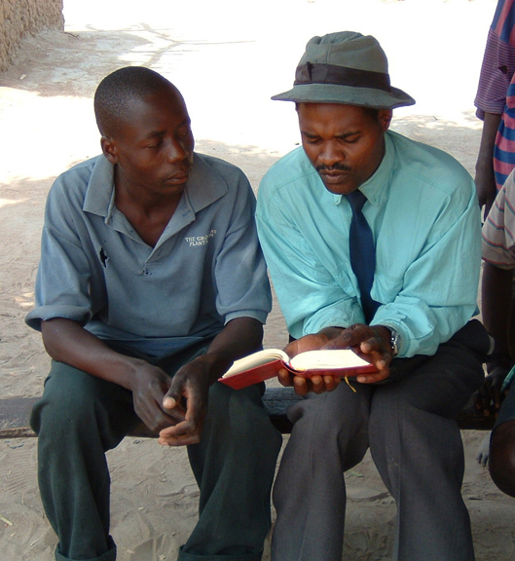
6.
Share your faith.

Slide 21
Be willing to be used by the Holy Spirit
Share your faith personally
Be willing to hold public evangelistic meetings
Fulfill the Great Commission

Slide 22
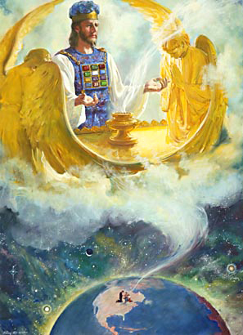
7.
Lift up
Christ, His righteousness, and the Sanctuary.

Slide 23
Lift up Christ in all you do
Make Christ the focus of your life
Speak often of Him to others
Only through Christ’s ministry in His life, death, and ministry as High Priest can we have assurance of eternal life

Slide 24
8.
Proclaim the Three Angels’ Messages

Slide 25
Proclaim this message with a loud voice
Recognize the Seventh-day Adventist Church has a unique message to proclaim to the earth
Proclaim it with the power of the Holy Spirit

Slide 26
9.
Have a sunny disposition.

Slide 27
Be positive in your approach to life
Have a sunny disposition when relating to others
Bring encouragement to others
Be part of the solution, not part of the problem
Bring reconciliation to those around you

Slide 28
10.
Be observant and affirming.

Slide 29
Observe others accomplishments
Be affirming
Bring encouragement
Remember that you are part of a team

Slide 30
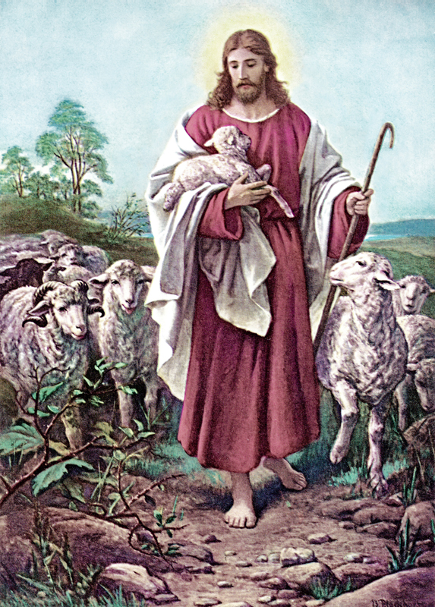
11.
Trust in God’s leading.

Slide 31
Never doubt God is leading the Seventh-day Adventist Church
Trust in the promises of Scripture
Trust in the Spirit of Prophecy
Know that God has called this church to a unique role to lift up the true worship of God

Slide 32
12.
Be sure to exercise
and eat properly.

Slide 33
Recognize that exercise, sleep, rest, recreation, and diet affect your spiritual life
Take time for proper exercise
Get enough rest
Eat a vegetarian diet
Avoid harmful beverages and other detrimental habits

Slide 34
13.
Be fair and balanced.

Slide 35
Be known as one who is fair
Evaluate situations carefully
Be impartial
Make reasonable decisions based on Biblical principles
Take counsel from the Spirit of Prophecy

Slide 36
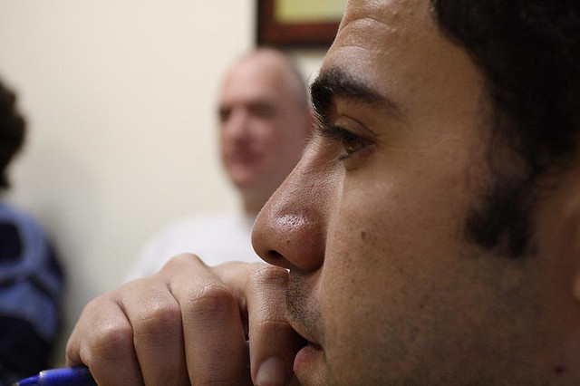
14.
Be a good listener.

Slide 37
Learn the art of listening
Reserve comments until after hearing the whole story
Don’t jump to conclusions
Wait and listen
Be willing to learn

Slide 38
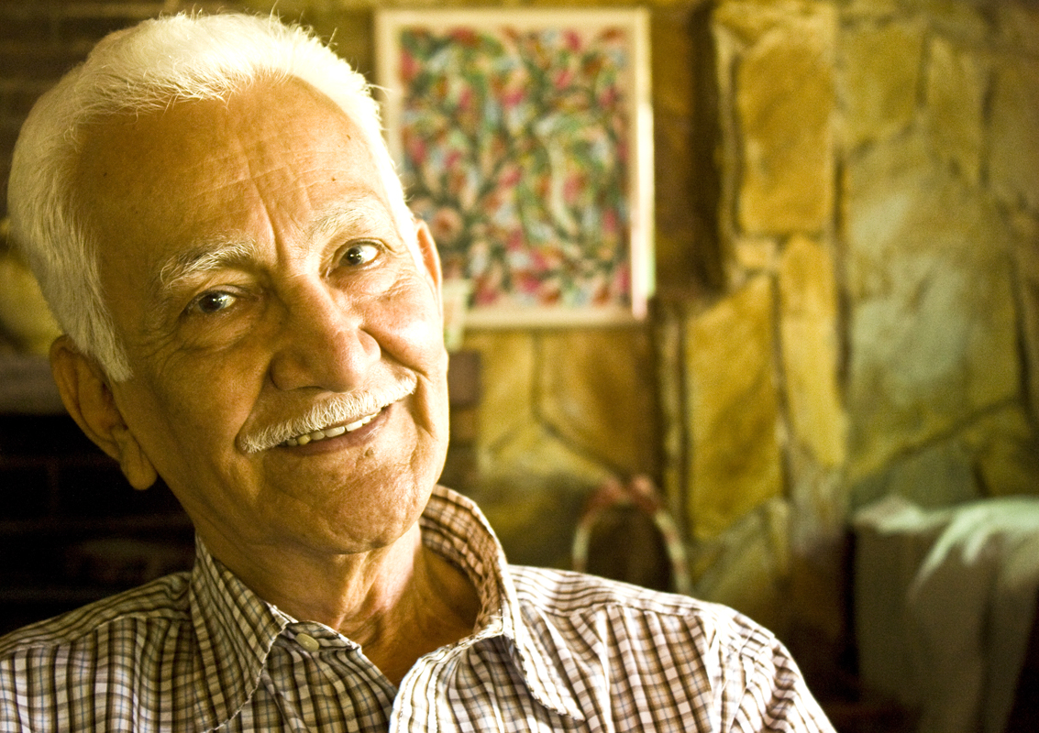
15.
Seek counsel from others.

Slide 39
Ask for counsel from Godly people
Do not think you know all the answers
Seek guidance from those who know the Lord and you can trust

Slide 40
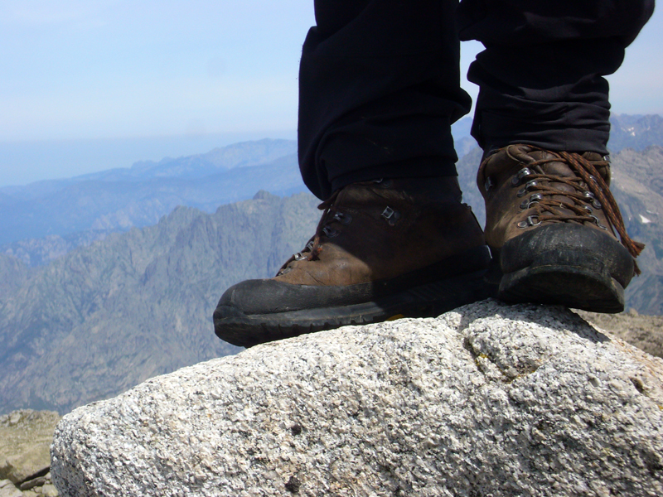
16.
Stand for the right.

Slide 41
Be willing to stand for what is right
Don’t be afraid to stand for something even if it is unpopular
Allow the Holy Spirit to lead you in forming opinion and belief
Stand tall for truth

Slide 42
17.
Stand for those who cannot stand.

Slide 43
Be willing to stand for people or causes that have no voice and need to be heard
Ask God for guidance
Follow the ministry of Christ

Slide 44
18.
As for wisdom every day.

Slide 45
Each morning claim James 1:5 asking for wisdom
Realize you are powerless without the wisdom of heaven
God will give you what you need to accomplish your tasks

Slide 46
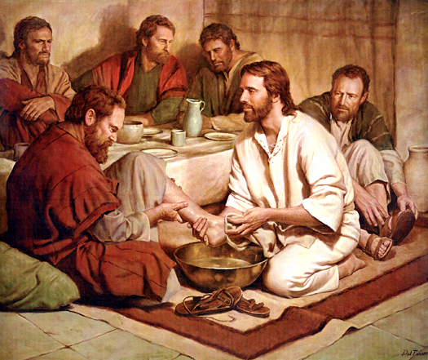
19.
Be a humble servant.

Slide 47
Remember you are God’s servant
Remember Jesus’ words that whoever would be chief should be a servant
Follow Christ’s example

Slide 48
20.
Believe Christ is coming soon.

Slide 49
Accept and believe the prophecies indicating Christ’s soon return
Shape your thinking in accordance with this belief
Know we are living in the last days of earth’s history
Preach about Christ’s return

Slide 50
As a Seventh-day Adventist administrator seek to increase your spiritual connection with heaven.

Slide 51
Commit yourself to Proverbs 3:5, 6:
“Trust in the Lord with all your heart and lean not on your own understanding; In all your ways acknowledge him, and he will make your paths straight.”

Slide 52
“We must have a greater nearness to God. Much less of self and much more of Jesus Christ and His grace must be brought into our every day life.”
Selected Messages, vol. 2, p. 376

Slide 53
Plead with God for revival and reformation in your life
and His church.

Slide 54
“A revival of true godliness among us is the greatest and most urgent of all our needs. To seek this should be our first work.”
Selected Messages, vol. 1, p. 121

Slide 55
Finally, ponder the counsel in 1 Peter 1:13-21.
“Therefore gird up the loins of your mind, be sober, and rest your hope fully upon the grace that is to be brought to you at the revelation of Jesus Christ . . .”

