Slide 1


A LEADERSHIP WORKSHOP
Based on the Collected Papers
from the Leadership Symposium
General Conference Session
July 3-7, 2005

Slide 2
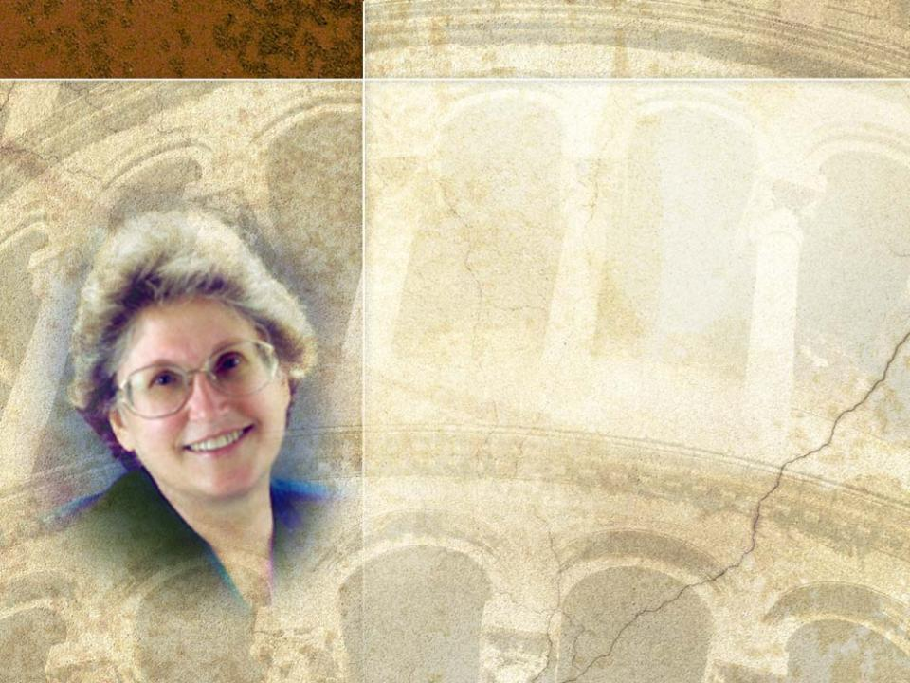
SESSION five
Integrity:
A 21st Century Imperative–
PART 2
Based on the Presentation by
B. Lyn Behrens
President, Loma Linda University and Medical Center

Slide 3

Session 5 will address the
following questions:
1
In what ways can integrity be breached, and what are the consequences?
2
Why is integrity so important?
3
What are the effects of immoral conduct on the part of church leaders?
4
What types of hostile work environments should we avoid?

Slide 4

5
If colleagues or employees are underperforming, what is our responsibility? What are the effects of failing to be honest in our performance evaluations?
6
How can we safeguard personal and organizational integrity?
7
How do we live a life of integrity amidst the opportunities and challenges of the 21st Century?

Slide 5

III. In What Ways Can Integrity Be Breached and What Are the Consequences?
Breaches of integrity always hurt
people
institutions
churches
the reputation of our God
Already the 21st Century has been
marred by blatant breaches in integrity.

Slide 6
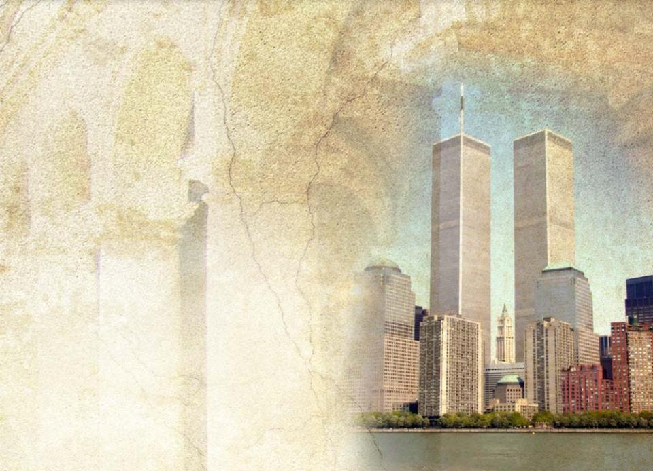
World Trade Center
September 11, 2001
Why did it collapse?
The inferno buckled
the steel girders that
ringed and
supported
each floor.

Slide 7
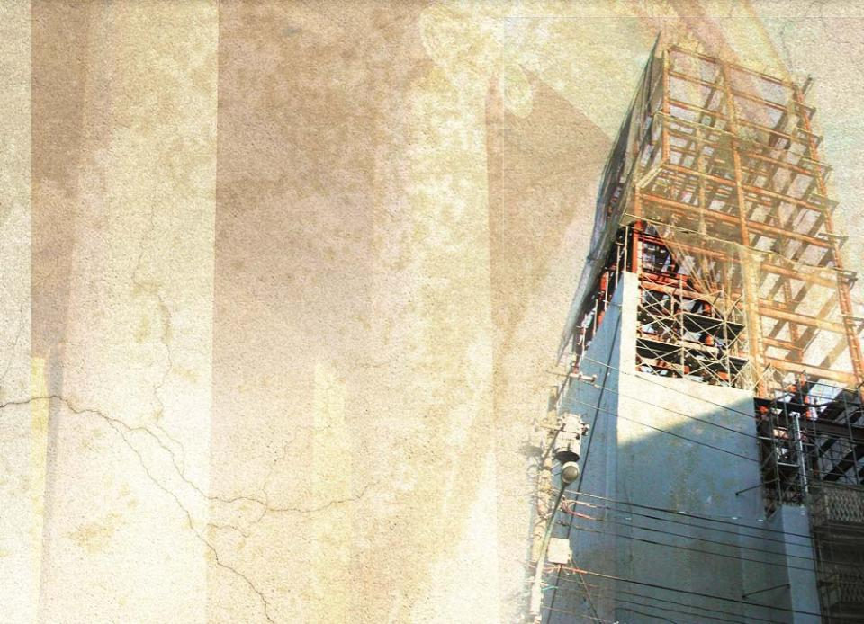
Integrity is the steel infrastructure
that supports our
characters
families
institutions
communities
church
Broken integrity fractures
personal and professional
relationships
trust within a family,
community, institution,
and church
There is no such thing as
a minor lapse of integrity.

Slide 8

Dishonest Behavior:
Perjury, Duplicity, Fraud, Immorality
1–Fraud and illegal conduct
WorldCom: at one time the
world’s second largest telecommunications provider
Bernie Ebbers, CEO of WorldCom
was convicted of profiting from fraudulent accounting practices and hiding $366 million in personal loans
with his associates, caused the bankruptcy of WorldCom
Shareholders in WorldCom lost $180 billion; 20,000 employees lost their jobs.

Slide 9

Enron: formerly a world leader in electricity, natural gas, and communications
Kenneth Lay, CEO of Enron
Jeffrey Skilling, COO of Enron
have been indicted for securities fraud
(insider trading), bank fraud, and wire fraud
caused the bankruptcy of Enron
caused thousands of employees and
investors to lose their life savings
went on trial beginning January 2006
Enron “has since entered the common conscious[ness] as a symbol of fraud and corruption.” (Wikipedia online encyclopedia)

Slide 10

Arthur Andersen: formerly one of the big five accounting firms in the US
David B. Duncan
was the Arthur Andersen auditor for Enron accounts
ordered the shredding of Enron documents to conceal Enron’s fraudulent accounting practices
has pleaded guilty to obstruction of justice in the Enron case
helped cause the downfall of
Arthur Anderson
as a result, the company has gone
bankrupt and nearly 28,000
employees have lost their jobs

Slide 11

Tyco International: a producer of electronic components, health care, fire safety, security, and fluid control products
Dennis Kozlowski, Tyco CEO
Mark Swartz, Tyco CFO
fraudulently inflated the company’s
stock prices
stole about $600 million from the
corporation and its shareholders in
forgiven loans and bonuses
have been convicted and sentenced
for their crimes

Slide 12

Qwest International: a large telecommunications carrier in the western states
Joseph Nacchio, former Qwest CEO
was recently indicted for insider trading
was also accused along with others of $3 billion in stock fraud

Slide 13

Adelphia: America’s sixth largest cable television provider.
John Rigas, Adelphia CEO
Timothy Rigas, Adelphia CFO
stole hundreds of millions of dollars from the company
caused investors to lose more than $60 billion
have been convicted and sentenced
to prison

Slide 14

Corporate leaders such these have
put their own self-interest ahead of organizational responsibilities
put the public at risk by causing the collapse of large corporations through their fiscal irresponsibility and blatant dishonesty
robbed shareholders of their rightful returns
jeopardized the employment of staff and their longer-term financial stability

Slide 15

2–Immoral Conduct
Widespread in the secular world, immoral conduct has even
invaded the Christian church.
Televangelists Jim Bakker
and Jimmy Swaggart are
two of the best-known
televangelists to fall prey
to this temptation.

Slide 16

The fallout from immorality on the part of church leaders is always devastating.
disrupts and usually irreversibly damages the lives of family members
impacts corporate communities and church organizations
causes confusion among church members about the moral code for living
ruptures trust of our families, communities, and church entities
always dishonors God’s name

Slide 17
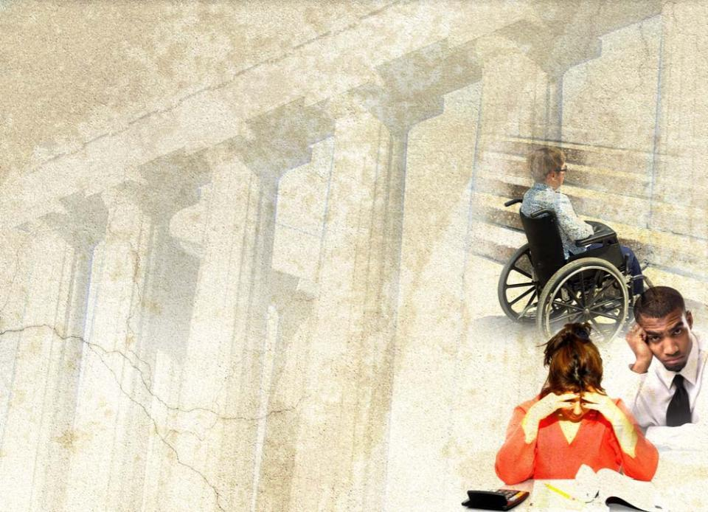
3–Hostile Work Environment
Some hostile environments follow.
Discrimination based on
race or ethnicity
gender
disabilities
should never occur.

Slide 18

Sexual harassment is unacceptable.

Slide 19

Like discrimination, sexual harassment
is illegal in many countries
should be cause for discipline up to and including dismissal

Slide 20
Nepotism is a perception of favoritism towards the employed relative of a leader or manager, such as having access to special perks, receiving insider” information, or being excused for unsatisfactory performance.
Associates and supervisors often feel intimidated.
Fear of retaliation may prevent confrontation of unacceptable behavior.
Reverse discrimination may occur.

Slide 21

The “End Justifies the Means” Trap
1
It is not appropriate to engage in a cover-up even to protect the good name of the church.
Transparency demands that
financial difficulties be promptly disclosed to, and addressed by, the responsible governing bodies
failure to fulfill regulatory requirements be reported to the appropriate agency as soon as the failure is recognized

Slide 22
2
It is not appropriate to hide confirmed sexual misconduct of
a teacher with students
a pastor with parishioners
supervisors with subordinates
In the USA, sex offenders must register with law enforcement.
It is never appropriate
to agree to hold that information secret
to allow such offenders to participate with children in church activities

Slide 23

3
In the matter of performance evaluations, “loving kindness” must never blunt honesty.
Colleagues and employees deserve authentic feedback in their evaluations. If they are underperforming, we must
communicate concerning areas
that need change
address unacceptable behavior
provide coaching to help them
achieve a positive outcome

Slide 24

Failure to be forthright on a timely basis in our evaluations
robs colleagues and employees of growth opportunities
sets them up for major professional failure
keeps them from maximizing their God-given potential
If remediation is not successful, individuals
should not be moved from one place to another to avoid the crucial confrontation
should be counseled about other career paths
should be helped in pursuing these options

Slide 25
It is never appropriate to hide confrontation of a negative outcome behind prayer.
When we make a negative decision about employing someone, we should
not give a positive impression to the person that he/she will be hired
inform that person in a timely manner about our decision

Slide 26
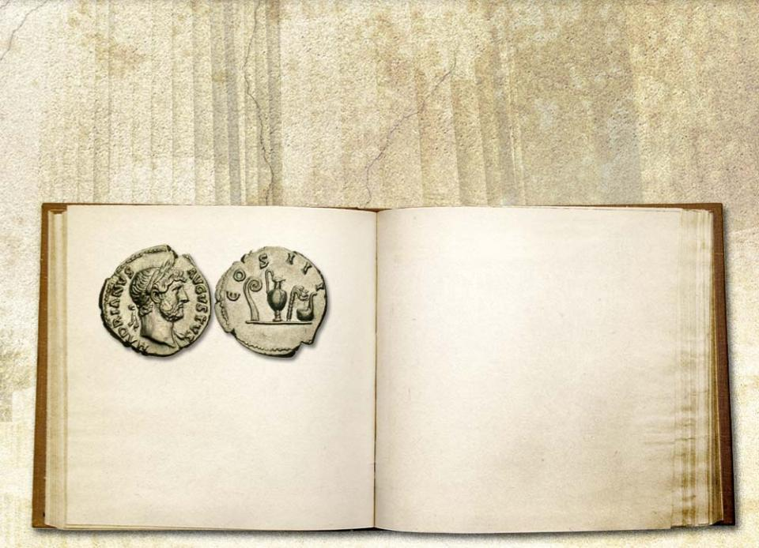

4
We must protect the ethical line between advancing the gospel with integrity while coping with restrictive civil laws.
²⁰and he asked them, “Whose portrait is
this? And whose inscription?”
²¹“Caesar’s,” they replied. Then he said to them, “Give to Caesar what is Caesar’s, and to God what is God’s.” Matt 22:19-21 (NIV)
¹⁹“Show me the coin used for paying the tax.” They brought him a denarius,

Slide 27

When civil law and Christ’s commands come into conflict, wisdom, prayerful thought, and God’s guidance are required.
²⁹Peter and the other apostles replied, “We must obey God rather than men!” Acts 5:29 (NIV)
¹³Submit yourselves for the Lord’s sake to every authority instituted among men: whether to the king,
as the supreme authority, ¹⁴or to governors who are sent by him to punish those who do wrong and to commend those who do right.
¹⁷ . . . fear God, honor
the king.
I Pet 2:13,14,17 (NIV)

Slide 28

Paul
¹Everyone must submit himself to the governing authorities, for there is no authority except that which God has established…
⁵Therefore, it is necessary to submit to the authorities, not only because
of possible punishment but also because of conscience.
Rom 13:1,5 (NIV)

Slide 29

Behavior that Jeopardizes Integrity
Facts should not be manipulated or exaggerated.
We must avoid deceit in
Thought
• Word
• Action

Slide 30

Backbiting is never appropriate.
Ellen White has characterized backbiting as “cannibalism.”
We are called to be loyal to all members of our teams, especially to those who are not present in the meeting.

Slide 31
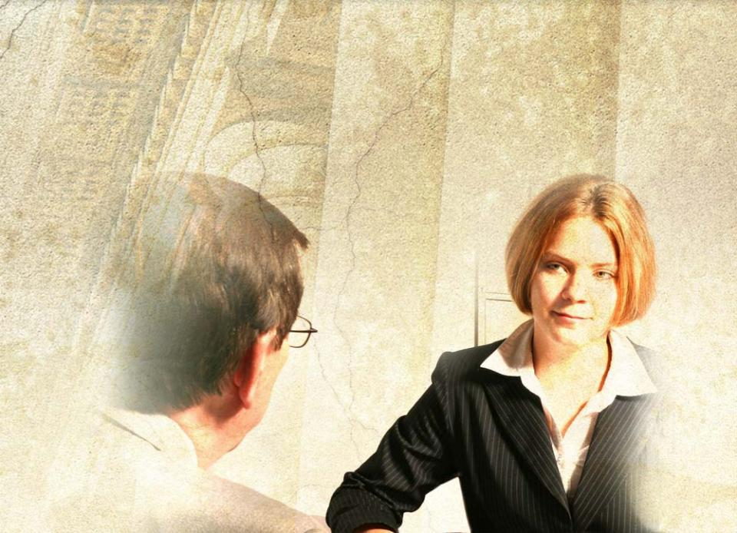
“Praise in public; counsel in private”
is wise advice for every leader and manager
builds organizational confidence and commitment

Slide 32
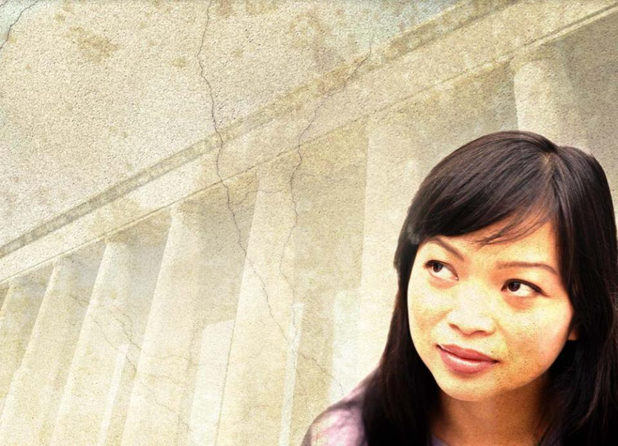
“The integrity of the upright guides them, but the unfaithful are destroyed by their
duplicity.”
King Solomon (Prov 11:3 NIV)

Slide 33

IV. How Can We Live a Life of Integrity Amidst the Challenges and Opportunities of the 21ST Century?

Slide 34

Steps to Safeguard Personal and Organizational Integrity
1
Always practice transparency
2
Treat all employees fairly
3
Be courageous
4
Establish and maintain appropriate boundaries
5
Declare conflicts of interest
6
Acknowledge errors promptly
7
Investigate concerns fairly and impartially

Slide 35



How Does One Live a Life of Integrity in the 21st Century?
Percentage of Leadership Failures
Character Failures
Other Failures
90%
10%
Estimate from Stephen R. Covey
The 8th Habit: From Effectiveness to Greatness

Slide 36

Our characters are built from the accumulation of our day-by-day choices and actions.
What we think, what we say, what we do in relationship to others and to our God determines who we are in our inner being.
We are counseled to “weave stern principles of integrity into our characters.” (Messages to Young People, p. 45)

Slide 37

We all have lapses in our integrity.
Conviction of our brokenness comes to us through
confrontation by a colleague
observation of another’s brokenness
Scripture
prayer as we reflect on the day’s activities
With conviction, we have a choice:
to make excuses until the conviction
fades, or
to accept conviction and be changed.

Slide 38

⁸When he [he Holy Spirit] comes, he will convict the world of guilt in regard to sin and righteousness and judgment: ⁹in regard to sin [the brokenness of my integrity], because men do not believe in me;
¹⁰in regard to righteousness [that Christ is my righteousness], because I am going to the
Father, where you can see me no longer;
¹¹and in regard to judgment [that I am freed from Satan’s slavery, free to be transformed by Christ’s power and grace to wholeness and full integrity], because the prince of this world now stands condemned. John 16:8-11 (NIV)

Slide 39
Three gospel writers record the story of the demon-possessed boy whom nine of the disciples were unable to heal.
The father pled with Jesus, “But if you can do anything, take pity on us.” Jesus responded, “Everything is possible for him who believes.”
In desperation the father cried out, “I do believe; help me overcome my unbelief!” Mark 9:24 (NIV)
Jesus healed the son, but also healed
the father of his unbelief.
This miracle gives us the assurance
that His grace can
bridge the brokenness in our lives
bring unity or integrity to our being

Slide 40

Christian author Gordon MacDonald asks, “How did Daniel survive and even
thrive in a world of
incredible brutality and
disregard for human
value?” p. 121

Slide 41
Scripture answers
¹⁰Now when Daniel learned that the decree had been published, he went home to his upstairs room where the windows opened toward Jerusalem.
Three times a day he got down on his knees and prayed, giving thanks to his God, just as he had done before.
Dan 6:10 (NIV)

Slide 42
We in the 21st Century are invited to maintain a living connection with the Sovereign Lord of the Universe.
He is the Source of all wisdom and power.
We can
know about His agenda
experience His transforming grace
Empowerment comes from a living connection with the God of the Universe.

Slide 43

Crucial Questions for
21st Century Living:
Do we, as leaders, stop three times
a day to
refocus on God?
seek His wisdom in dealing with the dilemmas we encounter?
If we did, what might be
the transformation in
our personal lives?
the institutions or entities
entrusted to our leadership?

Slide 44


Do we, like Christ, rise early for unhurried time with our Creator?
Henri Nouwen said, “Without solitude it is virtually
impossible to live a
spiritual life. Solitude
begins with a time and
place for God, and
Him alone.” p. 69

Slide 45

Is our mind informed and enriched by Scripture?
Do we experience God’s sustaining power and grace?

Slide 46
Power for Integrity
Ours for the asking
“The power that is near to deliver from physical harm or distress is also near to save from the greater evil, making it possible for the servant of God to maintain his integrity under all circumstances and to triumph through divine grace.”Patriarchs and Prophets, p. 545
WARNING: while you are free to copy and translate the text of the content of this DVD for training purposes within the Seventh-day Adventist Church, illustrations are owned by various entities that have provided us limited use rights. DO NOT COPY OR USE THE ILLUSTRATIONS WITHOUT OBTAINING LICENSES AND PERMISSION TO DO SO IN ADVANCE.

