Slide 1


A LEADERSHIP WORKSHOP
Based on the Collected Papers
from the Leadership Symposium
General Conference Session
July 3-7, 2005

Slide 2
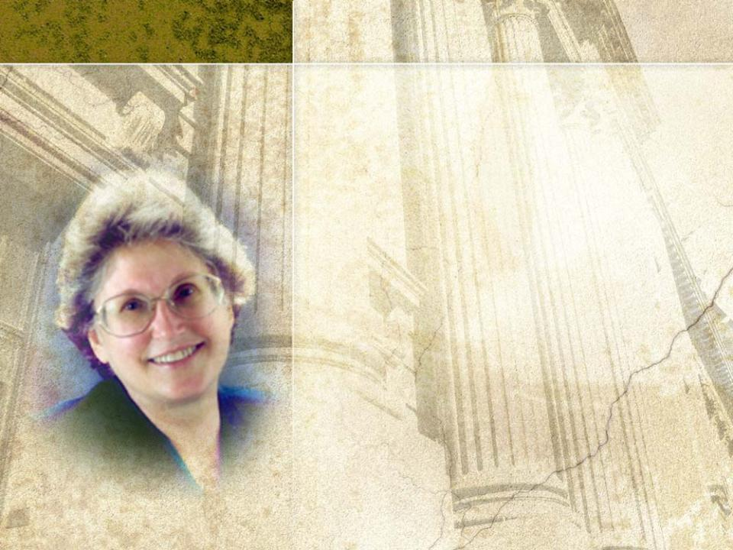
SESSION four
Integrity:
A 21st Century Imperative–
PART 1
Based on the Presentation by
B. Lyn Behrens
President, Loma Linda University and Medical Center

Slide 3

Session 4 will address the
following questions:
1
What is integrity, and why is it important in the 21st Century?
2
What does integrity look like in the lives of individuals and leaders, and in institutions?
3
How can we identify integrity in our institutions and church entities?
4
How can we handle with integrity errors
that occur?
5
How can we ensure corporate integrity in dealing with errors?

Slide 4

Integrity: An Essential Quality of Leadership
From the Wise Man
²⁰The Lord hates people with twisted hearts,
but he delights in those who have integrity.
Prov 11:20 (NLT)

Slide 5
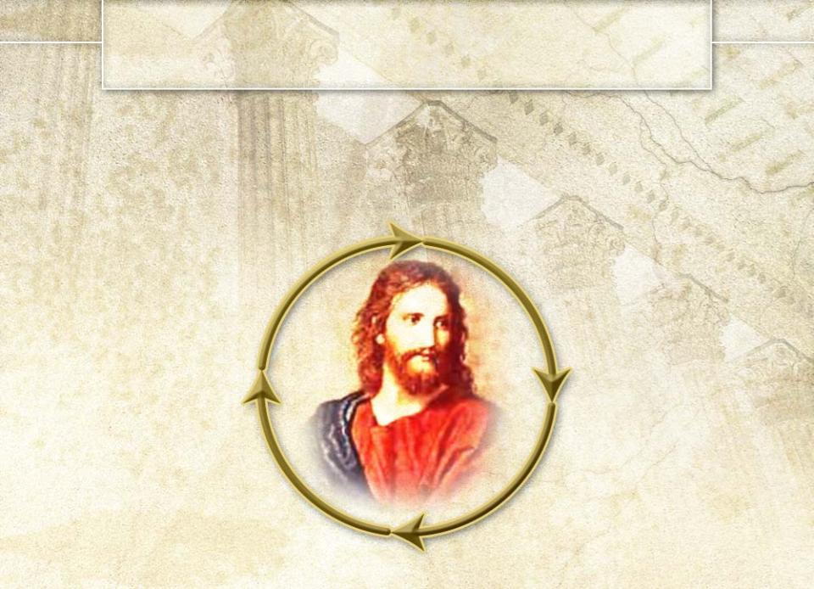
I. What Is Integrity, and Why Is It Important in the 21ST Century?
At Loma Linda University,
Christ is central to all activities.
Mission Statement
Daily Objectives
Long-range Plans
Short-range Goals

Slide 6
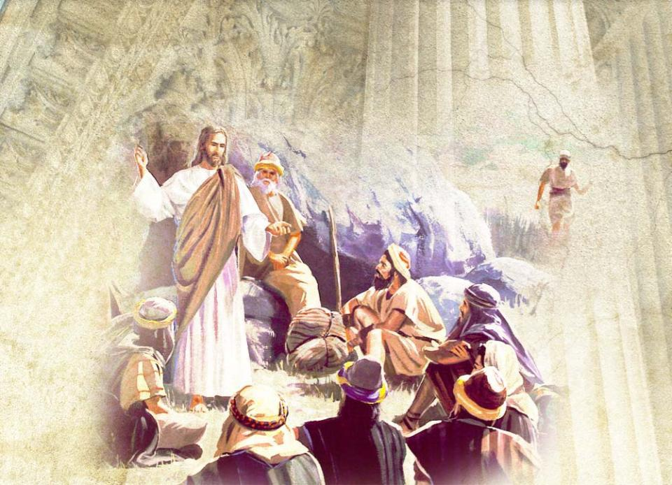
At Loma Linda, Christ is the Model
Master Teacher

Slide 7
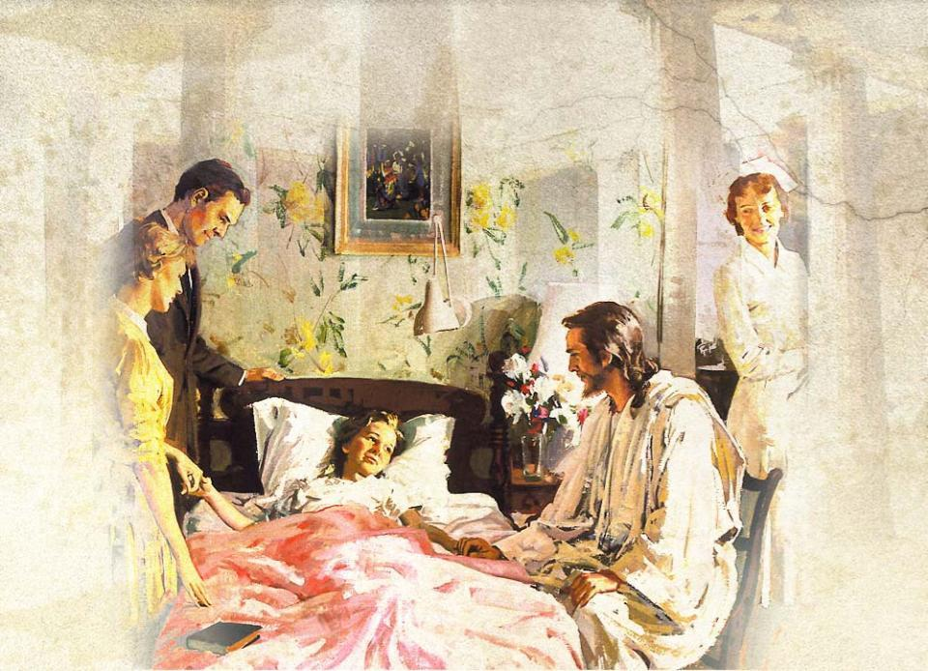
Great Physician

Slide 8
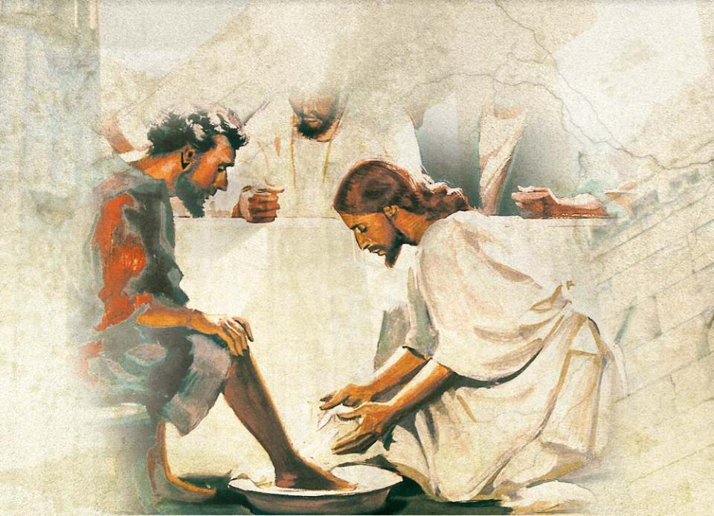
Servant Leader

Slide 9

He is the Motivation for daily work.
He is the Means to accomplish all He calls us to be and do.
³⁴"A new command I give you: Love one another. As I have loved you, so you must love one another. ³⁵ . . .All men will know that you are my disciples, if you love one another.“ John 13:34-35 (NIV)
¹²I know what it is to be in need, and I know what it is to have plenty. I have learned the secret of being content in any and every situation, whether well fed or hungry, whether living in plenty or in want.
¹³I can do everything through him who gives me strength.Phil 4:12,13 (NIV)

Slide 10

Christ is the Foundation of
faith, hope, and love.
¹³And now these three remain: faith, hope and love. But the greatest of these is love.
1 Cor 13:13 (NIV)

Slide 11

Integrity
One of the seven virtues selected to guide personal and professional behavior at Loma Linda

Slide 12
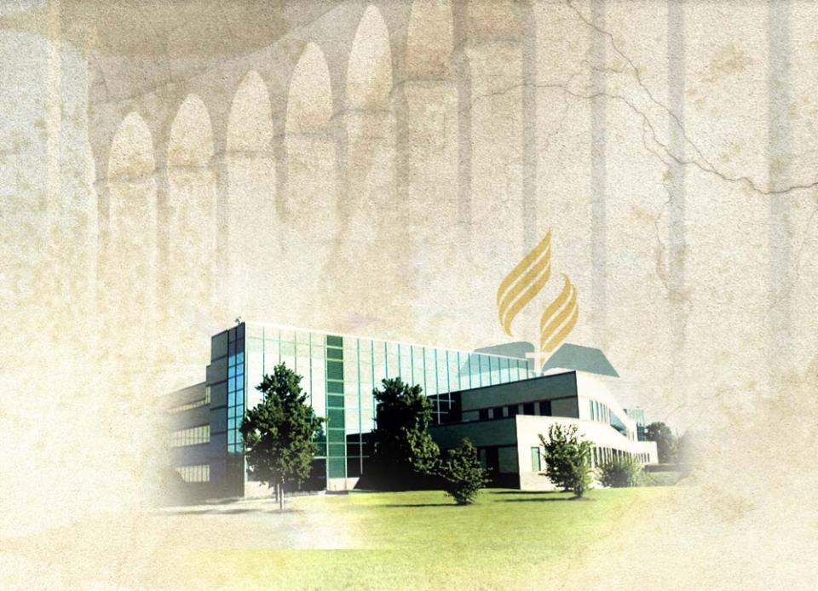
Integrity
A valued foundation for all actions
of the General Conference and its employees

Slide 13

Integrity defined:
1
“an unimpaired condition . . .
2
firm adherence to a code of. . . moral or artistic values . . .
3
the quality or state of being complete or undivided . . .”(Webster’s New Collegiate Dictionary, p. 595)
Integrity defines a state of “being” and “living” characterized by unity, completeness and wholeness, (Stephen L. Carter, Integrity, p. 7.)

Slide 14


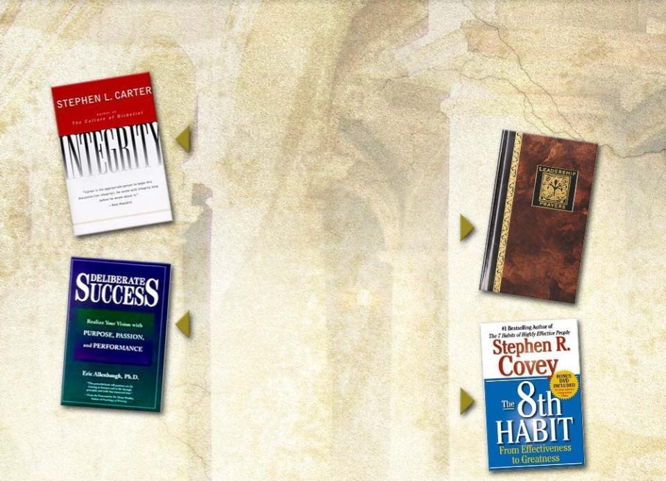


Four excellent books are used in this session:
Integrity
Stephen L. Carter
Leadership Prayers
Richard Kriegbaum
Deliberate Success
Eric Allenbaugh
The 8th Habit
Stephen R. Covey

Slide 15


Integrity is being “one person,” being as “true to duty as the needle to the pole.”
Synonyms for integrity:
Soundness, incorruptibility, completeness, honesty, unity
Purpose
(Why I exist)
Principles
(What I Stand for)
Integrity
Intentions
(What I am up to)

Slide 16

Words we use to show a lack of integrity:
“duplicity”
being “two-faced”
being “double-tongued”

Slide 17
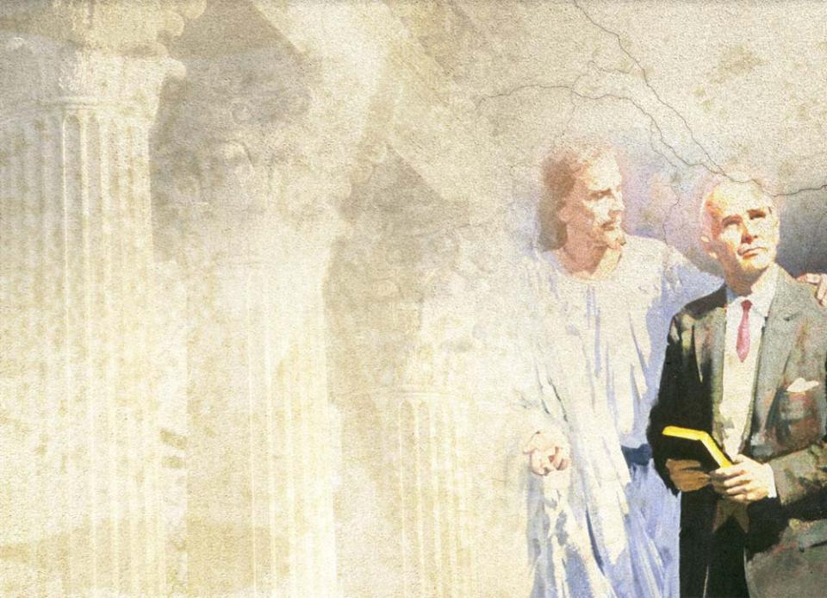
Integrity
Is the wholeness of our character
Is the foundation of our
conscience (Covey, p. 8)
Calls us to discern right
from wrong
Calls us to identify the path
of upright living
Leads us to walk that pathway
even at personal sacrifice or
institutional cost (Carter, p. 7)
Is a universal and timeless
principle for living

Slide 18

Integrity manifests itself as
Authenticity–”being who I claim to be and doing what I promise to do”
Honesty, sincerity, forthrightness, and consistent truthfulness (Kriegbaum, p. 85)
Promise keeping
Avoidance of all forms of deception (Covey, p. 150)

Slide 19

Integrity:
the soil from which trust grows
an essential principle of living for leaders
the number one quality needed in a leader (from research of 54,000 people, Covey, p. 148)
“the supreme quality for leadership” (Dwight D. Eisenhower, Covey, p. 146)
essential for corporate success (as listed by 100 top executives of Fortune 500
Companies, Allenbaugh, p. 83)

Slide 20
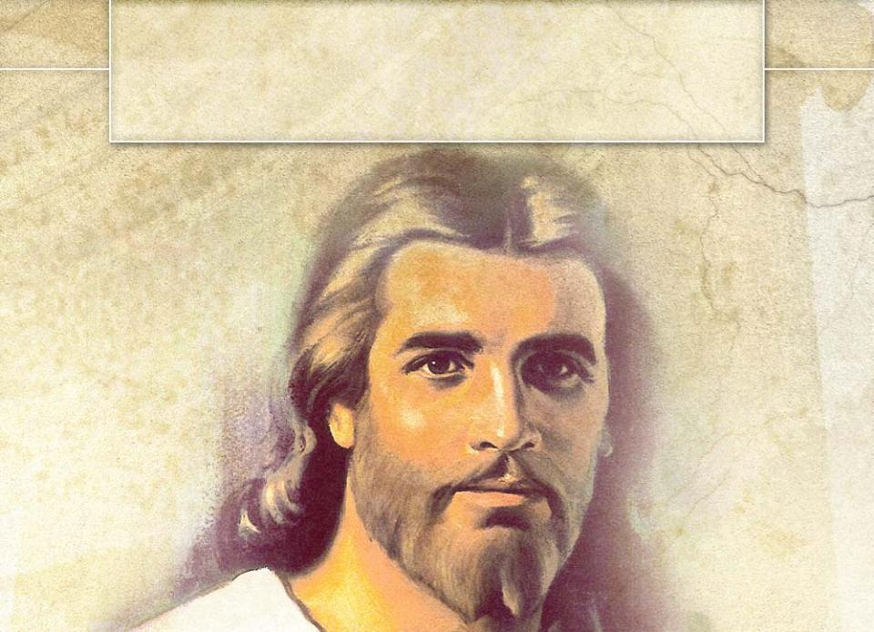
II. What Does Integrity Look Like in the Lives of Individuals and Leaders, and in Institutions?

Slide 21
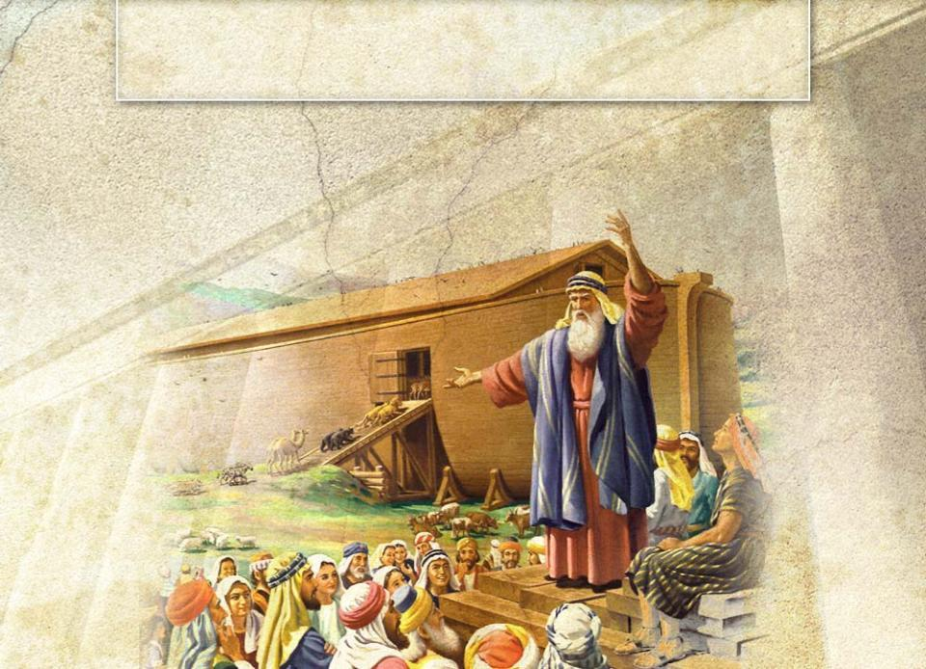
Integrity in the Lives of
Biblical Heroes
“Noah was a righteous man.”
Gen 6:9 (NIV)

Slide 22
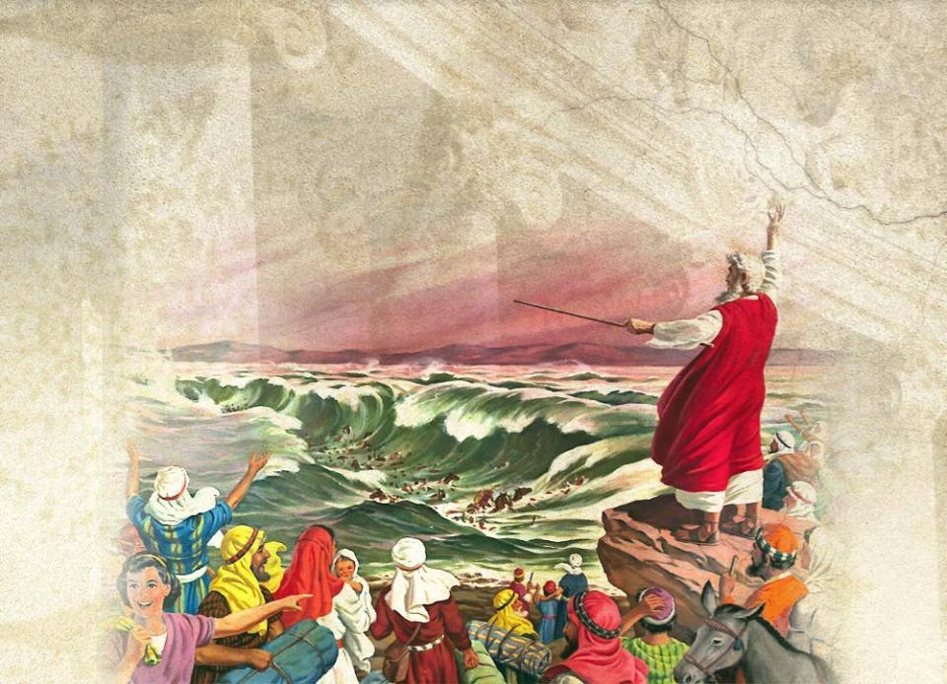
Moses “chose to be mistreated along with the people of God rather than to enjoy the pleasures of sin for a short time.”
Heb 11:25 (NIV)

Slide 23
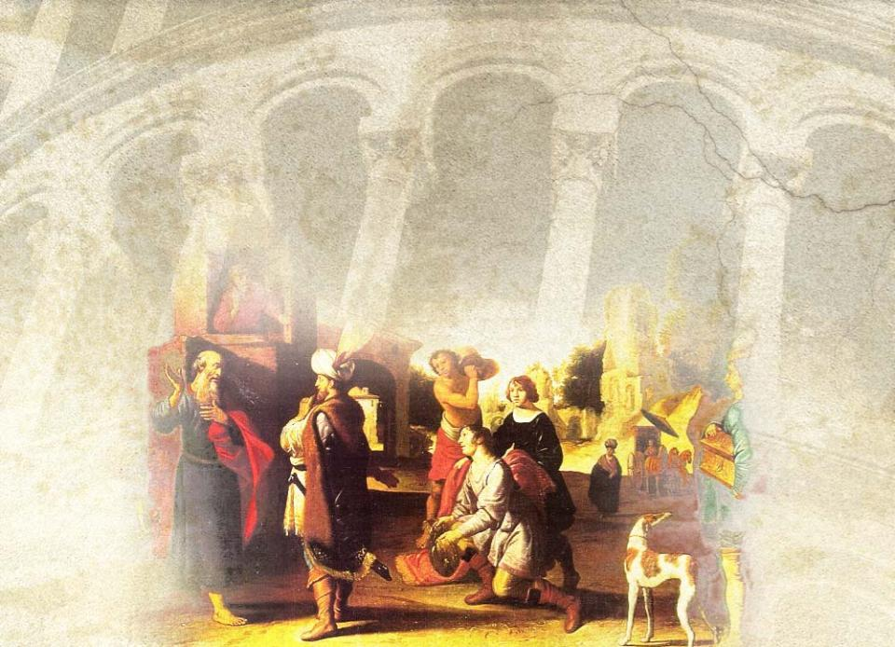
Elisha refused to accept payment for the miracle the Lord performed. He told Naaman, “‘As surely as the Lord lives, whom I serve, I will not accept a thing.’ And even though Naaman urged him, he refused.”
II Kgs 5:16 (NIV)

Slide 24
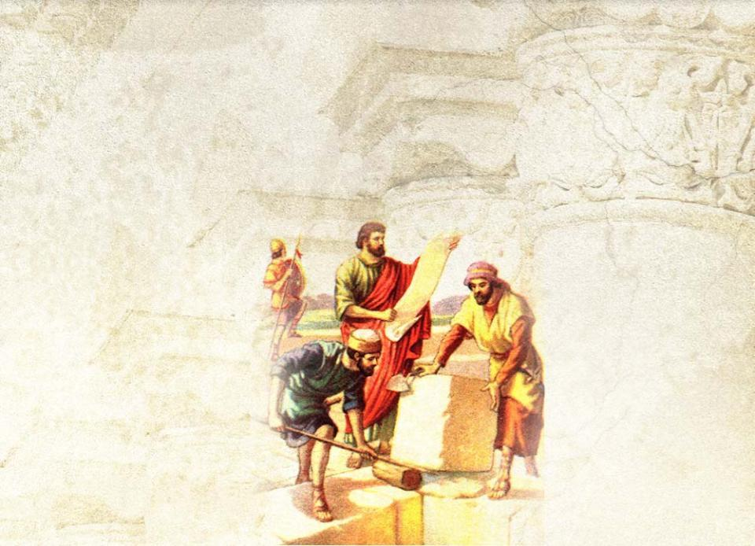
Nehemiah would not be deterred from his task. He said, “I am carrying on a great project and cannot go down.”
Neh 6:3 (NIV)

Slide 25
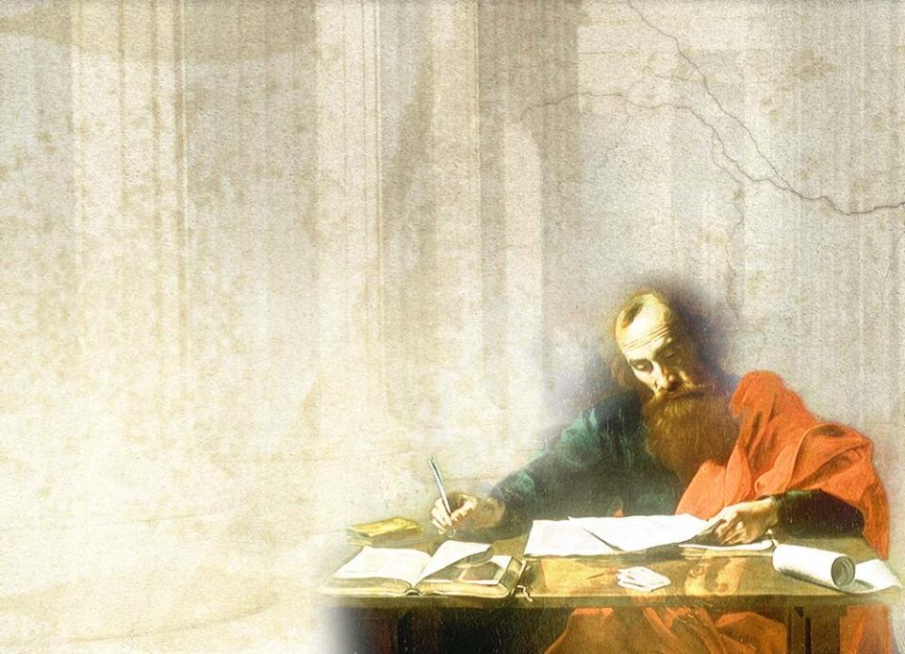
Paul: “Let me say plainly that I have been faithful.” Acts 20:26 (NLT)
“So then, King Agrippa, I was not disobedient to the vision from heaven.” Acts 26:19 (NIV)
“I have fought the good
fight, I have finished
the race, I have
kept the faith.” II Tim 4:7 (NIV)

Slide 26

Joseph: integrity in confronting sexual temptation

Slide 27

⁶. . .Now Joseph was well-built and handsome, ⁷and after a while his master’s wife took notice of Joseph and said, “Come to bed with me!”
⁸But he refused. “With me in charge,” he told her, “my master does not concern himself with anything in the house;
everything he owns he has entrusted to my care.
⁹No one is greater in this house than I am. My master has withheld nothing from me except you, because you are his wife. How then could I do such a wicked thing and sin against God?” Gen 39:6-9 (NIV)

Slide 28
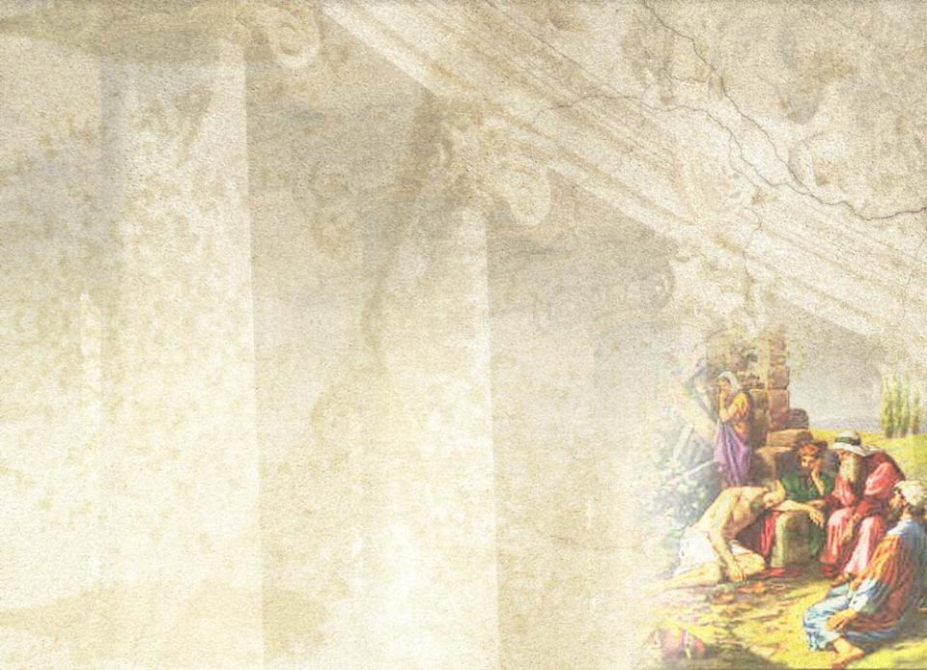
Job: integrity in extreme adversity
“In the land of Uz there lived a man whose name was Job. This man was blameless and upright; he feared God and shunned evil.” Job 1:1 (NIV)
After Satan destroyed all Job’s property and family, “Job did
not sin by charging God with wrongdoing.” Job 1:22 (NIV)

Slide 29
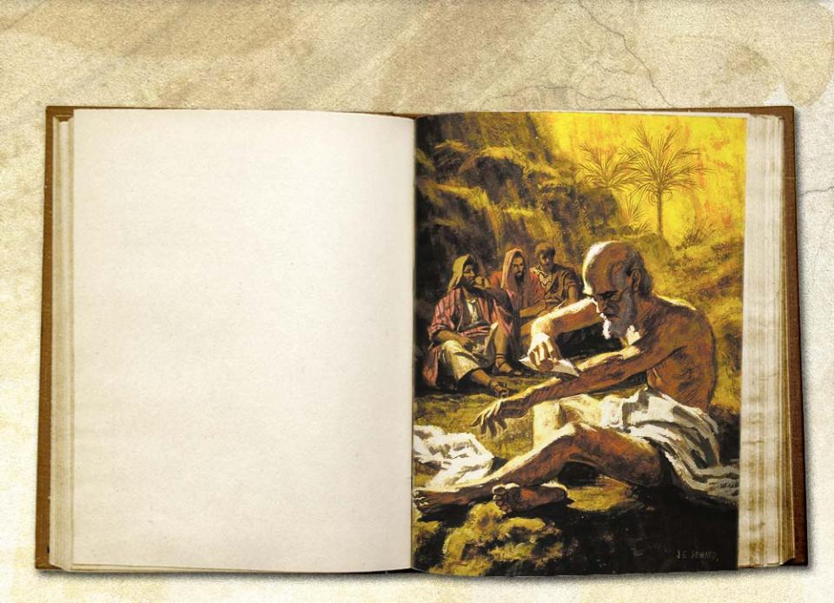
When Satan struck him with a terrible case of boils,
⁹His wife said to him, “Are you still holding on to your integrity? Curse God and die!”
¹⁰He replied, “You are talking like a foolish woman. Shall we accept good from God and not trouble?” In all this, Job did not sin in what he said.
Job 2: 9-10 (NIV)

Slide 30
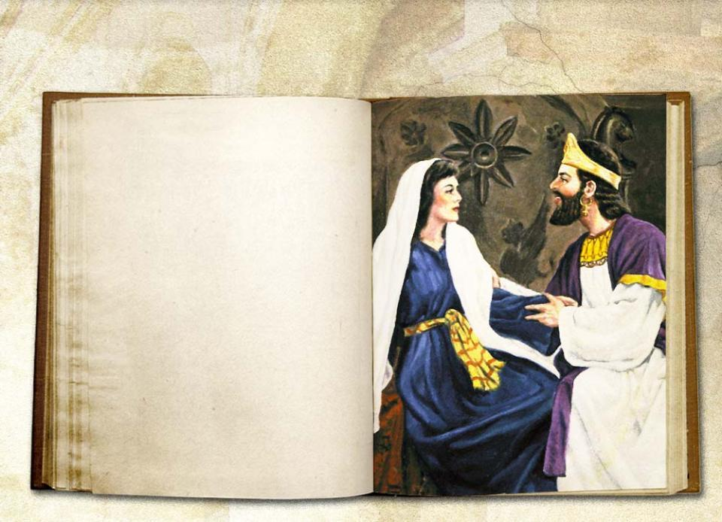
David: integrity in repentance
⁷Then Nathan said to David, “You are the man! . . . ⁹Why did you despise the word of the Lord by doing what is evil in his eyes? You struck down Uriah the Hittite with the sword and took his wife to be your own. . . .”
¹³Then David said to Nathan, “I have sinned against the Lord.”
II Sam 12:7,9,13 (NIV)

Slide 31
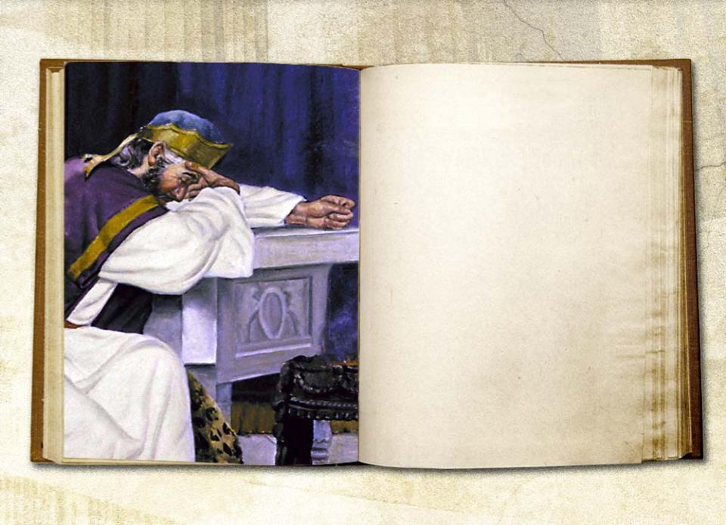
²Wash away all my iniquity and cleanse me from my sin. ³For I know my transgres-sions, and my sin is always before me. ⁴Against you, you only, have I sinned and done what is evil in your sight, . . . ⁷Cleanse me with hyssop, and I will be clean; wash me, and I will be whiter than snow. . . . ¹⁰Create in me a pure heart, O God, . . . ¹²Restore to me the joy of your salvation . .
Ps 51:2-4,7,10,12 (NIV)

Slide 32
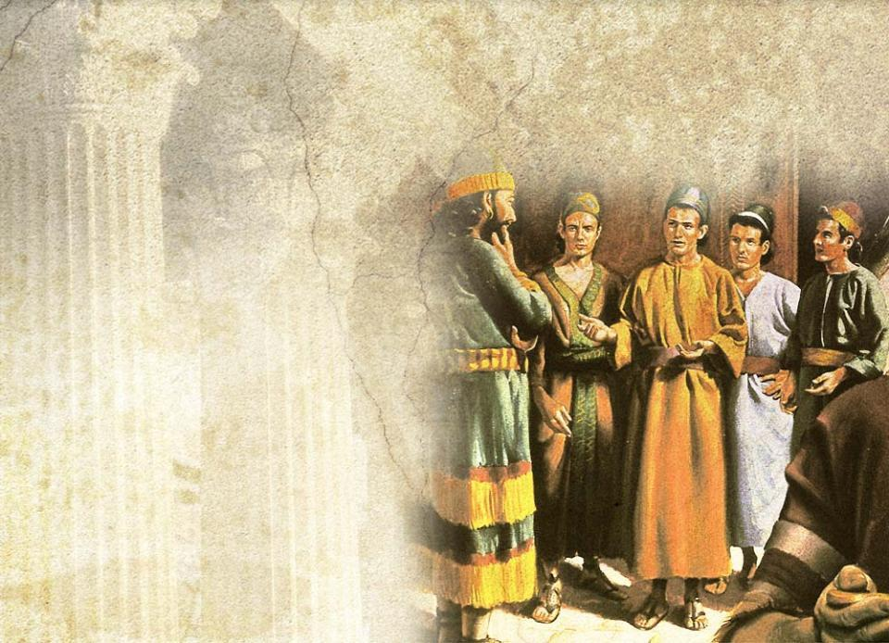
Daniel
As a youth he lived in integrity in adverse circumstances. With his three companions,
“Daniel resolved
not to defile himself
with the royal
food and wine. . .” Dan 1:8 (NIV)
He did not
lose his identifying values
succumb to despair

Slide 33
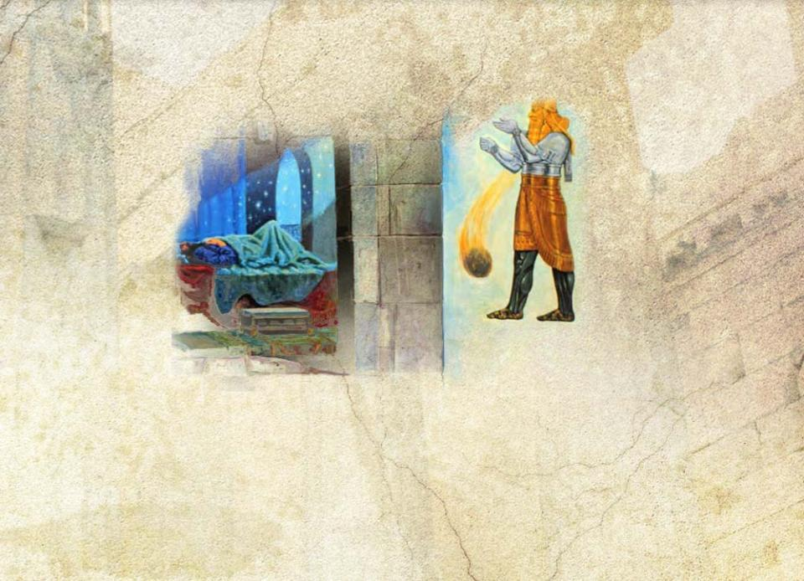
Daniel lived with integrity when he was an academic superstar.
Even though he was given preeminence after interpreting the king’s dream, he remained humble and compassionate towards his peers.

Slide 34
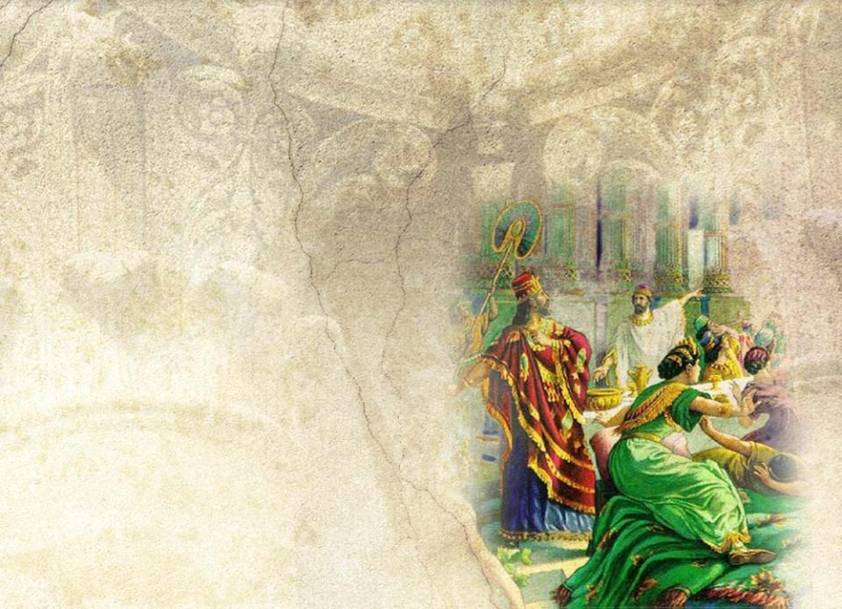
Daniel lived with integrity despite the turbulence of national conquest.
His counsel was
equally valued by
the leaders of
Babylon and
Medo-Persia.

Slide 35
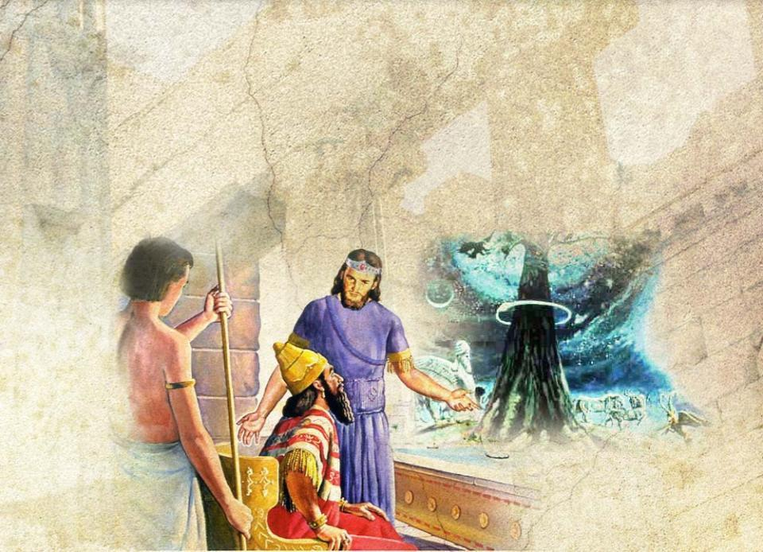
At great personal risk, he warned Nebuchadnezzar of impending punishment to be inflicted because of kingly pride and arrogance.

Slide 36
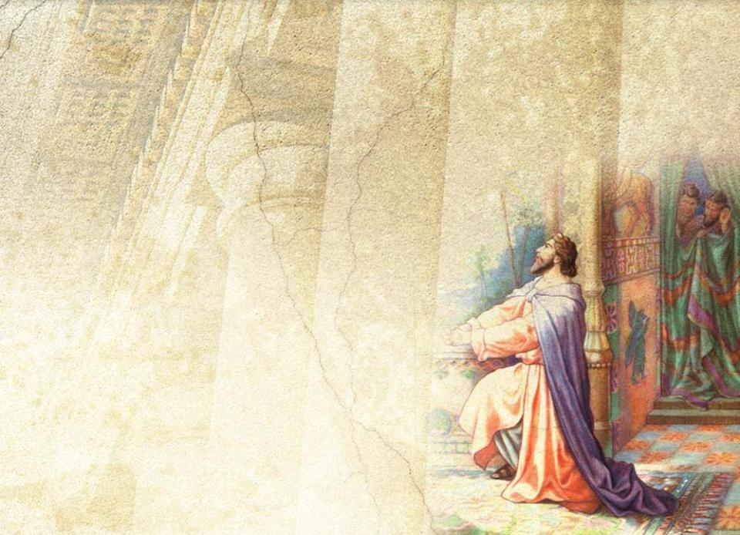
The final and supreme test of Daniel’s integrity came in his old age.
In spite of the king’s decree to the contrary, “he went home to his upstairs room where the
windows opened . . .
Three times a day he
got down on his
knees and prayed . . .
just as he had
done before.” (Dan 6:10 (NIV)

Slide 37

God rewarded his integrity. “My God sent his angel, and he shut the mouths of the lions. They have not hurt me, because I was found innocent in his sight. Nor have
I ever done any wrong before
you, O king.”
Dan 6:22 (NIV)

Slide 38

Examples of Integrity in Recent History
Mahatma Gandhi modeled nonviolent resistance to win
India’s independence.

Slide 39
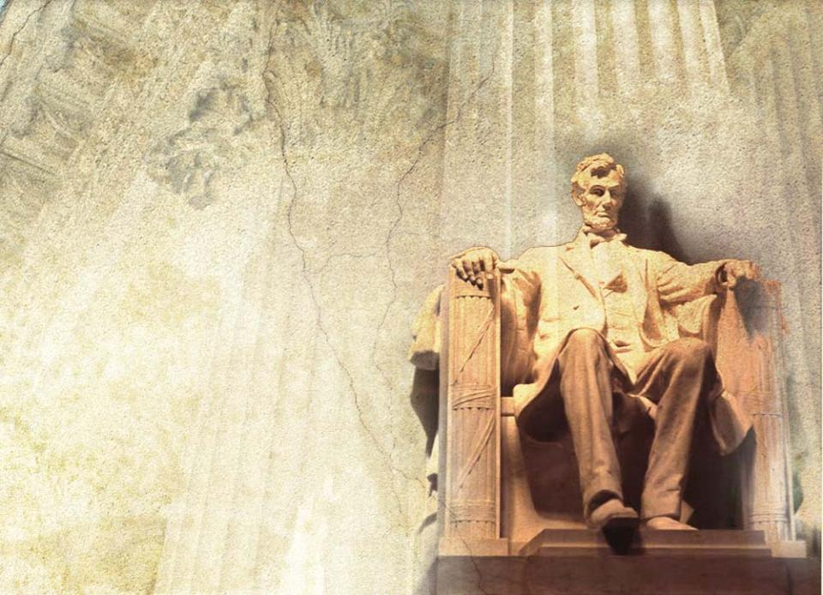
Abraham Lincoln endured
civil war to free the
American slaves.

Slide 40
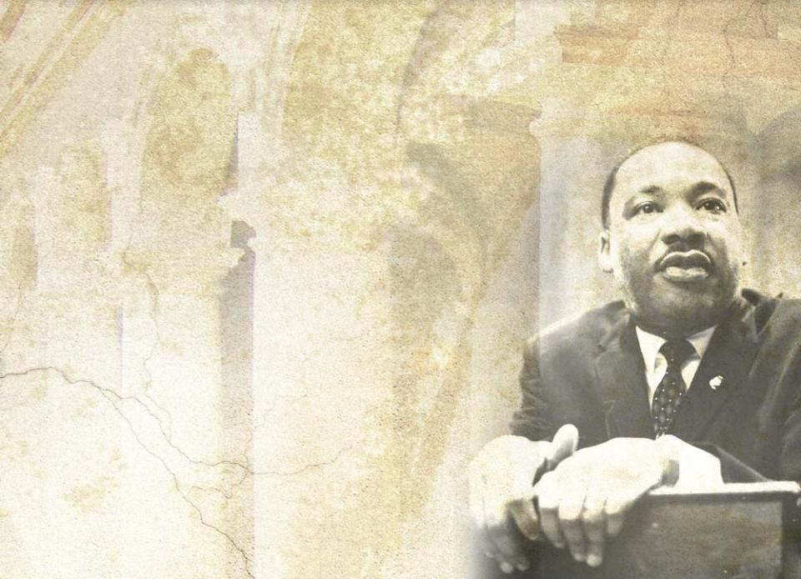
Martin Luther King Jr. championed
non-discrimination,
even though he knew
his life was in danger.

Slide 41

Mother Teresa ministered to the untouchables of Calcutta.

Slide 42
James E. Burke, CEO of Johnson & Johnson Company, demonstrated integrity in 1982 when he
acted on the company’s credo to to provide safe quality products
refused to cover up the news that
seven people died when someone
laced Tylenol with cyanide
alerted the public to the danger
removed all Tylenol from the U. S.
until it was safe to redistribute
His decision cost the company $100 million, but earned it priceless public trust.

Slide 43

(Johnson &Johnson, continued)
Tylenol was again tampered with and cyanide inserted into some capsules in 1986, resulting in one fatality.
This time the company withdrew Tylenol in capsule form until they reintroduced it in tamper-proof caplets, and later in tamper-evident packaging.
The company received much praise for its quick and honest handling of the crises.

Slide 44

We Identify Integrity in Our Church Entities by the Following Behaviors:
1- We see integrity in corporate governance when Boards of Trustees
ensure that appropriate policies and procedures are approved and implemented
hold leaders and managers accountable for
  fulfilling the institution’s mission
  implementing strategic action plans
  achieving quality in programs and products
  ensuring healthy public relations
  prudently handling all resources
fully disclose real or potential conflicts of interest

Slide 45

2- We see integrity when everyone is treated with fairness and equality without favoritism or discrimination.
Academic personnel consistently implement policies of academic integrity.
Quality health care is provided to all patients regardless of their social status or ability to pay.
All persons are treated fairly with dignity and respect.
The environment is free from discrimination, hostility, or any form of harassment.
All persons are held to a single standard of accountability for their behavior and performance.

Slide 46

3- We see integrity in business practices when
commitments and contracts are honored even when they may be unfavorable to the person making the commitment
there is
regulatory
compliance
and financial
integrity in all
dealings
¹Lord, who may dwell in your sanctuary? Who may live on your holy hill?
²He . . .
⁴who keeps his oath even when
it hurts.
Ps 15:1,2,4 (NIV)

Slide 47
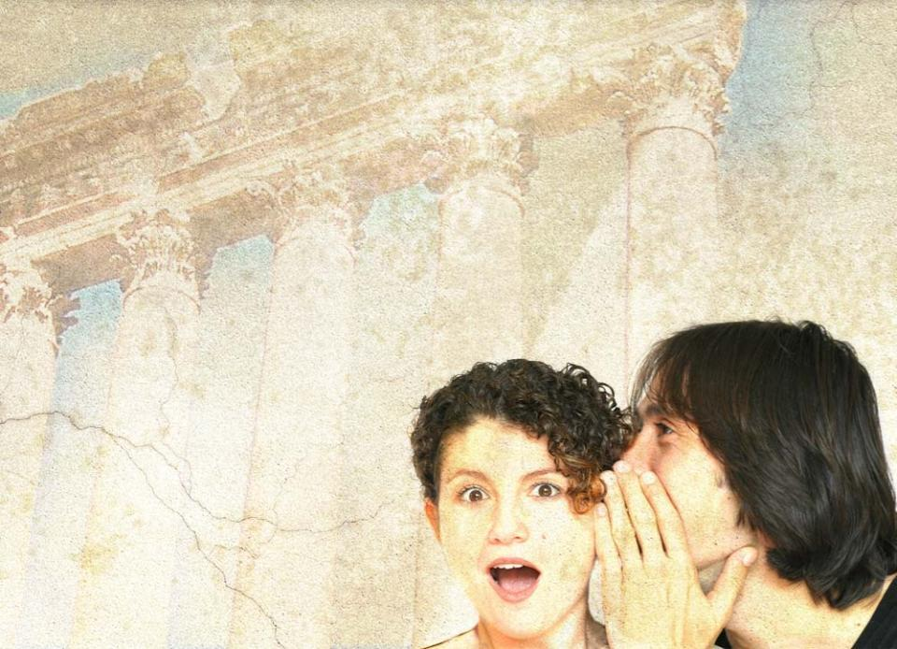
4- We see integrity in our institutions and churches when rumors and gossip are confronted and investigated.
Investigation
helps to identify the guilty party
helps to clear the
falsely accused
stops gossip
restores the
reputation of the
falsely accused

Slide 48
Integrity does not mean perfection.
When an error does occur
report it immediately to the proper authority
acknowledge the error to those who are directly concerned
implement action to keep such an error from happening again

Slide 49

“To err is human.” Corporate integrity is displayed when
governing bodies approve procedures for dealing with errors
leaders create pathways for reporting errors so they can be corrected and prevented in the future
employees are educated about, and rewarded for, following protocol if a mistake does occur

Slide 50

Integrity: The Golden Egg in Business
The Integrity-based Organization displays
1
“Integrity of Vision–” creates “the greatest value service or product.”
2“Integrity of Mission–” makes “your [organization’s] quality the best it can be.”
3Integrity of Function–” makes “all functioning parts . . . the best that they can be.”

Slide 51

4
“Integrity of Individual” – inspires each individual to give or do “his or her best in all aspects of [his/her] job.”
5
“Integrity of (financial) Compensation–” ties all pay and benefits to performance.
6
“Integrity of (nonfinancial) Compensation–” ties “respect, gratitude, and recognition to performance.”
7
“Integrity of Security–” develops “a plan that allows for stability and security of employment.”
From Sherwood Business Consulting Services at www.shrwood.com
WARNING: while you are free to copy and translate the text of the content of this DVD for training purposes within the Seventh-day Adventist Church, illustrations are owned by various entities that have provided us limited use rights. DO NOT COPY OR USE THE ILLUSTRATIONS WITHOUT OBTAINING LICENSES AND PERMISSION TO DO SO IN ADVANCE.

