Slide 1


S E S S I O N O N E : C h a r a c t e r a n d P e r s o n a l i t y o f A d v e n t i s t L e a d e r s h i p • SLIDE
A LEADERSHIP WORKSHOP
Based on the Collected Papers
from the Leadership Symposium
General Conference Session
July 3-7, 2005

Slide 2
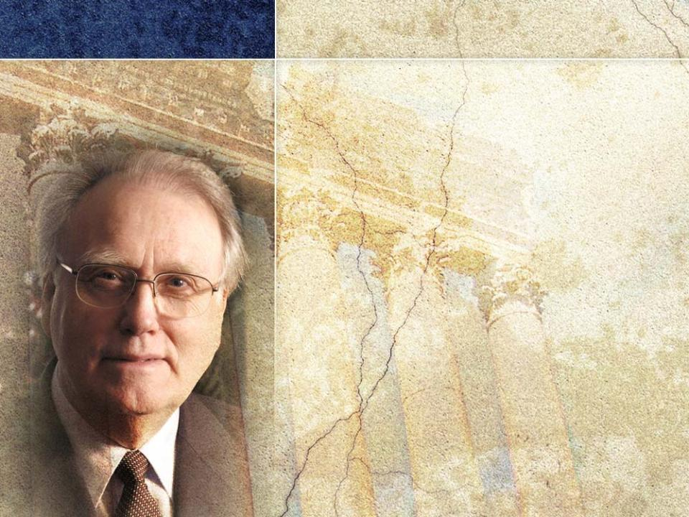
S E S S I O N O N E : C h a r a c t e r a n d P e r s o n a l i t y o f A d v e n t i s t L e a d e r s h i p • SLIDE
SESSION one
Character and Personality of Adventist Leadership
Based on the Keynote
Presentation by General Conference President
Jan Paulsen

Slide 3

S E S S I O N O N E : C h a r a c t e r a n d P e r s o n a l i t y o f A d v e n t i s t L e a d e r s h i p • SLIDE
ADVENTIST LEADERSHIP
A SACRED TRUST
These workshop sessions on leadership will explore
1Why the subject of Adventist leadership is especially important now.
2 What makes Adventist leadership so special.
3 Where we go and what we look for when we seek to profile the leadership character of our church.

Slide 4

S E S S I O N O N E : C h a r a c t e r a n d P e r s o n a l i t y o f A d v e n t i s t L e a d e r s h i p • SLIDE
4Where the leadership models are. What we are to look at.
5What is expected globally of leadership in the Adventist Church.
6
How leadership functions.
7
The best climate or mode for Adventist leadership to express itself.
8
What is acceptable in leadership. What is not acceptable.
9
What the boundaries of leadership are.

Slide 5

S E S S I O N O N E : C h a r a c t e r a n d P e r s o n a l i t y o f A d v e n t i s t L e a d e r s h i p • SLIDE
Session 1 will address the
following questions:
1
Why is it important that we focus on Adventist leadership at this time?
2What are the major qualities that Adventist leaders should demonstrate?
3How can leaders develop these characteristics?
4What characteristics should leaders avoid?

Slide 6

S E S S I O N O N E : C h a r a c t e r a n d P e r s o n a l i t y o f A d v e n t i s t L e a d e r s h i p • SLIDE
Leadership in
the Adventist Church
is different
from leadership
in business
or leadership in
politics.

Slide 7

S E S S I O N O N E : C h a r a c t e r a n d P e r s o n a l i t y o f A d v e n t i s t L e a d e r s h i p • SLIDE
TRUST
is critical in church leadership.
A leader cannot command or demand trust; he/she must earn trust by being trustworthy.

Slide 8

S E S S I O N O N E : C h a r a c t e r a n d P e r s o n a l i t y o f A d v e n t i s t L e a d e r s h i p • SLIDE
It is vitally important that trust NOT be swallowed up by
obsession for control.
Trust
Obsession for control

Slide 9
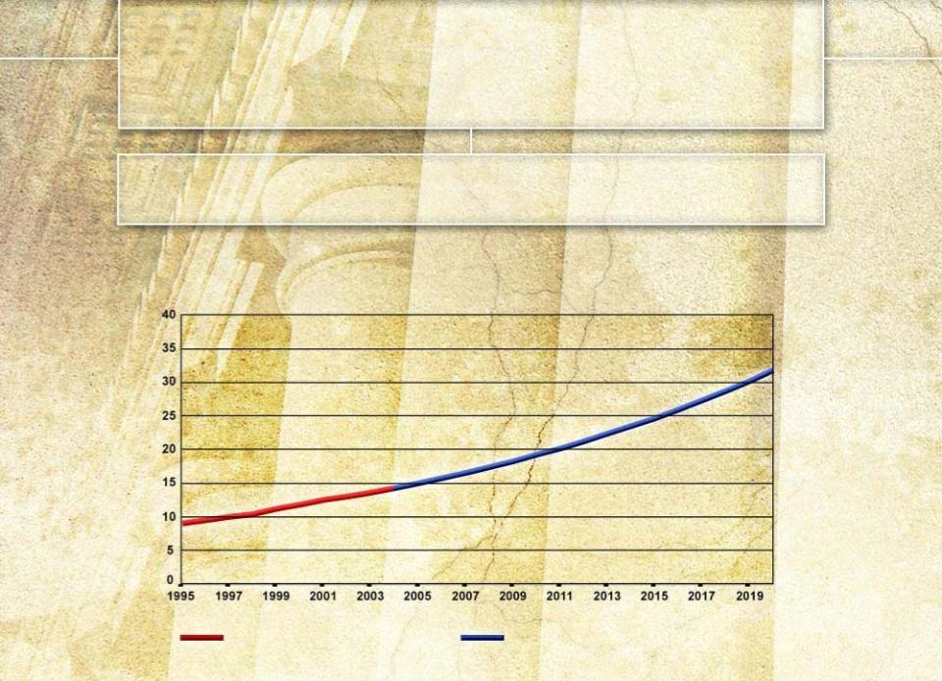

S E S S I O N O N E : C h a r a c t e r a n d P e r s o n a l i t y o f A d v e n t i s t L e a d e r s h i p • SLIDE
Realities that Compel Us to
Consider the Matter of Leadership
I. The Expanding Church
FIGURE 1. Actual & Projected Church Growth — 1995 - 2020
Growth in Millions of Members
Actual Growth
Projected Growth

Slide 10
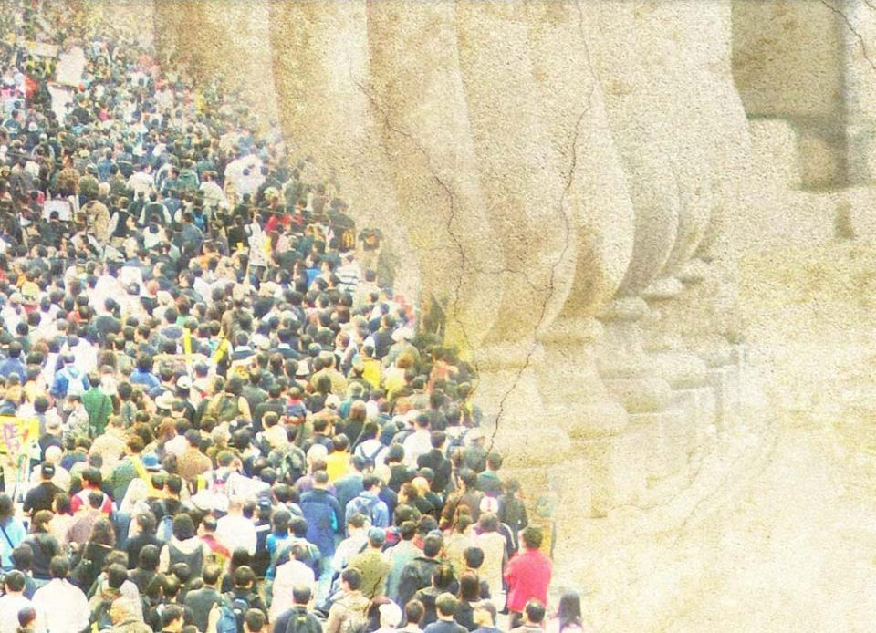
S E S S I O N O N E : C h a r a c t e r a n d P e r s o n a l i t y o f A d v e n t i s t L e a d e r s h i p • SLIDE
There will be about 31.5 million baptized Adventist members by the year 2020.
These members, together with their children and
other unbaptized
church attendees,
will total nearly
50 million by
that time.

Slide 11


S E S S I O N O N E : C h a r a c t e r a n d P e r s o n a l i t y o f A d v e n t i s t L e a d e r s h i p • SLIDE
By 2020, the Adventist Church will be a “young church;” most will have been members for 20 years or less.
FIGURE 2. Projected Distribution of Adventist Church Members in 2020
Members in 2000
12%
New Members
88%

Slide 12
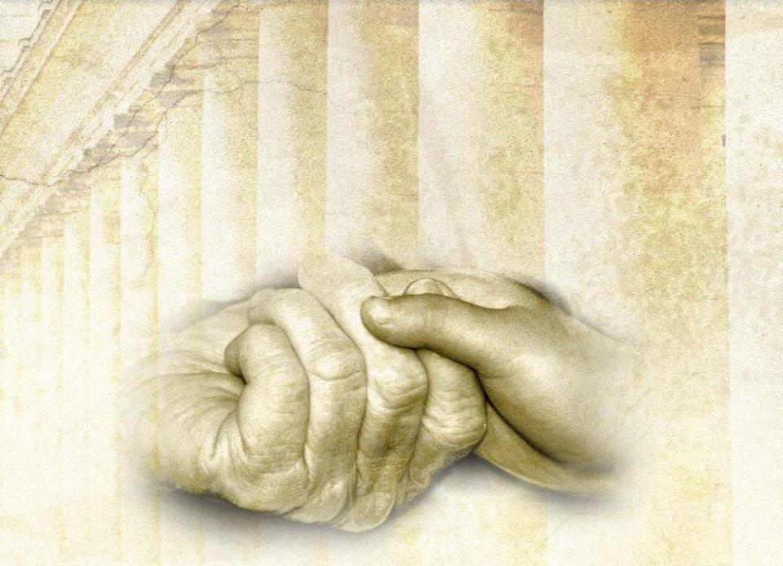
S E S S I O N O N E : C h a r a c t e r a n d P e r s o n a l i t y o f A d v e n t i s t L e a d e r s h i p • SLIDE
Since the expanding church will be a “young” church, we must consider how we pass on identity and values from one generation of believers to the next.

Slide 13

S E S S I O N O N E : C h a r a c t e r a n d P e r s o n a l i t y o f A d v e n t i s t L e a d e r s h i p • SLIDE
Leadership must identify the faith identity and range of values that are integral to being a Seventh-day Adventist anywhere.
These values transcend
time and culture.
Leadership must
give priority to
asserting and
nurturing these
values.

Slide 14


S E S S I O N O N E : C h a r a c t e r a n d P e r s o n a l i t y o f A d v e n t i s t L e a d e r s h i p • SLIDE
II. The Inevitability of Change
Change cannot be resisted and should not be feared.

Slide 15

S E S S I O N O N E : C h a r a c t e r a n d P e r s o n a l i t y o f A d v e n t i s t L e a d e r s h i p • SLIDE
It is critical that leadership clearly identify the spiritual DNA of Seventh-day Adventism.
This spiritual DNA transcends
cultures and traditions.
Leadership must retain, treasure,
nurture, and pass it on to our
children and to the next
generation of church members.

Slide 16
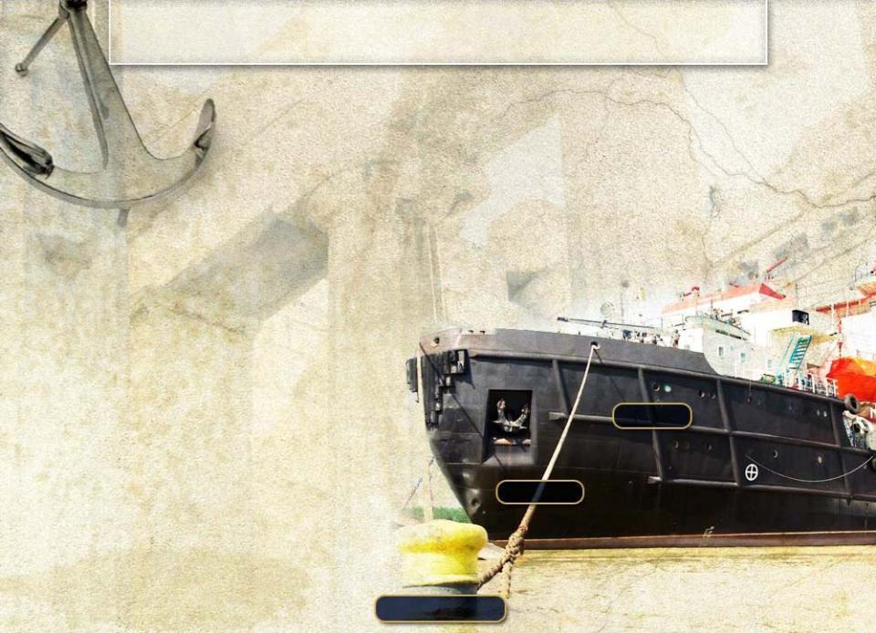



S E S S I O N O N E : C h a r a c t e r a n d P e r s o n a l i t y o f A d v e n t i s t L e a d e r s h i p • SLIDE
III. The Strength of Permanence
Leadership must guide the church in living creatively with both.
Change will be anchored to the church’s specific landmarks.
Change
Tension
Permanence

Slide 17

S E S S I O N O N E : C h a r a c t e r a n d P e r s o n a l i t y o f A d v e n t i s t L e a d e r s h i p • SLIDE
IV. Living Creatively with Diversity
The Adventist
Church is a global
community with
constant interaction
among cultures.
Leadership must clearly identify those values that
we will continue to hold
transcend time and culture
identify us as a church community

Slide 18
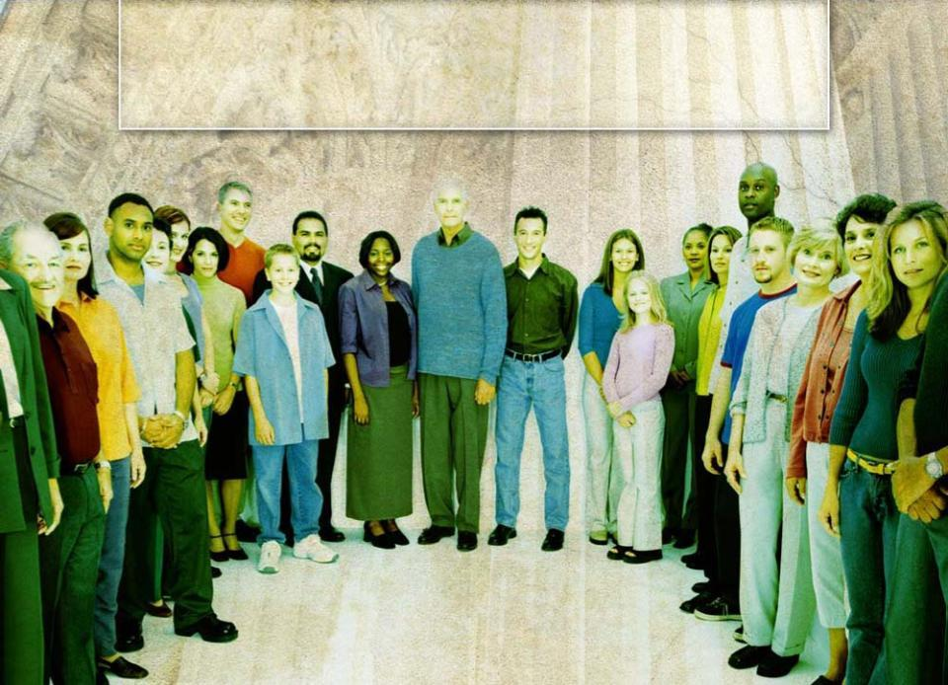
S E S S I O N O N E : C h a r a c t e r a n d P e r s o n a l i t y o f A d v e n t i s t L e a d e r s h i p • SLIDE
V. Celebrating Diversity While Maintaining Our Values

Slide 19

S E S S I O N O N E : C h a r a c t e r a n d P e r s o n a l i t y o f A d v e n t i s t L e a d e r s h i p • SLIDE
Leadership must
identify the basket of Adventist non-variables
not be threatened by local cultural
expression
place values above culture
Sabbath
Second
Coming
State of
The Dead
Adventist non-variables
Local traditions can only do us harm if we are uncertain about our faith and moral values.

Slide 20


S E S S I O N O N E : C h a r a c t e r a n d P e r s o n a l i t y o f A d v e n t i s t L e a d e r s h i p • SLIDE
Leadership must react proactively to bring out the appropriate richness in our global family.
Values
Culture

Slide 21

S E S S I O N O N E : C h a r a c t e r a n d P e r s o n a l i t y o f A d v e n t i s t L e a d e r s h i p • SLIDE
The Church as a
Global Community

Slide 22
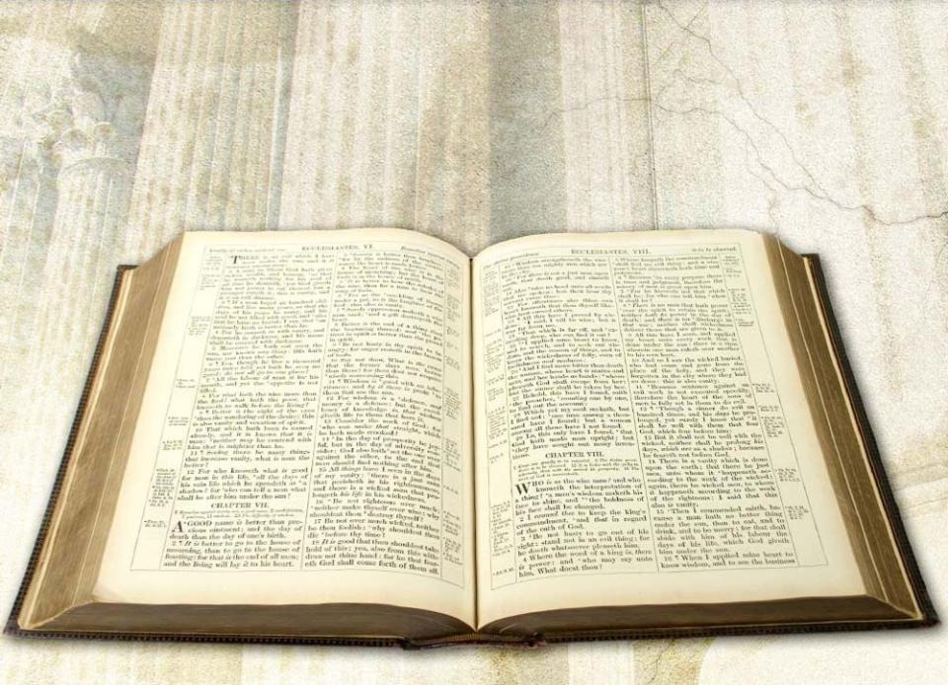
S E S S I O N O N E : C h a r a c t e r a n d P e r s o n a l i t y o f A d v e n t i s t L e a d e r s h i p • SLIDE
Our unity as a global church is based on the strong foundation of God’s Word.

Slide 23

S E S S I O N O N E : C h a r a c t e r a n d P e r s o n a l i t y o f A d v e n t i s t L e a d e r s h i p • SLIDE
E P H E S I A N S
E P H E S I A N S
³Make every effort to keep the unity of the Spirit through the bond of peace.
⁴There is one body and one Spirit—just as you were called to one hope when you were called—
⁵one Lord, one faith, one baptism;
⁶one God and Father of all, who is over all, and through all and
in all.
Eph 4:3-6 (NIV)

Slide 24

S E S S I O N O N E : C h a r a c t e r a n d P e r s o n a l i t y o f A d v e n t i s t L e a d e r s h i p • SLIDE
As a global community,
we have in common
a model constitution
a set of policies
a church manual
28 fundamental beliefs
an integrated financial resource support system
These foster our commitment to unity.
The unity we share is primarily spiritual.

Slide 25
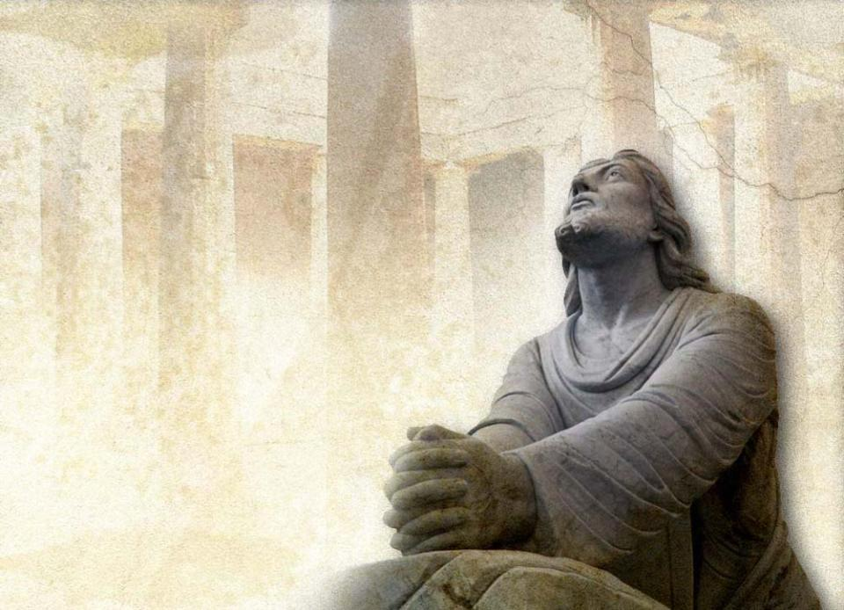
S E S S I O N O N E : C h a r a c t e r a n d P e r s o n a l i t y o f A d v e n t i s t L e a d e r s h i p • SLIDE
Jesus wants His church
to be united.
Just before His crucifixion He prayed the prayer in John 17.

Slide 26
S E S S I O N O N E : C h a r a c t e r a n d P e r s o n a l i t y o f A d v e n t i s t L e a d e r s h i p • SLIDE
¹¹“. . . I am coming to you. Holy Father, protect them by the power of your name— the name you gave me—so that they may be one as we are one. . .
²¹“that all of them may be one, Father, just as you are in me and I am in you. May they also be in us so that the world may believe that you have sent me.
²²“I have given them the glory that you gave me, that they may be one as we are one:
²³“I in them and you in me. May they be brought to complete unity to let the world know that you sent me and have loved them even as you have
loved me.” John 17:11, 21-23 (NIV)

Slide 27
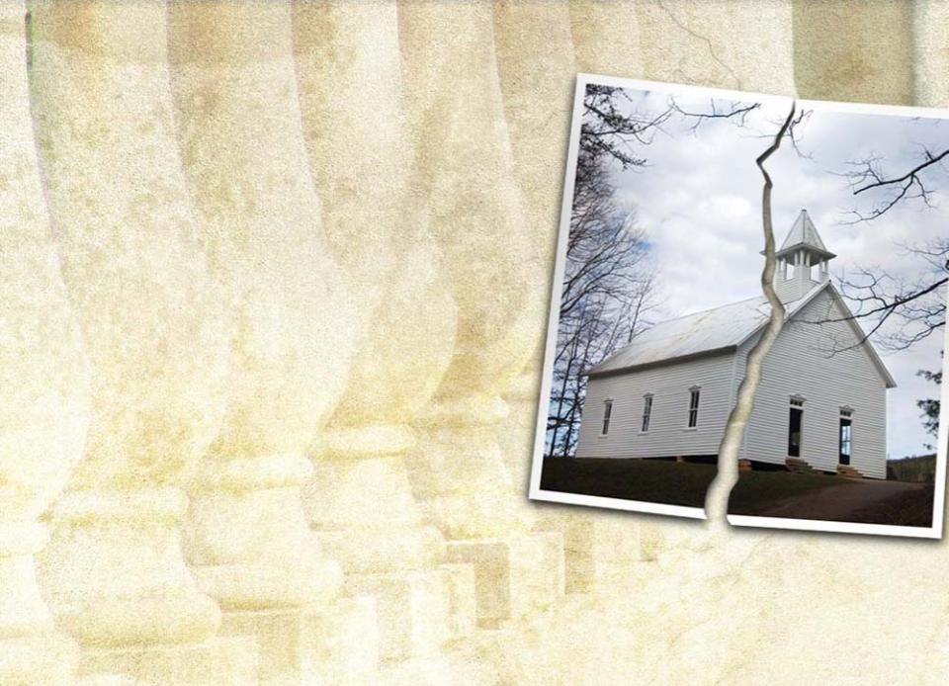
S E S S I O N O N E : C h a r a c t e r a n d P e r s o n a l i t y o f A d v e n t i s t L e a d e r s h i p • SLIDE
The church is Christ’s mystical body in the world today.
A fractured church is a church in denial.
The church is God’s preferred instrument of mission.

Slide 28
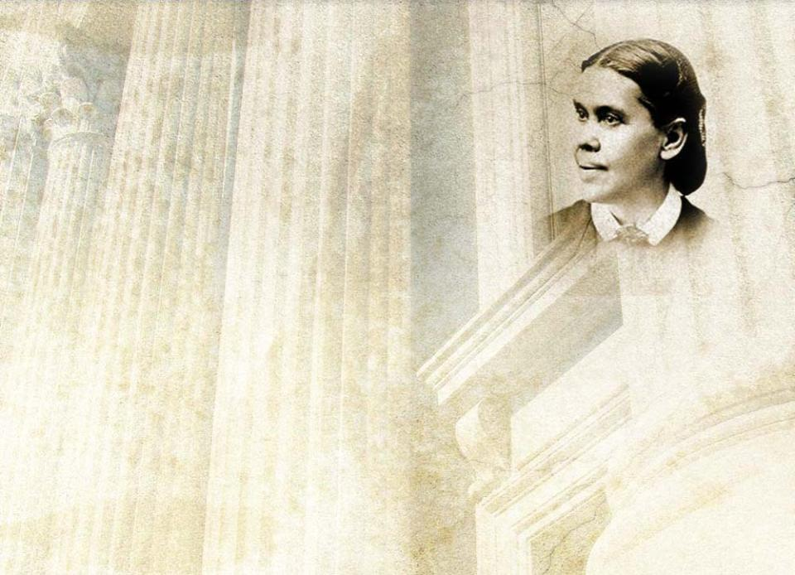
S E S S I O N O N E : C h a r a c t e r a n d P e r s o n a l i t y o f A d v e n t i s t L e a d e r s h i p • SLIDE
“Enfeebled and defective
as it may appear, the
church is the one object
upon which God bestows in
a special sense His supreme regard.” (Acts of the Apostles, p. 12)

Slide 29

S E S S I O N O N E : C h a r a c t e r a n d P e r s o n a l i t y o f A d v e n t i s t L e a d e r s h i p • SLIDE
Imperatives for Adventist
Church Leadership
Leadership must
give undivided allegiance to the Lord and to His Body
tenderly care for the needs of the church

Slide 30

S E S S I O N O N E : C h a r a c t e r a n d P e r s o n a l i t y o f A d v e n t i s t L e a d e r s h i p • SLIDE
“Love” is Christ’s favored word to describe
the bonding relationship between members of the family
of faith.

Slide 31
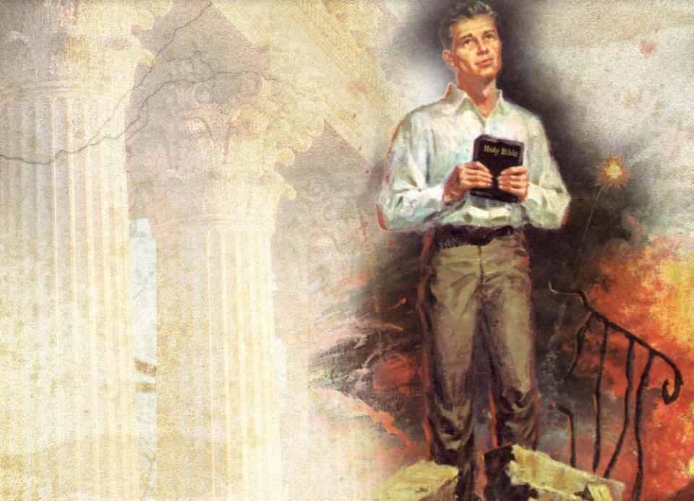
S E S S I O N O N E : C h a r a c t e r a n d P e r s o n a l i t y o f A d v e n t i s t L e a d e r s h i p • SLIDE
Church leaders must love the church enough
to suffer for it
to give themselves for it

Slide 32
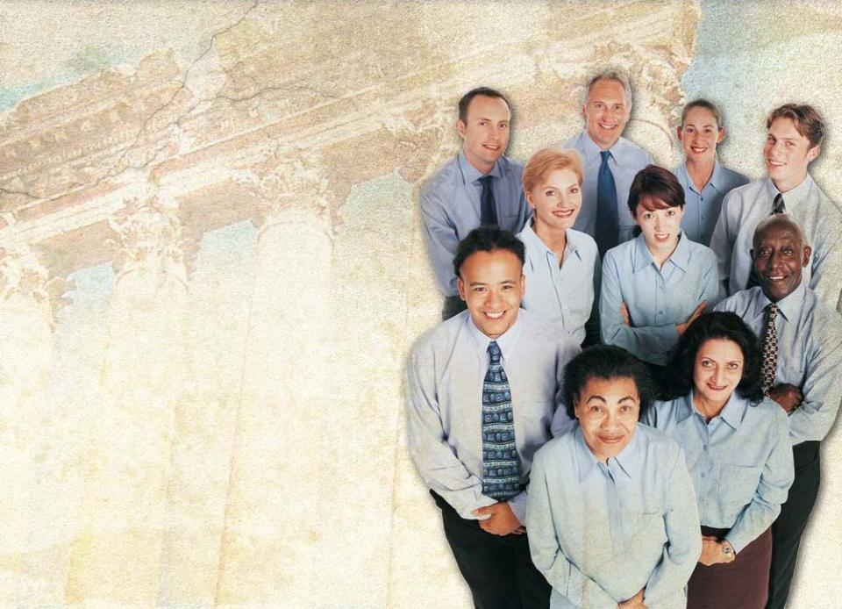
S E S S I O N O N E : C h a r a c t e r a n d P e r s o n a l i t y o f A d v e n t i s t L e a d e r s h i p • SLIDE
Leaders will not
be self-serving
be casual or frivolous with the life and well-being of the church
impose their own independent “wisdom” on
the church

Slide 33
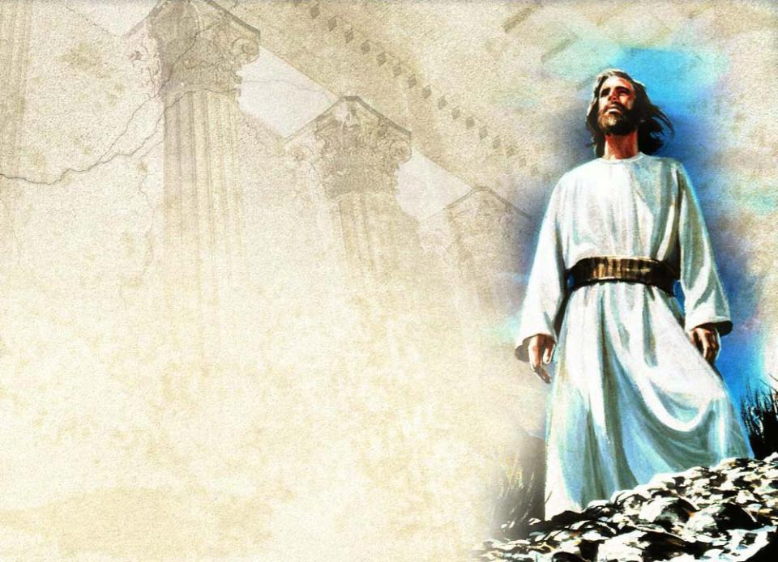
S E S S I O N O N E : C h a r a c t e r a n d P e r s o n a l i t y o f A d v e n t i s t L e a d e r s h i p • SLIDE
Christ is the model for Adventist leaders.
The church has only one Lord, Jesus Christ, not the elected church leader.

Slide 34
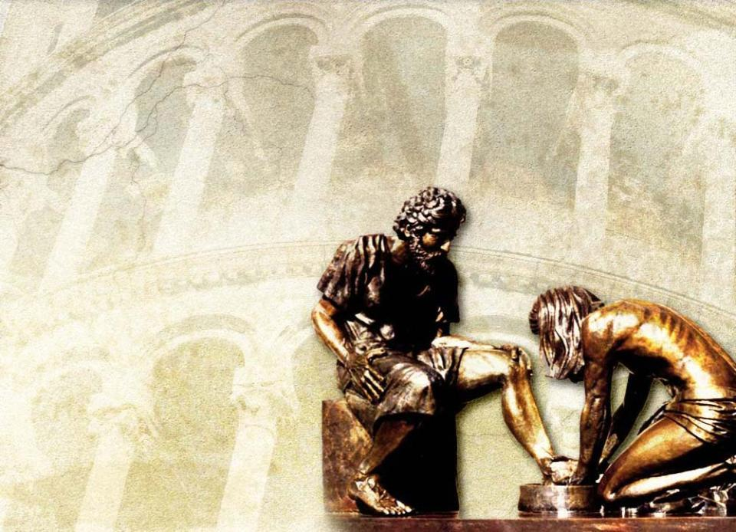
S E S S I O N O N E : C h a r a c t e r a n d P e r s o n a l i t y o f A d v e n t i s t L e a d e r s h i p • SLIDE
Leaders will
remember that they are servants
love and respect members of the
church family
reflect this in
their style
of leadership

Slide 35

S E S S I O N O N E : C h a r a c t e r a n d P e r s o n a l i t y o f A d v e n t i s t L e a d e r s h i p • SLIDE
Adventist leadership
always defers to what is understood and agreed upon by the larger church body
agrees as a global family on how we shall act and what we shall do
works on the basis of consultation and consensus

Slide 36
S E S S I O N O N E : C h a r a c t e r a n d P e r s o n a l i t y o f A d v e n t i s t L e a d e r s h i p • SLIDE
Adventist leadership
will be sensitive to what the church can accept at any given time
will not outpace the community it serves
will not show a spirit of independence

Slide 37

S E S S I O N O N E : C h a r a c t e r a n d P e r s o n a l i t y o f A d v e n t i s t L e a d e r s h i p • SLIDE
“There have ever been in the
church those who are constantly inclined toward individual independence. They seem
unable to realize that indepen-
dence of spirit is liable to lead
the human agent to have too much confidence in himself and to trust in his own judgment rather than to respect the counsel and highly esteem the judgment of his brethren.” (Testimonies for the Church, Vol 3, p. 431)
© Ellen G. White Estate

Slide 38
S E S S I O N O N E : C h a r a c t e r a n d P e r s o n a l i t y o f A d v e n t i s t L e a d e r s h i p • SLIDE
“Sometimes a man who has
been placed in responsibility
as a leader gains the idea that
he is in a position of supreme authority, and that all his
brethren, before making advance moves, must first come to him for permission to do that which they feel should be done.
© Ellen G. White Estate

Slide 39
S E S S I O N O N E : C h a r a c t e r a n d P e r s o n a l i t y o f A d v e n t i s t L e a d e r s h i p • SLIDE
Such a man is in a dangerous position. He has lost sight of the
work of a true leader among
God’s people. Instead of
acting as a wise counselor, he assumes the prerogatives of an exacting ruler. God is dishonored by every such display of authority and self-exaltation.”
(Testimonies for the Church, Vol 3, p. 493)
© Ellen G. White Estate

Slide 40

S E S S I O N O N E : C h a r a c t e r a n d P e r s o n a l i t y o f A d v e n t i s t L e a d e r s h i p • SLIDE
Leaders in the church
will seek that which is good for the whole body
function in the interest of the whole church
If this is compromised, the unity of the whole church is undermined.
One who cannot see this or will not abide by it should not accept a leader-
ship appointment in the church.

Slide 41

S E S S I O N O N E : C h a r a c t e r a n d P e r s o n a l i t y o f A d v e n t i s t L e a d e r s h i p • SLIDE
A conference organization is as bonded to the whole body of the church as it is to the local congregation under its supervision.
Whole
Church
Body
bond
Local
Conference
bond
Local
Congregation

Slide 42

S E S S I O N O N E : C h a r a c t e r a n d P e r s o n a l i t y o f A d v e n t i s t L e a d e r s h i p • SLIDE
Election to Church Office
Church leaders
serve at the pleasure of the community
should not take service for granted
should not become bitter if not reelected

Slide 43

S E S S I O N O N E : C h a r a c t e r a n d P e r s o n a l i t y o f A d v e n t i s t L e a d e r s h i p • SLIDE
“If you cannot accept being elected out,
you should not
accept being
elected in!”

Slide 44

S E S S I O N O N E : C h a r a c t e r a n d P e r s o n a l i t y o f A d v e n t i s t L e a d e r s h i p • SLIDE
Qualities Needed for Election to Church Leadership
Spirituality
A church leader
must be driven by spiritual
qualities and concerns
must demonstrate
spiritual leadership

Slide 45

S E S S I O N O N E : C h a r a c t e r a n d P e r s o n a l i t y o f A d v e n t i s t L e a d e r s h i p • SLIDE
After spirituality, humility andintegrity are the
highest qualities
needed in Adventist
leadership.
Transparency is the
filter through which humility and integrity are seen.

Slide 46

S E S S I O N O N E : C h a r a c t e r a n d P e r s o n a l i t y o f A d v e n t i s t L e a d e r s h i p • SLIDE
Humility
Not being proud, haughty, or arrogant
O L D T E S T A M E N T
N E W T E S T A M E N T
⁸He has showed you, O man, what is good. And what does the LORD re-quire of you? To act justly and to love mercy and to walk humbly with your God.
Mic 6:8 (NIV)
⁴"Therefore,
whoever humbles himself like this child is the greatest in the kingdom of heaven.”
Matt 18:4 (NIV)

Slide 47

S E S S I O N O N E : C h a r a c t e r a n d P e r s o n a l i t y o f A d v e n t i s t L e a d e r s h i p • SLIDE
Integrity
When one stands at the helm of leadership, it is critical that one not sell his soul or get caught
in a conflict of interest.

Slide 48

S E S S I O N O N E : C h a r a c t e r a n d P e r s o n a l i t y o f A d v e n t i s t L e a d e r s h i p • SLIDE
Greed and self-seeking do not belong in any leadership assignment in our church.
“If self is woven into the work, it is as the offering of strange fire in the place of the sacred. Such workers incur the displeasure of the Lord.” (Testimonies to Ministers, p. 260.1)
© Ellen G. White Estate

Slide 49

S E S S I O N O N E : C h a r a c t e r a n d P e r s o n a l i t y o f A d v e n t i s t L e a d e r s h i p • SLIDE
Vision
The capacity
to see beyond where you are presently standing
to see opportunities
to define their values

Slide 50

S E S S I O N O N E : C h a r a c t e r a n d P e r s o n a l i t y o f A d v e n t i s t L e a d e r s h i p • SLIDE
The Adventist community wants to know where
their leaders are going,
not just what they
hold in their hands.

Slide 51

S E S S I O N O N E : C h a r a c t e r a n d P e r s o n a l i t y o f A d v e n t i s t L e a d e r s h i p • SLIDE
The honor to serve the church and the Lord in a leadership capacity should be accepted only after prayerful consideration by the individual and his family.

Slide 52
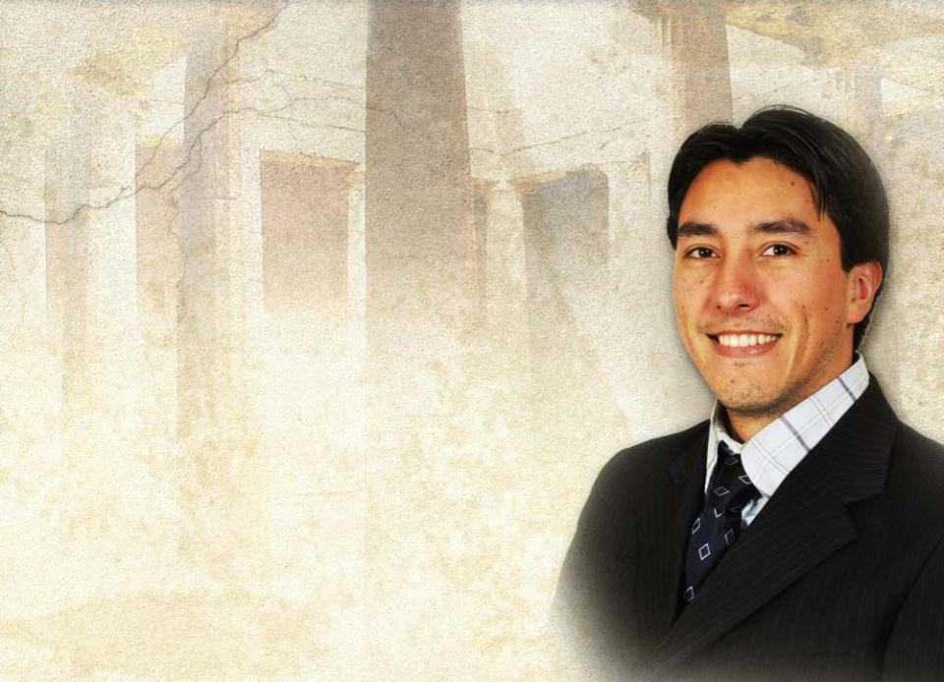
S E S S I O N O N E : C h a r a c t e r a n d P e r s o n a l i t y o f A d v e n t i s t L e a d e r s h i p • SLIDE
Leadership should be an
experience of joy and
fulfillment.
When it ceases to be
that, the leader should
step aside.

Slide 53
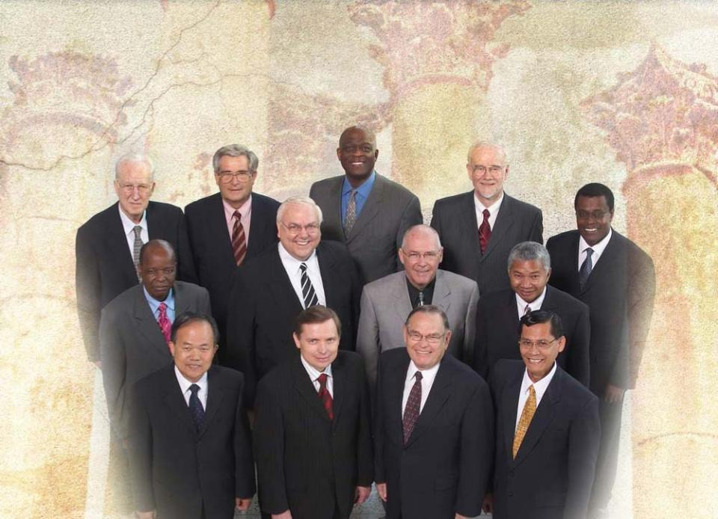

S E S S I O N O N E : C h a r a c t e r a n d P e r s o n a l i t y o f A d v e n t i s t L e a d e r s h i p • SLIDE
Adventist Church leaders always operate with an awareness of certain fundamental truths.
World Division Presidents
(L-R) Top Row: Ruy H. Nagel–SAD, Ulrich W. Frikart–ESD, Israel Leito–IAD, Bertil A. Wiklander–TED, Geoffrey G. Mbwana–ECD. Second Row: Luka T. Daniel–WAD, Don C. Schneider–NAD, Laurie J. Evans–SPD, Paul S. Ratsara–SID
Bottom Row: Jairyong Lee–NSD, Artur A. Stele–EUD, D. Ronald Watts–SUD, Alberto C. Gulfan Jr.–SSD

Slide 54

S E S S I O N O N E : C h a r a c t e r a n d P e r s o n a l i t y o f A d v e n t i s t L e a d e r s h i p • SLIDE
1They always live in anticipation of our Lord’s return.

Slide 55

S E S S I O N O N E : C h a r a c t e r a n d P e r s o n a l i t y o f A d v e n t i s t L e a d e r s h i p • SLIDE
2
They are conscious that we live with the unfinished assignment of being Christ’s witnesses.

Slide 56

S E S S I O N O N E : C h a r a c t e r a n d P e r s o n a l i t y o f A d v e n t i s t L e a d e r s h i p • SLIDE
3
They are ever deliberate in focusing the church on mission.
Mission is THE primary reason for our being as a church.

Slide 57

S E S S I O N O N E : C h a r a c t e r a n d P e r s o n a l i t y o f A d v e n t i s t L e a d e r s h i p • SLIDE
This is our Mission:
¹⁹“Therefore go and make disciples of all nations, baptizing them in the name of the Father and of the Son and of the Holy Spirit,
²⁰and teaching them to obey everything I have commanded
you. . . .”
Matt 28:19,20 (NIV)

Slide 58

WARNING: while you are free to copy and translate the text of the content of this DVD for training purposes within the Seventh-day Adventist Church, illustrations are owned by various entities that have provided us limited use rights. DO NOT COPY OR USE THE ILLUSTRATIONS WITHOUT OBTAINING LICENSES AND PERMISSION TO DO SO IN ADVANCE.
S E S S I O N O N E : C h a r a c t e r a n d P e r s o n a l i t y o f A d v e n t i s t L e a d e r s h i p • SLIDE
IN SUMMARY
Leadership in the Adventist Church is an assignment of
love,
loyalty,
and devotion
to the Lord and to His church.

