Slide 1
1st WORLD CHURCH
LEADERSHIP COUNCIL
February 9-10, 2021
Hensley M. Moorooven

Slide 2
The Importance of a United Strategy to Encourage Common and Effective Programs to “Reach the World”
TOPIC
1st World Church Leadership Council ● February 9-10, 2021

Slide 3
OBJECTIVE
To encourage participants to embrace the I Will Go Strategic Plan by showing them four ways it helps us ‘Reach the World.’
1st World Church Leadership Council ● February 9-10, 2021

Slide 4
“I WILL GO” HELPS US “REACH THE WORLD”
FOUR WAYS
1st World Church Leadership Council ● February 9-10, 2021

Slide 5
ONE
It provides a clear and common destination.
1st World Church Leadership Council ● February 9-10, 2021

Slide 6
A Strategic Plan is a road map, with a clear destination that helps get from where we are to where we want to be
1st World Church Leadership Council ● February 9-10, 2021

Slide 7
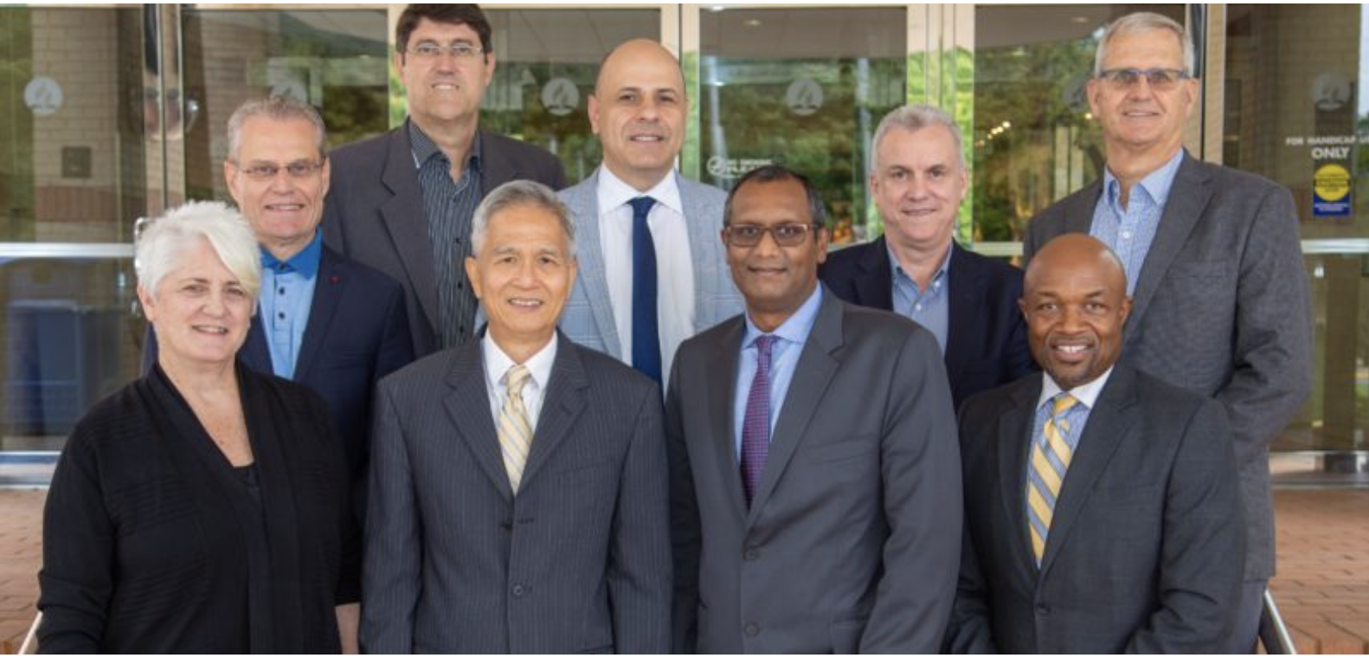
Tap into the Collective Wisdom of your Leadership Team
1st World Church Leadership Council ● February 9-10, 2021

Slide 8
Mission Strategies
Working Policy
ISE Call Process
Training and Evaluation
Missionary Care
Membership Audit
Nurture and Retention

Slide 10
TWO
It provides a clear and common destination.
It helps optimize the use of our resources.
1st World Church Leadership Council ● February 9-10, 2021

Slide 11
It doesn’t matter how many resources you have.
1st World Church Leadership Council ● February 9-10, 2021

Slide 12
It doesn’t matter how many resources you have.
If you don’t know how to use them, and if they are not aligned with your strategic goals,
they will never be enough.
1st World Church Leadership Council ● February 9-10, 2021

Slide 13
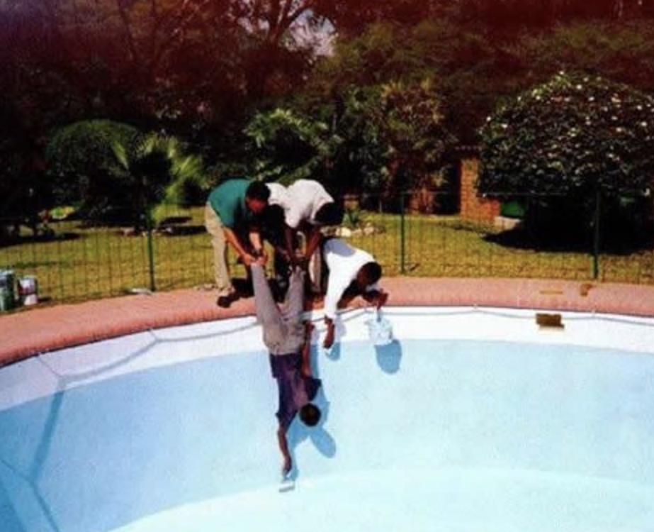
1st World Church Leadership Council ● February 9-10, 2021

Slide 14
Too many resources
Too few resources
1st World Church Leadership Council ● February 9-10, 2021

Slide 15
THREE
It provides a clear and common destination.
It helps optimize the use of our resources.
It helps us discover the difference between being busy and productive.
1st World Church Leadership Council ● February 9-10, 2021

Slide 16
1st World Church Leadership Council ● February 9-10, 2021

Slide 17
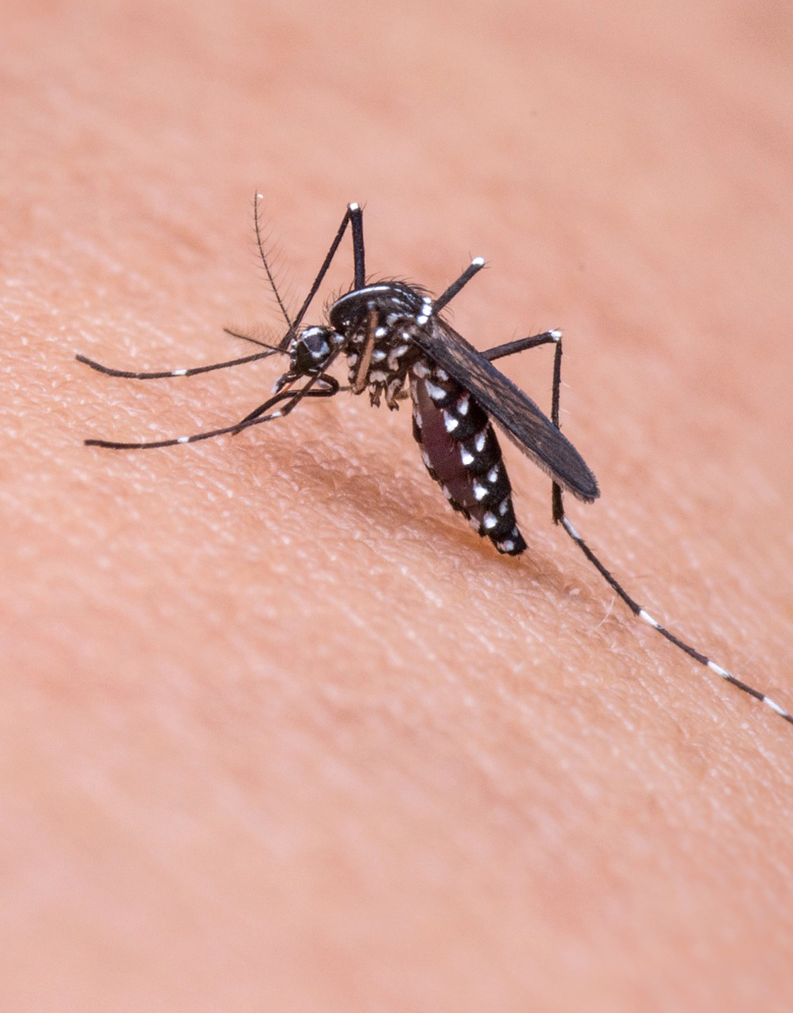
1st World Church Leadership Council ● February 9-10, 2021

Slide 18
The bee is busy . . .
but, so is the mosquito.
Busy
1st World Church Leadership Council ● February 9-10, 2021

Slide 19
THE MEANING OF BUSY
Being
Under
Satan’s
Yoke
Octo
1st World Church Leadership Council ● February 9-10, 2021

Slide 20
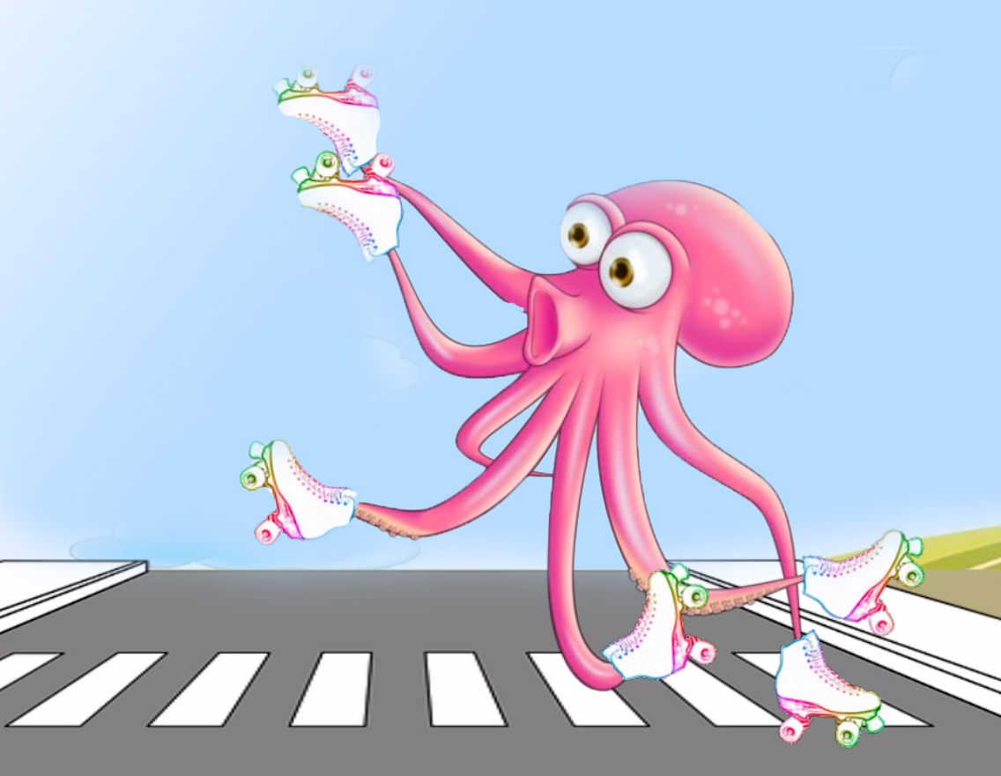
Performing your work without planning is like an octopus on roller skates. There’s plenty of movement, but you never know if it’s going to be forward, backward
or sideways.
pare
1st World Church Leadership Council ● February 9-10, 2021

Slide 21
The Pareto Principle (80-20 Principle)
NON-PLANNING ENVIRONMENT
80%
20%
80%
RESULTS
RESULTS
RESULTS
80%
20%
20%
EFFORTS
EFFORTS
EFFORTS
1st World Church Leadership Council ● February 9-10, 2021

Slide 22
The Pareto Principle (80-20 Principle)
NON-PLANNING ENVIRONMENT
PLANNING ENVIRONMENT
80%
20%
80%
RESULTS
RESULTS
RESULTS
80%
20%
20%
EFFORTS
EFFORTS
EFFORTS
1st World Church Leadership Council ● February 9-10, 2021

Slide 23
The Pareto Principle (80-20 Principle)
NON-PLANNING ENVIRONMENT
PLANNING ENVIRONMENT
80%
20%
80%
RESULTS
RESULTS
RESULTS
80%
20%
20%
EFFORTS
EFFORTS
EFFORTS
1st World Church Leadership Council ● February 9-10, 2021
EGW

Slide 24
“If we see no necessity for harmonious action, and are disorderly, undisciplined, and disorganized in our course of action, angels, who are thoroughly organized and move in perfect order, cannot work for us successfully. They turn away in grief, for they are not authorized to bless confusion, distraction, and disorganization.”
(Testimonies to the Church, vol. 1, p. 649)
X
1st World Church Leadership Council ● February 9-10, 2021

Slide 25
THE DIFFERENCE BETWEEN BEING BUSY AND PRODUCTIVE
1st World Church Leadership Council ● February 9-10, 2021
Poll

Slide 26
ACTIONABLE ADVICE
Be intentional in developing a robust process to implement the I Will Go Strategic Plan and ensure that we measure progress and track results.
1st World Church Leadership Council ● February 9-10, 2021

Slide 27
FOUR
It provides a clear and common destination.
It helps optimize the use of our resources.
It helps us discover the difference between being busy and productive.
It creates an environment conducive for God to bless His work..
1st World Church Leadership Council ● February 9-10, 2021
EGW

Slide 28
It is a religious duty to cultivate and to exercise every power which will render us more efficient workers in the cause of God. Careful consideration and well-matured plans are as essential to the success of sacred enterprise today as in the time of Nehemiah. If all who are engaged in the work of God would realize how much depends upon their fidelity and wise forethought, we would see far greater prosperity attend their efforts. . . . God will work for us, when we are ready to do what we can and should do on our part. (Signs of the Times, November 29, 1883, par. 14)
5p

Slide 29
FOUR WAYS – “ I WILL GO” HELPS US “REACH THE WORLD”
It provides a clear and common destination.
It helps optimize the use of our resources.
It helps us discover the difference between being busy and productive.
It creates an environment conducive for God to bless His work.
1st World Church Leadership Council ● February 9-10, 2021
Not subs

Slide 30
A Strategic Plan is not a substitute to God’s intervention and to the power of His Holy Spirit.
1st World Church Leadership Council ● February 9-10, 2021

Slide 31
THE PURE GIFT OF LEADERSHIP
He who leads, let him lead with diligence (Romans 12:8).
1st World Church Leadership Council ● February 9-10, 2021

