Slide 1
MEASURABLE GOALS
ARE THEY WORTH IT?

Slide 2
S.M.A.R.T.
S – Specific
M – Measurable
A – Attainable
R – Realistic
T – Time-bound

Slide 3
PRODUCTION RESULTS
----------------------.97
Control Group
------------------------------------1.44
SMART Group

Slide 4
Center for Management and Organization Effectiveness - CMOE
Teams who set goals obtain 20-25% improved work performance

Slide 5
CMOE – RESEARCH - BENEFITS
More self-confident
Experience less stress
Report and experience being happier at work
Report desiring to be more productive

Slide 6
VITAL TO THE PROCESS
Collaborate with individual team members in setting goals

Slide 7
4 STEPS TO SETTING GOALS
Identify potential goal areas
Create a SMART goal statement
Define the Action Plan
Implement and track

Slide 8
IDENTIFY POTENTIAL GOAL AREAS PROCESS:
What is the PRIMARY BUSINESS of your organization?
What are the SKILLS of your team?
What areas have OPPORTUNITIES to set goals?
Select HIGHEST priorities

Slide 9
QUIZ: WHICH OF THE FOLLOWING WOULD REPRESENT THE CHURCH’S HIGHEST PRIORITY?
Build a hospital on the moon
Re-freeze the melting glaciers
Ensure all men wear suits and ties to church
80% of church members practicing TMI

Slide 10
CREATE A SMART GOAL STATEMENT PROCESS:
What will be done? (Measurable)
Who will do it? (Ownership, responsibility, accountability)
When will it be accomplished? (Moving together)

Slide 11
QUIZ: WHICH IS THE BETTER GOAL STATEMENT ?
Ministries must work together to establish UCIs
Church administrators, working with10 identified departments of the church, will coordinate plans, resources and calendars to establish 6 UCIs in Cairo, Egypt before 2025

Slide 12
DEFINE THE ACTION PLAN PROCESS:
Goals need an action and implementation plans to have substance
People understand what needs to be done to be successful
Facilitates early identification of obstacles
Defines objectives (micro goals), actions and timelines

Slide 13
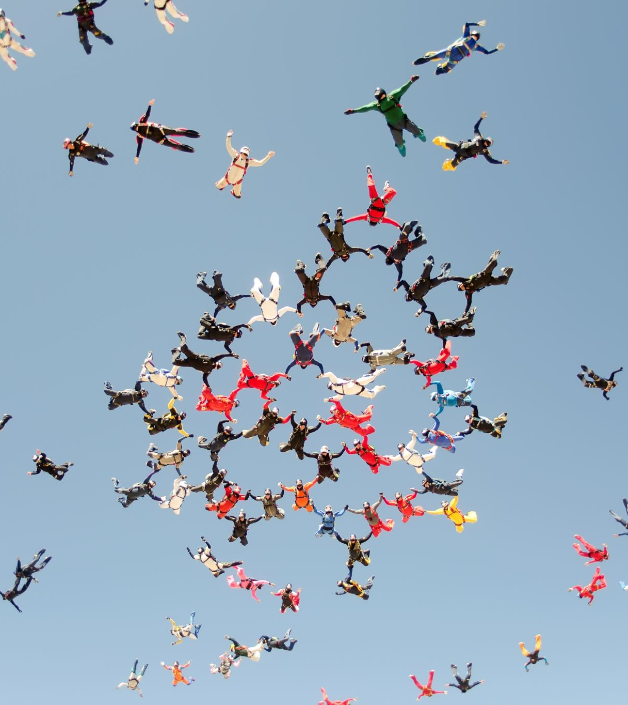
QUIZ: WHICH IS THE BETTER ACTION PLAN DEVELOPMENT PROCESS?
1. The Mission Offering goal will be communicated and realized by voting the goal at ADCOM and the GCEC
2. The mission offering goal will be communicated and realized by;
a. Taking appropriate voted actions
b. Divisions developing and reporting specific plans
c. Departments and services developing goal related resources
d. Informing members of the urgency

Slide 14
IMPLEMENT AND TRACK PROCESS/BENEFITS:
Make room on your schedule to track progress
Daily assessment of timelines and progress
Higher performance

Slide 15
QUIZ: WHICH IS THE BETTER TRACKING AND IMPLEMENTATION PROCESS?
Trust the team to become involved and listen to voluntary comments made during committees
Trust the team and listen, but also develop a system that intentionally calls for reports and requires specific scheduled involvement

Slide 16
EGW: Evangelism page 94
”Well defined plans should be freely presented to whom they may concern, and it should be ascertained that they are understood. Then require of all those who are at the head of the various departments to cooperate in the execution of these plans. If this sure and radical method is properly adopted and followed up with interest and good will, it will avoid much work being done without any definite object, much useless friction. “

