Slide 2
Notes:
They came from widely different backgrounds, diverse occupations and distinct religious persuasions. They were farmers, teachers, merchants, artisans and sailors. Some were young and others much older.

Slide 3
Notes:
One central truth united them. They were bound together by their deep conviction that Jesus was coming soon, and they were willing to sacrifice their energies, time and personal finances to spread the message.

Slide 4
Notes:
There was Willian Miller a farmer from Low Hampton, NY who in his 50’s after studying the prophecies of Daniel and Revelation sensed the call the share his conviction that Christ was coming in a few short years. From 1831 to 1844, he traveled thousands of miles by horseback and horse drawn carriage throughout New England and New York preaching to tens of thousands night after night wherever he could get an audience. He never received a salary and spent his life savings in the cause of Christ for one reason and one reason alone, he believed Jesus was coming soon.

Slide 5
Notes:
There was Joseph Bates a Sea captain from New Bedford, Massachusetts who preached against alcohol and tobacco, accepted the Sabbath, and became a committed Adventist believing Christ was coming soon. He sold his home, lived in humble quarters and at one time had only enough money to buy two cups of flour. He gave unstintingly to the cause of Christ for one reason and one reason alone, he believed Christ was coming and coming soon.

Slide 6
Notes:
There was Hiram Edson from Port Gibson, NY who although deeply disappointed when Christ did not return as these early Adventists expected in 1844 did not lose faith. He believed Christ was coming soon and he and his wife covenanted to do everything they could to proclaim the good news of Christ’s coming and sold their wedding silver to finance the cause of Christ.

Slide 7
Notes:
There was a young couple named James and Ellen White who labored incessantly for the cause of Christ believing that Jesus was coming soon. Early Adventist hearts beat with the eager anticipation that Jesus was soon to return. Their lives were wrapped up in one grand purpose to proclaim in every way possible the truth of the second advent.

Slide 8
Notes:
Through her prophetic visions Ellen constantly directed the Adventist people to the reason for their existence: to prepare a people for the soon return of Jesus.
She pointed them to an end time message symbolically carried by Three Angels tucked away in the heart of the book of Revelation.

Slide 9
Notes:
The first of these three angel’s messages are found in Revelation 14:6.

Slide 10
Notes:
“Then I saw another angel flying in the midst of heaven, having the everlasting gospel to preach to those who dwell on the earth -to every nation, tribe, tongue and people-

Slide 11
Notes:
saying with a loud voice, fear God and give glory to Him, for the hour of His judgment has come, and worship Him who made heaven and earth and the sea and the fountains of water.”

Slide 12
Notes:
Through a perceptive, deep study of the Bible, Adventists had a growing understanding of the significance of these messages. They sensed that God had a message tailormade for this generation- an urgent end time message that must be proclaimed to “every nation, tribe, tongue and people, to prepare a world for Christ’s return. The messages of the Three Angels have been the motivation for Adventist missions since our inception.

Slide 13
Notes:
In 1874 the General Conference sent out our first missionary to Europe. Ellen White called John Andrews, “the ablest man in our ranks.”

Slide 14
Notes:
Andrews spoke at least six languages, could repeat the New Testament from memory and knew most of the Old Testament. He was a brilliant scholar, a prolific writer, a powerful preacher and a competent theologian.
Why send a man like that to a place where there were very few Adventists? Why send “the ablest man you had” to an unknown mission field? And why was he willing to go? His wife had died a few years earlier. Why would he be willing to leave family and friends behind in America and sail with two of his surviving children to an unknown land risking all for the cause of Christ?
There is only one reason. He believed that Jesus was coming soon, that the message of end time truth must go to the entire world.

Slide 15
Notes:
Throughout our history, our brightest and our best have travelled to the ends of the earth to proclaim God’s last day message.

Slide 16
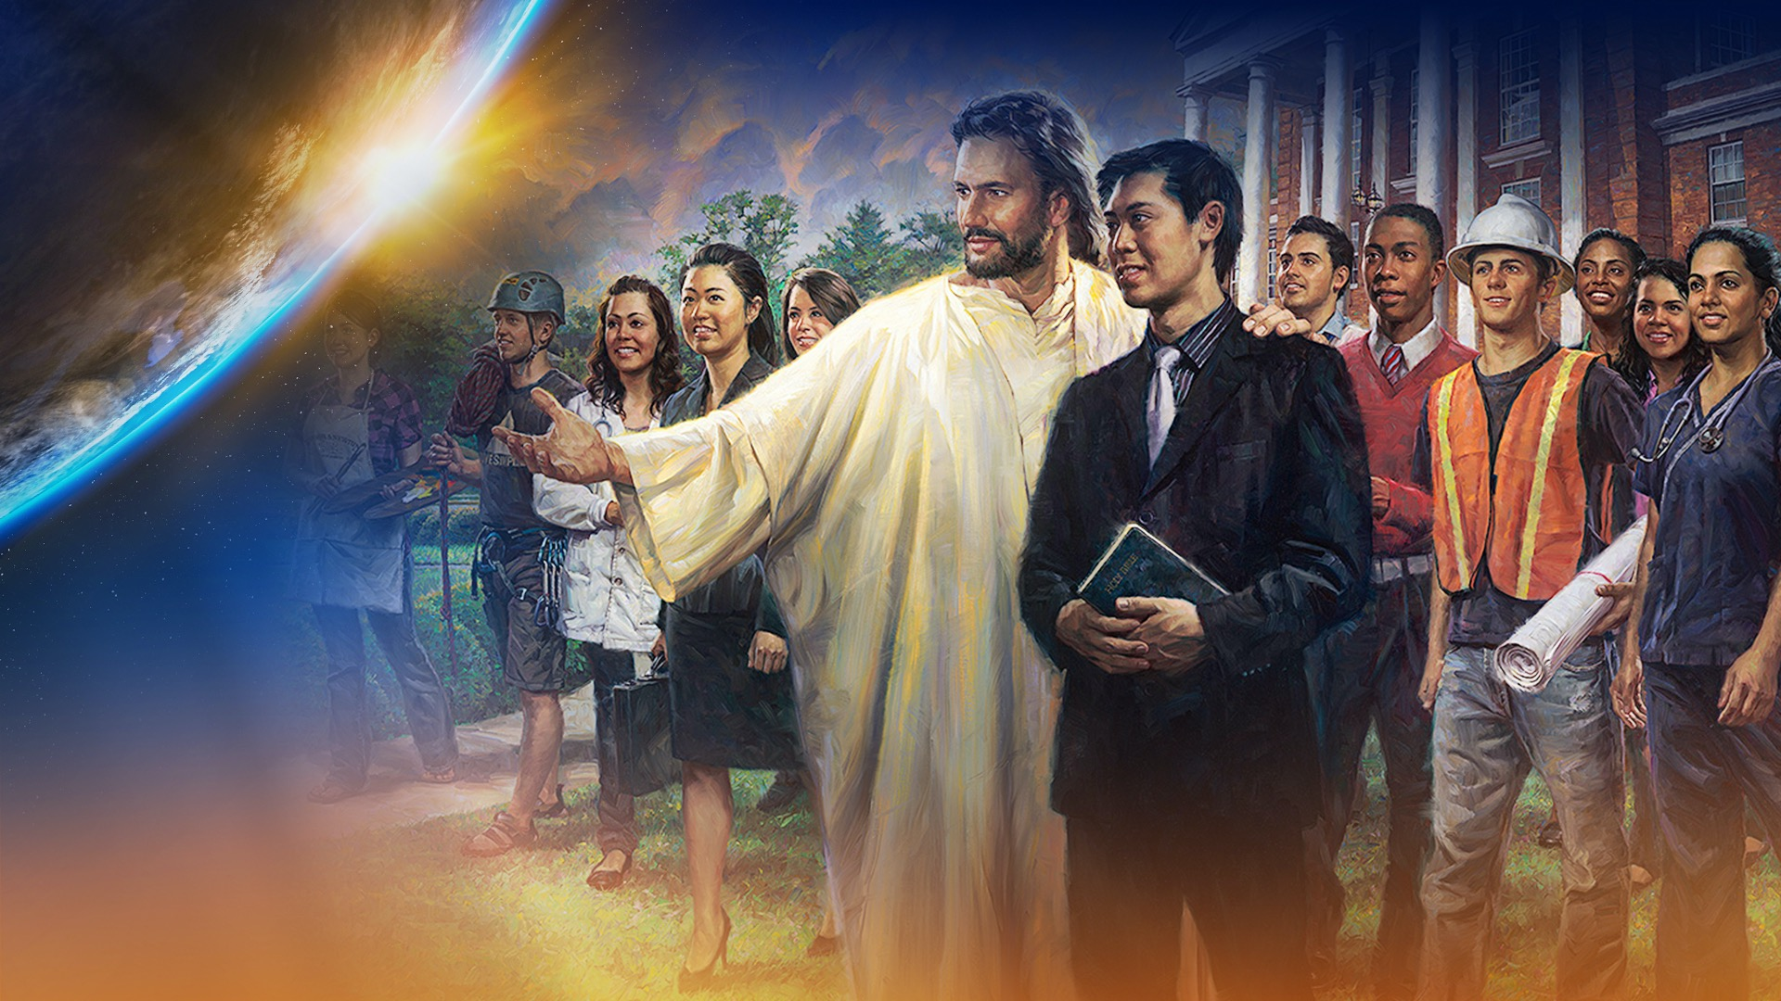
Notes:
Here is a message that is as important for our day as Noah’s message was in His day. Noah preached a message of God’s saving grace in the light of the coming flood.

Slide 17
Notes:
Adventists believe that God has entrusted us with a last day message that must be shared with the world. An urgent message-an eternal message- a universal message-a grace filled message, a message that contains unchanging Bible truths that have been lost sight of down through the centuries that must be understood to prepare a people for the coming of Jesus.

Slide 18
Notes:
The calling of the Seventh-day Adventist church is to proclaim a message of God’s saving grace in the light of the coming destruction of this world by fire.

Slide 19
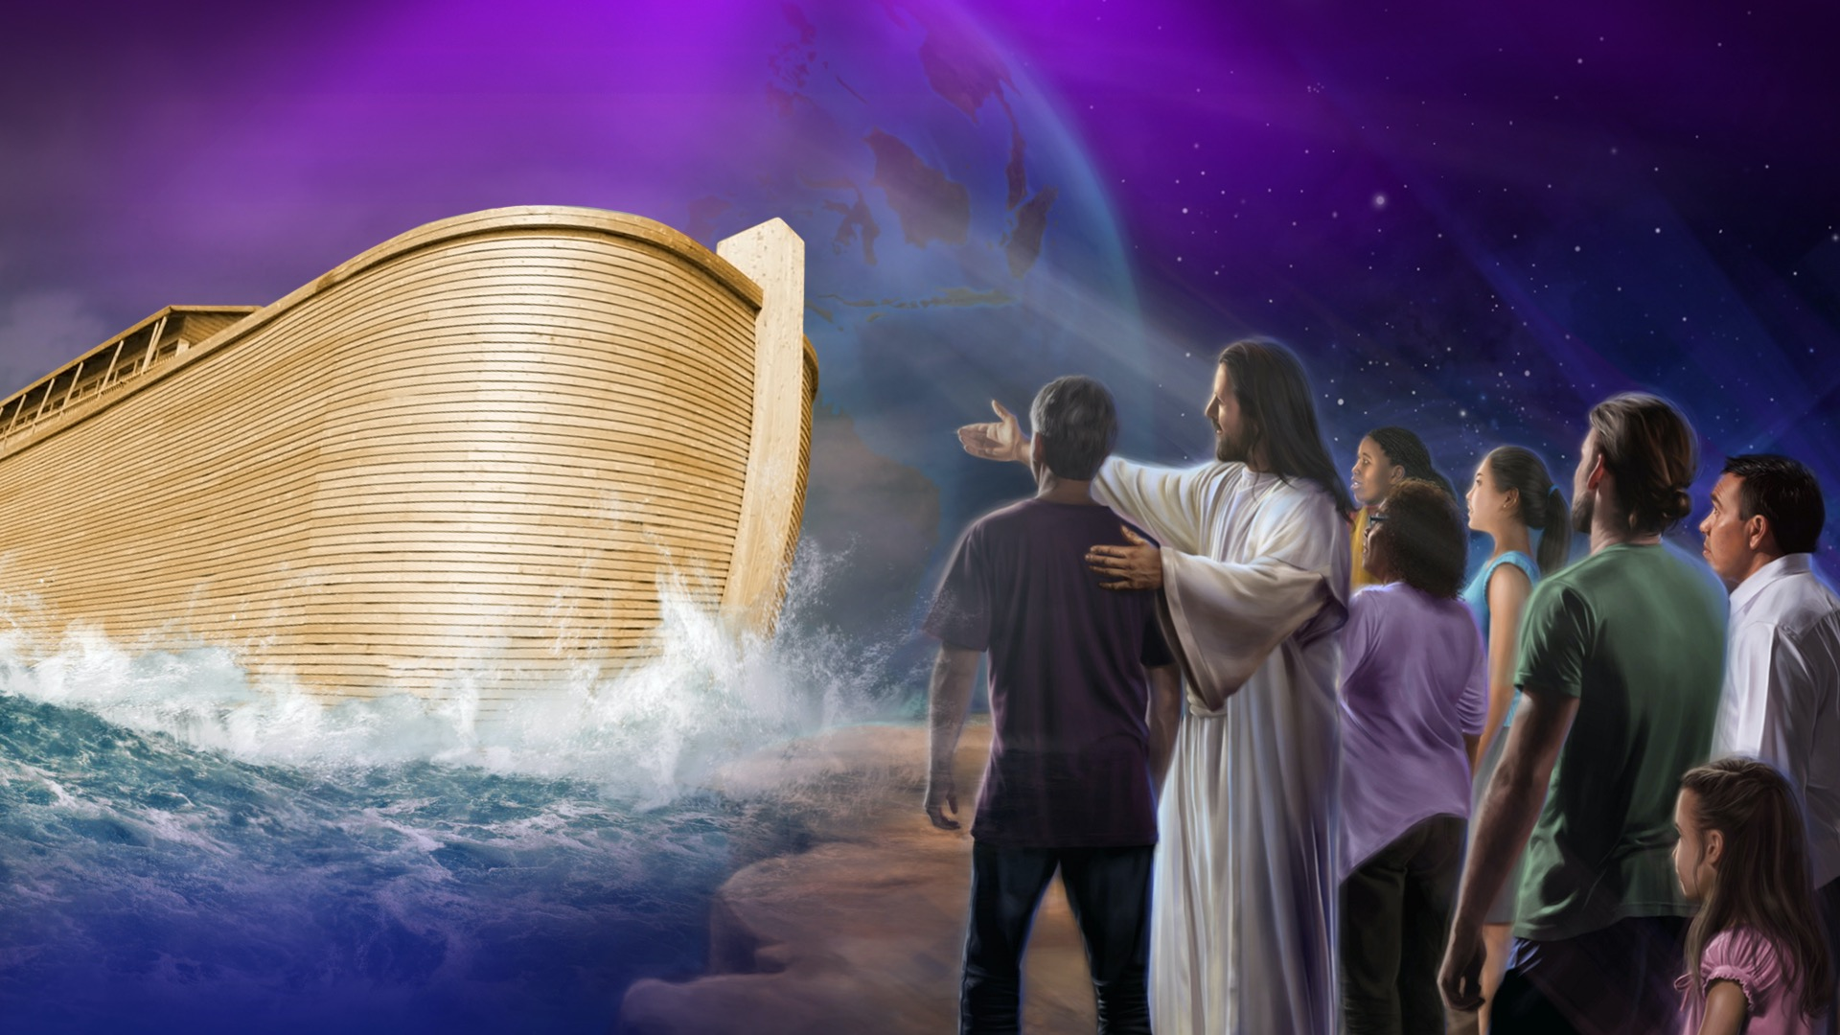
Notes:
Both in Noah’s day and in this generation, a loving God wants as many people saved as possible. He is “not willing that any should perish”. (2 Peter 3:9) He longs for “all to be saved and come to a knowledge of the truth.”(1 Timothy 2:4)

Slide 20
Notes:
Just as God raised up John the Baptist with a special message for a special time to prepare for a special event- the first coming of Christ, Seventh-day Adventists have been raised up by God with a special message, for a special time to prepare the world for a special event- the second coming of Christ.

Slide 21
Notes:
Ellen White makes the primacy of proclaiming the Three Angel’s messages clear in these words,
“In a special sense Seventh-day Adventists have been set in the world as watchmen and light-bearers. To them has been entrusted the last warning for a perishing world. On them is shining wonderful light from the Word of God.

Slide 22
Notes:
They have been given a work of the most solemn import, the proclamation of the first, second, and third angels' messages. There is no other work of so great importance. They are to allow nothing else to absorb their attention”. (Evangelism, page 119)

Slide 23
Notes:
The book of Revelation, the Bible’s last book, reveals the plans of God and unmasks the plans of Satan. It presents Jesus in all His beauty and fulness as our dying lamb and our living priest.

Slide 24
Notes:
Revelation chapter 12 describes the identifying characteristics of the last day remnant in these words, “And the dragon (Satan) was wroth(angry) with the woman and went to make war with the remnant of her seed who keep the commandments of God and have the testimony of Jesus.” (Revelation 12:17) God’s end time people are in love with Jesus so they keep His commandments including the Bible Sabbath and have the testimony of Jesus or the Spirit of Prophecy.

Slide 25
Notes:
Revelation chapter 14 describes the message God’s last day church will proclaim to the world to prepare a people for the coming of Jesus.

Slide 26
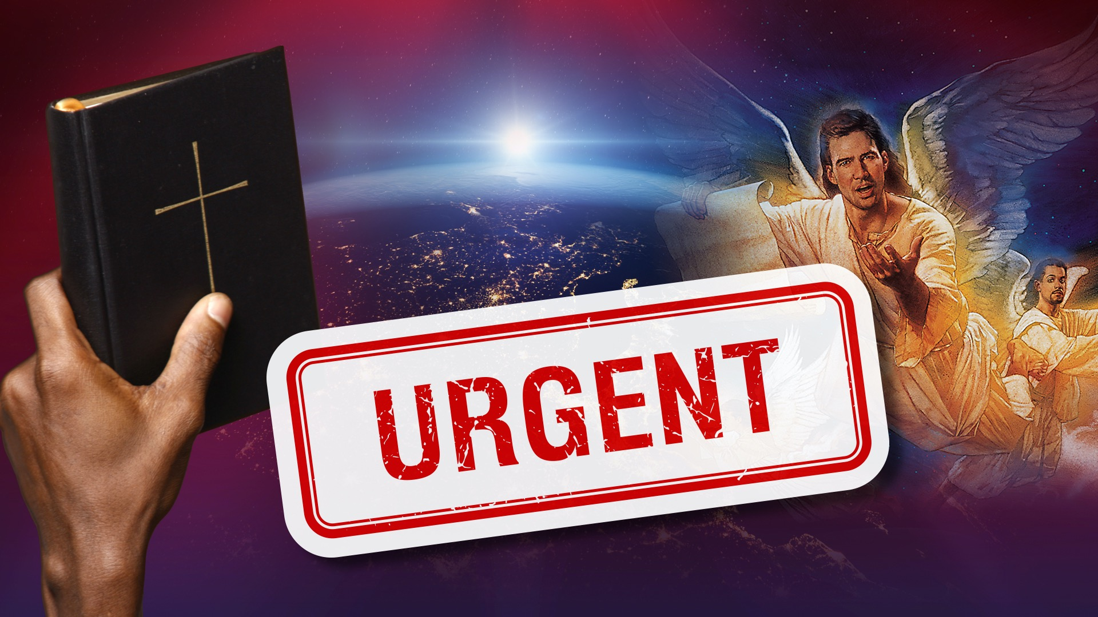
Notes:
How significant are the Three Angels Messages? Are they merely something that is on the periphery of Adventism? Are they of minor importance? According to this reference, “There is no other work of so great importance”. They are to allow nothing else to absorb their attention. In Adventist thinking the three angels’ messages are primary.

Slide 27
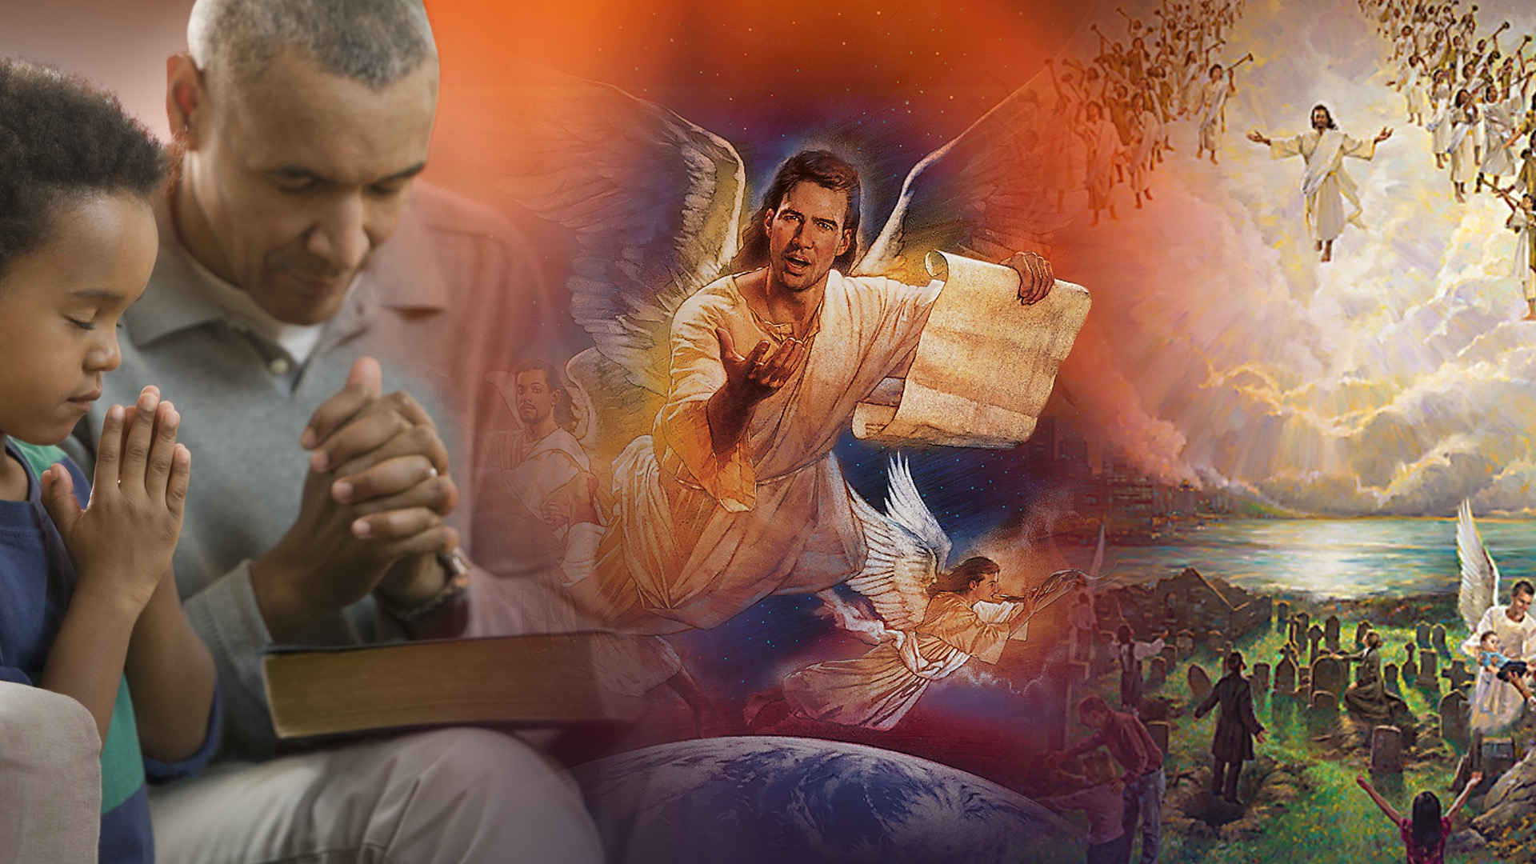
Notes:
Revelation 14 is divided into three parts Revelation 14:1-5 pictures the redeemed standing on the sea of glass in heaven with Jesus. Revelation 14:6-12 describes the messages that prepares them to live with Christ in heaven forever. Revelation 14:14-20 reveals the event that the message prepares them for.

Slide 28
Notes:
In the picture of two harvests, God describes that the entire world will be led to make one of two decisions as the result of the preaching of the Three Angel’s messages: absolute loyalty to Christ or total rejection of Christ. This message leads men and women to eternal decisions. There is no middle ground-no neutrality- no half-hearted-compromising- superficial Christianity.

Slide 29
Notes:
The Harvest Principle: Revelation 14: verses 14-20 picture Jesus coming on a white cloud and one angel cries out to another angel, “Thrust in your sickle and reap for the time has come for you to reap for the harvest of the earth is ripe.” (Revelation 14:15)

Slide 30
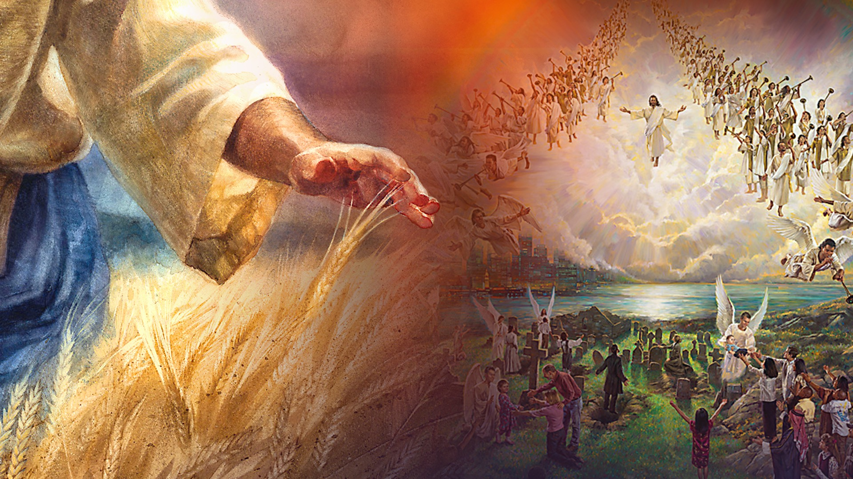
Notes:
The harvest of golden grain is fully ripe. God’s people are totally committed to Him. All the demons in hell cannot break their loyalty.

Slide 31
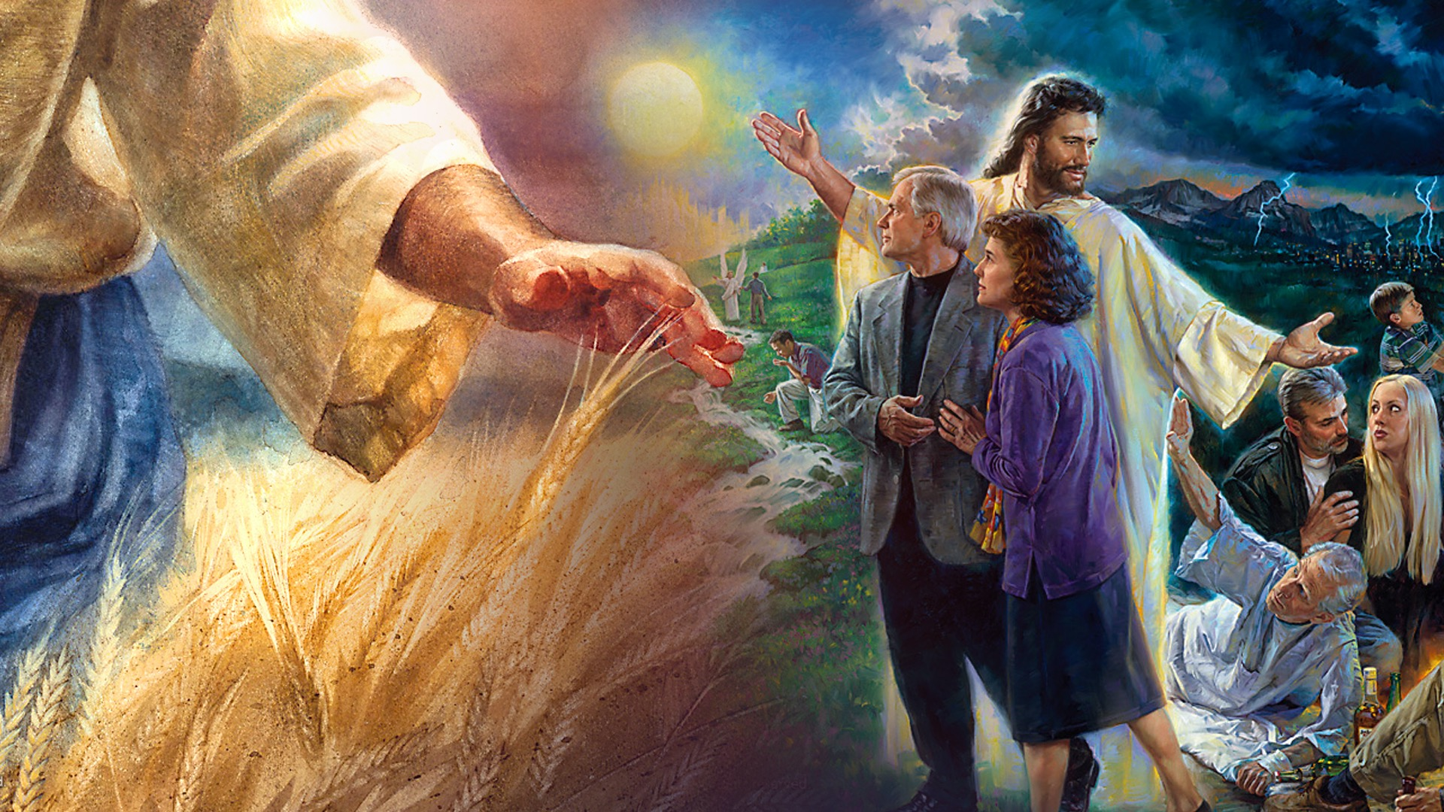
Notes:
Filled with His grace, charmed by His love, redeemed by His power they are overcomers. They live in the light of His presence. They walk in the light of His truth. They rejoice in the light of His grace. Jesus is all they want. He is their hearts desire and they long to be with Him through all eternity.

Slide 32
Notes:
The gory grapes are also fully ripe. Wickedness has gone to seed. Evil is fully developed. Sin and lawlessness prevail. Men and women have made their final irrevocable decision for or against Christ.

Slide 33
Notes:
The purpose of the Three Angels messages is to prepare a people to meet their God. The purpose of these messages is to prepare people for eternity. The purpose of these messages is to get people ready for the events that are to break upon our world as an overwhelming surprise and prepare them to stand with Christ through the great time of trouble that is coming and get them ready for heaven.

Slide 34
Notes:
“After these things I saw another angel coming down from heaven having great authority and the earth was illuminated with his glory and He cried mightily with a loud voice,

Slide 35
Notes:
Babylon the great is fallen, is fallen, come out of her my people…”

Slide 36
Notes:
Notice carefully these four phrases:

Slide 37
Notes:
An angel comes down from heaven… here is a message directly from the throne of God. Here is a message with divine credentials.

Slide 38
Notes:
The angel has great authority…. Or power. Christ has triumphed over the principalities and powers of hell. He defeated the forces of evil on the cross. Satan is a defeated foe. Christ imparts to His church the power of the Spirit to finish His mission on earth and triumph over the powers of evil.

Slide 39
Notes:
The earth is illuminated with His glory…. Christ’s glory is His character. In earth’s final hour the entire world will be lightened with the glory of god through a people whose hearts are one with His heart. Their minds are one with His mind and their lives reflect His grace and goodness to a waiting world and a watching universe.

Slide 40
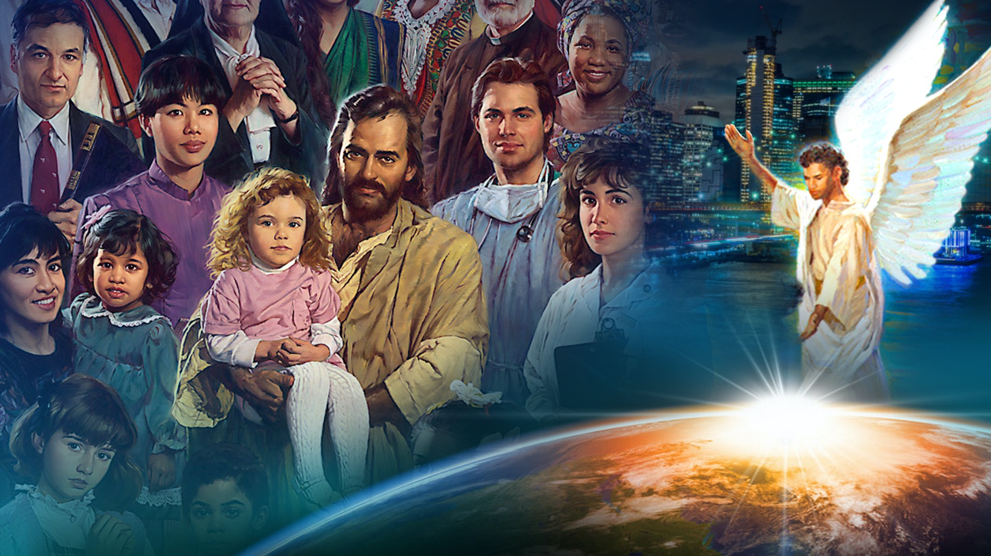
Notes:
Through the witness of their lives and the proclamation of their voices in the power of the Holy Spirit they give the loud cry to prepare a world for the coming of Jesus. Tens of thousands respond and join in this final, end time proclamation.

Slide 41
Notes:
The Three Angels Messages clearly reveal God’s end time message to protect us from Satan’s counterfeit, to shield us from Satan’s delusions, to inform us of Satan’s deceptions, and enlighten to Satan’s lies. The Three angels Messages are heaven’s safeguard against error.

Slide 42
Notes:
Revelation 18: 2: “And he cried mightily with a loud voice saying, “Babylon the great is fallen, is fallen, and has become a dwelling place of demons,

Slide 43
Notes:
a prisoner of every foul spirit and a cage for every unclean and hated bird, for all nations have drunk of the wine of her fornication and the kings of the

Slide 44
Notes:
earth have committed fornication with her and the merchants of the earth have become rich through the abundance of her delicacies.”

Slide 45
Notes:
The devil will introduce heresies into the church. He will pass His wine cup of false doctrines around that will appear so attractive and enticing. Millions will be deceived. What will keep us from His deceptions- only the grace of God and a love for Jesus so deep and a knowledge of His Word so complete that we will not be enticed by Babylon’s wine. Specifically, it is both a knowledge of these Three Angels Messages and a relationship with the Christ they reveal that will keep us securely anchored when every wind of doctrine is blowing. Listen to this remarkable statement.

Slide 46
Notes:
“These messages were presented to me as being an anchor to the people of God. Those who understand and receive them will be kept from being swept away by the many delusions of Satan.”

Slide 47
Notes:
The latter Rain will soon be poured out. The loud cry will be given.

Slide 48
Notes:
Thousands around the world will accept God’s last day message and stand with us but wait, the devil can read these prophecies and with his cunning deceptions, he is preparing a counterfeit revival. It would be well to take note of the following statement…

Slide 49
Notes:
The Three Angels Messages proclaimed with the power of the latter rain in the loud cry of Revelation 18 propel the gospel forward to impact the world. Each year more than one million people are baptized into the Seventh-day Adventist church.

Slide 50
Notes:
Both are Sabbath keeping movements who believe the Bible and are committed to Jesus. Although there are some doctrinal differences such as the state of the dead and healthful living the most significant difference is that Seventh-day Adventists are a prophetic movement, preaching a prophetic message at a prophetic moment in this earth’s history. Ellen White distinguishes between the Seventh-day Baptists and the Seventh-day Adventists in this insightful quote.

Slide 51
Notes:
“Thus, the message of the third angel will be proclaimed. As the time comes for it to be given with greatest power, the Lord will work through humble instruments,

Slide 52
Notes:
leading the minds of those who consecrate themselves to His service. The laborers will be qualified rather by the unction of His Spirit than by the training of literary institutions.

Slide 53
Notes:
Men of faith and prayer will be constrained to go forth with holy zeal, declaring the words which God gives them….”

Slide 55
Notes:
“Servants of God, with their faces lighted up and shining with holy consecration, will hasten from place to place to proclaim the message from heaven.

Slide 56
Notes:
By thousands of voices, all over the earth, the warning will be given. Miracles will be wrought, the sick will be healed, and signs and wonders will follow the believers.”

Slide 57
Notes:
This is the destiny to which we have been called. This is the mission heaven has given to this people. This is the purpose of our existence. This is the appeal of heaven in earth’s final hour.

Slide 58
Notes:
There is nothing more important than being ready for the coming of Christ and giving your life to get others ready. The sands in the hourglass of time are running out.

Slide 59
Notes:
There is a mission to be accomplished. The is a message to be proclaimed. There is a Master calling for our total allegiance, our complete surrender and our absolute trust. Will you open your heart to Him anew, afresh right now and ask Him to give you a new vision of who He wants you to be and what He wants you to do in this crisis hour of earth history as we pray?

