Slide 1
The Blessing to Encourage Innovative and Creative Ways to Fulfill the Mission with One Unifying Strategy 'I Will Go'
World Church Leadership Council, February 9, 2021

Slide 2
This Photo by Unknown author is licensed under CC BY-NC.

Slide 3
Overview
A few formalities
What is Innovation?
Approaches to Innovation
Culture and Innovation
Application

Slide 4
A few formalities

Slide 6
NOT talking about changes in...
28 Fundamental Beliefs
Traditional church structure

Slide 7
Definitions
Creativity - the ability to transcend traditional ideas, rules, patterns, relationships, or the like, and to create meaningful new ideas, forms, methods, interpretations, etc.; originality, progressiveness, or imagination
Innovation - the act of innovating; introduction of new things or methods.
https://www.dictionary.com/

Slide 8
What is Innovation?

Slide 9
Peter F. Drucker
“the effort to create purposeful, focused change in an enterprise’s economic or social potential.”
Drucker, Peter F., The Discipline of Innovation, May 1985, Harvard Business Review

Slide 12
Thomas A Edison
Genius is 1% inspiration
and
99% perspiration!
https://en.wikiquote.org/wiki/Thomas_Edison

Slide 13
Peter F. Drucker
“What all the successful entrepreneurs I have met have in common is not a certain kind of personality but a commitment to the systematic practice of innovation.” (emphasis supplied)
“But when all is said and done, what innovation requires is hard, focused, purposeful work.” (emphasis supplied)
Drucker, Peter F., The Discipline of Innovation, May 1985, Harvard Business Review

Slide 14
1. Does your organization have an innovation strategy?

Slide 15
Approaches to Innovation
Notes:
.

Slide 16
Look Outside Your Industry
Hamish Taylor – “Master Thief”
British Airways
Beds – yacht designer
Queuing – Disney
Process
Lifeboat experts
Notes:
Management Consultant at Price Waterhouse,
Head of Brands at British Airways,
CEO of Eurostar, and
CEO of Sainsburys Bank
Speaker and Consultancy
From http://www.hamishtaylor.com/biography/

Slide 17
Envision Engage Evolve Evaluate Execute

Slide 18
2. Is there close alignment between your innovation strategy and the "I Will Go" strategic focus?

Slide 19
4 Elements of Corporate Innovation
Innovation must be pushed from the top of the organization
Strategies and Plans throughout the organization should be permeated with Innovation
Organization’s culture should be strongly supportive of Innovation
Take advantage of external Innovation whenever practicable
Corporate Innovation in the Fifth Era, by Matthew C. Le Merle and Alison Davis, 2017, Cartwright Publishing, Corte Madera, CA

Slide 20
3. Is your division's president also designated as the chief innovation officer?

Slide 21
4. Is your executive officer team enthusiastic about urging your organization to be innovative?

Slide 22
5. Is innovation a regular item on the agenda of your executive committee?

Slide 23
6. Do your department/ministry directors feel they are full partners in the innovation strategy?

Slide 24
8. Does your organization have a strategy regarding external innovation?

Slide 25
culture

Slide 26
Ethical Foundations for the General Conference and Its Employees
Our Mission...
Our Responsibilities...
Our Values
We value the Bible as the primary reference for life’s direction and qualities.
We value excellence in all that we do.
We value ethical and moral conduct at all times and in all relationships.
We value creativity and innovation in the completion of our mission.
We value honesty, integrity, and courage as the foundation of all our actions.
We value the trust placed in us by colleagues and by the world church membership.
We value people as children of God and therefore brothers and sisters of one family.
Voted by the General Conference Executive Committee at Annual Council, September 29, 1999

Slide 27
Innovat---
B 10 30 Variations in Administrative Relationships --
2. Innovations in organizational structure and administrative
relationships must be approved by…

Slide 28
Creativity
GC WP FE 10 10 -- Responsibilities and Outcomes
3. Tertiary Institutions --
b. Outcomes –
2) Exhibit proficiency in critical thinking, stewardship, creativity, appreciation of beauty and the natural environment, communication, and other forms of academic scholarship toward fulfillment of their vocations and lifelong learning.

Slide 29
Creat---
Created (21)
Creation (21)
Creator (16)
Create (14)
Creative (6)
Creating (3)
Creatively (2)

Slide 30
Creatively
A 15 20 -- What Total Commitment to God Involves for a Congregation—A Seventh-day Adventist congregation creatively and self-critically functions as a witnessing and nurturing community…

Slide 31
Creative
HC 20 Mission Awareness
HC 20 05 Principal Objectives—1. To raise awareness of mission among members of the Seventh-day Adventist Church.
2. To find creative ways of promoting the World Mission Fund

Slide 32
Creative & Creating
FW 15 -- Objectives
5. Build networks among women in the world Church that encourage bonds of friendship, mutual support, and creative exchange of ideas and information.
6. Mentor and encourage young Adventist women, creating paths for their involvement in the Church as they reach for their full potential in Christ.

Slide 33
Peter F. Drucker
“Culture eats strategy for breakfast!”

Slide 34
7. Is your innovation strategy supported by the organization's internal culture?

Slide 35
Application

Slide 36
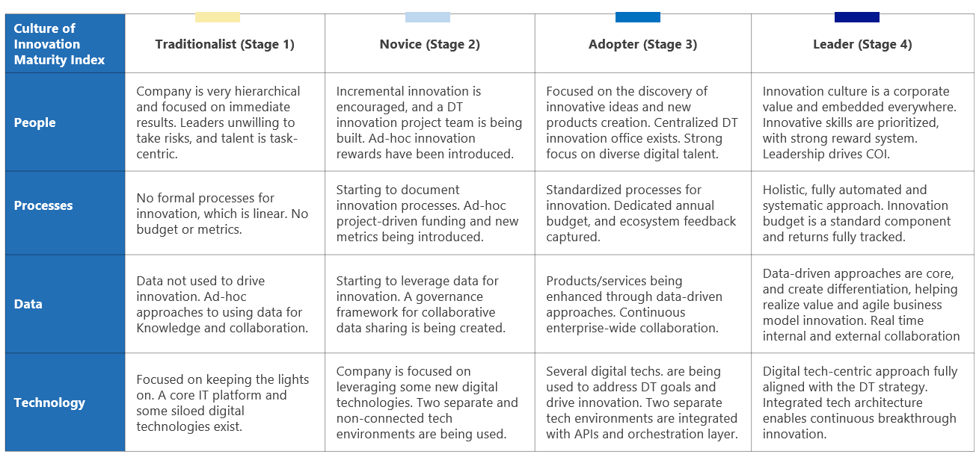
Used with permission granted by Microsoft and IDC; source: https://news.microsoft.com/apac/2020/09/10/a-culture-of-innovation-fuels-business-resilience-and-economic-recovery/

Slide 37
Best Practices
Strengthen digitization efforts
Invest in KSAs
Use data to maximum advantage
Systematic approach to innovation
https://news.microsoft.com/apac/2020/09/10/a-culture-of-innovation-fuels-business-resilience-and-economic-recovery/

Slide 38
I Will Go
2020 – 2025 Strategic Focus

Slide 40
For Further Conversation
Consider:
Creation of a strategy for internal and external innovation
Creation of collaborative environments where church members share and brainstorm possible innovations
Growing promising solutions into robust plans
Provision of micro grants for field testing
Evaluation of solutions with most potential impact
Development of packages that can be replicated around the world
Energized by much prayer and the infilling of the Holy Spirit

Slide 41
Kevin Kelly
“The nature of an innovation is that it will arise at a fringe where it can afford to become prevalent enough to establish its usefulness without being overwhelmed by the inertia of the orthodox system.”
Kevin Kelly Quotes. (n.d.). BrainyQuote.com. Retrieved February 8, 2021, from BrainyQuote.com Web site: https://www.brainyquote.com/quotes/kevin_kelly_268023

Slide 42
Thank you

