Slide 1

An Imperative:
Children, Teenagers, and Youth Proclaiming God’s End-time Message
Dr. Ella Smith Simmons
FIRST WORLD CHURCH LEADERSHIP COUNCIL
February 10, 2021

Slide 2

Review and Herald
Vol. 146 No. 35
August 28, 1969

Slide 3
Notable Young People in the Bible
David
Joseph
Esther
Mary
Boy Who Shared his Lunch
Miriam
Jeremiah
Little Maid of Israel
Josiah
Daniel
Shadrach
Meshach
Abednego
Ruth
Samuel
Rahab
Miriam
Solomon
Jonathan
Mary
Timothy
Jesus

Slide 4
Jeremiah
The name “Jeremiah” means “whom Jehovah appoints.”
He was called to the ministry while still “a child” (1:4–6) in the year 627 B.C.
Jeremiah ministered during the last forty years of Judah’s history, from the thirteenth year of Josiah (627 B.C.) to the destruction of Jerusalem and beyond (587 B.C.).

Slide 5
Jeremiah 1:5-10
Dybdahl, J. L. (Ed.). (2010). Andrews Study Bible Notes (p. 944). Berrien Springs, MI:
Andrews University Press.
1:5 Before I formed you. Jeremiah is specially chosen for the prophetic office.
  The appointment is made by God alone; the prophetic office is not inherited.
1:6 I cannot speak, for I am a youth. Jeremiah feels inadequate for the task.
1:7 Do not say. God counteracts Jeremiah’s objections.
1 Timothy 4:12, “Let no one look down on your youthfulness . . .

Slide 6
Jeremiah’s Message
Jeremiah had to predict doom for his nation. He had to call out the people, priests, and princes for their sins, especially the sin of idolatry.
He addressed “backsliding” (2:19; 3:6, 8, 11–12, 14, 22; 49:4) and false prophets who led the nation to worship idols.
Jeremiah was called a traitor and was persecuted by his own people for prophesying their captivity and telling the kings to surrender to Babylon.
He prophesied a “new covenant” between God and His people, not a covenant of law and works written on stones, but one of love and faith, written in the heart.

Slide 7
Called A Prophet
Nichol, F. D. (Ed.). (1977). The Seventh-day Adventist Bible Commentary (Vol. 4, pp. 354–355).
A prophet. A prophet is one who receives direct revelations from God to be communicated to others. He is not primarily a foreteller, or predictor. He is a spokesman or interpreter for God. The revelation that the prophet receives may or may not refer to the future.
Nations. Heb. goyim, also translated “heathen,” or “Gentiles.” Jeremiah was to be God’s messenger not only to Judah but to the outlying Gentile nations as well.

Slide 8
Prophecy: an inspired utterance revealing God's will
Prophet: one gifted with more than ordinary spiritual and moral insight
And afterward, I will pour out my Spirit on all people. Your sons and daughters will prophesy, . . .” Joel 2:28a NIV
In the last days, God says, I will pour out my Spirit on all people. Your sons and daughters will prophesy, . . . Acts 2:17a NIV

Slide 9
Jeremiah and Jesus – Similarities
Wiersbe, W. W. (1993). Wiersbe’s Expository Outlines on the Old Testament (Je)
Neither married (16:2)
Both were rejected by their own towns (11:21 and 12:6 with Luke 4:16–30).
Jeremiah ministered under the menacing shadow of Babylon, Jesus under the shadow of Rome.
Both were considered traitors by their people.
Jeremiah was viciously opposed by the false prophets, Jesus by the scribes and Pharisees, the false leaders of His day.
Both wept over the city of Jerusalem, and both predicted its ruin.
Jeremiah gathered few disciples about him; Jesus had a small following.

Slide 10
Jeremiah and Jesus – Similarities
Wiersbe, W. W. (1993). Wiersbe’s Expository Outlines on the Old Testament (Je)
Both were arrested falsely and persecuted.
Both emphasized a religion of the heart, and not merely one of outward forms and ceremonies.
It was Jeremiah 7:11 that Jesus quoted when He cleansed the temple and told the priests they had made it “a den of thieves.”
Both emphasized the new covenant in the heart (31:31–37; Heb. 8:7).
In their preaching, both used striking illustrations and comparisons.
Both revealed a tender, sympathetic heart that was crushed by the wickedness of a nation that should have obeyed God’s Word.
In the end, it seemed that both were failures in their lives and ministries, but God honored them and made their work successful.

Slide 11
Message to Young People (and Us)
In the olden days, . . . the prophet, in vision, heard one heavenly messenger saying to another, “Run, speak to this young man.” And so, in these days, the young men and young women of the Advent movement have been given an important part to act in the closing drama of earth's history. MYP 7.1
The Lord has appointed the youth to be his helping hand. 7T64; MYP 7.2
With such an army of workers as our youth, rightly trained, . . . !—Education, 271; MYP 7.3

Slide 12
Messages to
the Youth (and US)
White Estate
Such messages as these have been coming to the young people of this movement, through the spirit of prophecy, from the very beginning of our work.

Slide 13
How will we respond? What will we do with this information?
Ellen White’s final vision; March 3, 1915. She died July 16, 1915.
She wrote of this vision in the April 15, 1915, edition of The Review and Herald. “A Message for Our Young People.”
“Now is our time and opportunity to labor for the young people. They need to be helped, uplifted, and encouraged.
“There is a work to be done for the young by which their minds will be impressed and molded by the sanctifying truth of God.
Ellen White felt strongly that our youth deserve our first and best creative energies. And, not to put too fine a point on it, apparently God thought so as well.
Omar Miranda, Adventist Review, October 5, 2018

Slide 14
The Strengths and Weaknesses of Every Generation in your Workforce [Ministry]
GetSmarter, July 2, 2020
There are a number of strengths and weaknesses that can generally be found in each working generation.

Slide 15
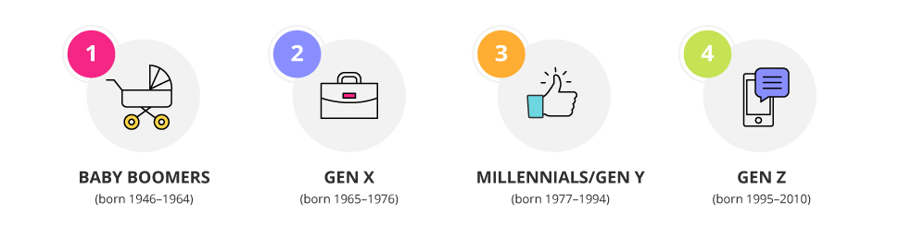
The Different Generations

Slide 16
Baby Boomers
Strengths
Boomers are characterised as being workaholics who relish long weeks and overtime. They are more committed to their roles than any other generation.
Baby boomers are considered good team players.
The professionals in this generation are regarded as making excellent mentors to their colleagues and juniors.
Weaknesses
This generation has a preference for structure and discipline, and are less inclined to welcome change.
Boomers are competitive, so they need recognition and rewards to keep them motivated to achieve more.
Baby boomers are regarded as the least tech savvy of all generations, prohibiting their ability to keep up with developments.

Slide 17
Gen X
Strengths
Gen X are believed to be the best overall workers.
They are committed to juggling work with family time, and favour work-life balance in an organization.
Gen X are considered to be the biggest revenue generators.
Weaknesses
Many Gen X are satisfied with the senior management in their organization.
This generation is less inclined to say something if they disagree with management than their successive generations.
Gen X value being able to do things quickly and are less inclined to spend hours of overtime completing something perfectly.

Slide 18
Millenials /Gen Y
Strengths
Millennials are considered the most independent workers.
Millennials are concerned with ethics and the social responsibility of the organisation they work for.
Millennials have grown up sourcing information; they need to be left to create their own processes rather than being told exactly what to do.
Weaknesses
Due to their independent nature, Millenials are not as interested in teamwork as other generations.
Millennials do not have as strong a work ethic as previous generations.
This generation is impatient when it comes to career growth –and are likely to leave before two years if they feel their skills are not being developed..

Slide 19
Gen Z
Strengths
Gen Z is the most tech competent; they are able to pick up new developments quicker than others.
This generation is particularly ambitious, with two-thirds of Gen Z saying their goal in life is to make it to the top of their profession.
Gen Z are natural entrepreneurs, with 72 per cent wanting to start their own business and hire people.
Described as the ‘always on’ generation, Gen Z are able to multitask unlike any others, using up to five screens at once.
Weaknesses
Gen Z are regarded as more cynical than their predecessors, favouring a realistic outlook over the idealism of Gen Y.
Gen Z don’t know much about a time before social media and easily accessible technology. They can be very reliant on technology to solve problems.

Slide 20
Survey of 19 Countries Shows How Generations X, Y, and Z Are
— and Aren’t — Different
Henrik Bresman and Vinika D. Rao
Harvard Business Review, 8/25/2017

Slide 21
Survey of 18,000 Professionals and Students
  across these three generations
  from 19 countries
  found some important differences in their aspirations and values.
Henrik Bresman and Vinika D. Rao, Harvard Business Review, 8/25/2017

Slide 22
Leadership Ambitions
Becoming a leader was important to 61% of Gen Y, 61% of Gen Z, and 57% of Gen X respondents. But responses varied by country:
Nordic country respondents were significantly less likely to covet leadership roles than those in Mexico.
Among Gen Y respondents, 76% of Mexicans said attaining a leadership role is important, but only 47% of Norwegians said the same.
77% of American Gen Y professionals said that gaining a leadership position was important to them.
Lacking enthusiasm for leadership were those in Denmark, Sweden, and France,

Slide 23
Leadership Ambitions
Gen Y and Gen X professionals are more enthusiastic about the coaching and mentoring that comes with management jobs than the higher responsibility.
However, Gen Z cites higher levels of responsibility and more freedom as attractive attributes of leadership.
Geographically, Gen X respondents in Spain put coaching and mentoring others as what is most attractive about leadership.
But this was a lower priority for respondents from Germany, Norway, Denmark, Britain, and the U.S., who all put challenging tasks as the most attractive aspect.

Slide 24
Entrepreneurial Ambitions
They found a strong interest in entrepreneurship across all three generations.
Their results show that one in four students (Gen Z) is interested in starting their own business.
And among those already in the workforce (Gen Y and Gen X professionals), one in three yearned to be entrepreneurs.
Gen Y professionals in Mexico (57%) and the UAE (56%) were the most interested in starting their own businesses.

Slide 25
Entrepreneurial Ambitions
When asked whether they would want to work for an international company or start their own business, respondents in Gen Z favored working for an international company, while Gen Y and Gen X professionals preferred starting their own business.
Only 27% of Gen Y professionals in Mexico reported wanting a career at an international company.
In India 43% of Gen X wanted to start their own businesses and 25% to work for an international company.
To keep those interested in entrepreneurship close to the firm, leaders might want to consider “intrapraneurship,” giving employees the ability to work on startup projects within the firm.

Slide 26
Relying on Technology
Gen Z was most enthusiastic about the potential of virtual reality (VR).
This was stronger in certain countries such as Mexico and Singapore and weaker in countries such as India.
Gen Y professionals also saw VR as the technology most likely to revolutionize their work in the coming decade, putting it ahead of wearable technology, project management, and audio/video conferencing.
Companies may want to consider virtual reality as a tool for recruiting these cohorts.

Slide 27
Relying on Technology
Gen X, on the other hand, believed virtual reality technologies would have a low impact on their work. They had the most enthusiasm for project management tools, with certain countries, such as Germany, Japan, and Russia, also expressing excitement about cloud computing and e-learning tools.
More older professionals considered technology a hindrance in Britain, Sweden, and Norway.
Technology was most viewed as helpful by Gen Xers in Denmark, Sweden, and Mexico.
Gen Y respondents in Mexico, Sweden, and Germany perceived technology most favorably.
And Gen Z students in Germany, Japan, and Mexico also saw technology as useful, while those in China, the U.S., and Canada were more likely to view technology as a hindrance to their work.

Slide 28
Training
Respondents differed in their preferences for work training.
When asked if they would take an online course if offered one by their employer, 70% of Gen Z respondents said yes, while 77% of Gen Y and 78% of Gen X professionals said they would take it.
Given the choice between an online course and an in-person one, 69% of Gen Z chose an in-person program, compared with only 13% choosing an online one
It was the Gen Xers who gravitated most toward online training, with 25% of respondents choosing this option.
But 21% of Gen Y professionals also said they preferred online training over in-person teaching.

Slide 29
Fitting In
All generations were concerned about whether their personalities fit with where they work (50% of both Gen Y and Z respondents and 40% of Gen Xers).
Japanese Millennials (66%) and Spanish Millennials (57%) were most concerned about fit.
This was observed among Japanese Gen Zers (60%) and French Gen Zers (64%), too.
Japanese, Danish, and Indian Gen Xers also put fit as an important priority.
But what most bothered Gen X in general was not being able to enjoy retirement, getting stuck with no opportunities, or losing job security.
Not being able to enjoy retirement emerged as a top concern in the UK, the U.S., and Spain.

Slide 30
What Will It Take to Disciple the Next Generation?
Barna Group, Research Releases in Millennials & Generations, August 27, 2019
Over the last 15 years, one of Barna’s primary missions has been to understand emerging generations—specifically Gen Z and Millennials in the US—and discover how to best equip them to grow and share their faith.
  interviewed nearly 100,000 teens and young adults to learn more about their worldview, on Christianity, religion and culture.
  expanded the scope of this inquiry to a global level at Faith for the Future, a free webcast revealing findings from an international study of 18–35-year-olds conducted in partnership with World Vision.

Slide 31
Barna Group
April 6, 2016
While there are many aspects of youth ministry that seem to be strong and “business as usual,” the fact that Millennials continue to leave the church—in larger numbers than ever before—when they reach adulthood, suggests a need to either revise current approaches or double-down on efforts to equip and prepare today’s youth.
The fact that teens lack commitment due to general busyness, and the broad scarcity of student leaders, suggests that relationships and engagement in church are not reaching sufficient depth.
Youth leaders are right to prioritize discipleship and relationship building.

Slide 32
The Priorities, Challenges, and Trends in Youth Ministry
Research Releases in Leaders & Pastors
Barna Group, April 6, 2016

Slide 33
Millennials are leaving the church.
Nearly six in ten (59%) young people who grow up in Christian churches end up walking away, and the unchurched segment among Millennials has increased in the last decade from 44% to 52%, mirroring a larger cultural trend away from churchgoing.
When asked what has helped their faith grow, “church” does not make even the top 10 factors.
Barna Group, April 6, 2016

Slide 34
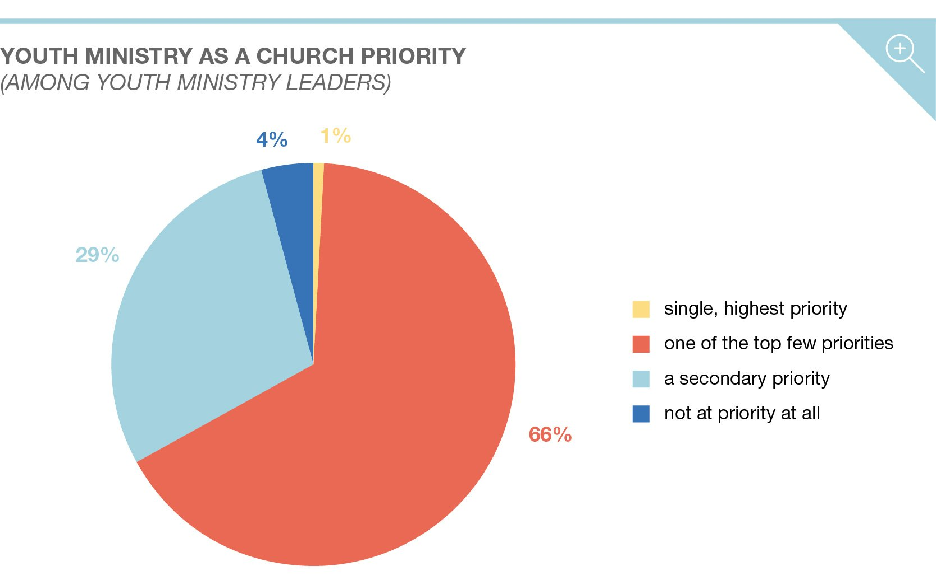
Barna Group, April 6, 2016

Slide 35
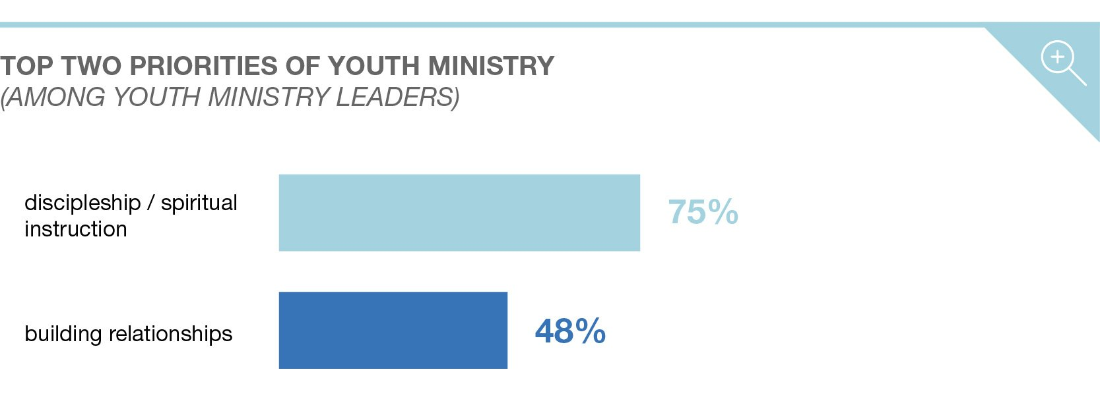
Priorities
Barna Group, April 6, 2016
The two priorities among youth pastors of large churches are “discipleship and spiritual instruction” (75%), and “building relationships” (48%).
The next-highest priority, mentioned by one-fifth of youth leaders (20%) was evangelism and outreach.

Slide 36
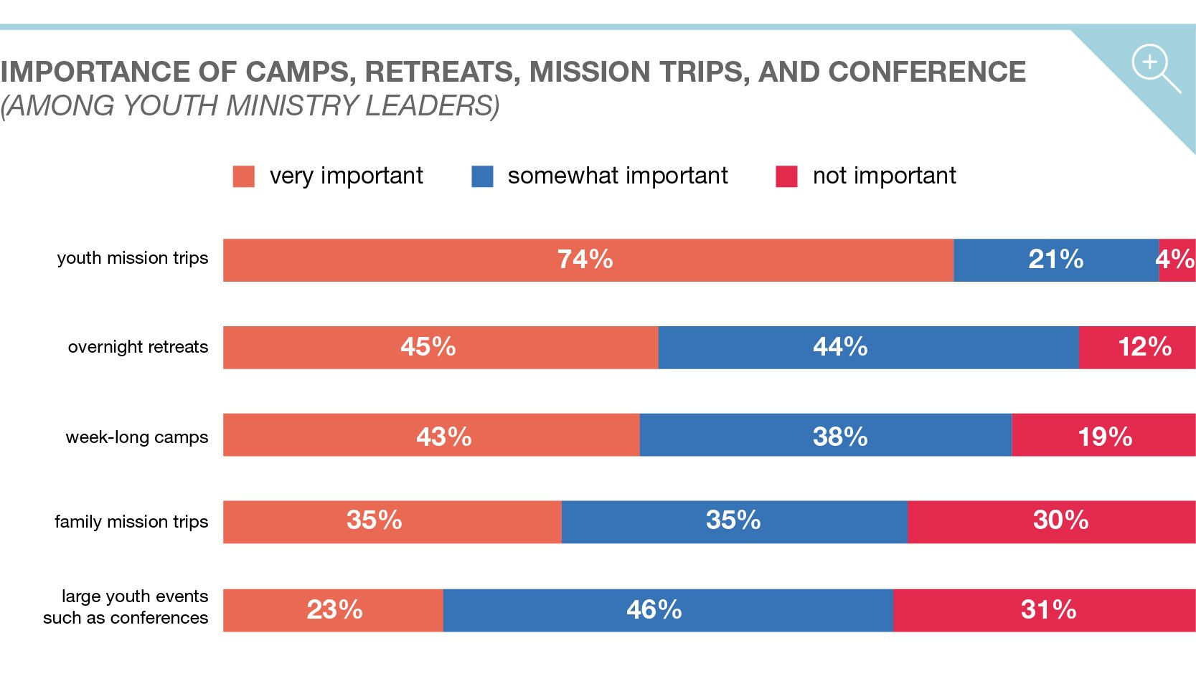
Barna Group, April 6, 2016

Slide 37
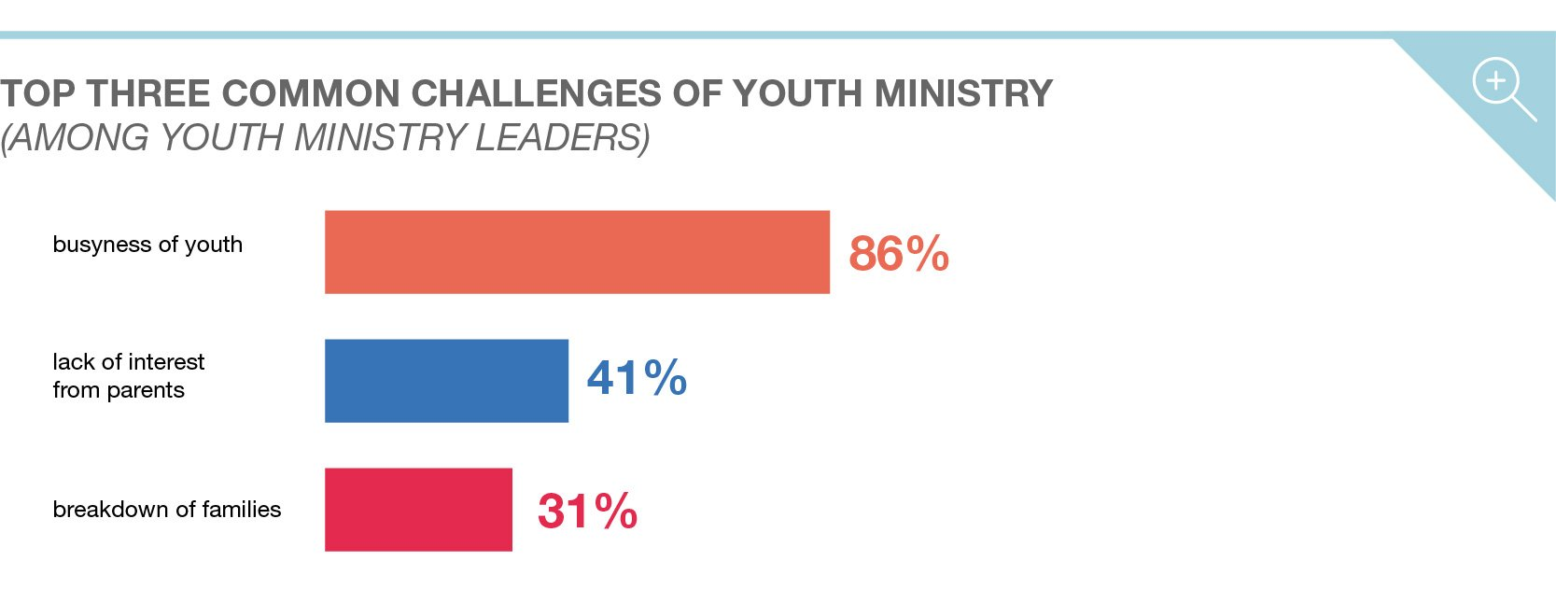
Barna Group, April 6, 2016

Slide 38
IN THE LAST DAYS
Your sons and daughters will prophesy, . . . Joel 2:28a NIV
In the last days, God says, I will pour out my Spirit on all people. Your sons and daughters will prophesy, . . . Acts 2:17a NIV

Slide 39
White, E. G. (1917). The Story of Prophets and Kings as Illustrated in the Capitvity and Restoration of Israel (Vol. 2, p. 409).
Of his call to the prophetic mission, Jeremiah himself wrote: “The Lord put forth His hand, and touched my mouth. And the Lord said unto me, Behold, I have put My words in thy mouth.
See, I have this day set thee over the nations and over the kingdoms, . . .” Jeremiah 1:9, 10.

Slide 40
Valuegenesis Study
The Valuegenesis study of Adventist youth begun in 1989
was an important landmark study carried out by the
Seventh-day Adventist Church in North America. It was
without question the largest and most comprehensive study ever made of church youth.
It assessed their faith and values in the context of the most influential institutions:
family, church, and school. It was possible to identify what it was in those venues that
encouraged a mature faith, and positive values development.
Valuegenesis2 studied a population sample of almost 25,000 students in Seventh-day Adventist schools. This is almost twice the number of respondents that was achieved in the original Valuegenesis project of 1989.

Slide 41
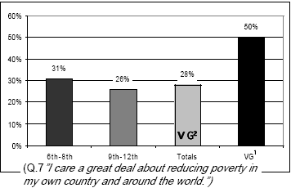
Valuegenesis Study
V. B. Gilespie
Priorities

Slide 42
Valuegenesis Study
V. B. Gilespie
Priorities

Slide 43
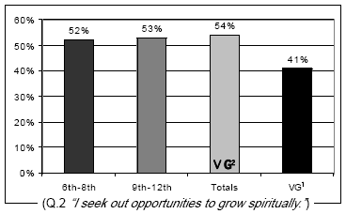
Valuegenesis Study
V. B. Gilespie
Priorities

Slide 44
Valuegenesis Study
V. B. Gilespie
Priorities
Priorities

Slide 45
Valuegenesis Study
V. B. Gilespie
Priorities

Slide 46
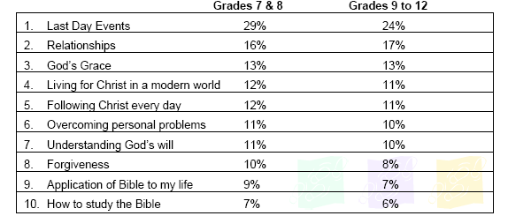
Valuegenesis Study, V. B. Gilespie
Priorities

Slide 47
Valuegenesis Study
V. B. Gilespie
Priorities
Perceptions

Slide 48
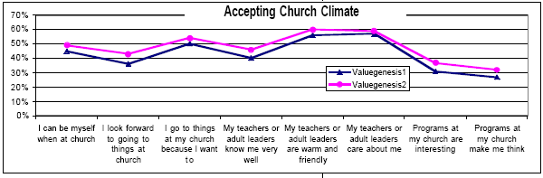
Valuegenesis Study
V. B. Gilespie

Slide 49
Why You Might Be Aiming at the Wrong Target in Your Ministry to the Next Generation
Leaders & Pastors in Millennials & Generations, October 7, 2020
With only 10 percent of 18- to 29-year-olds who grew up Christian or in the Church qualifying as what Barna defines as “resilient disciples,” pastors [and others of us] may wonder, what can be done to engage young people and even raise this percentage in the years to come?

Slide 50
How Tesla’s Charging Stations Left Other Manufacturers in the Dust
Hemant Bhargava, Jonas Boehm, and Geoffrey G. Parker
January 27, 2021
FOCUS:
Perfecting the car
Providing Charging Stations

Slide 51
Five Tips for Engaging a Young Generation Impacted by COVID-19
n=520 U.S. teens and young adults ages 13-21; self-identify as Christian; have attended church monthly
June 15-July 17, 2020.

Slide 52
1. FIND WAYS TO CREATE AND PRESERVE CONNECTION.
Almost half of 13- to 17-year-old Gen Z churchgoers say they have felt less connected to their local church during the pandemic.
How are you finding creative ways to establish and preserve connections with Gen Z individuals, especially those who were not highly involved with a church before 2020?

Slide 53
2. ACTIVELY ADDRESS NEGATIVE EMOTIONS.
Gen Z needs help processing their emotions, especially as they work through the long-term effects of this pandemic.
How are you helping Gen Z process a wide range of emotions, like exhaustion, discouragement, fear, loneliness, life satisfaction and safety?

Slide 54
3. CONSIDER THE LONG-TERM EFFECTS OF ONLINE LEARNING.
They have had to participate in online or distanced learning. They would prefer online learning in the future.
How will the exposure to online education this year impact your sphere of influence and ministry to Gen Z?

Slide 55
4. GIVE THEM REAL CHANCES TO CONTRIBUTE.
Barna research shows that activating Gen Z’s gifts and passions is an important part of their faith experience.
What does “making a contribution to church” look like, and how are you facilitating these opportunities? How will making a contribution to church change, and how will you restructure your invitation for involvement?

Slide 56
5. TEACH THEM HOW TO BE FAITHFUL CHRISTIANS IN A MODERN WORLD.
The majority of Gen Z Christians wants to learn how to live out their faith within the world and not separated from it.
They want their faith in Jesus to be “rooted in the real world.”
This is especially true of males.
What does it mean to be a Christian with a fully integrated faith? How do you stretch even further to teach Gen Z to cling to a faith that helps them live in the real world?

Slide 57
I want to be a Christian without separating myself from the world around me.
Teach them how to be faithful Christians in a modern world.

Slide 58
I want to be a Christian without separating myself from the world around me.
What does it mean to be a Christian with a fully integrated faith?
Especially in a world that has been shaken by a pandemic, how do you stretch even further to teach Gen Z to cling to a faith that helps them live in the real world?

Slide 59
Seven Principles for Youth Ministry Excellence
Feldbush, J., Yeagley, S., & Whitehead, R. (2007). Seven Principles for Youth Ministry Excellence (Second Edition, p. 6). Lincoln, NE; Berrien Springs, MI: AdventSource; Center for Youth Evangelism.
Principle one: grow spiritually
Principle two: equip for leadership
Principle three: nurture relationships
Principle four: plan with purpose
Principle five: empower others
Principle six: promote your ministry
Principle seven: mobilize for service evangelism

Slide 60
Grow spiritually.
Your Word is a lamp to my feet and a light for my path (Psalms 119:105).
I pray that you may be active in sharing your faith, so that you will have a full understanding of every good thing we have in Christ (Philemon 6).
Feldbush, J., Yeagley, S., & Whitehead, R. (2007). Seven Principles for Youth Ministry Excellence (Second Edition, p. 12)

Slide 61
PASS IT ON
Equip for Leadership.
1. Tell them about it.
2. Be patient.
3. Consistently use prayer and Bible study in your youth events.
4. Let your youth lead.
5. Connect with the Holy Spirit.
Feldbush, J., Yeagley, S., & Whitehead, R. (2007). Seven Principles for Youth Ministry Excellence (Second Edition, pp. 23–24).

Slide 62
The Value of Youth to the Cause of God
Jackson, Wayne. "The Value of Youth to the Cause of God." ChristianCourier.com. Access date: February 1, 2021. https://www.christiancourier.com/articles/866-the-value-of-youth-to-the-cause-of-god
Mary’s Understanding of the Word of God
Something of her spiritual depth is seen in the psalm she uttered when greeted by Elizabeth. “My soul magnifies [present—continuously] the Lord, and my spirit hath rejoiced in God my Savior” (Lk. 1:46).
This little song, of ten verses in the English Bible, draws from twenty-three separate passages in the Old Testament (Harry Rimmer ).
What a commentary on how her precious mind was filled with the word of God!

Slide 63
Last Day Events
The calamities by land and sea, the unsettled state of society, the alarms of war, are portentous. They forecast approaching events of the greatest magnitude. The agencies of evil are combining their forces and consolidating. They are strengthening for the last great crisis. Great changes are soon to take place in our world, and the final movements will be rapid ones. 9T11 (1909); LDE 11.2
In the last days, God says, I will pour out my Spirit on all people. Your sons and daughters will prophesy, . . . (Acts 2:17a NIV)

