Slide 1
Transparency and Loyalty Promotes Trust in Leadership
13th Global Leadership Summit
Cape Town, SOUTH AFRICA
February 4-6, 2020

Slide 4
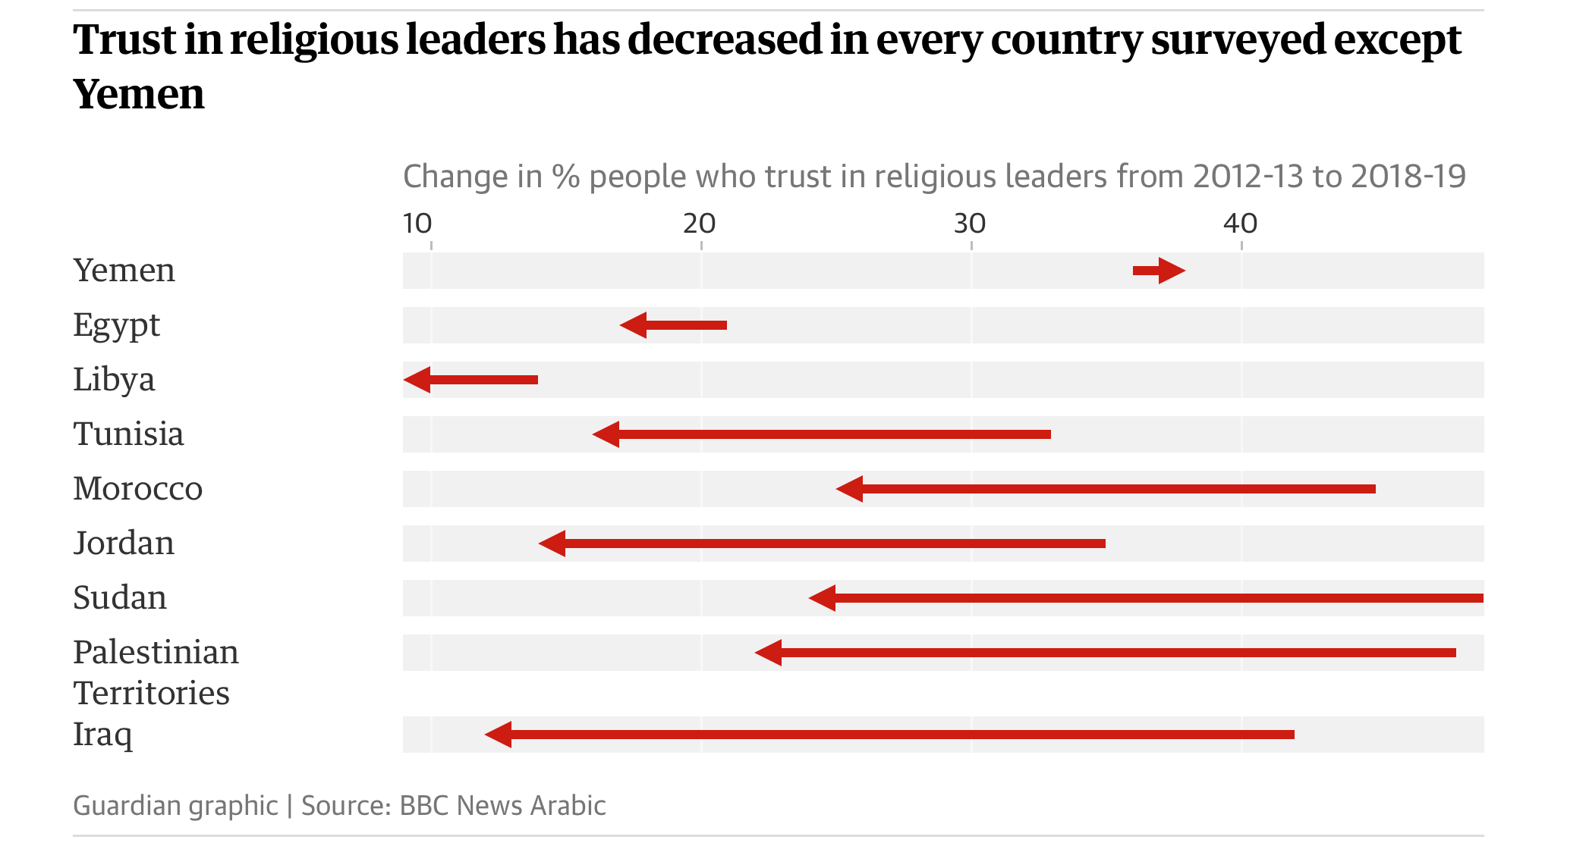

Slide 5
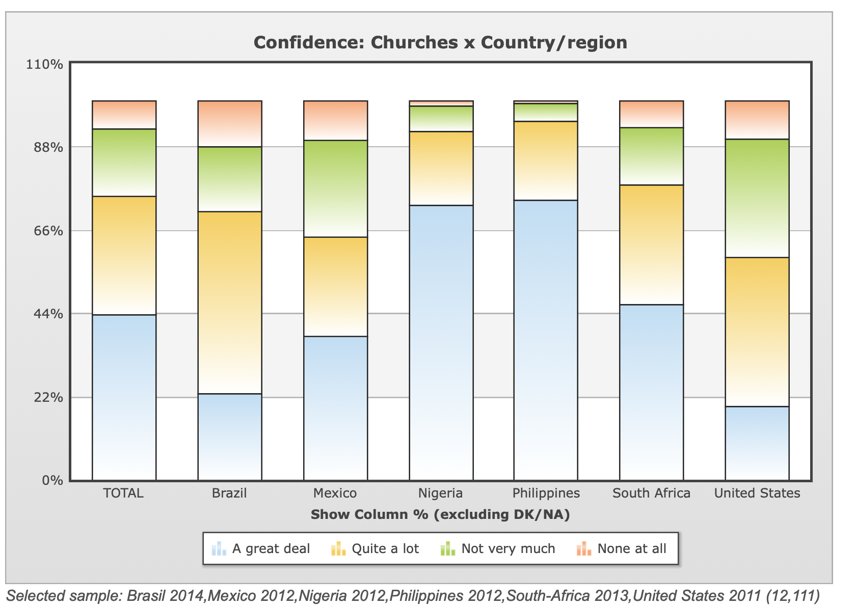

Slide 6
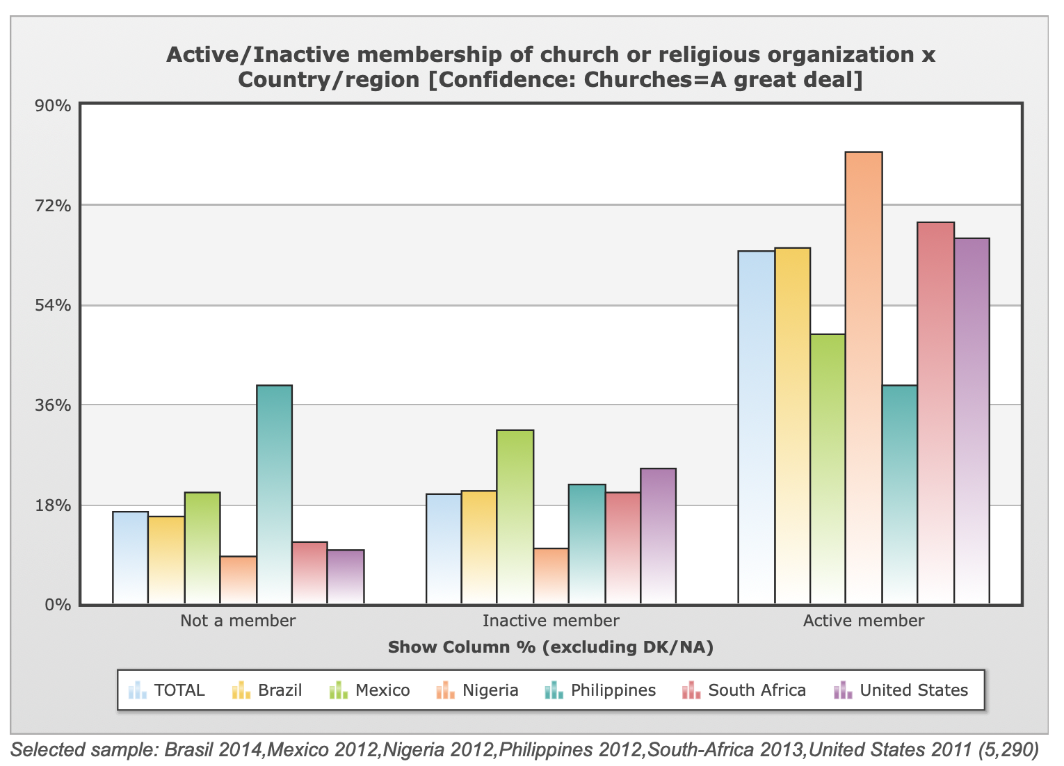

Slide 7
Overall confidence in organized religion
36%

Slide 8
Leading causes for decline in trust
Financial misconduct
Sexual misconduct
General distrust with authority
Absence of outstanding leaders with high integrity and leadership capability
Typical

Slide 9
We have our own issues
The financial resources of a church organization and the personal resources of an administrator are one and the same
An executive committee refuses to hold an administrator accountable for wrong-doing so as not to cause embarrassment
An incompetent leader is transferred to role in another vineyard
Audit reports are prepared but are never shared by administrators with governance
Management of an organization meets in a small group and votes certain benefits that apply only to them
Travel expenses for an officer is excessive and most expenses are for out of territory travel
A treasurer invests money in a scheme without any prior authorization and loses it all and yet was still employed

Slide 10
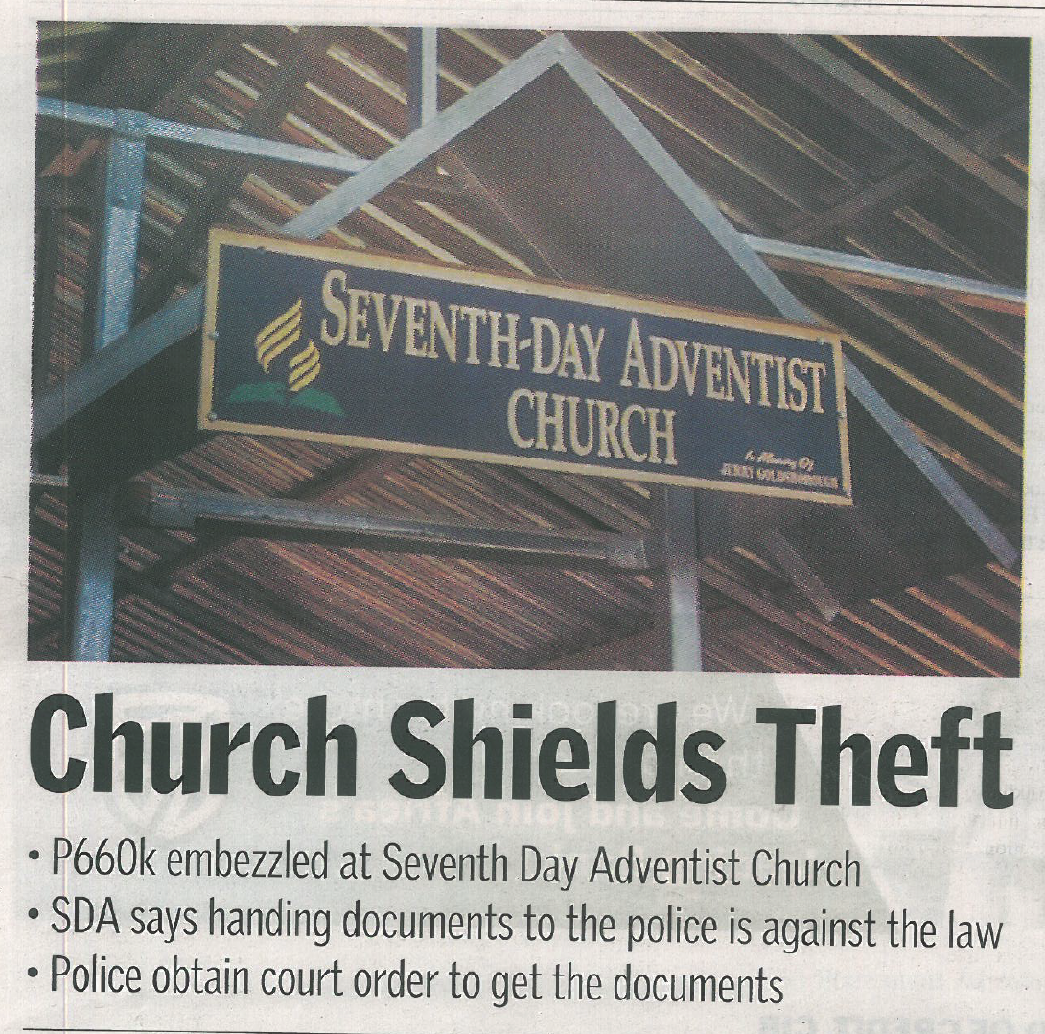

Slide 11
Promoting trust in leadership
Character
Communication
Competence

Slide 12
Promoting trust in leadership
Character
Communication
Competence
Emulate the life of Christ to be the standard of character to be developed and displayed

Slide 13
Promoting trust in leadership
The work of God calls for men[persons] of high moral powers to engage in its promulgation. [Persons] are wanted whose hearts are nerved with holy fervor, [persons] of strong purpose who are not easily moved, [persons] who can lay down every selfish interest and give all for the cross and the crown.
Ellen G White – Testimonies, Volume 3, p 23
Character
Communication
Competence

Slide 14
Promoting trust in leadership
Character
Communication
Competence
Engage in a program on of continuous learning to ensure the requisite competencies for leadership are obtained and maintained

Slide 15
Promoting trust in leadership
The man[person] at the head of any work in God’s cause is to be a [person] of intelligence, a [person] capable of managing large interests successfully, a [person] of even temper, Christlike forbearance, and perfect self-control. Only [the person] whose heart is transformed by the grace of Christ can be a proper leader.
Medical Ministry, pp. 164,165
Character
Communication
Competence

Slide 16
Promoting trust in leadership
Embrace regular and open communication within the organization and with the controlling committee, audit committee, auditor, constituents, other stakeholders, and next higher organization
Character
Communication
Competence

Slide 17
Promoting trust in leadership
Do nothing in an underhanded manner, be open as the day, true to your brethren and sisters, dealing with them as you wish Christ to deal with you
Review and Herald, May 14, 1895
Character
Communication
Competence

Slide 18
Promoting trust in leadership
Character
Communication
Competence

Slide 19
Church Members
Policy Accountability
Ladder of Transparency and Accountability
Program Accountability
Expectations
Expressions
Performance Accountability
Process Accountability
Accountability for Probity and Legality
Church Leaders
Adapted from Stewart (1994)

Slide 20
Church Members
Policy Accountability
Ladder of Transparency and Accountability
Program Accountability
Expectations
Expressions
Performance Accountability
Process Accountability
Accountability for Probity and Legality
Church Leaders
Adapted from Stewart (1994)

Slide 21
Loyalty Matters
Person Preference Position
Divine Purpose

Slide 22
TA x L = TL

Slide 23
When you weaken the confidence (trust) of God’s people in their leaders, you weaken the cause of God.
Letter 13, 1871

Slide 24
I call upon you leaders to be strong and of good courage. Be an example to the believers by your character, competence and communication!

Slide 25
Transparency and Loyalty Promotes Trust in Leadership
13th Global Leadership Summit
Cape Town, SOUTH AFRICA
February 4-6, 2020

