Slide 1
ENJOYING TEAMWORK WITH HIGH STANDARDS OF INTEGRITY AND LOYALTY

Slide 2
HIGH STANDARDS:
An encouragement

Slide 3
Finally, brethren, whatever things are true, whatever things are noble, whatever things are just, whatever thing are pure, whatever things are lovely, whatever things are of good report. If there is any virtue, and if there is anything praiseworthy, meditate on these things.
Philippians 4:8 NKJV

Slide 4
“And He Himself gave some to be apostles, some prophets, some evangelists, and some pastors and teachers,
for the equipping of the saints for the work of ministry, for the edifying of the body of Christ.
Ephesisans 4:11, 12 NKJV

Slide 5
…until we all come to the unity of the faith and of the knowledge of the Son of God, to a perfect man, to the measure of the stature of the fulness of Christ.
Ephesians 4:13 NKJV

Slide 6
“Show yourself in all respects to be a model of good works, and in your teaching show integrity, dignity, “
Titus 2:7 ESV

Slide 7
But as you excel in everything—in faith, in speech, in knowledge, in all earnestness, and in our love for you—see that you excel in this act of grace also.
2 Corinthians 8:7 ESV

Slide 8
“And it is my prayer that your love may abound more and more, with knowledge and all discernment, so that you may approve what is excellent, and so be pure and blameless for the day of Christ,”
Philipians 1:9-10 ESV

Slide 9
RAISING THE BAR
Because it is written “Be holy, because I am holy.”
1 Peter 1:16 NJKV
Be perfect, therefore, as your heavenly Father is perfect.
Mathew 5:48

Slide 10
“Place for yourself a high standard, and earnestly strive to reach it.”
CSA 51.6
“You should be content with no mean attainments. Aim high, and spare no pains to reach the standard. “
CSA 64

Slide 11
God will accept only those who are determined to aim high. He places every human agent under obligation to do the best.”
COL 330

Slide 12
Remember that you will never reach a higher standard than you yourself set. Then set your mark high, and step by step, even though it be by painful effort, by self-denial and sacrifice, ascend the whole length of the ladder of progress”
COL 331

Slide 13
“Higher than the highest human thought can reach is God’s ideal for His children. Godliness – godlikeness- is the goal to be reached.”
Ed. 18
PARTAKERS OF DIVINE IMAGE

Slide 14
PROFOUND
His divine power has given us everything we need for a godly life through our knowledge of him who called us by his own glory. Through these he has given us his very great and precious promises, so that through them you may participate in the divine nature, having escaped the corruption in the world caused by evil desires.
2 Peter 1:3,4.

Slide 15
A TEAM WITH HIGH VALUES OF INTEGRITY AND LOYALTY
A DELIGHT TO WATCH

Slide 16
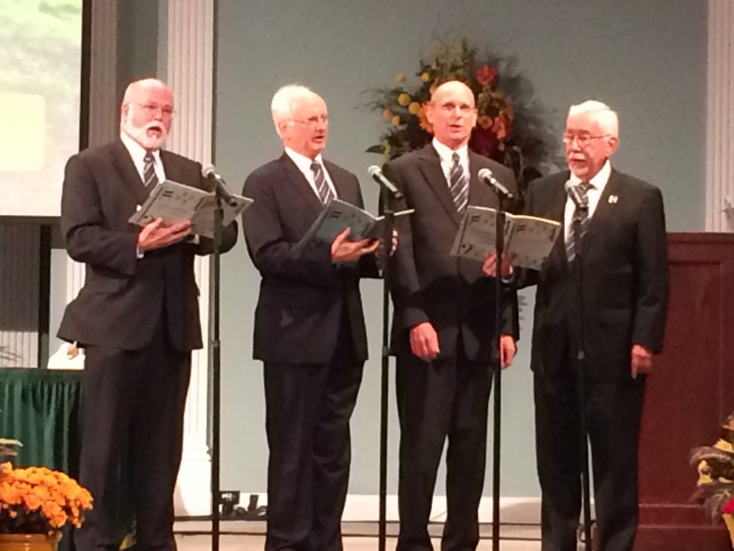
DEMONSTRATION
POWER OF UNITY
POWER OF ONENESS
POWER OF BEING A TEAM
POWER OF TOGETHER

Slide 17
AN EFFECTIVE TEAM
PEOPLE MATTER – all about people, care and respect people, building trust based relationships, establish win win partnerships. Results are fine but not at the expense of people.
COMMITMENT
EMBRACE CHANGE – don’t maintain but boldly multiply

Slide 18
GROWTH AND LEARNING IN ITS DNA – Great appetite for learning, always wanting to be better, pursuing growth on all levels and fronts.
THINK BIG BUT BEGIN SMALL – it is by caring the little day to day things that BIG comes.

Slide 19
GENEROUS GIVERS NOT SELF-SERVING – love giving more than receiving with view to helping. Teach and educate for success.
DOING MORE BY DOING LESS, BETTER AND FASTER – focused on excellence, obsessed with quality
ENJOYS ITS WORK AND HAS FUN.

Slide 20
WHY TEAM WORK?
Teams maximize involvement – every body’s strengths, skills, expertise while distributing work loads and responsibility to all.
Team maximize levels of knowledge and learning for the whole organization by sharing information.
Teams provide a wider range of solutions to a given problems providing greates choices for the best solution.

Slide 21
Teams have shared goal thereby providing incentive for encouragement and aiding other team members to achieve their goals
Teams provide opportunity for Collective wisdom
Teams provide improved outcomes which in turn provide motivation for achieving greater goals

Slide 22
Teams have a greater sense of ownership both collectively and individually – because of inclusiveness
A greater sense of security, more emotionally positive.
Great risk-taking, more daring
Decisions are better understood because of participation.

Slide 23
Scriptures TEAM WORKING

Slide 24
“Two are better than one, because they have a good return for their labor:”
Ecclesiastes 4:9
Doubles strength
Creates Harmony, order
Gives support

Slide 25
“As iron sharpens iron, so one person sharpens another.”
Proverbs 27:17

Slide 26
“I appeal to you, brothers and sisters, in the name of our Lord Jesus Christ, that all of you agree with one another in what you say and that there be no divisions among you, but that you be perfectly united in mind and thought.”
1 Corinthians 1:10

Slide 27
“May God who gives endurance and encouragement give you the same attitude of mind toward each other that Christ had, so that with one mind and one voice you may glorify the God and Father of our Lord Jesus Christ.”
Romans 15:5,6

