Slide 1
ESSENTIAL FOR MISSION
JUAN R. PRESTOL-PUESÁN FEBRUARY 2020
13th GLOBAL LEADERSHIP SUMMIT CAPE TOWN, SOUTH AFRICA

Slide 2
WHY IS INTEGRITY IMPORTANT? IS IT THE LEADER’S INTEGRITY OR THE FOLLOWER’S INTEGRITY? HOW IS HONESTY, MORAL UPRIGHTNESS, ADHERING OURSELVES TO STRONG MORAL AND ETHICAL VALUES A DETERMINANT FACTOR IN MISSION? IS INTEGRITY REALLY ESSENTIAL?
WHAT IS INTEGRITY?

Slide 3
INTEGRITY IS DEFINED AS:
Character
Ethics
Morals

Slide 4
It is also summarized as:
The quality of being honest and having strong moral principles; moral uprightness
The state of being whole and undivided
The condition of being unified, unimpaired, or sound in construction.
Internal consistency or lack of corruption when referred to in electronic data

Slide 5
INTEGRITY
“INTEGER”
means

Slide 6
French
Intégrité
Latin
Latin
Integer
(intact)
INTEGRITY
Integritas
Late Middle English
English
Integer
English
Intergrate

Slide 7
THOUGHT
ACTION
MIND
PRAXIS

Slide 8
CONSISTENCY

Slide 9
CONNECTION
CONSISTENCY

Slide 10
CONNECTION
CONGRUENCE
CONSISTENCY

Slide 11
CONNECTION
CONGRUENCE
CONSISTENCY
CONVERGENCE

Slide 12
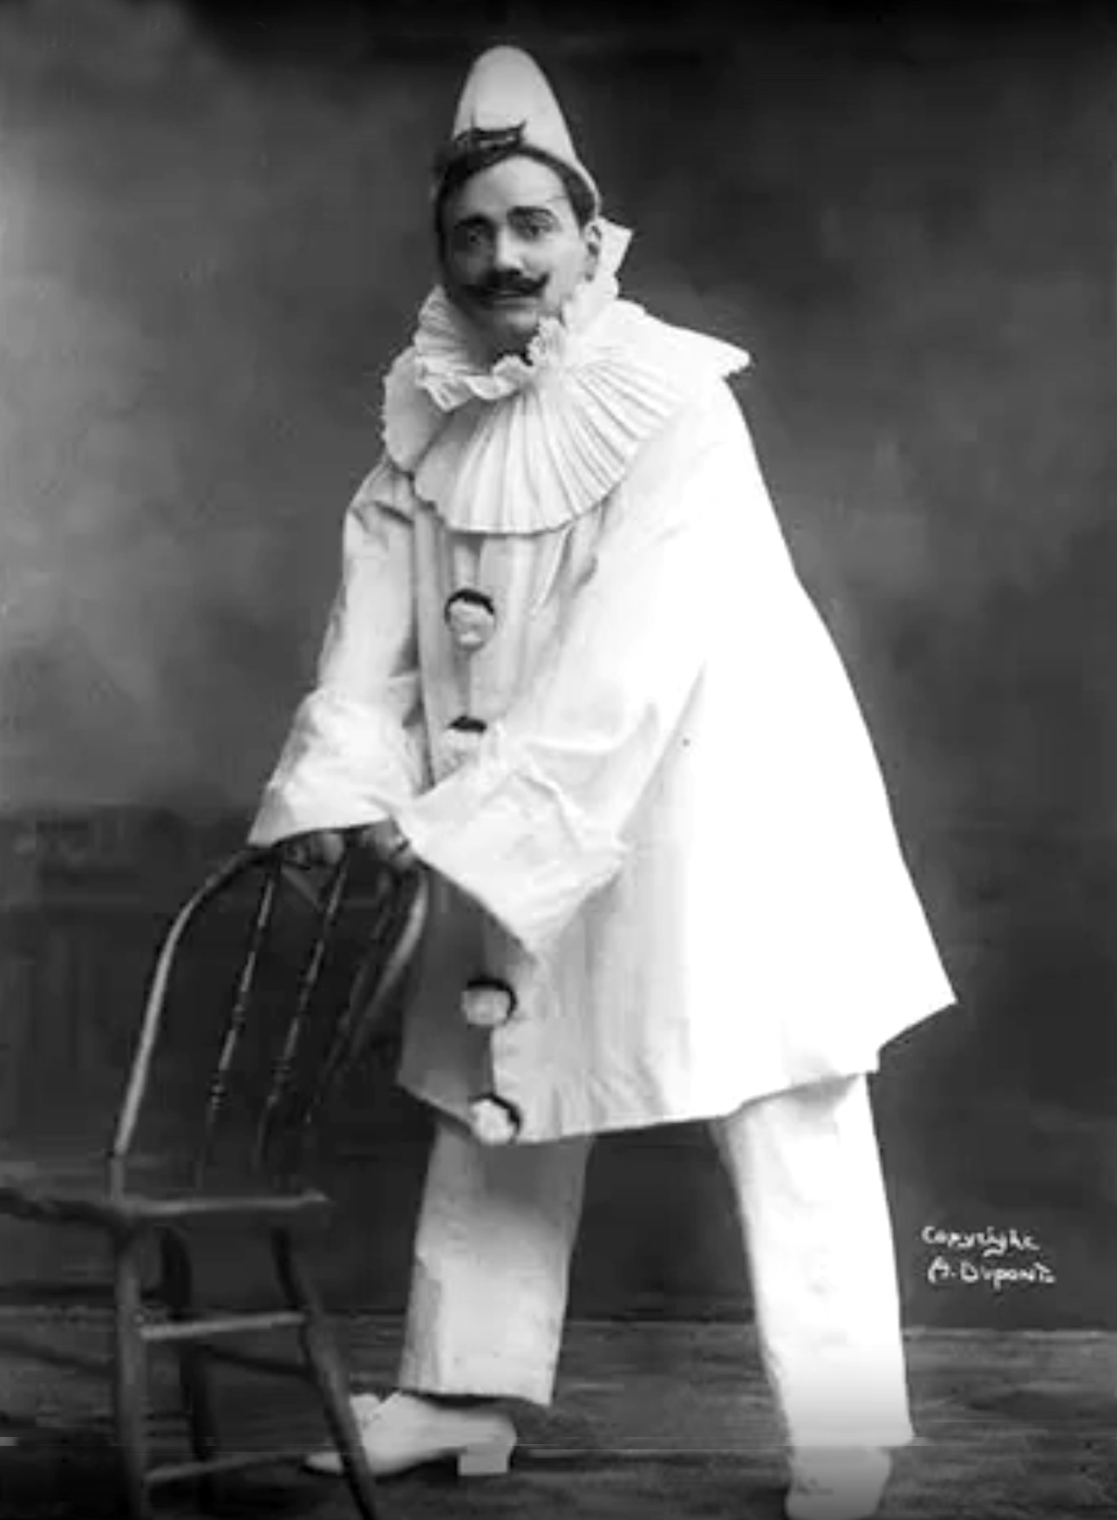
Enrico Caruso as “Canio” the Clown

Slide 13
CONNECTION
CONGRUENCE
CONSISTENCY
CONVERGENCE

Slide 14
CONNECTION
CONGRUENCE
IMPACT
CONSISTENCY
CONVERGENCE

Slide 15
Lord, who may abide in Your tabernacle? Who may dwell in Your holy hill? He who walks uprightly, And works righteousness, And speaks the truth in his heart; He who does not backbite with his tongue, Nor does evil to his neighbor,

Slide 16
Nor does he take up a reproach against his friend; In whose eyes a vile person is despised, But he honors those who fear the Lord; He who swears to his own hurt and does not change; He who does not put out his money at usury, Nor does he take a bribe against the innocent. He who does these things shall never be moved. (Psalm 15)

Slide 17
Integrity is core to:
The mental and moral qualities distinctive to an individual.
The distinctive nature of something.
The quality of being individual in an interesting or unusual way.
Strength and originality in a person’s nature.
A person’s good reputation.

Slide 18
INTEGRITY IS IMPORTANT FOR MISSION
Leading is about “one’s life, not one’s job or profession.” James MacGregor Burns
Trust will not flourish when there are character doubts.
A leader perceived to “compartmentalize,” will have difficulty with his/her followers.

Slide 19
THE JOURNEY OF MORALITY/ETHICS IN THE LITERATURE
From the Industrial Revolution in the 19th Century management did not include moral/ethical elements.
In the 20th Century, in the 1930s, leadership was conceptualized as “good management”
In the 60s and 70s, scholars defined leadership as influence. “The management of men by persuasion and inspiration.”
In 1978 leadership definitions began to include ethical/moral components.
In the 80s leadership was identified as a relationship between leader and follower, but predominantly as leaders getting followers to do the leader’s wishes.

Slide 20
THE JOURNEY OF MORALITY
In the 90s there was an abundance of literature with the Positive Forms of Leadership
Ethical, Spiritual, Servant, Transformational, Charismatic, among the better known Positive leadership theories.
In 2005, after the financial/moral failure of Enron, WorldCom, Tyco, Adelphia, Fannie Mae, United Way, HealthSouth, and Arthur Andersen,
leadership scholars simplified the previous theories identifying the leader, at the core, as 1) Self-aware, 2) Moral/Ethical, 3) Relationally Transparent, and 4) Balanced in processing the opinions of others. All four pointing to integrity.

Slide 21
Positive Forms of Leadership
Servant
Ethical
Spiritual
Charismatic
Transforma-tional
Authentic
d Gardner (2005), p. 323
Notes:
…or this?
[click]

Slide 22
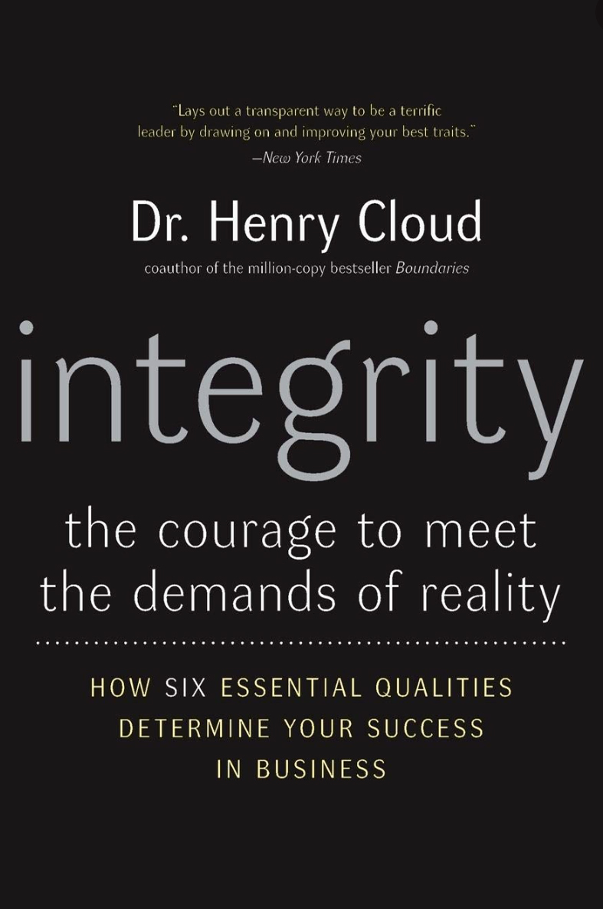

Slide 23
“the courage to meet the demands of reality”

Slide 24
“the courage to meet the demands of reality”
Reality is “the sum or aggregate of all that is real or existent within a system, as opposed to that which is only imaginary. The term is also used to refer to the ontological status of things, indicating their existence. In physical terms, reality is the totality of a system, known and unknown.”

Slide 25
SIX DIMENSIONS OF REALITY
Establishing Trust
TRUST: Through connection, extending favor, and vulnerability

Slide 26
SIX DIMENSIONS OF REALITY
Establishing Trust
TRUST: Through connection, extending favor, and vulnerability
Orientation
Toward
Truth
TRUTH: No manipulation, establishing confidence and strengthening relationships

Slide 27
SIX DIMENSIONS OF REALITY
Establishing Trust
TRUST: Through connection, extending favor, and vulnerability
Orientation
Toward
Truth
TRUTH: No manipulation, establishing confidence and strengthening relationships
RESULTS: Not theoretical, including quality and quantity, by respecting people while obtaining verifiable results
Getting Results

Slide 28
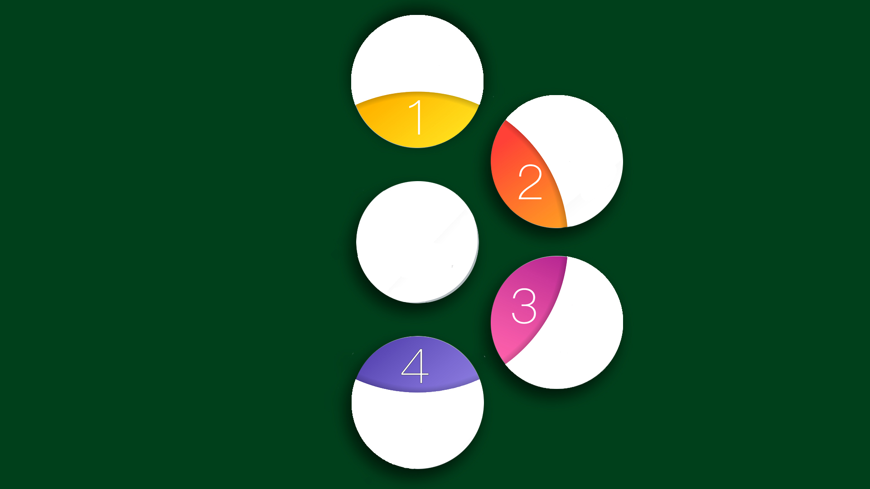
SIX DIMENSIONS OF REALITY
Establishing Trust
TRUST: Through connection, extending favor, and vulnerability
Orientation
Toward
Truth
TRUTH: No manipulation, establishing confidence and strengthening relationships
RESULTS: Not theoretical, including quality and quantity, by respecting people while obtaining verifiable results
Getting Results
Embracing the Negative
BALANCE: Learning from the lessons of past experiences

Slide 29
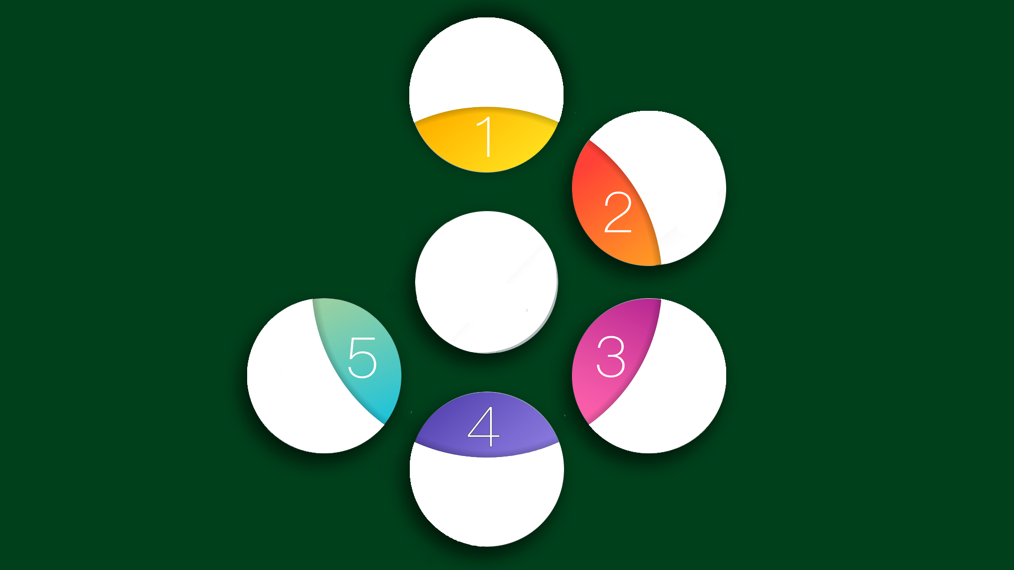
SIX DIMENSIONS OF REALITY
Establishing Trust
TRUST: Through connection, extending favor, and vulnerability
Orientation
Toward
Truth
TRUTH: No manipulation, establishing confidence and strengthening relationships
GROWTH: A critical result of leadership. Growth is important
RESULTS: Not theoretical, including quality and quantity, by respecting people while obtaining verifiable results
Getting Results
Oriented
Toward
Increase
Embracing the Negative
BALANCE: Learning from the lessons of past experiences

Slide 30
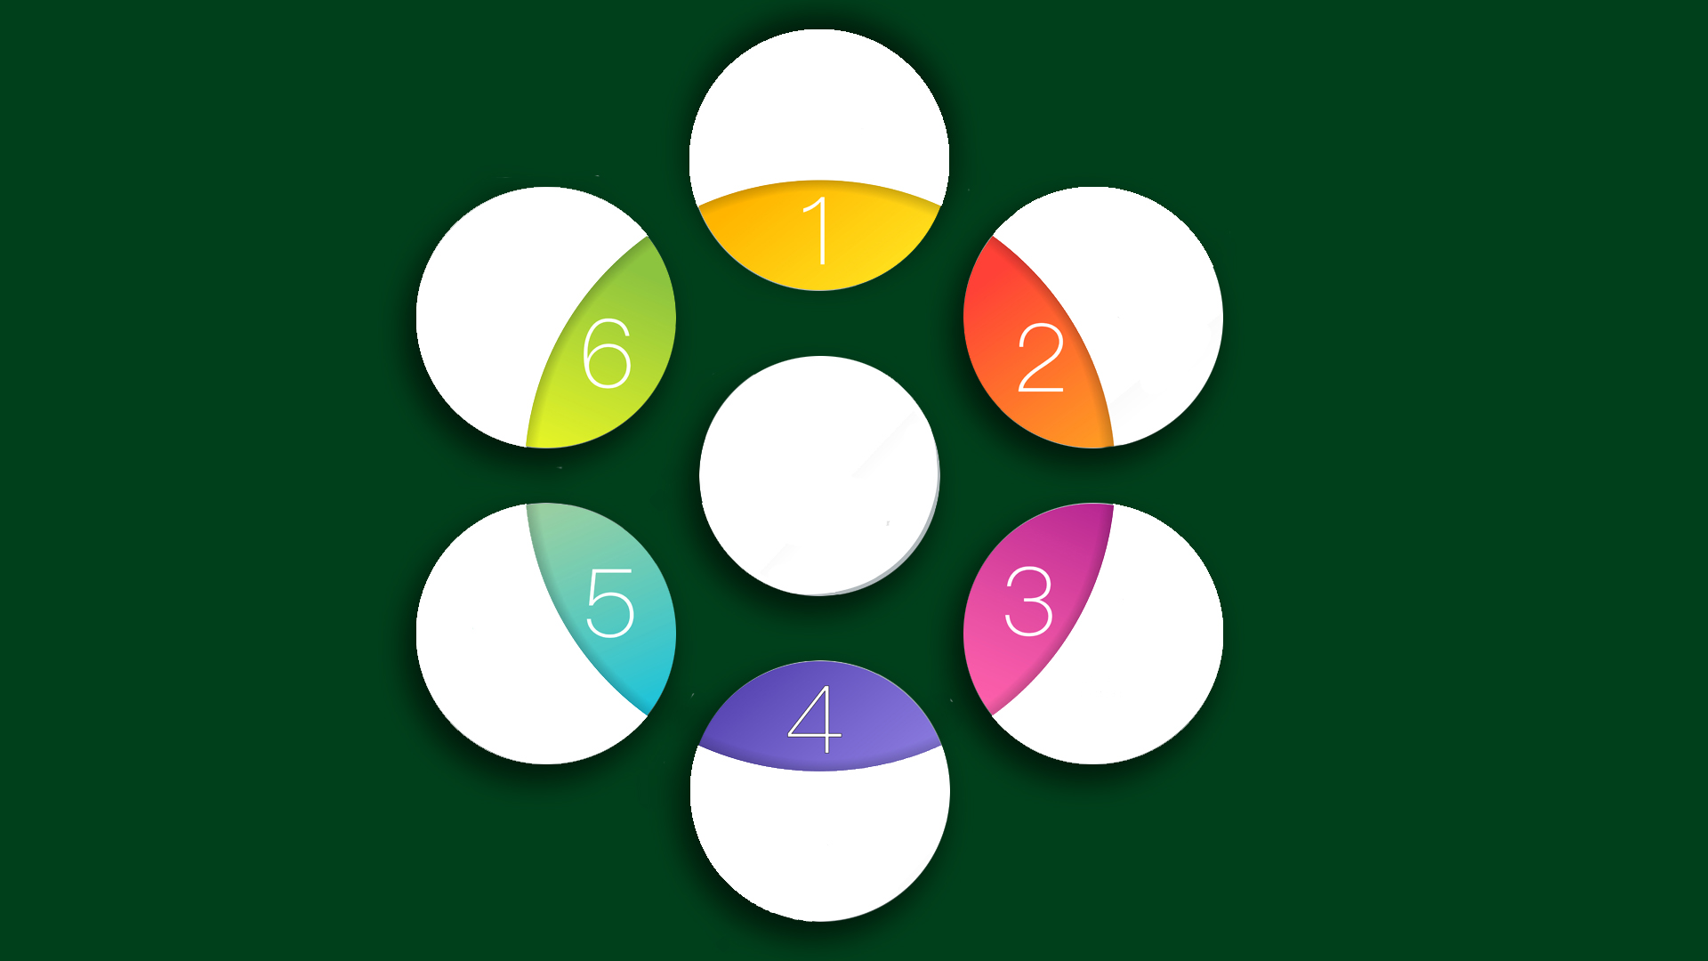
SIX DIMENSIONS OF REALITY
BIG PICTURE: Self-aware but not self-centered. Seeking the common good. Looking beyond ourselves.
Establishing Trust
TRUST: Through connection, extending favor, and vulnerability
Oriented
Toward
Tran-
scend-
ence
Orientation
Toward
Truth
TRUTH: No manipulation, establishing confidence and strengthening relationships
RESULTS: Not theoretical, including quality and quantity, by respecting people while obtaining verifiable results
GROWTH: A critical result of leadership. Growth is important
Getting Results
Oriented
Toward
Increase
Embracing the Negative
BALANCE: Learning from the lessons of past experiences

Slide 31
A LEADER OF INTEGRITY RELATES TO MISSION
Spiritually committed, with mind and heart reconciled
Competency proven, in theory and praxis
Dynamically engaged, with a deep sense of urgency
Sensitive and wise, as an effective leadership priest
Devoted to holiness, but also ready to learn morality and ethics
Able to deliver a sustained, verifiable, and positive performance

Slide 32
“Come, follow me,” Jesus said, “and I will send you out to fish for people.” Matthew 4:19 (NIV)
)
Are we willing to imitate Him?

Slide 33
THE END

