Slide 2
Are you a leader that God can use?
Global Leadership Summit - Cape Town, South Africa - February 4-6, 2020

Slide 3
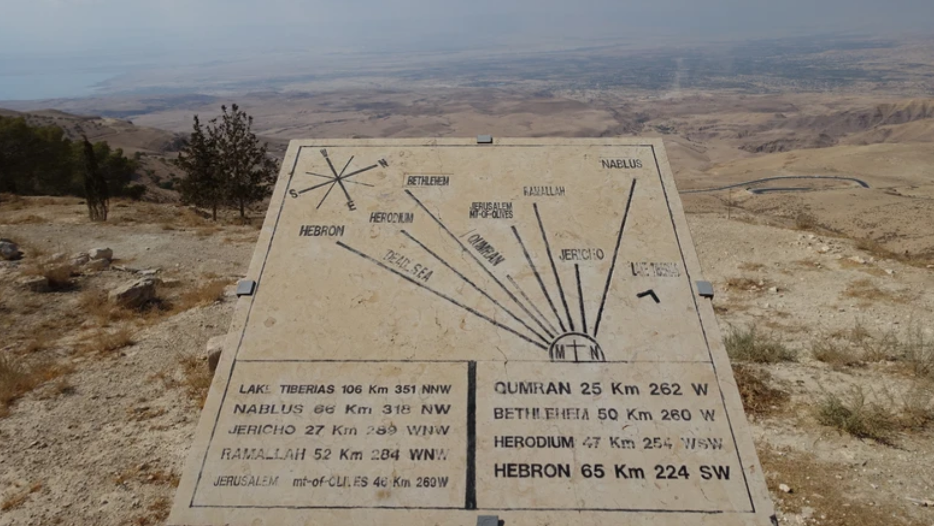
Global Leadership Summit
Cape Town, South Africa
February 4-6, 2020
Global Leadership Summit
Cape Town, South Africa
February 4-6, 2020

Slide 4
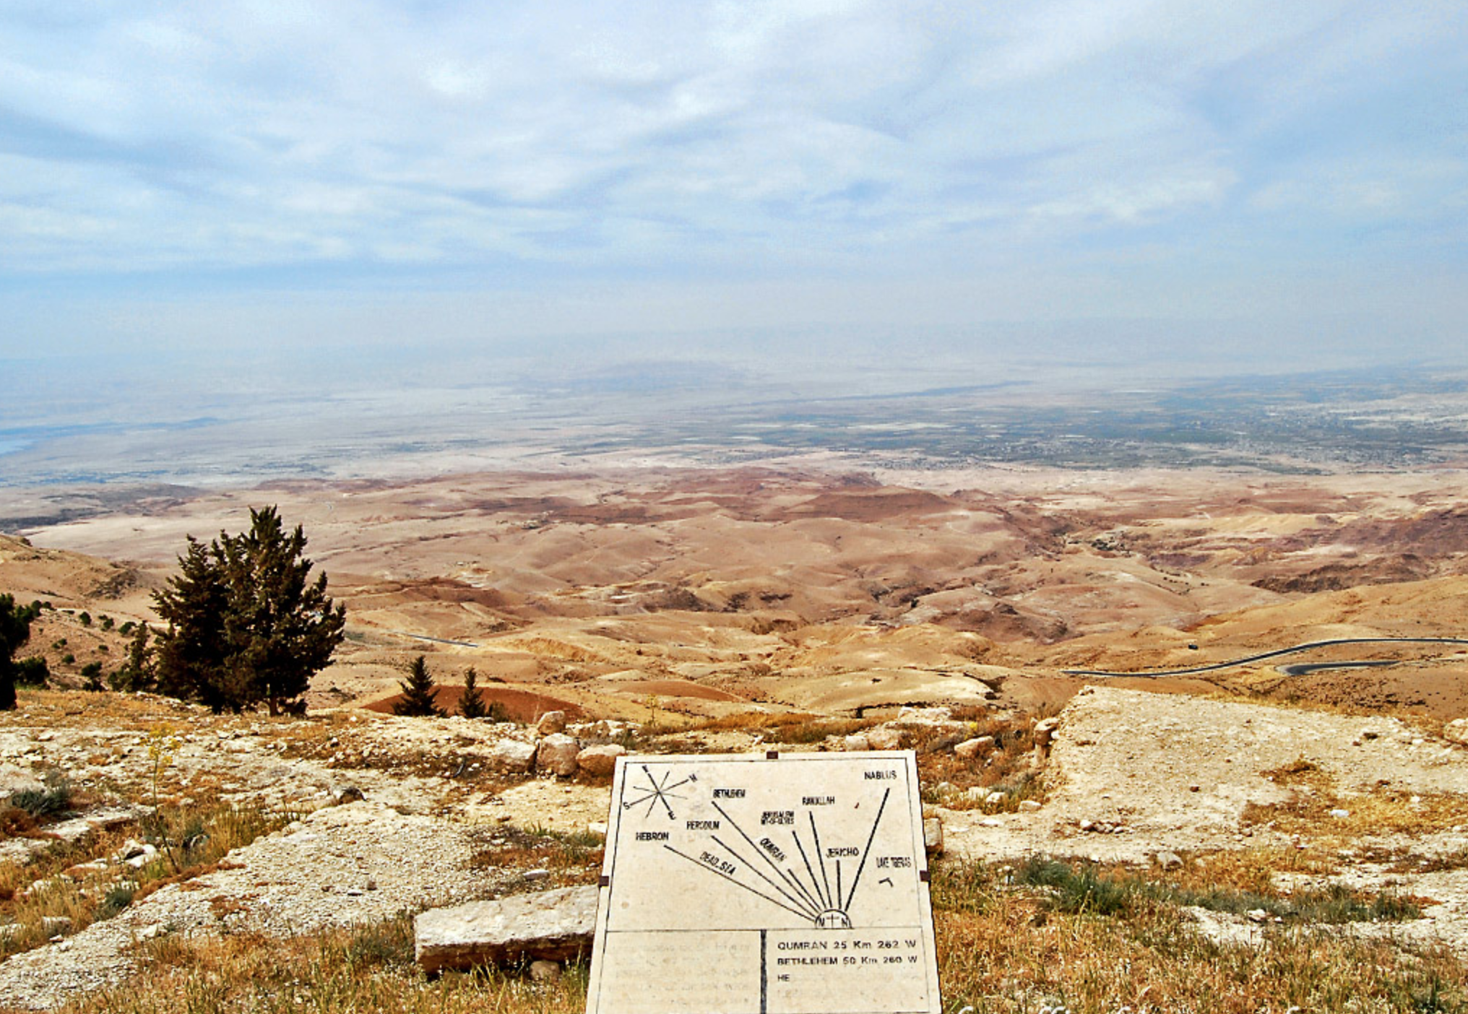
Global Leadership Summit
Cape Town, South Africa
February 4-6, 2020

Slide 5
1) God uses leaders who realize they are weak and limited
^{Joshua 1:6, 7, 9}
Global Leadership Summit
Cape Town, South Africa
February 4-6, 2020

Slide 6
2) God uses leaders who are faithful
^{Joshua 1:1}
Global Leadership Summit
Cape Town, South Africa
February 4-6, 2020

Slide 7
3) God uses leaders who who study and live by His word
^{Joshua 1:7, 8}
Global Leadership Summit
Cape Town, South Africa
February 4-6, 2020

Slide 8
4) God uses the leader who is patient and waits on His timing, not even knowing if God will ever call him to conquer the land or succeed in the eyes of the world.
^{Joshua 1:11}
Global Leadership Summit
Cape Town, South Africa
February 4-6, 2020

Slide 9
5) God uses leaders who care about lost people
^{Joshua 6:22}
Global Leadership Summit
Cape Town, South Africa
February 4-6, 2020

Slide 10
6) God uses leaders who intentionally set themselves apart for God!
^{Joshua 3:1-5}
Global Leadership Summit
Cape Town, South Africa
February 4-6, 2020

Slide 11
7) God uses leaders who know how to be positive and affirm others
^{Joshua 3:1-5}
Global Leadership Summit
Cape Town, South Africa
February 4-6, 2020

Slide 12
8) God uses leaders who serve others instead of themselves
^{Joshua 3:1-5}
Global Leadership Summit
Cape Town, South Africa
February 4-6, 2020

Slide 13
“Corporal, next time you have a job like this and not enough men to do it, go to your commander-in-chief and I will come and help you again.”
…With that, George Washington got on his horse and rode off!
Global Leadership Summit
Cape Town, South Africa
February 4-6, 2020

Slide 14
Are you a leader that God can use?
Global Leadership Summit
Cape Town, South Africa
February 4-6, 2020

Slide 15
Global Leadership Summit
Cape Town, South Africa
February 4-6, 2020

Slide 16
Global Leadership Summit
Cape Town, South Africa
February 4-6, 2020

Slide 17
Global Leadership Summit
Cape Town, South Africa
February 4-6, 2020

