Slide 1
Accountability: Needed in Today’s Leadership
13th Global Leadership Summit
Cape Town, South Africa
February 4, 2020
Karnik Doukmetzian
General Counsel

Slide 2
ac·count·a·bil·i·ty
The obligation of an individual or organization to account for its activities, accept responsibility for them and to disclose the results in a transparent manner. To give a reckoning or explanation for one’s actions and responsibilities

Slide 3
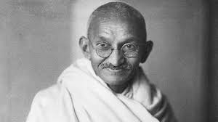
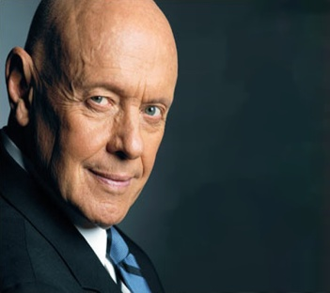
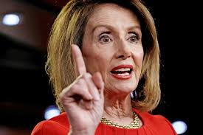
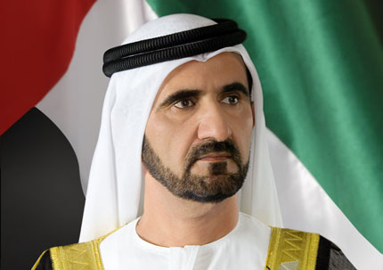
WHAT THE MEANING OF ACCOUNTABILITY?
The obligation of an individual or organization to account for its activities, accept responsibility for them, and to disclose the results in a transparent manner. (It also includes the responsibility for money or other property entrusted to them).
Obligation to account for our actions or inaction.
Ensuring that people are doing the job they have been elected or hired to do.
Defining, communicating and describing expectations so that individuals know what is expected from them.
Evaluating or accounting for the activities.
Recognizing the efforts.
“It is wrong and immoral to seek to escape the consequences of one's actions.” ― Mahatma Gandhi
“Accountability breeds response-ability. “
-Stephen Covey
“The president must be held accountable. No one is above the law.”
-Nancy Pelosi
Notes:
Dictionary definition

Slide 4
Accountability
Sir Thomas Pane
Anyone holding themselves accountable to nobody ought not to be trusted by anybody.
Don’t shy away from accountability because you see it as a system of checks and balances-being responsive to stakeholders
Where there is an absence of accountability there is often a culture of impunity
When a principal delegates authority to an agent to act in their interests, those who delegated the authority have the right to demand an accounting
Leaders should not serve without a support structure

Slide 5
Who are we accountable to?
We are accountable to God
We are accountable to the Church
Denomination, Constituency, Boards, Members
We are accountable to the community
We are accountable to one another
Being accountable makes us stronger
We are hard wired to not be accountable
Full of pride, arrogance and quest for independence

Slide 6
IMPORTANCE OF ACCOUNTABILITY
Accountability improves performance
Accountability eliminates the time and effort one spends on distracting activities and other unproductive behavior. Or that activity which brings shame and dishonor to the organization because of our actions.
Accountability is a desired trait for any individual and organization. Any organization, expects our members, employees, stakeholders, to desire it.
Accountability promotes ownership
When you hold people accountable for their actions, you’re teaching them to value their contribution to the cause.
Accountability inspires confidence
When done right, accountability can increase skills and confidence. Don’t mistake accountability for controlling behavior.
Accountability builds trust
Perhaps the most important result of accountability is trust, which is essential in any relationship.

Slide 7
Trust – An Organizational Necessity
The perception of honesty, openness and reliability or dependability.
Grows in direct relationship to meaningful interactions.
Takes time to develop but can be weakened or broken very easily.
Is an organization’s lubricant.
All we have is our REPUTATION

Slide 9
7 things to remember
Accountability starts with each of us as leaders
Leadership defines culture and if you want to create a culture of accountability, it starts with us
We need to model the behavior we want to see in our organization
If we don’t, then why should anyone else
Walk the talk if you want others to follow
We are accountable
It comes as a part of our job description
Try to avoid it and it has a negative impact on all levels
It is not a one-time thing
Those who don’t want to be accountable are always looking for ways to get out of accountability
We need to be seen as being accountable all the time
Applies to everyone
When we are looking for people to hold accountable, can’t apply inconsistently

Slide 10
Accountability cannot be delegated
Accountability must be accepted for that person to be accountable, take ownership
It is the difference between success and failure
If we don’t take ownership, we go into spectator mode and watch as things fail
Expected failure from beginning or go into I told you so mode
We must hold people accountable
Not enough to tell them so, set up review sessions, see how people are doing

Slide 11
ACCOUNTABILITY
is the glue that ties
COMMITMENT
to RESULTS

Slide 12
Where do we go wrong?
•Performing our duties inadequately due to involvement in external activities
•Accepting gifts or fees or personal benefits for performing duties of our office
•Accepting gratuities or favours from individuals or entities that do business with Organization
•Associating our name or work with external activity in way that implies endorsement by Church

Slide 13
Directing organizational resources to ourselves
•Diverting opportunities away from Organization to ourselves or family members
•Making use or disseminating information acquired through our position for personal profit
Providing favours to family members
Conflict of Interest Provisions

Slide 14
Where do we go wrong
Abuse of travel privileges
Denominational Finances
How do we treat our employees?
How do we treat our family?
People are watching you
When confronted with information, how do we react
When someone steals money, time
When someone abuses their power, is a bully, is a dictator
When someone is an abuser, do we arrange for a transfer
When someone comes to us with an issue, do we make promises we can’t keep just to get them out of our office

Slide 16
The greatest want of the world is the want of men– men who will not be bought or sold, men who in their inmost souls are true and honest, men who do not fear to call sin by its right name, men whose conscience is as true to duty as the needle to the pole, men who will stand for the right though the heavens fall. Education p. 57

Slide 17
The greatest want of the world is the want of men and women-- men and women who will not be bought or sold, who will not accept or give a bribe, men and women who in their inmost souls are true and honest, men and women who will not lie, steal or cheat, men and women who do not fear to call sin by its right name, men and women whose conscience is as true to duty as the needle to the pole, men and women who are accountable, men and women who will stand for the right though the heavens fall.
Education p. 57 (emphasis supplied)

Slide 18
But such a character is not the result of accident;….it is the result of self-discipline- the surrender of self for the service of love to God and man.

Slide 19
Questions

