Slide 2
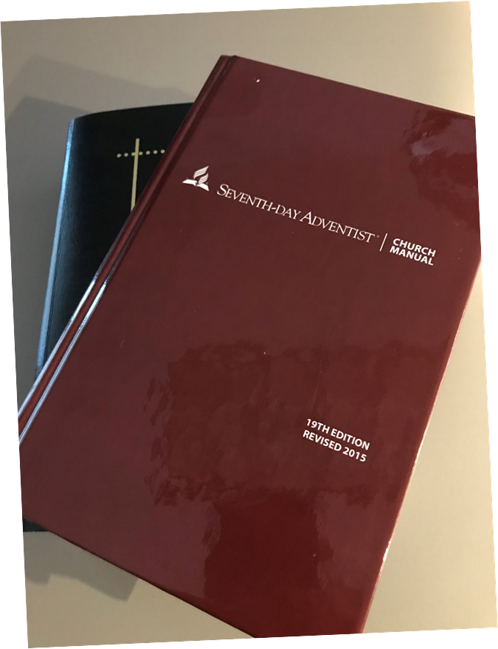
WHAT IS THE VALUE OF THESE BOOKS?
$50 or less to print
$1000s to edit and to publish
$20,000 to $25,000 for WP alone?
$50,000 for both?
If you had to pay a consulting firm, > $100,000

Slide 3
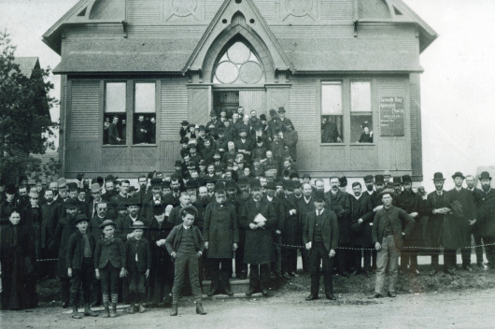
What is?
INVALUABLE!!
Notes:
When I prepared the ECD WP, I spent 2 ½ months FT putting it together, at today’s salary in MD $20,000_$25,000

Slide 4
What is?
Church Manual and Working Policy: represent the aggregate distilled wisdom of countless men and women over multiple generations!
INVALUABLE!!
Notes:
When I prepared the ECD WP, I spent 2 ½ months FT putting it together, at today’s salary in MD $20,000_$25,000

Slide 5
What is?
They are the distillation of best operating procedures
They are the source of order for the internal operations of the Church
They provides rule and discipline!
Notes:
When I prepared the ECD WP, I spent 2 ½ months FT putting it together, at today’s salary in MD $20,000_$25,000

Slide 6
What is?
It was in 1882 only that the GC Session voted to have prepared “instructions to church officers, to be printed in the Review and Herald or in tract form.” RH, Dec. 26, 1882
Notes:
When I prepared the ECD WP, I spent 2 ½ months FT putting it together, at today’s salary in MD $20,000_$25,000

Slide 7
What is?
It expresses “the Church’s understanding of Christian life and church governance and discipline based on biblical principles and the authority of duly assembled General Conference Sessions.”
Notes:
When I prepared the ECD WP, I spent 2 ½ months FT putting it together, at today’s salary in MD $20,000_$25,000

Slide 8
What is?
GC Working Policy: first edition in 1926, with 63 pages.
Today, it contains 790 pages:
The Fundamental Beliefs
The Constitution and Bylaws
The Working Policy
The Index
Notes:
When I prepared the ECD WP, I spent 2 ½ months FT putting it together, at today’s salary in MD $20,000_$25,000

Slide 9
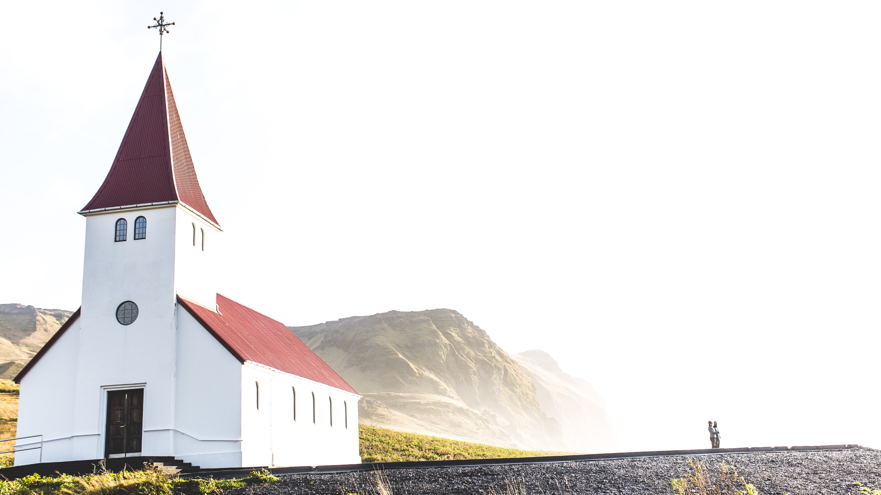
AMPLIFIERS OF TRUST
TRUST
Constitution and Bylaws
Working Policies
Fundamental Beliefs
TRUST

Slide 10
AMPLIFIERS OF TRUST
TRUST
Constitution and Bylaws
Binds all entities to the Corporate Body of the Church
Working Policies
Binds all administrators to the professional
Body of the Church
Fundamental Beliefs
Binds all members to the Body of the Church
TRUST

Slide 11
AMPLIFIERS OF TRUST
TRUST
Constitution and Bylaws
Entities are accountable to each other
Working Policies
Administrators are accountable to each other and their constituency
Fundamental Beliefs
Members are accountable to each other
TRUST

Slide 12
AMPLIFIERS OF TRUST
TRUST
Constitution and Bylaws
Facilitates Trust between entities and constituents
Working Policies
Facilitates Trust between administrators and entities
Fundamental Beliefs
Facilitates Trust between members
TRUST

Slide 13
TRUST IS THE KEY TO HARMONY

Slide 14
WHAT IS THE VALUE OF TRUST?

Slide 15
WHAT IS THE VALUE OF TRUST?
T = f(Ch + Co)
Trust is a function of Character plus Competence
Jack Welch: “Live the values and deliver the results”
Claude Richli: “Live the values (character), establish a transparent framework, and deliver the results (competence).”

Slide 16
AMPLIFIERS OF TRUST
TRUST
Constitution and Bylaws
= FRAMES CHARACTER + COMPETENCE INTO STRUCTURE
Working Policies
= COMPETENCE
Fundamental Beliefs
= CHARACTER
TRUST

Slide 17
AMPLIFIERS OF TRUST
“Organizational status is granted to a constituency as a trust. . . . Organizational membership and status are entrusted to entities that meet certain qualifications, including faithfulness to Seventh-day Adventist Fundamental Beliefs, compliance with denominational practices and policies, demonstration of adequate leadership and financial capacity, and responsiveness to mission challenges and opportunities.” WP, B 05, paragr. 3, p. 63-64

Slide 18
WHAT DO THESE HAVE IN COMMON?
Notes:
Both of them do not have an outlet in Vatican City
Both are recognized worldwide: McDo has a network of
Both are franchises, both have standard operating procedures and are bound by a set of rules and regulations.

Slide 19
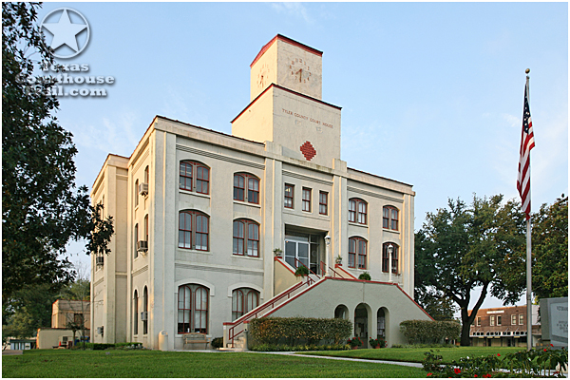
McDonalds: the “new American Church”

Slide 20
WHAT DO THESE HAVE IN COMMON?
World-wide operations
Present in 119 countries
Present in 208 countries
Notes:
Both of them do not have an outlet in Vatican City
Both are recognized worldwide: McDo has a network of
Both are franchises, both have standard operating procedures and are bound by a set of rules and regulations.

Slide 21
WHAT DO THESE HAVE IN COMMON?
36,899 outlets worldwide
375,000+ employees
91,410 outlets worldwide
300,000+ employees
Notes:
Both of them do not have an outlet in Vatican City
Both are recognized worldwide: McDo has a network of
Both are franchises, both have standard operating procedures and are bound by a set of rules and regulations.

Slide 22
BOTH ARE “FRANCHISE OPERATIONS”
36,899 outlets worldwide
375,000+ employees
91,410 outlets worldwide
300,000+ employees
Notes:
Both of them do not have an outlet in Vatican City
Both are recognized worldwide: McDo has a network of
Both are franchises, both have standard operating procedures and are bound by a set of rules and regulations.

Slide 23
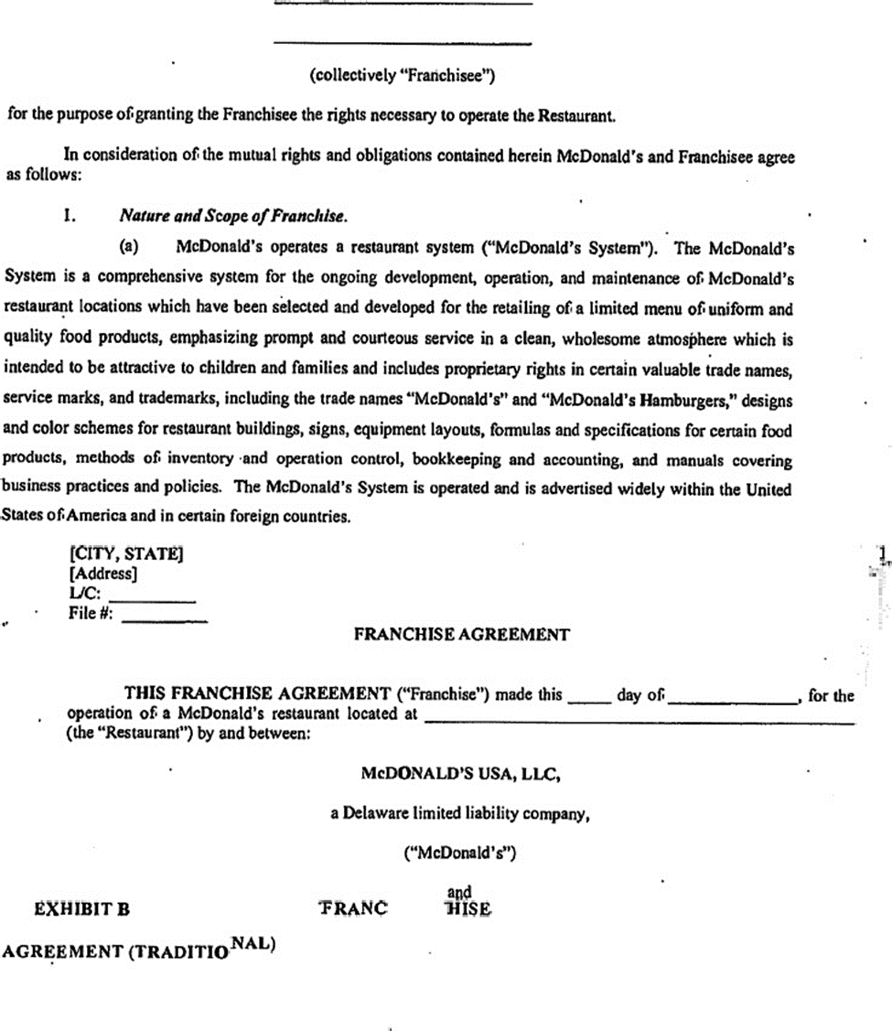
Notes:
ensuring every burger would taste the same in every restaurant. He set strict rules for franchisees on how the food was to be made, portion sizes, cooking methods and times, and packaging

Slide 24
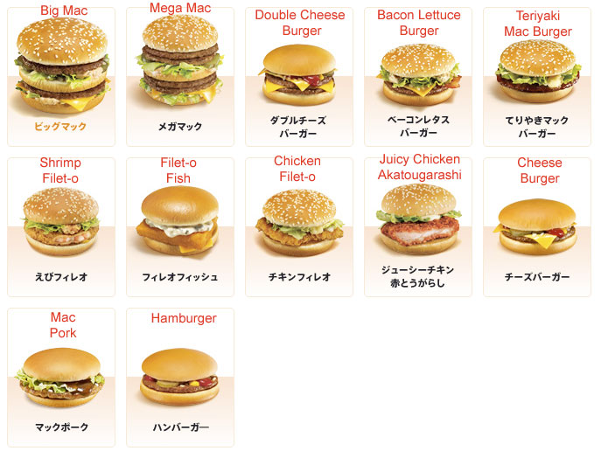

Slide 26
UNIFORMITY WITH EXCEPTIONS!

Slide 27
WHAT DO THESE HAVE IN COMMON?
8.5% of sales in rent costs + 4% in franchise fees = 12.5%
Owns the real estate
10% in tithes
Owns the real estate

Slide 28
WHY FRANCHISE? – FOR THE FRANCHISEE
A higher chance of success than standing alone
Provides training and support
Recognizable branding
A network of fellow franchisees
Assistance with securing funding
A higher chance of success than
standing alone
Provides training and support
Recognizable branding
A network of fellow brothers and sisters
Assistance with securing funding

Slide 29
WHY FRANCHISE?
Etc.
Provides personnel (pastors)
Provides trainers and consultants (departmental leaders)
Provides services: spiritual, health, educational, developmental, familial

Slide 30
WHY FRANCHISE? – FOR THE FRANCHISOR
Quality control
Financial control and risk mitigation
Leverage and bargaining power
Efficiencies and rationalization
Quality control (SEC Evaluations, AAA, IBMTE, GCAS, etc.)
Financial control and risk mitigation
Leverage and bargaining power
Efficiencies and rationalization

Slide 31
WHY FRANCHISE?
A shorter time from investment to opening →
To grow faster
To make money faster
A shorter time to accomplish the mission
To grow faster
To make disciples faster

Slide 33
TRUST = SPEED!
If we want to move fast, we have to have a high degree of trust towards each other
Speed of execution is directly correlated with the amount of trust

Slide 34
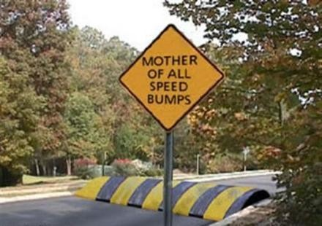
TRUST = SPEED!
If we want to move fast, we have to have a high degree of trust towards each other
Speed of execution is directly correlated with the amount of trust

Slide 35
LOW TRUST SLOWS THINGS DOWN!
Every decision
Every communication
Every relationship

Slide 36
LOW TRUST SLOWS THINGS DOWN!
Politics
Interpersonal conflicts
Interdepartmental rivalries
Win-lose thinking
Defensive and protective communication
Creates hidden agendas

Slide 37
HIGH TRUST SPEEDS THINGS UP!
Things flow like water
Problems are solved quickly
Missionaries are recruited more quickly

Slide 38
THE VALUE OF THE TRUST WE VALUE!
T = f(Ch + Co) → cA → cM
Trust is a function of CHaracter plus COmpetence to complete a Common Agenda while fulfilling a Common Mission

Slide 39
As an important factor in the spiritual growth of the new converts the apostles were careful to surround them with the safeguards of gospel order. . . . Officers were appointed in each church, and proper order and system were established for the conduct of all the affairs pertaining to the spiritual welfare of the believers. {AA 185.2} This was in harmony with the gospel plan of uniting in one body all believers in Christ..

Slide 40
Thank you!

