Slide 1
The Spiritual Necessity of Church Unity and Biblical Authority to Accomplish God’s Mission
General Conference Global Leadership Summit
Lisbon, Portugal • February 6, 2018
Ted N C Wilson

Slide 2
ehold how good and how pleasant it is for brethren to dwell together in unity! It is like the precious oil upon the head, running down on the beard. The beard of Aaron, running down on the edge of his garments. It is like the dew of Hermon, descending upon the mountains of Zion; for there the Lord commanded the blessing—life forevermore. —Psalm 133
B

Slide 3
In a special sense Seventh-day Adventists have been set in the world as watchmen and light bearers. To them has been entrusted the last warning for a perishing world. On them is shining wonderful light from the Word of God. They have been given a work of the most solemn import—the proclamation of the first, second, and third angels’ messages. There is no other work of so great importance. They are to allow nothing else to absorb their attention. —Testimonies for the Church, vol. 9, p. 19

Slide 4
Be still and know that I am God . . . —Psalm 46:10

Slide 5
ecome complete. Be of good comfort, be of one mind, live in peace: and the God of love and peace will be with you. —2 Corinthians 13:11
B

Slide 6
herefore if there is any consolation in Christ, if any comfort of love, if any fellowship of the Spirit, if any affection and mercy, fulfill my joy by being like-minded, having the same love, being of one accord, of one mind. Let nothing be done through selfish ambition or conceit, but in lowliness of mind let each esteem others better than himself. Let each of you look out not only for his own interests but also for the interests of others. —Philippians 2:1-4
T

Slide 7
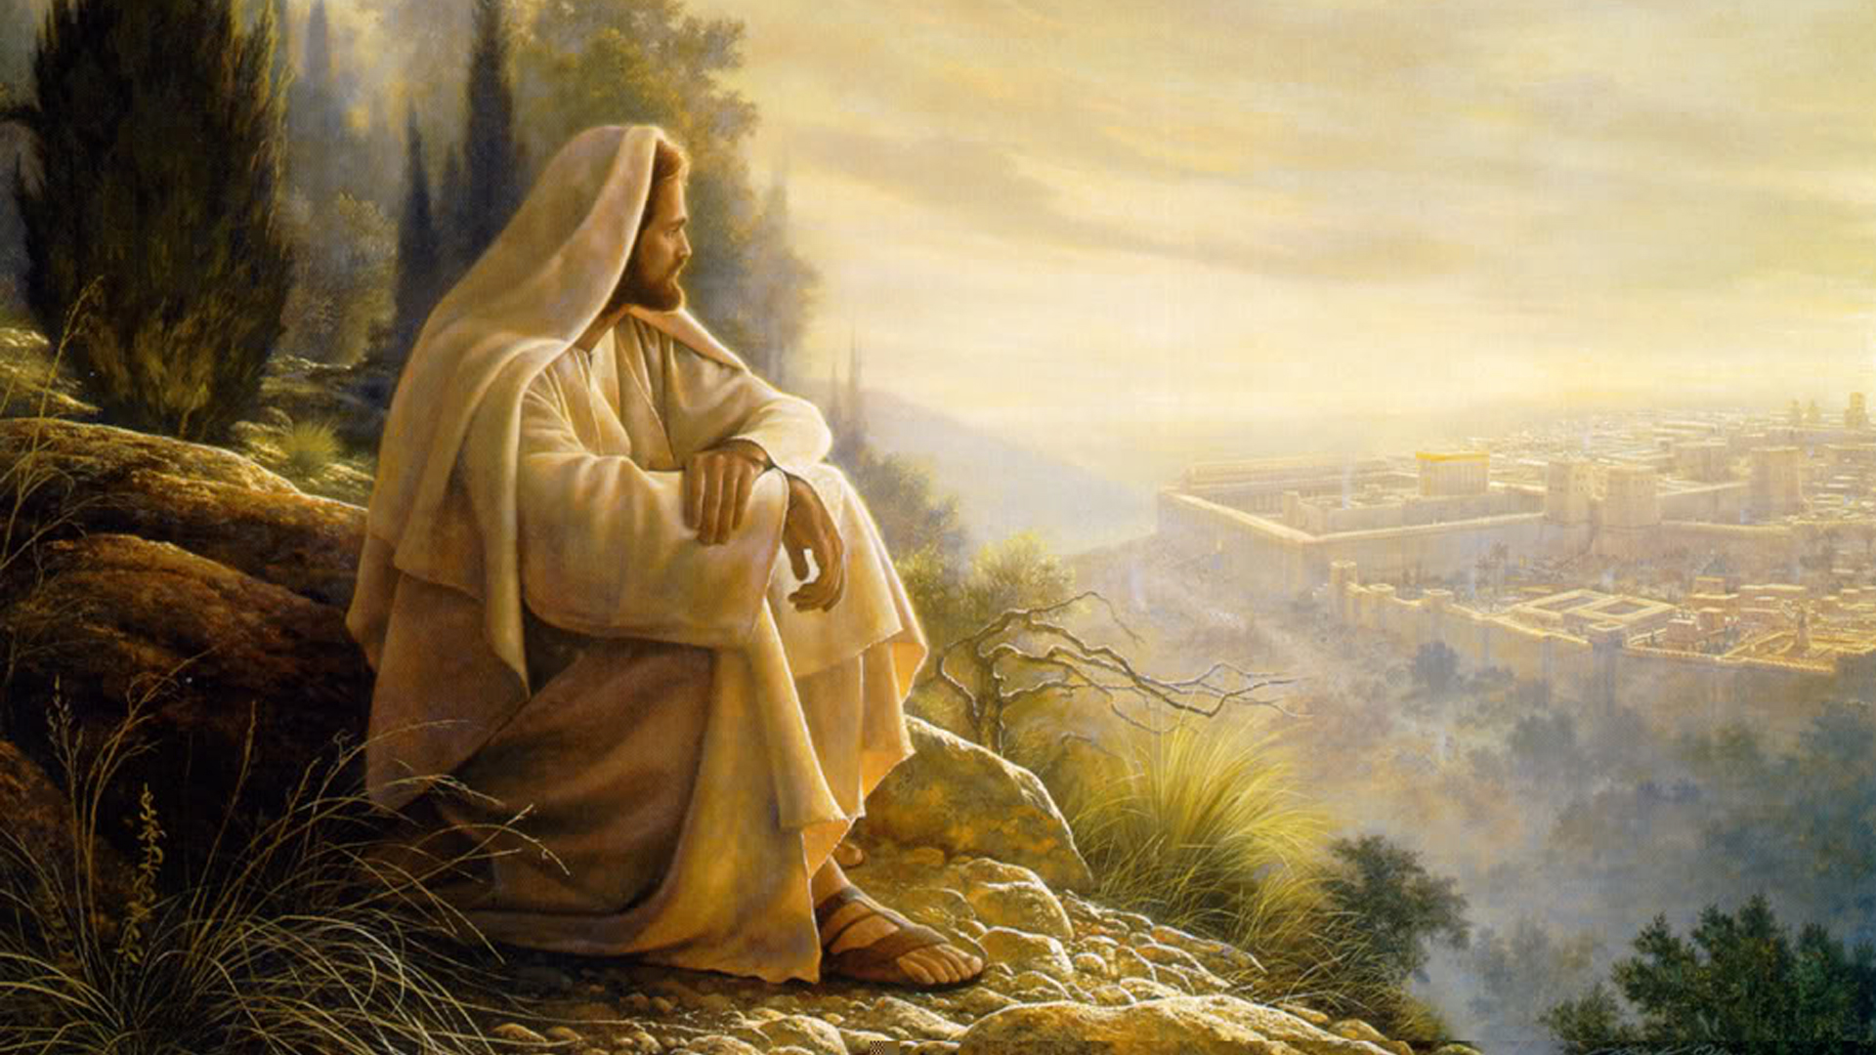
Let this mind be in you which was also in Christ Jesus. —Philippians 2:5

Slide 8
So continuing daily with one accord in the temple, and breaking bread from house to house, they ate their food with gladness and simplicity of heart.—Acts 2:46

Slide 9
Christians should make every effort to avoid tendencies that would divide them and bring dishonor to their cause. “It is the purpose of God that His children shall blend in unity. Do they not expect to live together in the same heaven? . . . Those who refuse to work in harmony greatly dishonor God (8T, p. 240). The church should discourage actions that threaten harmony among its members and should consistently encourage unity. —Church Manual, p. 59

Slide 10
The General Conference Working Policy shall be strictly adhered to by all organizations in every part of the world field. The work in every organization shall be administered in full harmony with the policies of the General Conference and of the divisions respectively. —Working Policy, B15 10

Slide 11
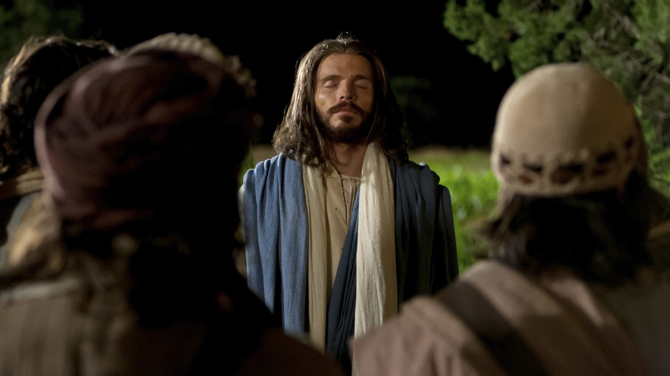
I do not pray for these alone, but also for those who will believe in Me through their word; that they all may be one, as You, Father, are in Me, and I in You; that they also may be one in Us, that the world may believe that You sent Me. And the glory

Slide 12
which You gave Me I have given them, that they may be one just as We are one: I in them, and You in Me; that they may be made perfect in one, and that the world may know that You have sent Me, and have loved them as you have loved Me. —John 17:20-23

Slide 13
t may seem to some that the contrast between their gifts and the gifts of a fellow laborer is too great to allow them to unite in harmonious effort. . . . Their talents, however diverse, may all be under the control of the same Spirit. In every word and act, kindness and love will be revealed; and as each worker fills his appointed place faithfully, the prayer of Christ for the unity of His followers will be answered, and the world will know that these are His disciples. In loving sympathy and confidence God’s workers are to unite with one another.
I

Slide 14
e who says or does anything that tends to separate the members of Christ’s church is counterworking the Lord’s purpose. Wrangling and dissention in the church, the encouragement of suspicion and unbelief, are dishonoring to Christ. God desires His servants to cultivate Christian affection for one another. True religion unites hearts not only with Christ, but with one another in a most tender union. When we know what it means to be thus united with Christ and with our brethren, a fragrant influence will attend our work wherever we go.—Testimonies for the Church, vol. 9, p. 145
H

Slide 15
hose who are truly converted will press together in Christian unity. . . . To the end of time Christ is to be first. He is the source of life and strength, of righteousness and holiness. And He is all this to those who wear His yoke and learn of Him how to be meek and lowly. The duty and delight of all service is to uplift Christ before the people. This is the end of all true labor. Let Christ appear; let self be hidden behind Him. This is self-sacrifice that is of worth. Such self-sacrifice God accepts. —Testimonies for the Church, vol. 9, p. 147
T

Slide 16
When the conscience is guided by human perceptions, which are not subdued and softened by the grace of Christ, the mind is in a diseased condition. Things are not seen in their true bearings. The imagination is wrought upon, and the eye of the mind sees things in a false, distorted light.” —Mind, Character, and Personality, vol. 1, p. 323
. . .

Slide 17
here have ever been in the church those who are constantly inclined toward individual independence. They seem unable to realize that independence of spirit is liable to lead the human agent to have too much confidence in himself and to trust in his own judgment rather than to respect the counsel and highly esteem the judgment of his brethren, especially of those in the offices that God has appointed for the leadership of His people. God has invested His church with special authority and power, which no one can be justified in disregarding and despising; for he who does this despises the voice of God.—Acts of the Apostles, pp. 163, 164
T

Slide 18
When, in a General Conference, the judgment of the brethren assembled from all parts of the field is exercised, private independence and private judgment must not be stubbornly maintained, but surrendered. Never should a laborer regard as a virtue the persistent maintenance of his position of independence, contrary to the decision of the general body. . . . God has
. . .

Slide 19
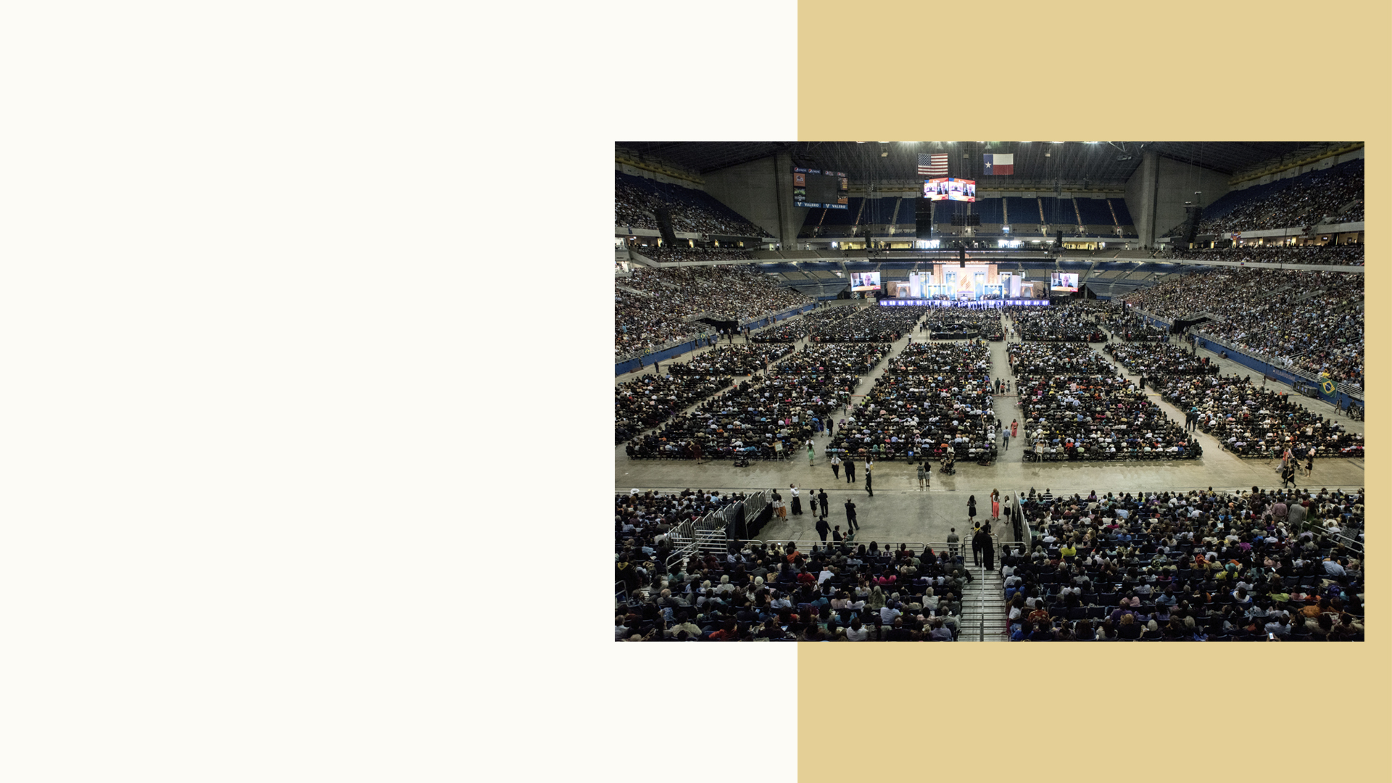
ordained that the representatives of His church from all parts of the earth, when assembled in a General Conference, shall have authority…….God has vested in His church in the judgment and voice of the General Conference assembled to plan for the prosperity and advancement of His work. —Testimonies for the Church, vol. 9, pp. 260, 261

Slide 20
The church of Christ is God’s appointed agency for the salvation of men. Its mission is to carry the gospel to the world. —Steps to Christ, p. 81

Slide 21
I, therefore, the prisoner of the Lord, beseech you to walk worthy of the calling with which you were called, with all lowliness and gentleness, with longsuffering, bearing with one another in love, endeavoring to keep the unity of the

Slide 22
Spirit in the bond of peace. There is one body and one Spirit, just as you were called in one hope of your calling; one Lord, one faith, one baptism, one God, and Father of all, who is above all, and through all, and in you all. —Ephesians 4:1-4

